Slide 1
Every Student Succeeds Act
Jennifer Kammerud
Policy Initiatives Advisor
Jeff Pertl
Senior Policy Advisor
Joint Education Committee - May 3, 2017

Slide 2
Agenda
Review Timeline & Process
Goals
Additional Accountability Indicator
School Improvement
Educator Development
Student Supports
Next Steps

Slide 3
I. Review Timeline & Process

Slide 4
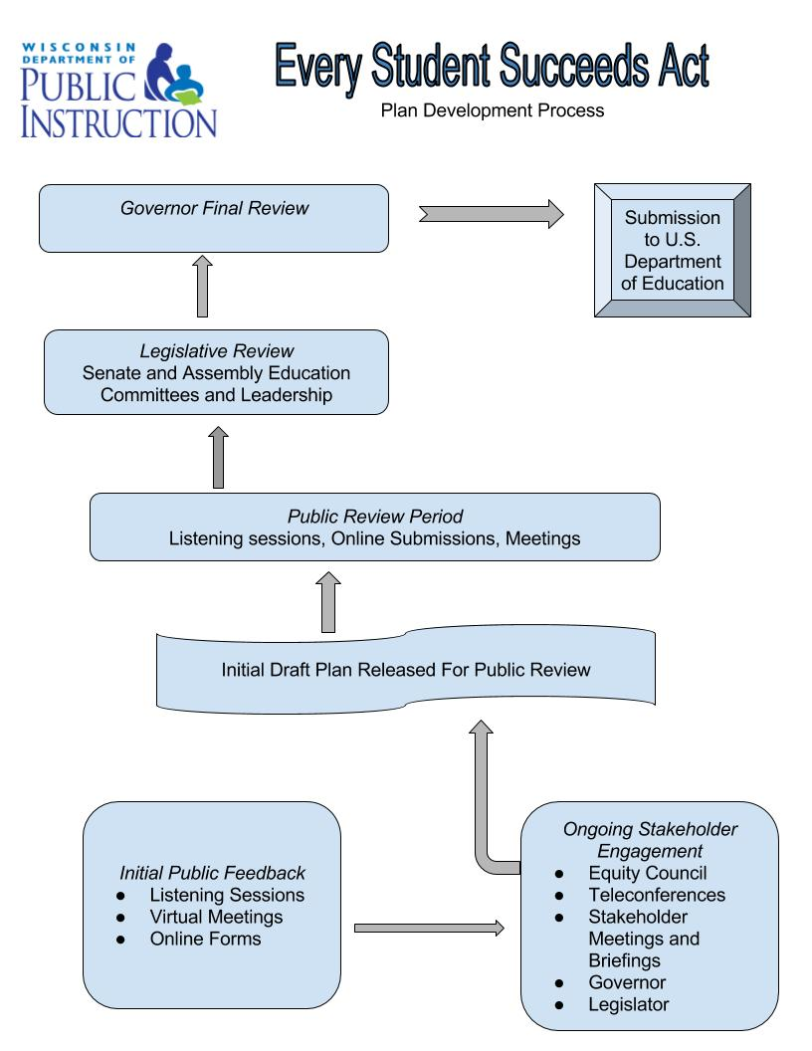
Deadlines & Process
Assurances: Due June 2, 2017
State Plan Template: Due Sept. 18, 2017
Key Timeline Considerations:
Submission Date: Sept. 18
Required minimum 30 day public review of plan.
Required minimum 30 day review by Governor.
DPI will revise the plan based on public, stakeholder, legislative, and gubernatorial input.

Slide 5
Core Requirements
Many provisions pieces of the law are similar to or unchanged from No Child Left Behind
Annual testing grades 3-8 and once in high school.
The state must identify schools if they aren’t meeting certain benchmarks.
States must disaggregate test data by subgroups.
States and schools must make available school performance information annually.
Private schools are entitled to services allocated from school district federal funds.
States must look at and address the distribution of teachers.
Homeless student provisions continue to apply under McKinney Vento.

Slide 6
ESSA is More Locally-Focused
NCLB
ESSA
District & school focused
Federally-determined interventions
State monitored prescriptive requirements
Priority & Focus Schools
School focused, District led
Locally-determined interventions
State is focused on implementation
Targeted (gaps) & Comprehensive (low achievement)
Notes:
Jonas - Under ESSA, we have to identify these 2 sets of schools

Slide 7
State Accountability is Primary
State Law | Federal Law
Requires a report card for public schools, school districts, and choice schools. | Requires individual public school reports.
Report Cards measure four priority areas: Student Achievement (English language arts, math) Student Growth (value-added, weighted relative to student poverty) Closing Gaps On-track and Postsecondary Readiness Report cards also look at performance on three student engagement Indicators: test participation, absenteeism, and dropout rate. | Accountability indicators must include: Results of state assessments A student growth or other measure at the elementary level High school graduation rate at the high school level English language proficiency (for English learners) At least one indicator of school quality or success
Report card results place schools and districts in one of five categories, identifying high-, mid-, and low-performing schools. | Accountability reporting is used to identify the lowest-performing schools (comprehensive) and schools with persistent achievement gaps (targeted).
Interventions outlined under state law for schools falling in the bottom category for a number of years include direction from the State Superintendent and the Opportunity Schools Partnership Program. | Targeted support schools are required to develop a plan for improvement that is overseen by the school district. Comprehensive support schools are required to develop a plan for improvement that is monitored and approved by the state.
Other Technical Points Non-tested students don’t count against the district or school. State system does not require summative results at a subgroup level. State system has no similar restrictions. | Other Technical Points Non-tested students count against the school. Summative results at the subgroup level are required. Requires the same data be used for schools in the same grade band.

Slide 8
II. Goals

Slide 9
DRAFT Long-Term Goals
Input: Set Ambitious Goals
Achievement gap is Wisconsin’s most important challenge
A decade too long for goals
Proposal: Cut Achievement Gaps in Half within 6 years
English Language Art proficiency
Mathematics proficiency
Graduation
Goals by subgroup (race, disability, EL)
Therefore the target goal varies by each subgroup
Interim measure reported annually

Slide 10
III. School Quality & Success Indicator

Slide 11
ESSA Requires a New Data Indicator
This may include these measures:
student engagement
educator engagement
student access to and completion of advanced coursework
postsecondary readiness
suspension & expulsion (discipline data)
bullying, harassment, crime data, etc.
Or…. we could use chronic absenteeism, which is already collected as part of the State Report Card System.
Engagement
College & Career Readiness
Climate & Safety
Notes:
For purposes of today’s discussion, we have grouped the measures here into a few categories

Slide 12
DRAFT Indicator
Input: Use existing data; Focus changes on the state report card
Great interest in college and career metrics for a revised/updated state report card for high school
Interest in other indicators: early childhood; parental involvement; physical education, etc.
Accountability should be universal, meaningful, fair, and drive improvement
Proposal: Chronic Absenteeism
A student is chronically absent if they miss more than 10% of possible attended days; then
Rate is calculated by school, using multiple years of data

Slide 13
IV. School Improvement

Slide 14
School Improvement Requirements
Identification | Support
Targeted Support (old “focus” schools) Schools with consistently underperforming subgroups as defined by the state. Comprehensive Support (old “Priority” schools) 5% of lowest performing Title I schools in achievement as defined by the state. All high schools with less than 67% high school graduation rate. Title I Schools with underperforming subgroups that do not improve after state-determined number of years. | Targeted Support Schools implement subgroup improvement plans, approved and monitored by the district. Comprehensive Support* Districts (LEAs) develop support and improvement plans with required elements. Plans are approved and monitored by the state. *No improvement in 4 years State must take more rigorous action.

Slide 15
Draft More Rigorous Intervention
Input: Require Rigor, Provide Support
Professional Development and Coaching
Positive Behavior Interventions and Support
Data Analysis
Alignment, Implementation, and Collaboration
Revised School Day/School Year Structure
Funding and Resources
Consistency
Flexibility
Student-focused
Support teachers and administration
Provide monitoring and support
Proposal: Implementation & Improvement
Independent Implementation Review
Customized Improvement Plan
Requirements & Supports
Family & Community Engagement
Professional Development
Mental Health, Socio-Emotional Learning, & Behavioral Issues
Community Schools, Project-Based Learning, & Personalized Learning
Expanded Academic Improvement

Slide 16
V. Educator Development

Slide 17
Improving Practice and Student Outcomes
Input: Align educator and school improvement efforts
Proposal - Focus state efforts on the following initiatives:
Use of data to improve student outcomes
Build and support effective school leadership
Equitable access to teachers
Teacher professional development
Response to intervention
Results driven accountability

Slide 18
VI. Student Supports & Other Provisions
Migrant Education
Neglected, Delinquent, and At-Risk Youth
English Learners

Slide 19
Special Student Populations
English Learners (EL)
Statewide entrance and exit criteria
Supports to all schools
Intensive supports to the following schools
Schools identified as comprehensive or targeted supports and identified as having insufficient EL progress.
Transition schools
Monitor Schools
At-Risk Youth
Transition plans with other state agencies
Technical assistance
Migrant Students
Systems to ensure educational continuity
Statewide service delivery plan
Interstate coordination

Slide 20
Other ESSA Requirements
Basic Learning Grant
Performance information for military and foster care students
Foster care liaison
School Level Financial Reporting
Private School Ombudsman
Equitable Participation Provisions
Cap on alternate assessments for special education students
Assessments provided in other languages

Slide 21
VI. Next Steps

Slide 22
Listening Sessions & Feedback
Stakeholder engagement is a critical part of our planning process
DPI will host listening sessions and is soliciting online feedback…
Date | Location
June TBD | Milwaukee
June TBD | Wausau/Eau Claire
June TBD | Up to four other locations under consideration
Online public feedback being solicited now through June 30, 2017.

Slide 23
Equity in ESSA Council
Michael Anton
Wisconsin PTA
John Ashley
Wisconsin Association of School Boards (WASB)
Jon Bales
Wisconsin Association of School District Administrators (WASDA)
Jim Bender
School Choice Wisconsin (SCW)
Evan Bradtke
Wisconsin Governor’s Office
Salvador Carranza
Latino Education Council
Kathleen Cullen
Wisconsin Technical College System
Frank Humphrey
Wisconsin NAACP, Madison
Gary Myrah
Wisconsin Council of Administrators of Special Services (WCASS)
Darienne Driver
Council for Great City Schools
Heather DuBois Bourenane
Wisconsin Public Education Network (WPEN)
Tony Evers
Wisconsin Department of Public Instruction (DPI)
Fran Finco
Wisconsin Association for Supervision and Curriculum Development (WASCD)
Jesse Harness
CESA Statewide Network
Mike Haynes
Cooperative Educational Service Agency 10
Chris Her-Xiong
Wisconsin Southeast Asia Resource Action Center Representative
Ralph Hollmon
Milwaukee Urban League
Brian Jackson
Wisconsin Indian Education Association (WIEA)
John Jacobs
Wisconsin eSchool Network (WEN)
Brian Juchems
Gay Straight Alliance for Safe Schools, GSAFE
Kim Kohlhaas
Wisconsin Federation of Teachers (AFT-Wisconsin)
Stephen Kolison
University of Wisconsin System
Jim Lynch
Association of Wisconsin School Administrators (AWSA)
Ronald Martin
Wisconsin Education Association Council (WEAC)
Rep. Adam Neylon
Assembly Majority
Sen. Luther Olsen
Senate Majority
Rep. Sondy Pope
Assembly Minority
Lisa Pugh
Disability Rights Wisconsin (DRW)
Sean Roberts
Milwaukee Charter School Advocates (MCSA)
Sen. Lena Taylor
Senate Minority
Rolf Wegenke
Wisconsin Association of Independent Colleges and Universities (WAICU)
Woodrow Wiedenhoeft
Wisconsin Association of School Business Officials (WASBO)

Slide 24
Additional Review
July
Legislative Review Requested by DPI
July 28
Version 2.0 Released
August
Gubernatorial Review

Slide 25
Process and Timelines Review
Key Timeline Considerations:
Submission Date: September 18
Required minimum 30 day public review of plan.
Required minimum 30 day review by Governor.

