Slide 1
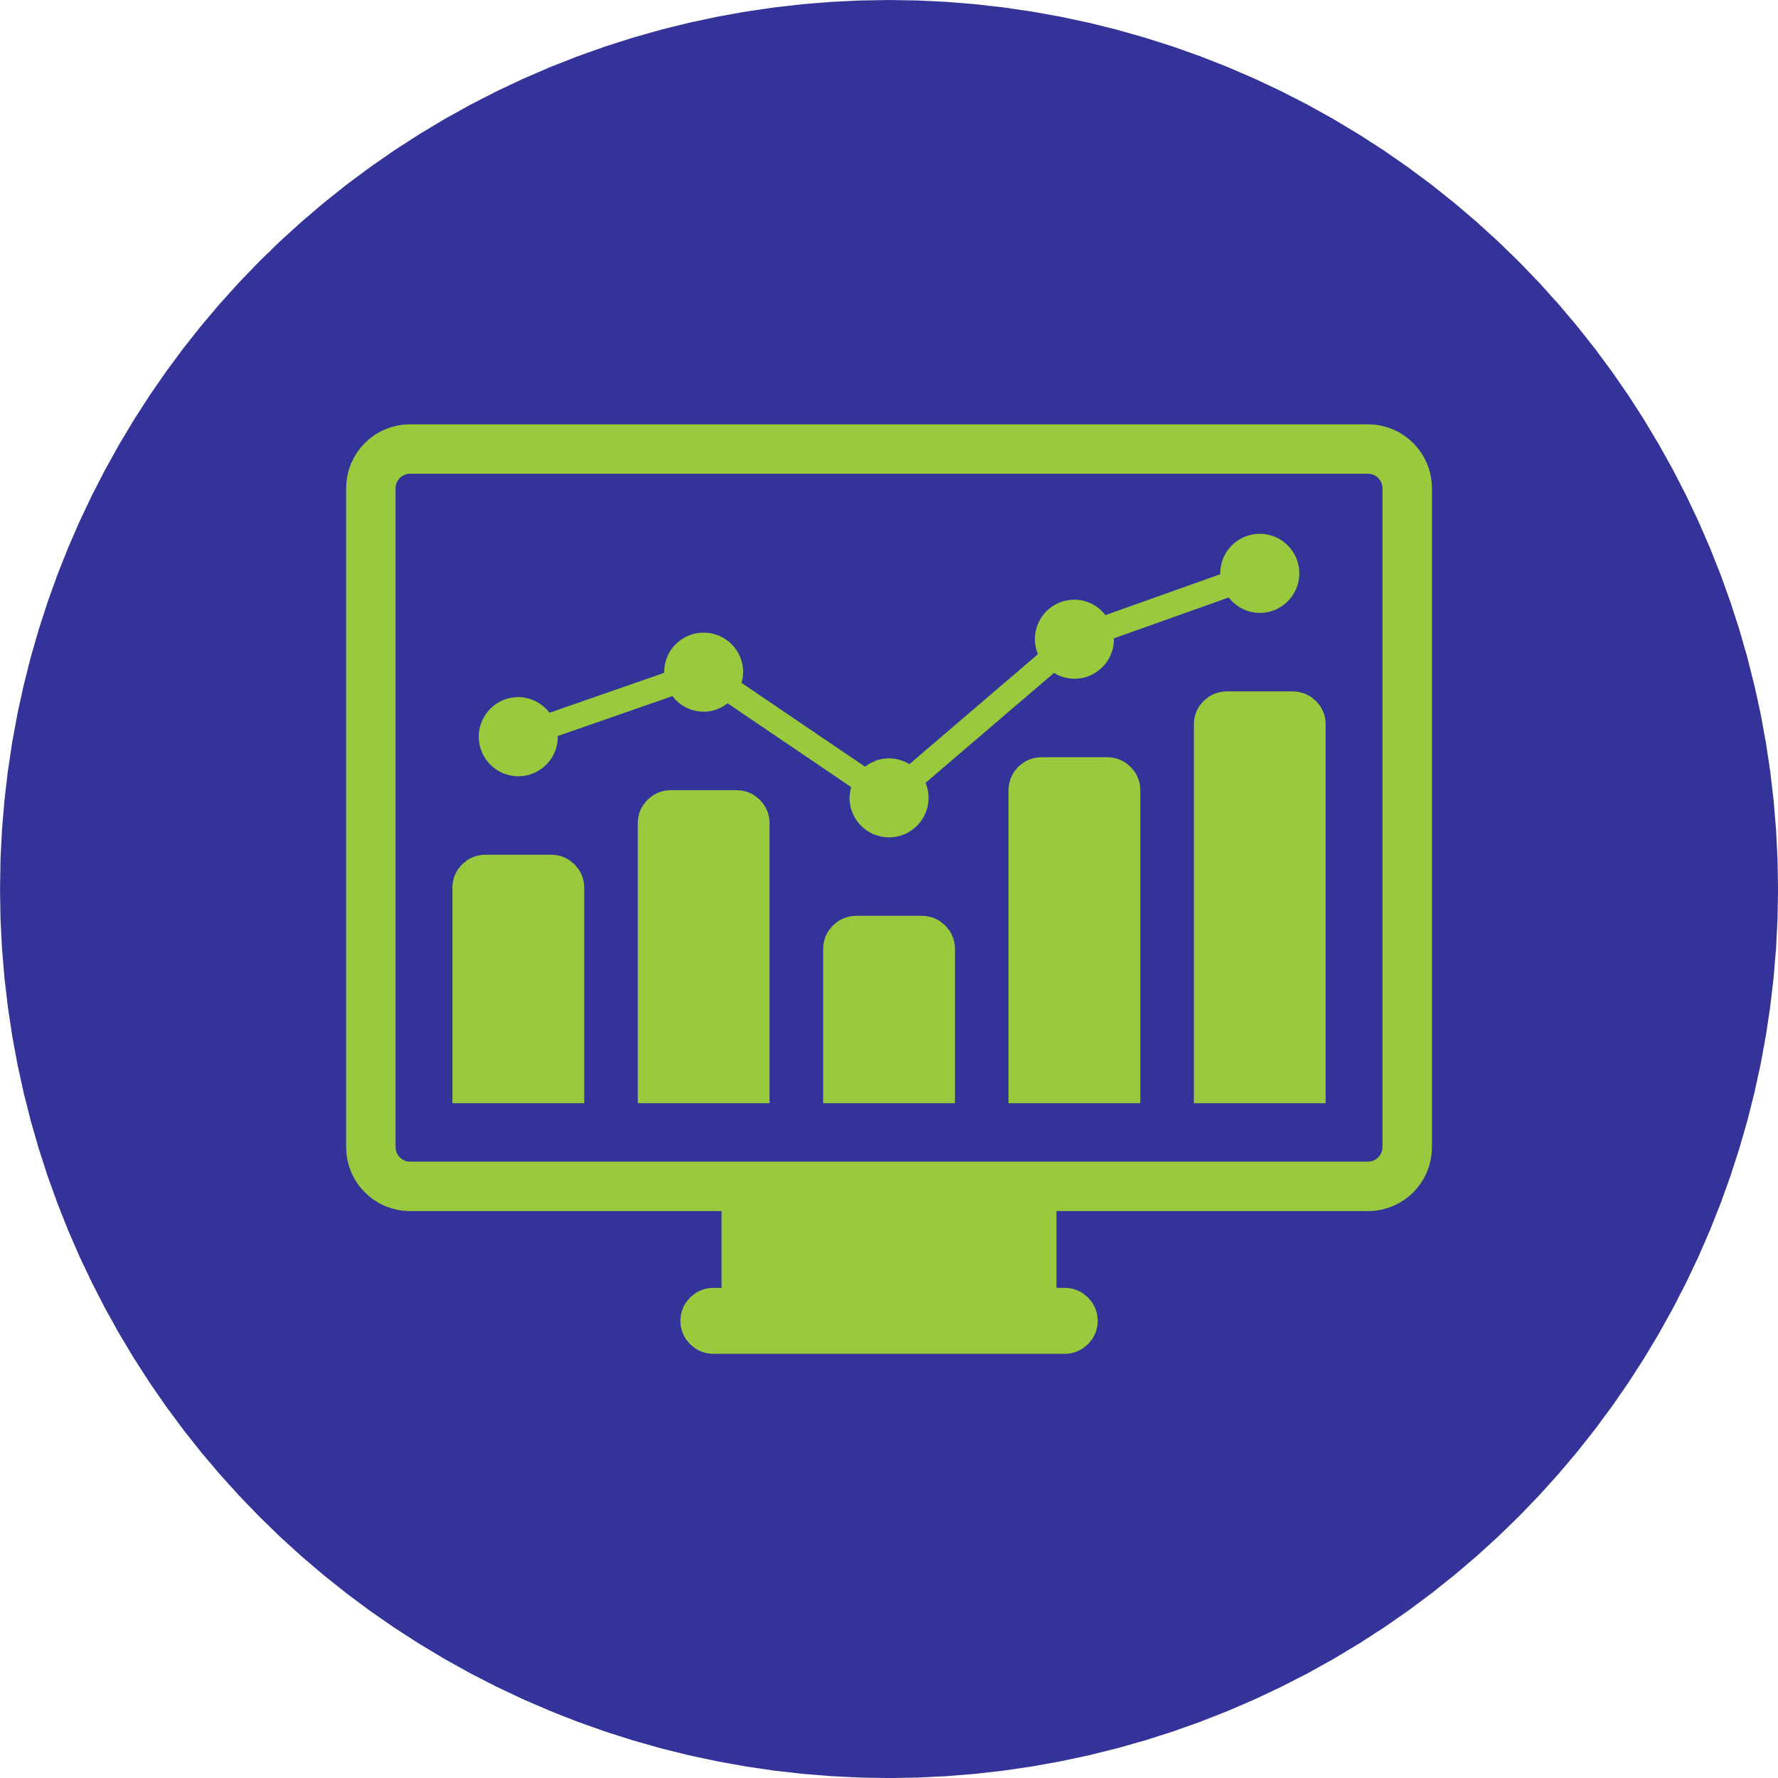
Data Landscape Project
Wisconsin Department of Public Instruction Southwest Wisconsin Library System May 2023
Notes:
Script: Hi! My name is Kim Kiesewetter and I work as a consultant and data analyst at WiLS. I’m here to share with you about a recently completed project on Wisconsin’s data landscape.

Slide 2
In 2022, Southwest Wisconsin Library System (SWLS), in partnership with WiLS, launched a statewide research project to gauge the research- and data-related skills and training needs of public library staff in Wisconsin. This project was funded by the Department of Public Instruction’s (DPI) allotment of LSTA funds from the Institute of Museum and Library Services (IMLS).
Notes:
Script:
In 2022, Southwest Wisconsin Library System (SWLS), in partnership with WiLS, launched a statewide research project to gauge the research- and data-related skills and training needs of public library staff in Wisconsin. This project was funded by the Department of Public Instruction’s (DPI) allotment of LSTA funds from the Institute of Museum and Library Services (IMLS).

Slide 3
Project Overview and Purpose
Notes:
Script:
In recent years, there has been increased awareness of the value of data-driven decision-making for libraries. Some national initiatives have provided a consolidated framework for considering the next steps in what library-centric data use looks like through a more theoretical lens. In addition, organizations like the Public Library Association have developed resources to increase public library data use; however, these resources often require money, time, and skills to be used effectively. Statewide, a number of data-related training opportunities have been offered for public library staff via a variety of channels, including DPI, universities and library schools, as well as library-focused nonprofit partnerships. However, a key element missing has been a fully informed picture of library and library system staff’s current skills around data use and their real and perceived strengths and challenges related to actionable data use. To address this gap, additional research was initiated to develop a more holistic picture of public library data use across the state; the findings from this endeavor are being released by DPI in a report format. Today we will run through some key finding and recommendations highlighted in this document.

Slide 4
Wisconsin’s Data Ecosystem
Data competence
Data self-confidence
Access to research- and data-related resources
Time and job-related demands
General attitudes towards data
Notes:
Script:
A key element of this project was to clearly articulate Wisconsin’s library “data ecosystem” – this required taking a look at everything from people to resources and how they intersect currently in order to create both opportunities and obstacles in library data usage. To this end, effective data use requires many different competencies and considerations that can intersect in different ways. As part of preliminary research, five elements were identified as key contributors to data use for professional decision-making and shaped the project’s data collection approach. These included:
Data competence: or, in other words, research and data skills typically obtained through avenues like formal academic training or professional development
Data self-confidence: or their self-reported perception of their ability to use their research and data skills
Access to research- and data-related resources: which can include software licenses, data dashboards, and relationships with mentors in the field
Time and job-related demands: which considers organizational impacts on people’s ability to spend time collecting and manipulating data into meaningful formats for decision-making
General attitudes towards data: how a staff member feels about data related to the profession, such as level of trust in data sets and other existing resources

Slide 5
Methodology and Findings
Notes:
Script:
The research design involved a mixed-method approach that paired a survey with focus groups. The Data Landscape Survey was sent out through a variety of channels across Wisconsin in Fall 2022. The survey included 38 primarily close-ended questions in an electronic format. The survey was completed by 530 public library and public library system staff with representation from all 16 public library systems in the state. The survey results were analyzed and high-level findings helped to inform the creation of a set of focus group questions. With input from the planning team, focus group participants were identified and invited to participate to ensure a diverse representation based on staff role, library size, geography, and personal interest in or confidence with data. In total, more than 30 public library and public library system staff participated in one of three focus groups held in early 2023. Each focus group was recorded, transcribed, and themed for analysis. Together, the survey results and focus group themes served as the basis of the findings for the report.

Slide 6
Key Findings
Notes:
Script:
A number of key findings were identified during the research phase about the current realities of library data use for staff:
Overwhelmingly, survey respondents (81%) are using data professionally on the job at least monthly.
The majority of this work is data collection (74%) followed by creating data visualizations (66%).
Survey takers were asked to describe the reason or purpose behind their professional data use; the top two selected items were to meet reporting requirements like the Annual Report (61%) and to facilitate collection development decision-making (60%).
The types of data people are accessing and using in professional library contexts are primarily coming from four different sources: internal library data (e.g. incident reports, feedback forms, etc.), Annual Report data, US Census data, and OverDrive data.
When it comes to data analysis and visualization tools, the majority of people are using free or low-cost and readily-accessible tools like Microsoft Office products, calculators, and Canva.
Library staff indicated that they are most interested in seeing their data in one of two ways; trend data related to different library metrics (e.g. circulation or library visits data over time); and comparison data of their library with similar libraries for benchmarking purposes.
Current professional library data collection was reported as being driven most strongly by outside reporting requirements, creating the sense that data is being collected and sent “up” to someone at the board, municipality, and/or state level.

Slide 7
People’s self-reported confidence finding, using, analyzing, and visualizing data was heavily correlated to a person’s research/data-oriented academic training and professional development experiences.
Data Activity | Professional Development | Academic Training | Academic Training |  | Professional Development + Academic Training
 | Yes | No | Yes | No | Both | Neither
Finding Data | 3.32 | 2.79 | 3.32 | 2.63 | 3.46 | 2.58
Using Data | 3.34 | 2.92 | 3.32 | 2.66 | 3.50 | 2.63
Analyzing Data | 2.91 | 2.50 | 2.92 | 2.20 | 3.08 | 2.18
Visualizing Data | 2.71 | 2.46 | 2.84 | 2.19 | 2.90 | 2.22
Overall Data Use | 3.18 | 2.85 | 3.21 | 2.59 | 3.33 | 2.58
Scale: Very Little Confidence (1) to Very Confident (5)
Notes:
Discussion:
Related to these findings, library staff’s background and preparation for data work is variable, leading in inequitable experiences. A person’s self reported confidence was highest for folks with both academic training and professional development related to data and research. On every item except for visualizing data, a person with neither was lowest. Overall, people were most confident about using data related to their job, followed by finding data, then analyzing, and lowest ranked on visualizing. This correlation between training and confidence is important because over 70% of survey respondents had no professional development or continuing education related to data and, of those people, 53% also had no formal academic training related to data work (37% of all survey takers). Notably, library directors with no formal academic training and no continuing education related to data were much more likely (80%) to come from libraries serving municipal populations of under 10,000 residents, highlighting unique data support needs for libraries in smaller communities.

Slide 8
Library Staff Desires and Needs
Notes:
Script:
In addition, public library staff identified a number of needs and desires to improve professional data use in library contexts:
A single, exhaustive repository of data resources tailored to libraries so that people have a “one-stop shop” for data-related resources and tools.
Curated opportunities to collaborate and learn from peers around library data use.
Access to “plug-and-play” data resources like dashboards and data templates as a foundation for data use across the state.
Assistance in the identification of meaningful peer comparisons for benchmarking library data, especially Annual Report data.
Real-life, hands-on training opportunities, especially ones that allow participants to use their own library data.
Access to a more formalized “data person” within each system who can provide expertise. Not all libraries have access to a resource like this at their library or system.
Opportunities to be more involved in the review of Wisconsin’s Annual Report process through a statewide data working group or similar effort.

Slide 9
Recommendations and Next Steps
Notes:
Script:
A number of recommendations were identified based on these emerging themes. At the heart of the report’s recommendations is a clear need for tiered data support and resources. All libraries need a baseline of support to facilitate basic consistency in data use. From there, stakeholders have differing, additional needs in order to develop a fully-scoped data ecosystem for the state. This would result in minimal duplication of efforts and a baseline level of equitable access. In addition to individual public libraries and their staff, additional stakeholders involved in the statewide data ecosystem include public library systems, DPI, and outside library support organizations (e.g. WILS, WLA, etc.). Together, these entities contribute to a well-functioning and, most importantly, actionable pathway to library data use that moves beyond philosophical ideas about libraries and data and, instead, focuses on ensuring libraries have what they need to fully use and leverage the data they already have access to and are already collecting.
The findings outlined in the report point to the need for a statewide “Data for Library Action Pathway” (e.g. a pathway for actionable library data use). This pathway involves four tiers that build on each other starting at the broadest, foundational level and building towards higher-level needs, such as leadership skills to craft impactful data stories through an advocacy lens. While it is not necessarily a requirement for a person to move through each identified tier to “graduate” on to the next one, it is expected that beginning at Tier 1 and progressing chronologically through to the tier most aligned with a person’s professional role will create the most holistic foundation for people to engage in data-informed advocacy (Tier 4). In other words, if someone needs to be using data for advocacy purposes, it’s important to make sure they have the needed skills and resources encompassed in Tiers 1, 2, and 3.

Slide 10
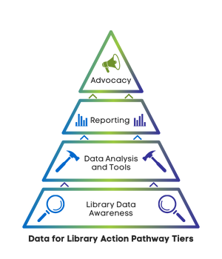
Data for Library Action Pathway
Notes:
Script:
Let’s jump into the pathway – I’ll take a moment now to touch on each tier. More exhaustive descriptions and recommended activities are included in the report for each tier.
Tier 1: Library Data Awareness
The most foundational tier of the pathway is library data awareness. This tier involves, largely, an educational component that ensures library staff across the state working in a variety of roles have access to a baseline of information about different types of library-oriented data. This is important for a number of reasons:
equitable access to and usage of library data regardless of library size and location
succession planning to ensure continuity in data collection and use at the organizational level
increased confidence and trust in certain types of library data and,
the potential to develop a level of consistency in certain library metrics and how they are used to promote stronger statewide data sharing.
Tier 2: Data Analysis and Tools
Once people have baseline knowledge about what data exists, where it lives, and its general purpose, the next tier considers how people might use it. In an ideal world, all the data library staff need would exist in a “plug and play” format; this is where dashboarding and templates can be beneficial. However, there will always be a need for select people to possess data analysis skills and have access to analysis tools in order to manipulate data both accurately and effectively to meet needs that aren’t met with templates. Based on the survey results, there is a clear preference for free or low-cost, easily-available tools such as calculators, Excel, PowerPoint, etc. This can provide a data-informed starting point for the types of training staff need, utilizing budget-friendly tools they already have access to. Developing this baseline level of knowledge and access is important for a number of reasons:
It ensures library staff who work with data professionally have access to the tools and skills they need to complete their jobs. 49% of library staff who have no academic training and no professional development in data work indicated they were using data either daily or weekly as a part of their professional duties., pointing to a gap between people’s training and the expectations of their job duties/
It addresses the fact that there will be data-related needs that cannot be accounted for in dashboards and templates and will require select people to possess higher-level data analysis skills.
Tier 3: Reporting
Building on the first two tiers, Tier 3 focuses on taking the awareness and data analysis skills learned and channeling them into the creation of effective reports. The most common way library staff are using data is to meet different reporting requirements (61% of survey takers). During the focus groups, library staff indicated that the majority of this reporting was being done both locally, at library board and city council meetings, as well as statewide for the completion of the Annual Report. A challenge in this realm overlaps with aspects of both Tier 1 (awareness) and Tier 2 (analysis) in that library staff experience a large part of their professional data use as providing information that goes “up” - in other words, libraries are providing data to stakeholders who require it from them, not necessarily because they can or are using it at the local library level. Because of this, there is a fear around some of this reporting and that sharing “negative” data (e.g. data trends that decrease over time, appear lower than peer comparisons, etc.) will hurt the library, especially when it comes to budgeting. Relatedly, there is a sense that some of the required data is outdated or not necessarily a fair representation of the library and how it functions. To that end, Tier 3 focuses on increasing library staff confidence in metrics that are commonly required by key stakeholders to meet reporting requirements and on providing training about how to use data collected for reporting more holistically so that efforts to collect data locally are also being used locally.
Tier 4: Advocacy and Data Story-telling
The final tier in the pathway focuses on something many library leaders are already engaged in: using data to advocate for their library. In an increasingly data-driven world, libraries are required to provide a variety of metrics about their organizations to different stakeholders for things like budgets, space planning, and grant writing. However, many people engaged in these activities are missing knowledge that would be gathered in Tiers 1-3 and feel unequipped to do them effectively and accurately. The final step in this pathway is to channel all of that knowledge into meaningful and impactful data stories that can be used in a variety of contexts, including for purposes of advocacy. A key element in that is to increase people’s data visualization skills.
---
In sum, across the state of Wisconsin, public library and public library system directors and staff are engaged daily in professional work that requires them to use data in a variety of ways. However, many of these same people have not ever received any professional or academic training in data, creating gaps in knowledge and contributing to a general lack of confidence around data use. Based on the survey and focus groups, professional development is highly correlated to increased confidence around using data in a variety of ways and is a mechanism for promoting meaningful data use. The development of a pathway to actionable data use will allow different stakeholders to come together to:
Improve data competence by creating an articulated baseline level of data knowledge and access to related data resources across all libraries, regardless of size and location.
Increase data self-confidence through the provision of training that mirrors actual needs and addresses gaps in knowledge to meet professional job expectations around data use.
Ensure equitable access to a baseline of research- and data-related resources across the state’s data ecosystem with an eye towards system-level equity (e.g. ensuring each system has knowledge of and access to a shared baseline).
Reduce time- and job-related barriers that make data learning and use challenging by decreasing the amount of time people spend looking for data resources through the creation of a streamlined, tiered approach to data use that matches people to training and resources that relate to their professional duties.
Improve general attitudes around data by providing opportunities to increase understanding of and involvement with the data that exists, the data they collect, and the data they use in library reporting and advocacy.
Reduce duplication of efforts and/or gaps in offerings by bringing different stakeholders involved in library data use together to more effectively strengthen the statewide data ecosystem.
Make sure to check out the full report for additional information. DPI will be sharing additional resources and next steps in support of this project.

