Slide 1
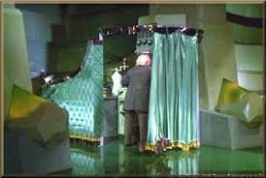

Science & Literacy - Text Complexity
“Beyond the Land of Oz”
Dr. Kevin Anderson
Sid Larson, Literacy Consultant
CESA2
Notes:
Kelly Gallagher’s 1st belief is that the Wizard of Oz would have made a lousy teacher. He uses his own classroom and the intensive preparation he went through to be ready for teaching Shakespeare. All of the preparation was behind the curtain leading students to think he must have some DNA Shakespearian gene. Students needed to see the reading, writing, and thinking he applied to his lesson. In other words, he needed to model the literacy demands of his discipline. As science teachers we also need to come out from behind the curtain and mentor the literacy demands of our discipline. This process can begin with a heightened awareness of the complexity of text used in the discipline of science.

Slide 2

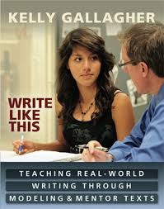
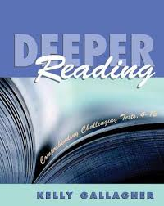
Kelly Gallagher
Notes:
Gallagher provides common sense relevant approaches to literacy. Easily transferred to all disciplines, he builds compelling reasons why we need to model to and mentor our students

Slide 3
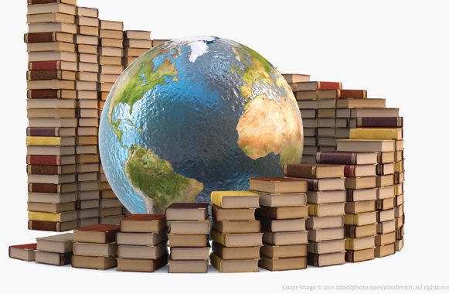
Text Complexity Staircase
Reading Anchor Standard #10:
Read and comprehend complex literary and informational texts independently and proficiently.
Notes:
Common Core insists that this is a shared responsibility. It is one of the major shifts from previous standards. To be college and career ready students need a deeper understanding of the literacy demands unique to many disciplines.

Slide 4
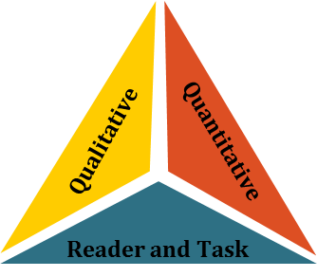
How Complex Are Your Science Texts?

Slide 5
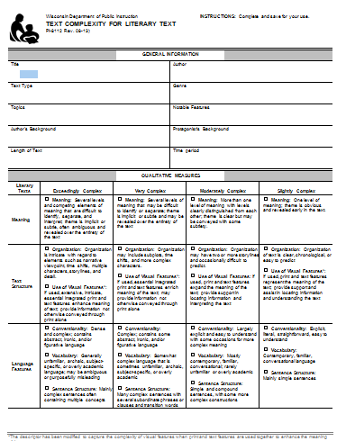
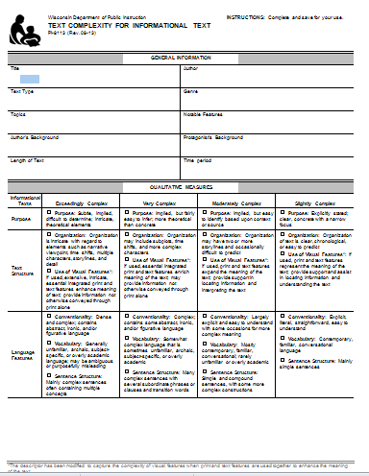
Recommended Placement
Qualitative
Quantitative
Reader and Task
Notes:
The Wisconsin Department of Instruction provides a rubric for measuring the complexity of both narrative and informational text. These rubrics are especially helpful for teachers to make professional judgments about the complexity of journal articles, supplementary resources and providing differentiated materials for their students.

Slide 6
Notes:
This page is from McDougall & Littells Integrated Course #2(7th grade). It was selected simply by randomly opening the book. The page is representative of the entire textbook. Almost every page contains written text and illustrations or other visuals. As a science teacher how carefully and closely do you read the text you assign? Do you read it through the lenses of the content it provides or do you read it through the lenses of its complexity?

Slide 7
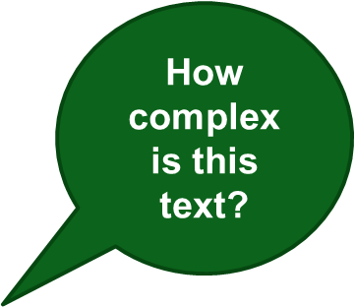
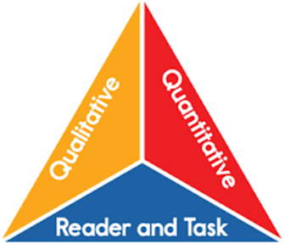
McDougal Littell
7th grade
Notes:
According to Anchor Standards #10, Common Core assumes you know where a page of text like this would fall on that staircase of text complexity. Notice the triangle insert. This represents the 3 components that combine to determine the complexity of text. Lets take a closer look at all three and apply them to this page of science text.

Slide 8
Notes:
If you are using this powerpoint in a PLC or as a part of a workshop. Stop and pause at this slide and allow everyone to read this page. Turn and talk. Is this a typical page? Would your students have difficulties comprehending it? Now let’s take a closer look at what makes a text complex.

Slide 9
Overview of Text Complexity
  Text complexity is defined by:
Quantitative measures – readability and other scores of text complexity often best measured by computer software.
Qualitative measures – levels of meaning, structure, language conventionality and clarity, and knowledge demands often best measured by an attentive human reader.
Reader and Task considerations – background knowledge of reader, motivation, interests, and complexity generated by tasks assigned often best made by educators employing their professional judgment.
Qualitative
Quantitative
Reader and Task
Notes:
This slide is basically self-explanatory. Text complexity consists of 3 components each measuring a different facet of the interactive nature of reading comprehension. Quantitative and qualitative contains various characteristics of what the text brings to the reader. Reader and task is essentially what the reader brings to the text. Knowing your reading material and your students through the lenses of text complexity will lead you to important professional decisions.

Slide 10
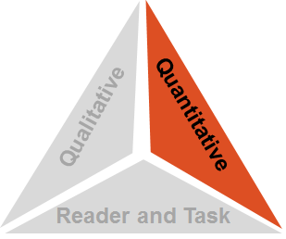
Step 1: Quantitative Measures
Measures such as:
  Word length
  Word frequency
  Word difficulty
  Sentence length
  Text length
  Text cohesion
Notes:
Unless you have taken course work in reading, reading levels might be a term used but vaguely understood. Most quantitative reading levels are determined in a similar way. Sentence length and word length intersect to provide a general idea of the difficulty of the text. The longer the words and the longer the sentences, the more difficult the reading. Let’s look at a segment of our 7th grade text from a quantitative view.

Slide 11
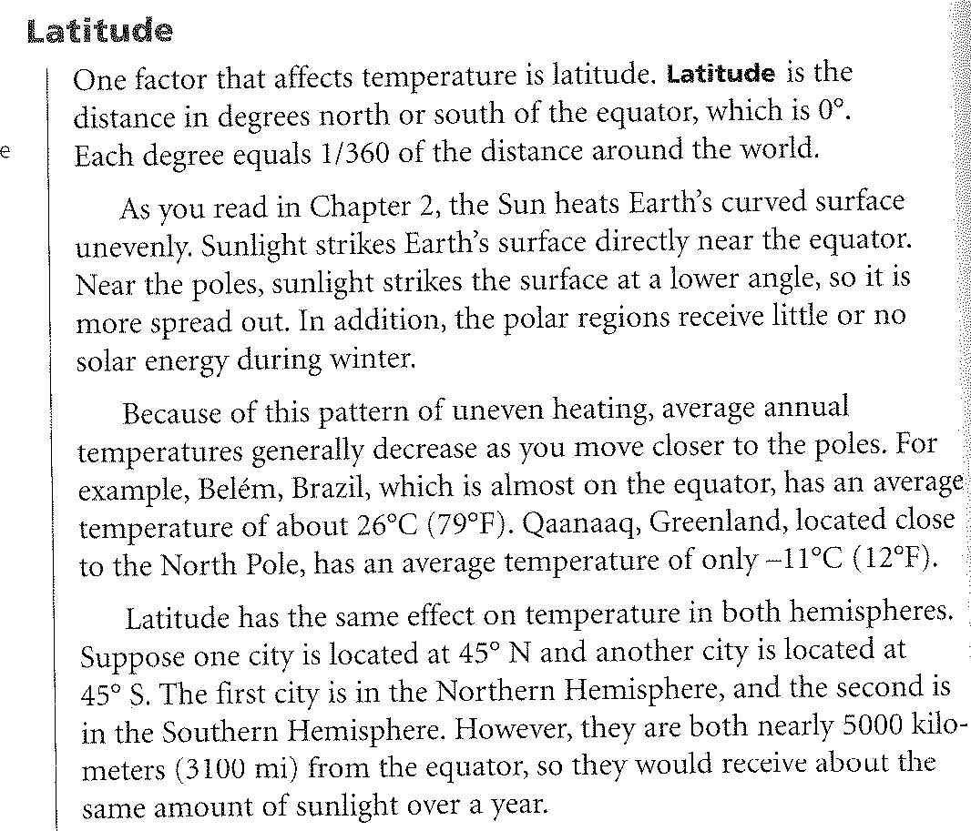
Count the number of sentences= 8
Syllables=166
Count 100 words
Notes:
Using the Fry Readability Formula which has been around for decades, start by counting 100 words. Mark that spot. Next, count the number of sentences contained in those 100 words. You may end with a part of a sentence. In this example, we are 1 word short of 8 sentences so we will say 8. Next, and it is a little tedious, count the number of syllables found within those 100 words.

Slide 12
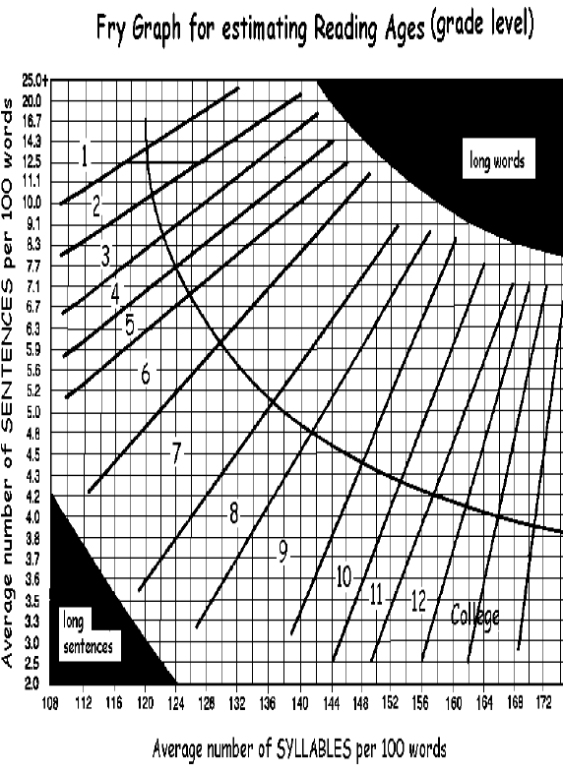
Notes:
Intersect the 166 syllables with the 8 sentences to arrive at an approximate grade level. This may not represent the entire chapter or textbook as it is one small sample. A readabilty of a larger body of text would require multiple random snapshots which would then be averaged.

Slide 13

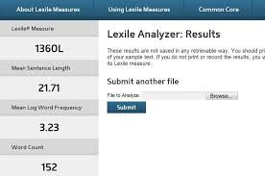
Notes:
The paper and pencil method has now given way to computer-based. Lexile is widely known and easy to use. Go to www.lexile.com. Registration is free and easy. 1000’s of books are already Lexiled so it might be as easy as typing in the ISBN number and receiving your Lexile score. Or you can go to Lexile Analyzer and either type the text for consideration or scan the text and submit it for a Lexile score.

Slide 14
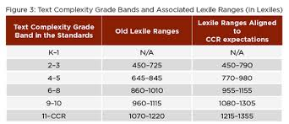
Lexile Measure Example
980L
Mean Sentence Length 13.60 Mean Log Word Frequency 3.33
Word Count 136
Notes:
When the same page was submitted to Lexile, the computer analysis placed the text in the 6-8 grade band. This is consistent with the fact that the text is used in 7th grade. Take a moment to notice what has happened to Lexiles and grade bands since the adoption of common core standards. This is an effort to close the gap between the levels of materials currently being read in high schools and the higher levels they will encounter either in college or the work force.

Slide 15
Reading Levels?
So Lexile has this page matched to the 6-8 grade band of the CCSS.
Fry places the page around 10th grade.
Matching text to student strictly by a readabilty score is not an exact science.
Convenience versus professional judgment.
Notes:
It’s easy and convenient to match the Lexile scores of students determined by a MAP test or reading inventory to reading material. There is more to it than just numbers. It’s messy and depends on your professional judgment

Slide 16
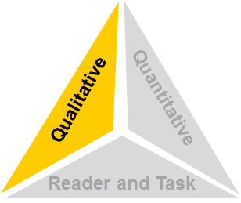
Step 2: Qualitative Measures
Measures such as:
  Levels of meaning
  Levels of purpose
  Structure
  Organization
  Language conventionality
  Language clarity
  Prior knowledge demands
http://www.livebinders.com/play/play?id=813039#anchor
Notes:
Become as knowledgeable as you can about qualitative measures because this is where your professional judgment takes place. How many times do we assign a reading without having closely read that text ourselves? When we read the text through the lenses of textual structures and organization, levels of meaning and purpose, clarity of language, vocabulary and prior knowledge requirements, we become to realize that any combination could limit the students’ efforts to access the meaning of the text. Let’s study our science page with qualitative considerations.

Slide 17
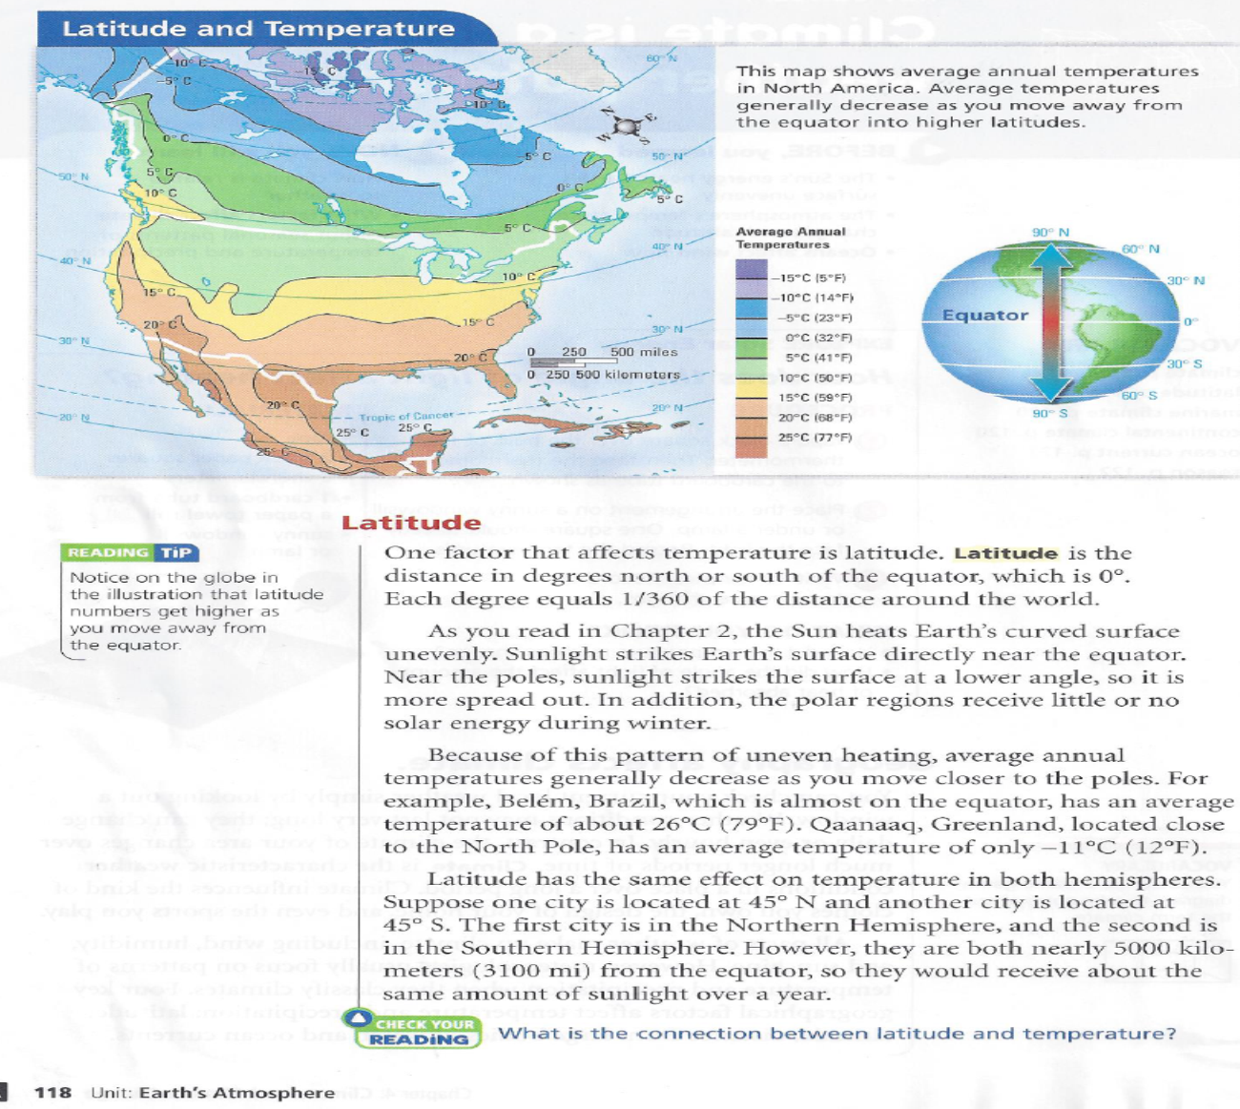
Let’s Analyze the Qualitative Features of the Science Text!
Notes:
So here’s our page again. We already know that sentence length and word length places it in several levels based on the quantitative measures we used. But what’s under those words in terms of organization, structure, and knowledge assumptions and demands?

Slide 18
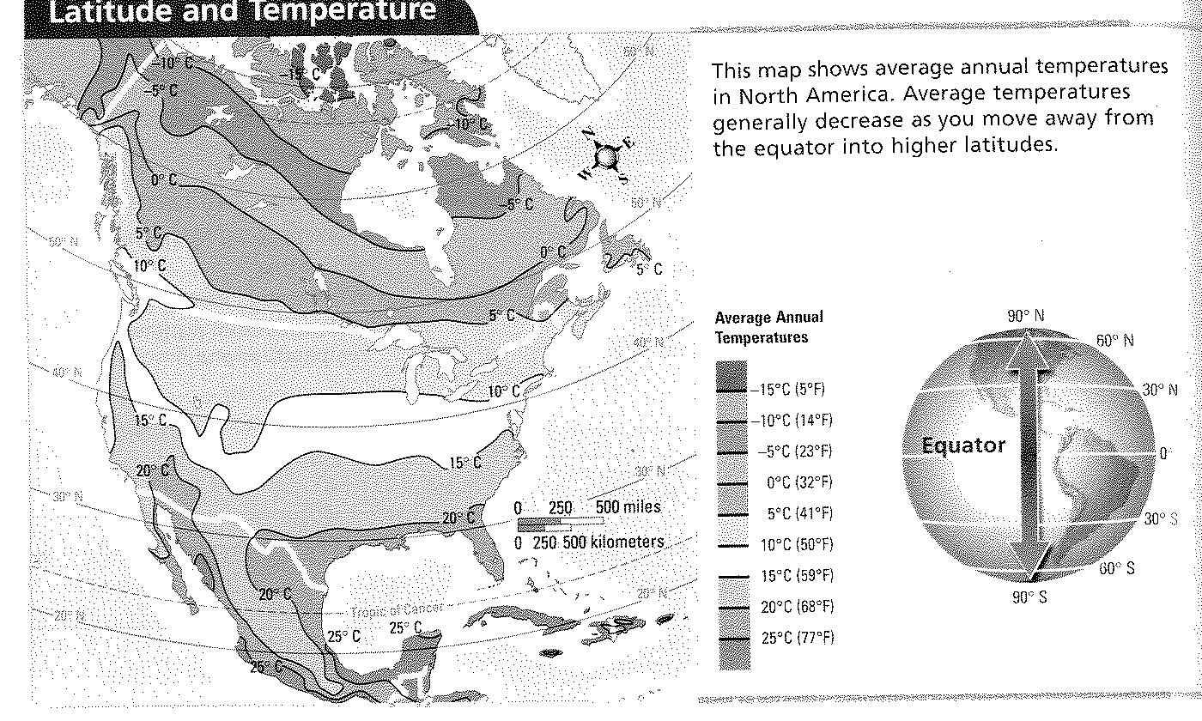
Equator?
Notes:
Many of our 7th grade readers will be drawn to the visuals on a page before they begin the reading. The author of this text has made a number of assumptions about the background knowledge of the students who will read it. First they must have foundational knowledge about the continents and know the map represents North America. Although the text in the upper corner says “equator”, it requires switching from visual text to written. Next, students must be able to move from the narrative to the map. Notice that the only vocabulary word bolded and defined is latitude. A distance in degrees north and south of the equator, yet the equator is not even on the North America map! This requires students to be strategic and notice the insert, see the equator in relation to the larger map and then move back to that map. How strategic will most 7th graders be knowing that they must work all 3 texts on this page to read and understand the relationship between temperature and distance from the equator? Yet as scientists we do that all the time, unconsciously moving from one text form to another. Students would benefit from you modeling this strategy. Does the map validate the claim of the text? Does an interpretation of the color symbols (another author assumption) prove that the further we get from the equator the colder it gets? Mid Oregon is much further in latitude than mid Mexico yet share similar average annual temperatures.

Slide 19
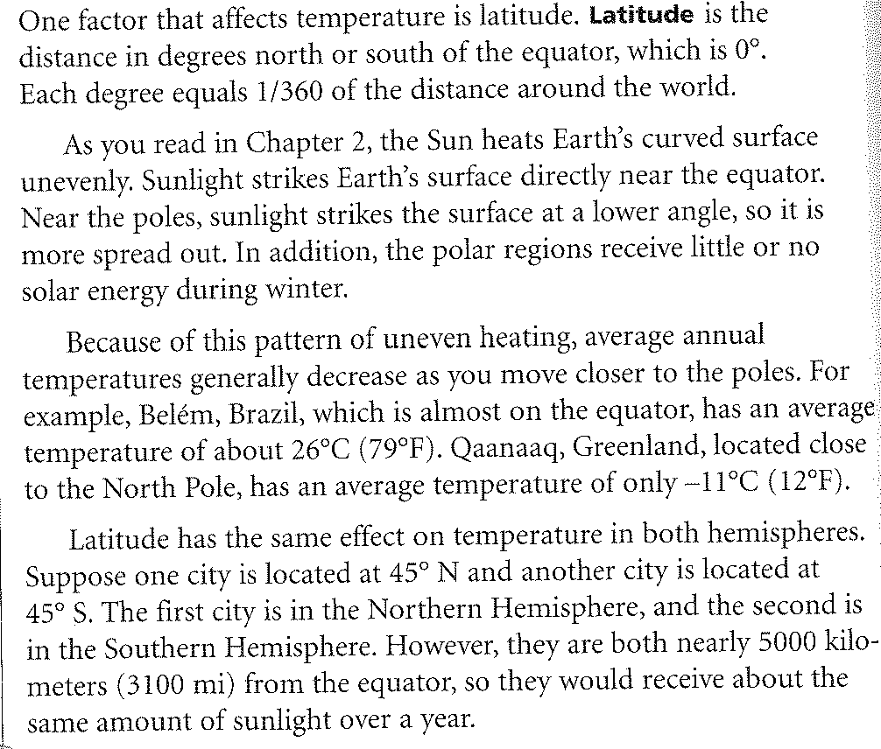
Math Vocab
Geography Vocab
2 Meanings
Notes:
Although only one vocabulary word is in bold type and defined,”Latitude”, this page is loaded with tier 2 vocabulary. Tier 2 vocabulary are academic words used across a variety of content areas. These are words commonly used but rarely taught explicitly because content teachers feel obligated to teach content specific words which are tier 3. For students to gain understanding of this text, they must have working knowledge of math terms such as “factor,angle, 1/360”, and geography words like,”poles, regions, and hemispheres. How many students realize “degrees” has two meanings and usages? The symbol for degree represents a temperature and a sentence later it means a distance.

Slide 20
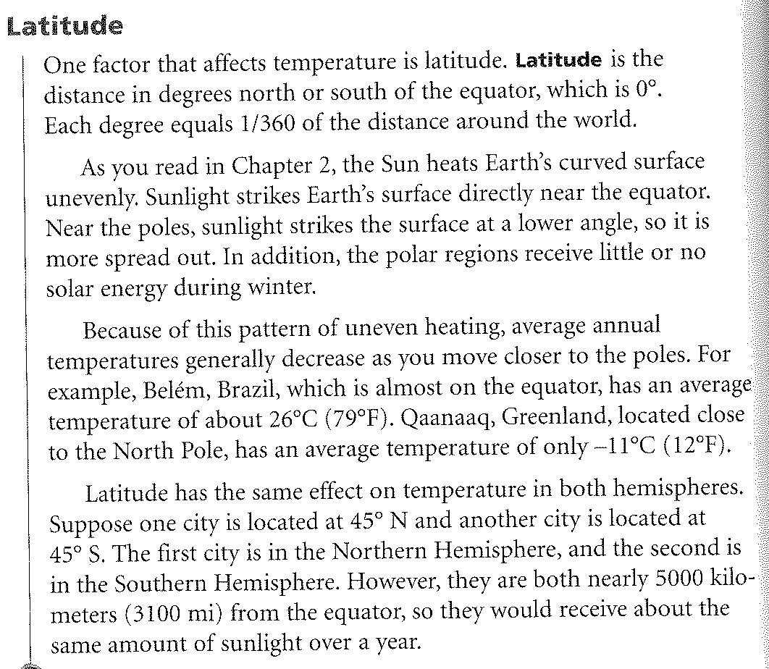
Notice the number of dependent clauses!
Grammar:
Dependent Clauses
Very Complex Sentences
Notes:
Nearly every sentence is a compound or complex sentence. If you think back to your English days you learned about simple and complex sentences. Yes, there is grammar on this page and it comes in the form of introductory dependent clauses which create a certain condition. Science text contains many of these because of the nature of its content. One science condition is the result of another. What an authentic and relevant place to teach this grammar!

Slide 21
Notes:
What organizational structures can you find? Do students truly understand cause-effect, compare-contrast, etc? Many teachers use organizing structures such as graphic organizers. Do these need to be taught explicitly?

Slide 22
Text Structures
Latitude affects temperature
The key concept. Notice “Check Your Reading” at the very bottom of the page! Also the thesis of the page. Notice the 1st sentence although “affects” is used not “effect”.
Cause & Effect
Chron. Order
Process
Problem/ Solution
Definition or Description
Compare
Contrast
Text structures - the way that authors organize information - help students focus attention on key concepts and relationships, anticipate what’s to come, and monitor their comprehension as they read.
Notes:
Similarly to how discipline specific texts have certain text features, they also have certain text structures. Text structure refers to the ways that authors organize information in text. Teaching students to recognize the underlying structure of content-area texts can help students focus attention on key concepts and relationships, anticipate what’s to come, and monitor their comprehension as they read. Text structures should be explicitly taught to support and scaffold students in their efforts to comprehend text structure more effectively. Different text structures use different key words to signal the relationship. While we will see words like “first, next,” etc in a sequential structure,
Words like “so and because” will signal cause and effect.

Slide 23
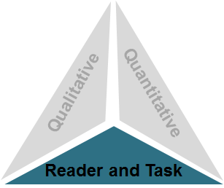
Step 3: Reader and Task
Considerations such as:
Motivation
Knowledge and experience
Purpose for reading
Complexity of task assigned regarding text
Complexity of questions asked regarding text
Notes:
This is what the reader brings to the act of reading. Louis Rosenblatt describes the reading process as a transaction arguing that words in themselves have no meaning. It’s what the reader brings to the act of reading that gives text meaning, so different readers bring different experiences which results in different transactions.

Slide 24
Reader and Task Considerations
Qualitative
Quantitative
Will the complexity of any before, during, and after reading tasks
or the complexity of any questions asked about the text interfere with the reading experience?
Reader and Task
What supports do I need to provide so all of my students (even those who are struggling readers) can access the text?
What aspects of the text will likely pose the most challenge for my students?
  What are natural areas of focus
  for this text?
  With what standards do my students need the most practice?
Notes:
The third and final measure of the CCSS three-part model for determining how easy or difficult a particular text is reader and task considerations. While the prior two elements of the model focus – quantitative and qualitative measures – on the inherent complexity of text, variables specific to particular readers - such as motivation, knowledge, and experiences - and to particular tasks - such as purpose and the complexity of the task assigned and the questions posed - must also be considered when determining whether a text is appropriate for a given student. Have you ever seen a student “shut down” while reading? Has it ever happened to you? If the task is unclear or purpose uncertain, there can be an emotional hijacking which makes it nearly impossible to continue the read.

Slide 25
Reader &Task
What purpose does the reader have? Answer questions at the end of section? Teacher discussion? Quiz?
The author of this science text page assumes many things about the students who will read :
  Working knowledge of tier 2 math & geography vocab
  Complex grammatical structures
  The strategy of moving across 3 separate texts
  Background knowledge of geography including map reading skills
  Background knowledge of Earth’s orbit

Slide 26
Analysis
Little on this page would prevent a 7th grader from fluently reading the text…”word calling”.
However, the complexity of the text could prevent access to comprehension.
“I read it, but I don’t get it” may be the truthful response of students lacking scaffolds and strategies to unlock what this text says.
Notes:
If you were doing a “popcorn” read( not recommended), or if you had students read out loud to you they would most likely read this page fluently, perhaps struggling with Quaanaaq, Greenland. Foundational reading skills taught in the primary grades enable most students to decode with little effort. Many of the words in the text are part of their site-based vocabulary. In other words, they are “word callers”. But a closer look at the qualitative features suggest the text is more complex than we realize.

Slide 27
How has Complex Text been handled in the Disciplines?
“Expectation condition” – students are expected to comprehend such texts without instruction and scaffolding
“Dependence condition” – students are assigned to read such texts but do not need to reach satisfactory comprehension as they can depend on being told what they need to know
“Bypass condition” – students are not even assigned to read such texts and operate in a “print free” environment where virtually all they need to know will be delivered through telling, showing, and interactive or “hands-on” activities
Notes:
Doug Buehl does an excellent job of explaining the different conditions or approaches teachers have taken with regards to literacy in their classes. Do you know teachers who fall under one of the above? What about you?

Slide 28
Our Role as Mentors
(A “New” Condition)
The person in your room most skilled as a reader of science is YOU! In comparison, your students are apprentices.
“Mentoring condition” – students are mentored to comprehend such texts and are provided instruction and scaffolding
Notes:
You are The Wizard of Oz in your classroom. The “mentoring condition” takes you out from behind the curtain where you can model and make visible the literacies of science that are so easy for you.

Slide 29

Frontloading Decisions
How do you decide if your text will
require frontloading?
What is “below” the surface of the text, unstated but necessary for comprehension?
What does the author assume the reader already knows? (Hidden Knowledge)
vocabulary
concepts
text structure
From a reader and task perspective, do you need to activate prior knowledge or do you need to build background knowledge? What do you want students to know and do?
Notes:
Although “frontloading” is a term often heard in a reading class, Doug Buehl argues that text, especially in the disciplines are authored by content experts who assume their audience, our students,
have certain background knowledge and are strategic readers of content specific text. This is called “hidden knowledge”. These assumptions may be very inaccurate. To prepare our students for the demands and nuances of our text may require certain “frontloads” not realized in the past. Let’s take a closer look at each component of complex text.

Slide 30

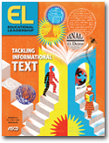
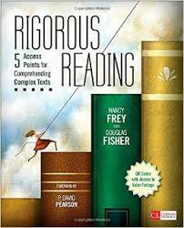
“Points of Entry” Nov. 2013
Rigorous Reading, 2013 by Doug Fisher &
Nancy Frey
Notes:
In other words, students do not automatically have access to what the text means simply by reading the words. You may have many students who can fluently “read” because they have a strong site-based vocabulary combined with strong decoding skills. They are “word callers”. Fisher and Frey provide excellent resources to guide teachers in the direction of the mentoring model. Content teachers may not realize that over the years they have acquired skills and strategies that allow them to read and comprehend the texts of their discipline. What may seem very natural for us ( the access points) may not even exist for many of our students.

Slide 31
Access Point One: Purpose and Modeling
Access Point Two: Close and Scaffolded Reading Instruction
Access Point Three: Collaborative Conversations
Access Point Four: An Independent Reading Staircase
Access Point Five: Demonstrating Understanding and Assessing Performance
Notes:
Access Point One: Purpose and Modeling – look at the important key principles and indicators of modeling thinking of complex texts through think-alouds, demonstrations, and annotation. Identify characteristics of a quality purpose statement, understand how a quality purpose statement will support students in accessing complex texts, and engage in and complete tasks assigned.
Access Point Two: Close and Scaffolded Reading Instruction – identify and understand the six essential practices of close reading instruction, and the importance of the six categories of text-based questions. Discuss the Four Principles of Scaffolded Instruction. These two instructional practices are avenues to support students as they begin to take responsibility for their learning as analytic readers.
Access Point Three: Collaborative Conversations – understand the value and necessity of student peer interaction in collaborative learning settings to gain access to independently read complex texts. Analyze the K–12 Speaking and Listening Anchor Standard 1 from the Common Core State Standards (CCSS). Closely examine and discuss the essential indicators and key elements of collaborative learning structures.
Access Point Four: An Independent Reading Staircase – understand the goal of independent learning. Analyze the similarities and differences between independent reading and silent sustained reading (SSR). In addition, examine the four elements of reading conferences and the purpose of reading conferences, and understand how to use conferences for formative assessments.
Access Point Five: Demonstrating Understanding and Assessing Performance – understand how to assign effective text-dependent tasks for student engagement with complex texts. In addition, participants will delve into formative assessments, such as feedback and feed-up with error analysis.

Slide 32
Access Point #1: Purpose
Tell students what they will be learning
What they will do with what they learn
How they will interact with others as they learn
A number of studies have found that when the teacher states objectives and provides feedback, student learning increases.(Dean, Stone, Hubbell, & Pitlet, 2012)
Students benefit from having a clearly established purpose for learning, which alerts them to what is expected and draws their attention to salient points of instruction.(Marzano, 2009)
Notes:
Access Point #1 begins with the lower piece of the text complexity triangle – reader and task. Notice that access #1 doesn’t just focus on what they will learn, it also emphasizes the “why” and “how”. Fisher & Frey provide several videos on youtube showing actual teachers beginning their lessons with access #1.

Slide 33
Modeling for Access
Model That Which is Difficult for Students
Model Ways to Resolve Problems
  Structural Analysis: Looking Inside Words
  Context Clues: Looking Outside Words
  Using Resources: Looking Further Outside Words
Model How You Interact With Texts(Annotations)
Model Through Think-Alouds
Model Through Interactive Shared readings
Notes:
In addition to setting purpose, access #1 emphasizes the various ways a teacher may need to model a strategy or skill. This is stepping out from behind the curtain. Gallagher says we should not be the “Wizard of Oz” in our classroom. We need to analyze our materials through a literacy lenses and anticipate where those literacy stumbling blocks may reside.
Access Point One: Purpose and Modeling – look at the important key principles and indicators of modeling thinking of complex texts through think-alouds, demonstrations, and annotation. Identify characteristics of a quality purpose statement, understand how a quality purpose statement will support students in accessing complex texts, and engage in and complete tasks assigned.
Access Point Two: Close and Scaffolded Reading Instruction – identify and understand the six essential practices of close reading instruction, and the importance of the six categories of text-based questions. Discuss the Four Principles of Scaffolded Instruction. These two instructional practices are avenues to support students as they begin to take responsibility for their learning as analytic readers.
Access Point Three: Collaborative Conversations – understand the value and necessity of student peer interaction in collaborative learning settings to gain access to independently read complex texts. Analyze the K–12 Speaking and Listening Anchor Standard 1 from the Common Core State Standards (CCSS). Closely examine and discuss the essential indicators and key elements of collaborative learning structures.
Access Point Four: An Independent Reading Staircase – understand the goal of independent learning. Analyze the similarities and differences between independent reading and silent sustained reading (SSR). In addition, examine the four elements of reading conferences and the purpose of reading conferences, and understand how to use conferences for formative assessments.
Access Point Five: Demonstrating Understanding and Assessing Performance – understand how to assign effective text-dependent tasks for student engagement with complex texts. In addition, participants will delve into formative assessments, such as feedback and feed-up with error analysis.

Slide 34
Access Point #2: Close and Scaffolded Reading Instruction
This means…asking students to “work” the text through text-dependent questions which require students to find the evidence of their answers in the text.
As the teacher you use questions differently. They are not meant to interrogate the class to see who read the assignment and who did not.
Notes:
First of all we are not reading teachers and this is not the newest addition of reading in the content area. Each discipline has its own literacy challenges for students. Generalized reading strategies may help the struggling readers in your class, but they probably won’t provide the access point for working through the demands and nuances of complex science text. Resources such as Buehl’s Interactive Strategies can provide specialized scaffolds. Call on your school’s literacy coach for ideas and support. Reflect on your teaching practices. Do you gravitate to some of those “conditions” not conducive to college or career literacy readiness?

Slide 35
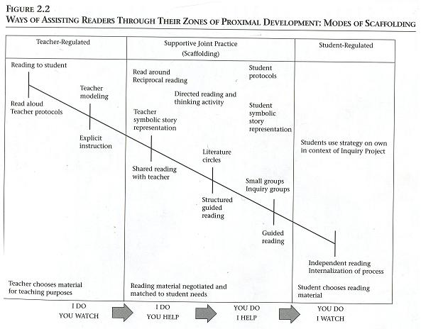
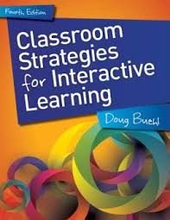
Comprehension Processes
Make connections
Generate Questions
Make inferences
Monitor reading
Synthesize
Determine importance
Create Mental Images
Disciplinary Lens
Literacy Practices
Notes:
“Doing literacy practices versus using literacy practices” The Buehl book has been inserted into the collaborative area of the Gradual Release Model. The strategies are intended for collaboration not as the newest homework worksheet. As students become more strategic the scaffolds can be taken away. The object is independent comprehension processes.

Slide 36
Access Point #3: Collaborative Conversations
Is a critical linchpin in the process of assessing complex texts
Supports student learning in the
absence of the teacher
Provides opportunities for students to apply skills and strategies
Allows for authentic practice of
academic language
Collaborative Learning
Notes:
Collaborative learning. Disciplinary literacy also includes “Listening and Speaking” Collaborative Conversations provide opportunities for students to communicate as scientists. This, in turn, becomes the oral rehearsal for writing science. The better we speak science…the better we write science.
is a critical linchpin in the process of accessing complex texts, as it allows students to work together to improve understanding.
supports students learning in the absence of a teacher. Remind participants of the gradual release of responsibility (Fisher & Frey, 2008; Pearson & Fielding, 1991) and the Zone of Proximal Development (Vygotsky, 1978)
provides opportunities for students to apply skills and strategies modeled during close and scaffolded reading instruction, such as practice in critical thinking, argumentation, and using evidence in their responses.
allows for authentic practice of academic language.

Slide 37


Access Point #4: An Independent Reading Staircase
Notes:
How many science teachers have their own classroom library of science related texts? By high school students should be reading considerably more informational text than narrative. Your text book doesn’t count! What journals and online texts can be available ? A literacy rich science class has the capacity to influence background knowledge, create curiosity, and affect the reader and task component of the text complexity triangle.

Slide 38

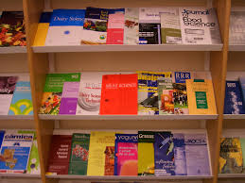
Classroom Libraries
Notes:
Science classroom/lab environments can almost be sterile literacy environments save the wall size periodic table hanging on the back wall. Allow students to be exposed to the texts of real-life science.

Slide 39

What is so complex about text complexity?
Building Collections of Appropriately Complex Texts in All Disciplines
http://www.livebinders.com/media/get/NDQ4Nzg3Mg==
Notes:
The Wisconsin DPI provides valuable resources promoting literacy in all disciplines. In addition the CESA’s throughout the state can be an important source for training and support.
One of the key requirements of the Common Core State Standards for Reading is that all students must be able to comprehend texts of steadily increasing complexity as they progress through school. By the time they complete high school, students must be able to read and comprehend independently and proficiently the kinds of complex texts commonly found in college and careers.

Slide 40
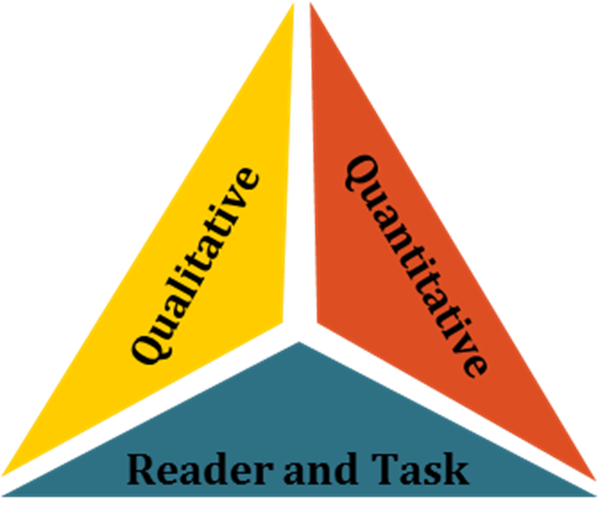
Access Point #5: Demonstrating Understanding and Assessing Performance
Deeper comprehension is not the ultimate goal.
What can students be asked to do
with that deeper understanding?
To KNOW …AND …
Be able to DO!
Notes:
Again the goal is not just increased comprehension, but what can students do with a deeper understanding of the materials and texts. Starting with the end in mind, “What do you want students to know and do? How will you assess? What tasks can be authentic and meaningful?

Slide 41
In Conclusion
Science literacy begins with each science teacher being aware of the unique demands of science text.
Lessons need to be strategic and purposeful and involve the same reading, writing, speaking & listening that real scientists use.

Slide 42
In Conclusion
Use the support available in your district such as a literacy coach.
Contact your CESA for workshops and additional support.
Contact Dr. Kevin Anderson kevin.anderson@dpi.gov
Contact Sid Larson , Literacy Consultant
sid.larson@cesa2.org

