Slide 1
WASBO Accounting Conference
20 March 2024
Categorical Aids
Kathy Fry Finance Consultant
Ben Kopitzke Finance Consultant
School Financial Services Team

Slide 2
2023-25 Biennial Budget Process
We are in the first year of the current biennial budget (FY24).
DPI will likely submit its departmental budget request for
2025-27 in November 2024.
Gov. Evers will likely release his proposal in February 2025.
The Legislative Joint Committee of Finance will work on
the 2025-27 budget and related documents through the spring/summer of 2025.
Ideally the final budget for FY26 and FY27 will be completed prior to July 1, 2025.

Slide 3
What is a Categorical Aid?
Targeted purpose
Outside revenue limit
Offsets shared cost
Notes:
With each of the aid programs we will review, your district should have a draft plan of how this revenue could be used.

Slide 4
What is a Categorical Aid?
Usually “sum-certain,” often prorated
Three broad types
    Reimbursement
    Formula
    Grant

Slide 5
Categorical Aid Funding
Special Ed. Aid
Per Pupil Aid
https://dpi.wi.gov/sites/default/files/imce/policy-budget/2023_Act_19_K-12_School_Aid_Budget.pdf
Notes:
Special Ed Aids $571,068,700
Per-Pupil Aid $591,003,000 → Declining enrollment
AGR $109,318,200
Common Sch Fund $65,000,000
Transportation Aids $46,800,000
Sparsity Aid $28,614,000
Bilingual-Bicultural $10,089,800
State Tuition $8,242,900
Mental Health Aid $12,000,000
Mental Health Grant $25,000,000
High Poverty Aid $0 RECENTLY REDUCED
Total $1,467,136,600

Slide 6
Special Education & School-Age Parents Aid
$558,036,700 in FY24; $574,777,700 in FY25
Districts, Independent Charters Schools (ICS), CESAs, CCDEBs
Reimbursement of prior year eligible costs
  Salary & benefits of licensed staff
  IEP-required specialized transportation
  Limited contracting
Sum-certain, prorated (31.5% in March payment)
  Paid in 6 installments
Special Education & School-Age Parents Aid
Authorization: s. 115.88
Appropriation: s. 20.255(2)(b)
Notes:
A slightly lower rate is used for monthly payments to avoid overpayment; the final payment in June 2024 will reflect each LEA’s full aid eligibility at the year’s final proration rate. More like 31.5% or so
Payments made in FY24 for costs incurred in FY23

Slide 7
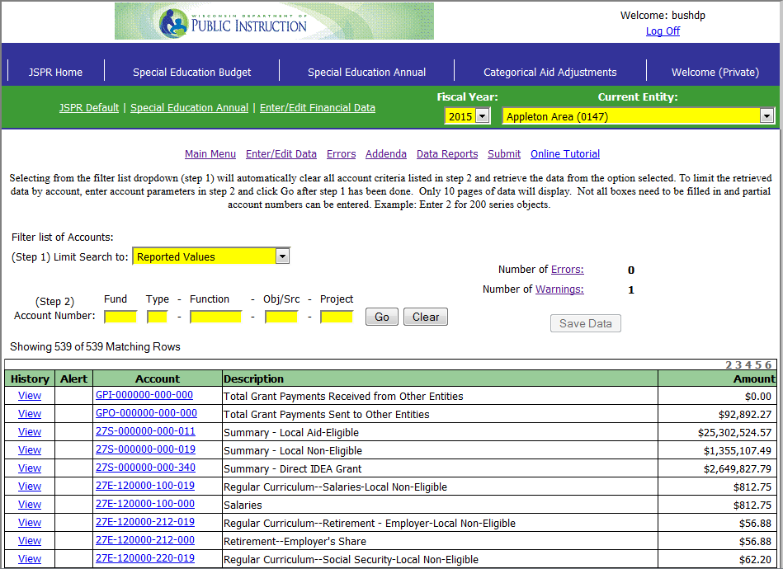
Special Education & SAP Aid: How do you get it?
PI-1505-SE Special Education
Annual Report
  Subset of full PI-1505 Annual Report
Fund 27 expenditures by project code
  011: Local aidable
  019: Local non-aidable
  340: IDEA grant roll-up

Slide 8
a
High Cost Special Education Aid
$13,032,000 in FY24; $14,480,000 in FY25
Districts, Independent Charter Schools, CESAs, CCDEBs
Average reimbursement rate of individual pupil costs over $30,000 in 2022-23 was 29.1%, after SPED/SAP aid was deducted
Sum-certain, prorated if necessary
  Paid in June
Authorization: s. 115.881
Appropriation: s. 20.255(2)(bd)
Notes:
Estimated to reimburse eligible costs at 40% in FY24 and 50% in FY25.

Slide 9
High Cost SPED Aid: How do you get it?
Deadline for 2023-24 claims for 2022-23 student costs was March 11, 2024.
Watch future School Finance Bulletins to follow the rule process and find out when details are available online: High Cost Special Education
Supplemental Special Education Aid ended in FY20

Slide 10
Per Pupil Aid
$591,003,000 in FY24; $587,812,400 in FY25
Per pupil aid is for districts only
$742 per pupil; calculated by DPI
    Uses Revenue Limit membership Line 6 less Special Needs Scholarship Program (SNSP) and New Charter Authorizer membership (ICS)
Sum-sufficient ($742 pp is guaranteed in FY24 and FY25)
  Paid in March
Authorization: s. 115.437
Appropriation: s. 20.255(2)(aq)
Notes:
“Sum-sufficient” means all districts are guaranteed per pupil amount, regardless of total cost.
SNAPSHOT in March, #s won’t match final RL
Lapsed $13.6M last year, only $1M this year

Slide 11
a
Achievement Gap Reduction
$109,184,500 in FY24 & FY25
Replaced the SAGE program at the end of the 2017-18 school year
Focused on closing achievement gaps
    Tutoring, teacher coaching, or class size reduction
Progress reporting to DPI and your board
AGR payments are per-pupil:
Appropriation ÷ total # of low-income kids in AGR districts
2022-23 AGR Allocations by District
Authorization: s. 118.44
Appropriation: ss. 20.255(2)(cu)
Notes:
AGR replaced SAGE end of 17-18
AGR meant to be more flexible, provide options besides class size reduction

Slide 12
a
Common School Fund (Library Aid)
Common School Fund is $65,000,000 in FY24 (25% increase YOY)
Districts only
Allocation based on resident population of children ages 4-20 (school census); reporting opens in June, closes in August
For purchase of library materials
Each district is expected to estimate their CSF amount in their own budget reports.
Authorization: Art. X, ss. 2 & 5,
Wis. Constitution; s. 43.70, Stats.
Notes:
Total available comes from interest earnings from Board of Commissioners of Public Lands, certain fines and forfeitures, sale of public lands—revenue is “segregated” from state general fund
BCPL tells DPI how much is available
Allocation divided proportionally by school census
Library materials include books, periodicals, other media, library computers

Slide 13
a
Common School Fund (Library Aid)
BCPL provides an estimate of the funds available in January
  CSF allocation will be approximately $56.87 per student
  Estimate = final payment to help districts plan
Districts are expected to spend this money during the current school year; no carry-over is the goal
  Paid in late April, must be spent by end of June
Common School Fund information
Notes:
Total available comes from interest earnings from Board of Commissioners of Public Lands, certain fines and forfeitures, sale of public lands—revenue is “segregated” from state general fund
BCPL tells DPI how much is available
Allocation divided proportionally by school census
Library materials include books, periodicals, other media, library computers

Slide 14
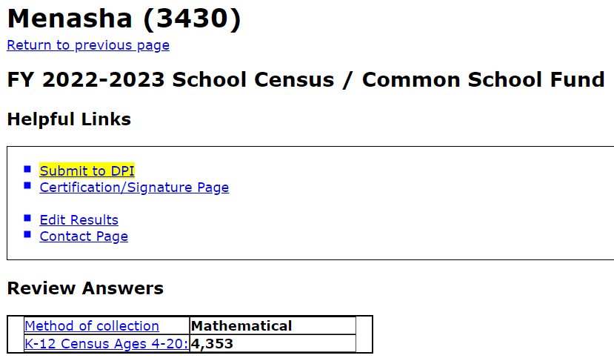
a
Common School Fund Library Aid: How do you get it?
PI-1505-Census
Census Report
  Count of district residents ages 4-20
  Can use physical count or mathematical approximation

Slide 15
a
Pupil Transportation Aid
Pupil Transportation Aid FY24 & FY25 is $24,000,000/year
Formula based on number of pupils transported
in mileage categories
Sum-certain, paid in January
Remaining balance distributed proportionally in June,
based on share of audited January payment
Authorization: s. 121.58
Appropriation: s. 20.255(2)(cr)
Notes:
Independent (2r/2x) charters eligible
State law requires transportation of pupils > 2 mi. from school or in hazardous area
Regular year per-pupil amounts:
< 2 mi. hazardous: $15
2-5 mi.: $35
5-8 mi.: $55
8-12 mi.: $110
> 12 mi.: $400
Lower rates for summer school: $10/pupil 2-5 mi., $20/pupil > 5 mi.
Half amount paid for pupils transported less than half for summer and/or interim sessions
Also includes amount for pupils transported over ice $35,000 (Bayfield)
No proration since FY 2006

Slide 16
PI-1547 Regular Year Reporting
Distance in Miles | Regular Year (PI-1547)
Less Than 2 miles (hazardous area) | $15/pupil
Over 2-5 miles | $35/pupil
Over 5 up to 8 miles | $55/pupil
Over 8 up to 12 miles | $110/pupil
Over 12 miles | $400/pupil (beginning with 2023-24)
The “0 to 2 Miles (Hazardous Area Transportation)” category requires DPI approval before data can be entered.

Slide 17
PI-1547-SS Summer/Interim Reporting
Distance in Miles | Summer/Interim (PI-1547-SS)
Less Than 2 miles (hazardous area) | NA
Over 2-5 miles | $10/pupil
Over 5 up to 8 miles | $20/pupil
Over 8 up to 12 miles | $20/pupil
Over 12 miles | $20/pupil
Recently revised: Increased payment, and distance from student’s residence to school only factor to be considered for summer school interim.
Districts are not required to transport for summer/interim sessions to the same standard as during the regular school year.

Slide 18
a
High Cost Transportation Aid
High Cost Transportation Aid is $22,800,000 in FY24 & FY25
  To districts only and based on previous school year data
  For districts with audited cost/member of 140% of statewide average
  and 50 or fewer students per square mile.
  $200,000 will go to districts that qualified the year before but not
  in the current school year, equal to 50%, prorated if necessary.
Formula based on per-member Fund 10 transportation expenses and calculated by DPI
Sum-certain, prorated (66.8% in FY22)
  Paid in June
Authorization: s. 121.59
Appropriation: s. 20.255(2)(cq)
Notes:
Proration of aid in FY 2016 was 60.37% (128 districts qualified)
Proration of aid in FY 2017 was 51.62% (123 districts qualified)
Proration of aid in FY 2018 was 84.84% (126 districts qualified)
Proration of aid in FY 2019 was 71.14% (139 districts qualified)
Proration of aid in FY 2020 was 79.27% (136 districts qualified)
Proration of aid in FY 2021 was 82.4% (136 districts qualified)
There is a "stop-gap" provision for any school district that qualified for High Cost Transportation aid in the immediately preceding school year but is ineligible in the current school year, equal to 50% of the High Cost Transportation aid that district received in the prior year. $200,000

Slide 19
a
Sparsity Aid
Sparsity Aid in FY24 & FY25 is $28,614,000
Districts only
Formula based on membership and density; calculated by DPI
Starting in FY22: two tiers of aid eligibility
  $400 pp: ≤745 members, <10 members/mi²
  $100 pp: 746-1,000 members, <10 members/mi²
  50% stop-gap for previously aided but now ineligible
Sum-certain, prorated if necessary (98.8% in FY24)
  Paid in September
Authorization: s. 115.436
Appropriation: s. 20.255(2)(ae)
Notes:
“Stop-gap" provision for any school district that received sparsity aid in the previous school year but is not eligible in the current school year, equal to 50 percent of the sparsity aid that district received in the prior year. If funding is insufficient, payments are prorated.
95% paid in September; 5% adjusted paid in November
The final 5% of the eligible amount is being held back until 10/19/2023, so adjustments can be made for membership changes that could affect a district's eligibility.

Slide 20
a
Bilingual-Bicultural Programs
Funding for FY24 & FY25 is $10,089,800/year
Districts only
Reimbursement of prior year eligible costs
Eligibility based on school ELL enrollment
Sum-certain, prorated if necessary (7.7% in FY23)
  Paid in December
Bilingual-Bicultural Programs
Contact Tanya Morin (608) 267-9393 for assistance
Authorization: s. 115.995
Appropriation: s. 20.255(2)(cc)
Notes:
~$105 million total PY costs 8% reimbursement. Just over half of ELLs have $ behind them
~50,000 EL, 27,000 served → need to reach threshold concentration to receive funds
10 students in grades K-3 WHO SPEAK SAME LANGUAGE
20 students in grades 4-8
20 students in grades 9-12
Also small pot of money $250,000 for >15% ELL
360+ districts report having ELLs; 50 received any funding

Slide 21
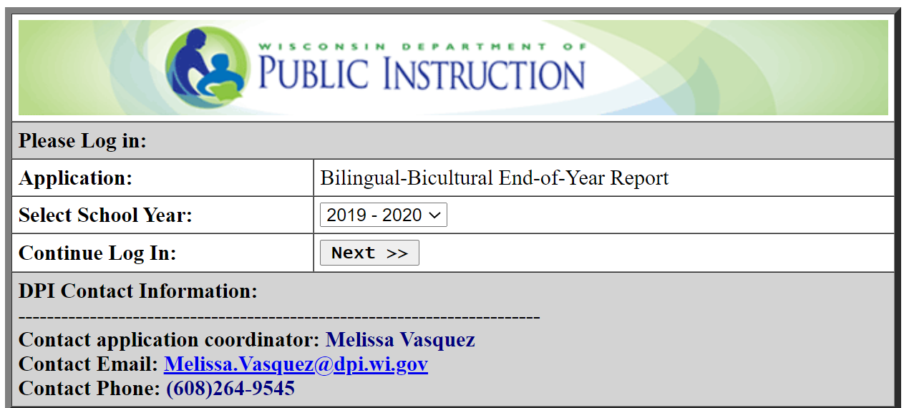
a
BLBC Education Aid: How do you get it?
Submit plan of service
before school year
begins
Submit end-of-year
report after school
year ends
Contact Tanya Morin (608) 267-9393 for assistance
BLBC Programs Website

Slide 22
a
State Tuition
State Tuition for FY24 & FY25 is $8,242,900 /year
Districts only
Reimbursement of prior year costs serving pupils in eligible facilities
Sum-certain, prorated if necessary
  Paid in June
Authorization: s. 121.79
Appropriation: s. 20.255(2)(cg)
Notes:
Unresolved open enrollment has “first draw” against the appropriation (funding has been sufficient in recent years)
Eligible facilities:
Children’s homes (usually juvenile detention, county jails)
State/federal institution w/ residential staff—cost of serving staff’s children (Ft. McCoy, VA Hospital, other institutions with employees residing on grounds)
Tax-exempt foster/group homes
Taxable foster/group homes if those pupils are at least 4% of total enrolled
Reimbursement reduced by imputed general, transportation, SPED/SAP aid
Paid on the first Monday in June

Slide 23
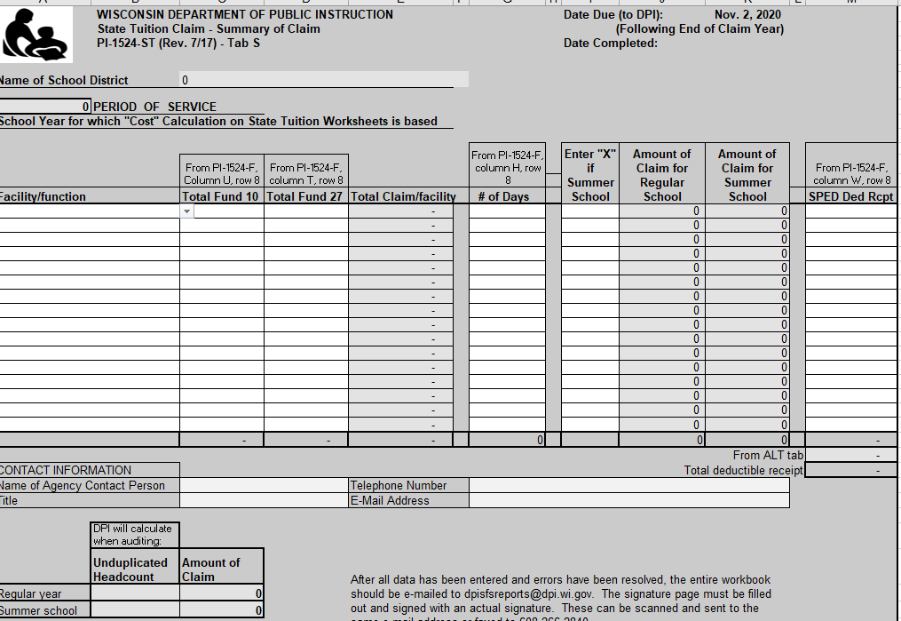
a
State Tuition: How do you get it?
PI-1524-ST Excel-based claim workbook
  Eligible costs
  Students & days served
  Due date: 9/30/24
Notes:
Workbook found at link. Complete and email KF for invitation to submit through secure Liquid Files due to PII contained.

Slide 24
a
High Poverty Aid
High Poverty Aid for FY24 and onward is $0/year
  Funds repurposed for general equalization aids
  Statutory language and appropriation retained
Districts only
Eligibility - A school district is eligible for aid if at least 50% (after rounding to the nearest whole percentage point) of the district's student enrollment on the third Friday in September in the immediately preceding even-numbered year satisfied the income eligibility criteria to be eligible for free or reduced-price lunch (i.e., economically disadvantaged).
  Formerly paid in March
Authorization: s. 121.136
Appropriation: s. 20.255(2)(bb)

Slide 25
a
Mental Health Categorial Aid Program
$12,000,000 GPR in FY24 & FY25
Mental Health Categorical Aid Program supports the expansion
of mental health services to students by providing state
reimbursements for expenditures on social worker services.
Two-tiered program
Authorization: s. 115.364
Administrative Code Sec. PI 31
Appropriation: s. 20.255(2)(da)
Notes:
Used to be $6M/yr

Slide 26
a
Mental Health Categorial Aid Program
Eligible school districts, private schools, and independent charter schools may receive partial reimbursement for salary and fringe benefits paid to employ, hire, or retain social workers or the costs to contract for the services of a social worker when the eligible entity increased in its expenditures in the prior school year compared to the immediately preceding school year.
June aid payments are prorated if the appropriation does not fully cover total aid eligibility
Claim form deadline was March 8, 2024.
Contact Julie Incitti (608) 266-0963 for assistance.

Slide 27
a
School-Based Mental Health Services Grant
School-Based Mental Health Services Grant provides $25,000,000 GPR in FY24 & FY25
This is a competitive grant process.
  Paid in June
Contact Liz Krubsack (608) 264-6719 or
  Jessica Frain (608) 266-0986
Authorization: s. 115.367
Appropriation: s. 20.255(2)(dt)
Notes:
Formerly $6.5M

Slide 28
Mental Health Training Programs for Schools
CESA – Trauma Sensitive Schools
Wish Center
    Youth Mental Health First Aid (YMHFA)
    Screening, Brief Interventions, and Referral to Treatment (SBIRT)
Contact Liz Krubsack (608) 264-6719 or Jessica Frain (608) 266-0986

Slide 29
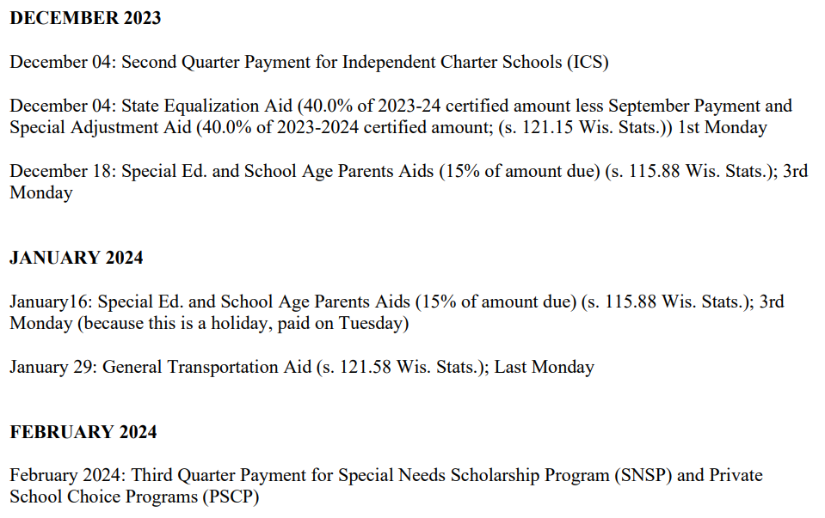
Aid Payment Schedule
2023-24 State Aid Payment Schedule

Slide 30
Aid Payment Adjustments
Madison, Final 2022-23
Actual and Projected State
Aid Adjustments &
June Aid Payment Reconciliation
Notes:
https://dpi.wi.gov/sfs/finances/aids-register/aid-payment-adj-exp

Slide 31
North
Lakeland,
Final 2022-23
Gibraltar,
Final 2022-23
Notes:
https://dpi.wi.gov/sfs/finances/aids-register/aid-payment-adj-exp

Slide 32
North
Lakeland,
Final 2022-23
Spooner,
Final 2022-23
Notes:
https://dpi.wi.gov/sfs/finances/aids-register/aid-payment-adj-exp

Slide 33
June Payment Reconciliation
Madison
Final 2022-23
Notes:
https://dpi.wi.gov/sfs/finances/aids-register/aid-payment-adj-exp

Slide 34
DPI Categorical Aid Contacts
Aid Program | Contact | Phone | Email
Special ED/SAP High Cost SPED | Rick Cruz | (608) 266-8255 | Ricardo.Cruz@dpi.wi.gov
Per-Pupil Aid | Ben Kopitzke | (608) 267-9279 | Ben.Kopitzke@dpi.wi.gov
Common School Fund | SFS Team | (608) 267-9114 | dpifin@dpi.wi.gov
Pupil Transportation Regular/High Cost State Tuition | Kathy Fry | (608) 224-5343 | Kathleen.Fry@dpi.wi.gov
Sparsity Aid | SFS Team | (608) 267-9114 | dpifin@dpi.wi.gov
Bilingual-Bicultural | Tanya Morin | (608) 267-9393 | Tanya.Morin@dpi.wi.gov
AGR | Shay Morris | (608) 264-9324 | Meeshay.Morris@dpi.wi.gov
General Inquiries | SFS Team | (608) 267-9114 | dpifin@dpi.wi.gov

Slide 35
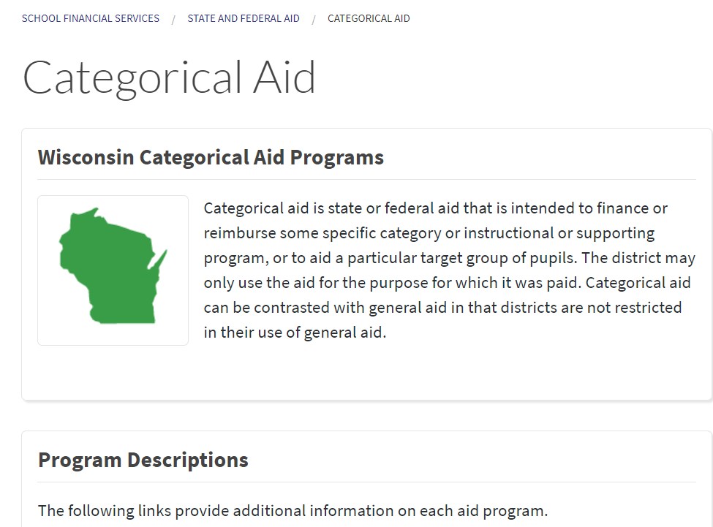
https://dpi.wi.gov/sfs/aid/categorical/overview
Notes:
Plug Statistical section of website: Basic Facts, Comp Cost/Rev, Longitudinal, worksheets, maps

Slide 36
Questions?
(608) 267-9114 or dpifin@dpi.wi.gov
https://dpi.wi.gov/sfs
Notes:
Variety of programs, contacts, and teams. Submissions to DPIfin will be delegated.

