Slide 1
Title Slide
DPI Current Updates, Reminders and
Reporting Requirements
Roger Kordus, Consultant
Bob Soldner, Assistant Director
School Financial Services Team
WASBO Spring Conference
May 19, 2022

Slide 2
Agenda
Energy efficiency exemption to revenue limits
Summer school FTE & fee reconciliation
Fund 80 eligible costs
Transfer of service (TOS) exemption to revenue limits
WISEdata Finance and WiSFiP

Slide 3
Energy Efficiency Exemptions

Slide 4
Energy Efficiency Exemptions - Overview
Energy Efficiency Exemption Resolution Overview
A school board was able to adopt a resolution to increase the revenue limit otherwise applicable to a school district under s. 121.91 (2m), Wis. Stats. in any school year by an amount spent by the school district in that school year on a project to implement energy efficiency measures or to purchase energy efficiency products. District may use this non-recurring exemption to the revenue limit to pay for an energy efficiency project in a single year or to repay a note, bond or loan used to finance the project.

Slide 5
Energy Efficiency Exemptions - Overview
Energy Efficiency Exemption (EEE) to the Revenue Limit
Per 2017 Wisconsin Act 59 (2017-19 Budget), school boards are prohibited from adopting a resolution to utilize the Energy Efficiency Exemption to the revenue limit after December 31, 2017 (through December 3018). School Boards have the authority to adopt EEE resolutions after October 1, 2017 and before January 1, 2018 that are applicable beginning in 2018-19 and thereafter.
A School Board may issue debt after December 31, 2017 to fund the energy efficiency exemption project(s) that were approved by the School Board prior to December 31, 2017. Under current law, resolutions may not be passed after December 31, 2017. This includes changes to any existing resolutions.

Slide 6
Energy Efficiency Exemptions - Overview
Energy Efficiency
2017 Wisconsin Act 59 Moratorium
Districts are no longer able to enter energy efficiency data into the School Finance Portal for the portal has been closed per 2017 Wisconsin Act 59 (2017-19 Budget). Districts may review their utility savings by going to the SAFR Reporting Portal. However, districts that need to update their energy efficiency utility savings or have other related questions should contact dpifin@dpi.wi.gov

Slide 7
Energy Efficiency Exemption is an Allowable Exemption
Revenue Limits Non-Recurring - Line 10 C
The EEE is on line 10C of the revenue limit worksheet. A non-recurring exemption to fund a project to implement energy efficiency measures or to purchase energy efficiency products. See DPI Rule and information at: Exemptions
Districts will need to review their Utility Savings to determine if they are up to date in the District’s Financial Data Home EEE page in DPI SAFR
Districts must complete the multi-year reconciliation located on page 4 of the worksheet when completing revenue limit worksheet.

Slide 8
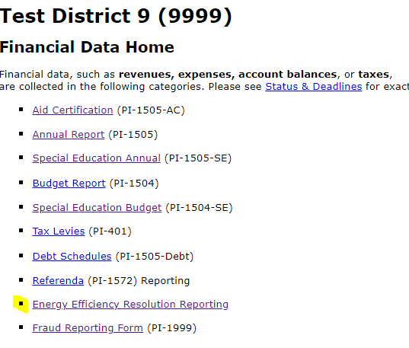
Energy Efficiency Exemption is an Allowable Exemption
Revenue Limits Non-Recurring - Line 10 C

Slide 9
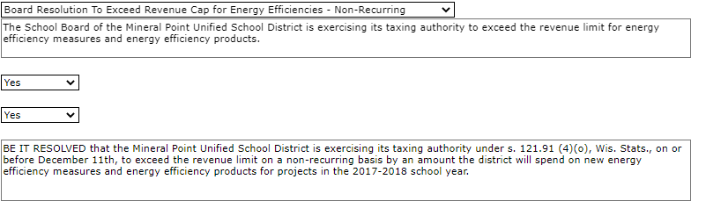
Energy Efficiency Exemptions – Utility Savings

Slide 10
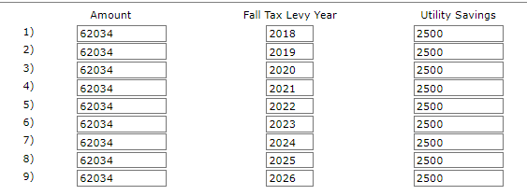
Energy Efficiency Exemptions – Utility Savings

Slide 11
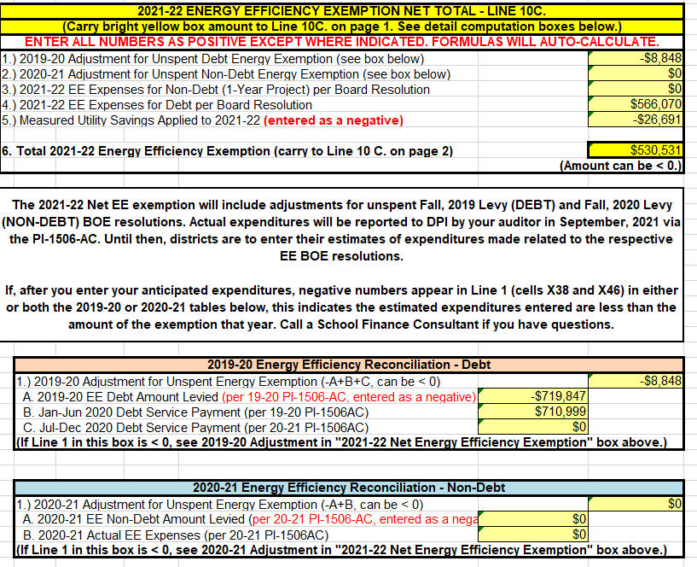
Step 3: Determine Allowable Exemptions
Line 10C Energy Efficiency

Slide 12
Summer School FTE & Fees

Slide 13
Summer Membership Reporting
PI-1804 or the PI-1804-1805 Excel Workbook
Milwaukee and the suburban districts use a special workbook (W1804-1805) that counts ITP students (Chapter 220)
Report Totals Using On-line PI-1804 Reporting Portal in the Non-Financial Data within DPI SAFR

Slide 14
Summer Membership Reporting-PI-1804
Summer and Interim Sessions start and end during periods outside of the school year.
The first day of summer school is typically the start of the next school year formembership purposes only, not the fiscal year.
The Excel worksheet (PI-1804/PI-1804-1805) is available to calculate minutes used for calculating a school district’s Summer FTE.

Slide 15
Summer School Reporting
The data on the 1804 W2 Summary Sheet of the Excel worksheet is reported to DPI through the PI-1804 on-line portal at the conclusion of summer school and is due October 1.
The summer school report is one of the few reports that asks you to calculate the FTE count as opposed to a head count.
Keep the Excel spreadsheet, as your auditor will review the information used to calculate your summer membership FTE and fee reconciliation.

Slide 16
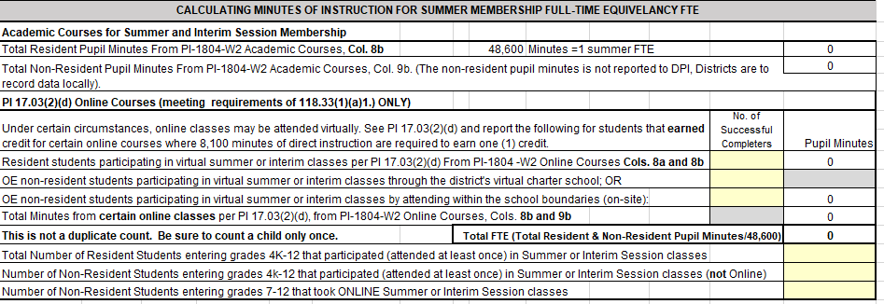
Summer School Reporting

Slide 17
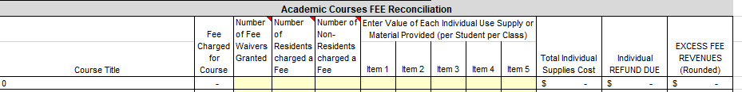
Summer School Reporting

Slide 18
Summer and interim Session Fees
DPI SFS Team's School Fees
Legislative changes such as revenue limits, changes in the equalized aid formula and general tightening of school funding have led some school districts to explore the use of "user fees" to supplement their budgets. Proponents argue that such fees can result in lower local taxes and increased services for students. Opponents argue that fees place a burden on poor and middle income families, thereby denying them equal educational opportunities.
Click the appropriate links below for more information.
Overview
Statute-authorized Fees
Statute-prohibited Fees
User Fee Categories
Frequently Asked Questions

Slide 19
Summer and interim Session Fees
  The fee must fund an item that is legally permitted and actually purchased for summer school use
  The fee may not be used to subsidize the cost of any other classes, students or administration
  The fee must be based upon the actual cost of the applicable item(s) the student received
  If your district is required to have a membership audit, the auditor will also review your summer school FTE and any associated summer school fees

Slide 20
Summer and Interim Session Fees
Fees for the resident student or parent may be charged for individual use supplies (towels, gym clothes, band instruments, notebooks, pencils), textbooks, or similar items (workbooks) if the district claims the members for State General Aid under ss. 121.14.
Fees may be charged for social, recreational, or extracurricular summer classes and programs which are neither credited toward graduation nor eligible for State General Aid [s. 118.04(4)].
DPI SFS Team's School Fees

Slide 21
Fund 80 - Community Programs and Services

Slide 22
Fund 80
The authority for a school board to operate Community Programs and Services (Fund 80) is established under sec. 120.13(19), Wis. Stats., and PI 80.
120.13(19) concludes with this sentence:
  The school board may not expend moneys on ineligible costs, as defined by DPI by rule.
  Costs associated with such programs and services shall not be included in the school district's shared cost under s. 121.07 (6).
Fund 80 Community Services Overview

Slide 23
Fund 80
A bit of history of Fund 80
The levy for Fund 80 was removed from revenue limit control starting in the 2000-01 school year [s. 121.91(2m)(e)1.] As a result, the Fund 80 levy is mostly completely funded by local taxpayers.
It has never been a factor in the equalization aid calculation.
Chapter PI 80 Community Programs and Services was created per 2013 Wisconsin Act 306. Effective Date: May 1, 2015.
Fund 80 Community Services Overview

Slide 24
Fund 80
In addition, PI 80.02 defines ineligible Fund 80 costs as:
Costs for any program or service that is limited to only school district pupils.
Costs for any program or service whose schedule presents a significant barrier for age-appropriate school district residents to participate in the program or service.
Costs that are not the actual, additional cost to operate community programs and services under s. 120.13 (19), Stats. (No percentages of cost allowed).
Costs that would be incurred by the school district if the community programs and services were not provided by the school district

Slide 25
Does a program or service belong in Fund 10 (General) or Fund 80?
It is the Board of Education and the Administration who decide what meets the criteria to be in Fund 80.
Districts are encouraged to use the “Decision Tree for potential Fund 80 Community Programs and Services” Fund 80 Community Services Decision Tree before proceeding with a change.
Through this evaluation process the Board and Administration will decided if certain activities are associated with:
The educational curriculum (curricular and extra-curricular activities) including summer school programs where student minutes will be counted (Fund 10) or
if the program has the primary function of serving the community. (Fund 80) It is a local decision.

Slide 26
Fund 80 (PI-80)
2013 Act 306 requires that Fund 80 expenditures be audited by the school district’s auditor.
NOTE: Current law already directs DPI to exclude from Shared Costs (for General Aid purposes) any Fund 80 expenditures.
If a Fund 80 expenditure audit determines that a district had inappropriately coded Fund 80 expenditures to Fund 10, those expenditures would have to be removed from Fund 10 and would decrease the district’s Shared Costs for General Aid purposes. Wis. Stat. § 121.91(4)(r)
Districts using Fund 80 will need to address this question: When the program/activity is held in a K-12 facility, which Fund is paying for the utilities and other related cost?

Slide 27
Fund 80 (PI-80)
Current law requires DPI to determine if ineligible Fund 80 expenditures exist
If reported in the audit process; DPI must reduce the district’s allowable revenue limit authority the following year by the amount of the ineligible Fund 80 expenditures; structured as a negative exemption rather than a reduction to the district’s base.
This was first applied to the Revenue Limit calculation for the 2015-16 school year, based on 2014-15 expenditures.

Slide 28
Fund 80
Preparing for an CPS audit;
Each program or service will need to be documented within the district’s accounting system.
Supporting documentation will be part of the audit process.
Community Service Fund Information Wisconsin Uniform Financial Accounting Requirements (WUFAR) will assist each district in this process.
Our Fund 80 Community Services Overview webpage provides the most recent information regarding Fund 80.
“Latest News” includes information on how Fund 80 could re-paying Fund 10 for operational costs.

Slide 29
Sample Text Slide
What is a Transfer of Service (TOS)
The Transfer of Service Exemption (Wis. Stat. § 121.91(4)(a)3) provides that a school district which assumes responsibility for a program or service from another governmental unit may request and be granted an exemption to the district revenue limit.
The Transfer of Service (TOS) request is for the estimated additional, increased cost as determined after a review of the district’s current staffing and service capacity of that program or service.
A TOS request can be for an individual student or between the school district and a local municipality, such as city or county.

Slide 30
Sample Text Slide
What is a Transfer of Service (TOS)
Transfer of financial responsibility between a school district and a local municipality, where the municipality previously paid related costs are processed through a Narrative Transfer of Service process.
Individual student requests are processed through the PI-5000 TOS online portal.
Majority of requests are for individual students.

Slide 31
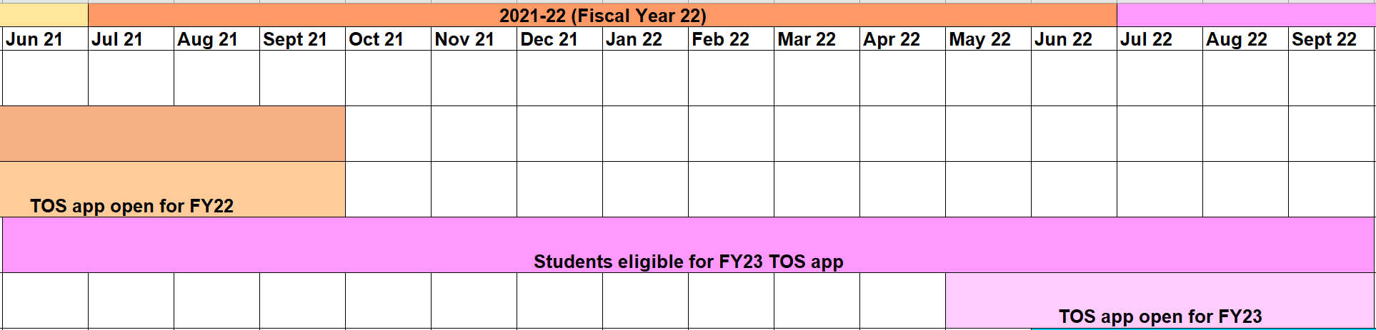
Sample with XL chart or image
TOS Eligibility
Eligibility Requirement #1: Be within the current application timeline

Slide 32
Sample Text Slide
TOS Eligibility
Eligibility Requirement #2: The student came to your district from another governmental unit
  Wisconsin school districts, including:
  A district that educates a student as a result of their residing in a juvenile detention facility, county jail, group or foster home, or another county-ordered placement without an educational program (whether or not that district received State Tuition reimbursement for the student).
  A district that places a student with one of the DPI schools (WCVBI or WESP-DHH).
  District charter school.

Slide 33
Sample Text Slide
TOS Eligibility
Eligibility Requirement #2: The student came to your district from another governmental unit
  Other Wisconsin governmental units :
  Independent (2r or 2x) charter schools.
  Wisconsin counties with birth-to-three programs for children with disabilities.
  Facilities run by the State of Wisconsin which are considered LEAs: Lincoln Hills School, and the Winnebago and Mendota Mental Health Institutes.

Slide 34
Sample Text Slide
TOS Eligibility
Eligibility Requirement #2: The student came to your district from another governmental unit
  Public schools outside Wisconsin, including :
  Schools operated by another state or sub-unit of another state,
  Schools operated by the federal government; and
  Schools operated by a foreign country or sub-unit of a foreign country.

Slide 35
Sample Text Slide
TOS Eligibility
Eligibility Requirement #3: The student is a student with a disability or limited English proficiency
Transferred into the district with an identified need.
Typically, the need will be identified by an Individualized Education Program (IEP) or English Learner (EL) service plan with a Limited English Proficient (LEP) classification of 1 through 5.
A district is not eligible to receive a Transfer of Service exemption for new services required by an evaluation or re-evaluation of a student after they transfer into the district.

Slide 36
Sample Text Slide
TOS Eligibility
Eligibility Requirement #4: There is an increased cost for the district
This is not the same as just an increase in service.
TOS Eligible Example: The district never had a speech and language teacher before, now they have a new student who needs that service so they must hire a speech and language teacher.
Not TOS Eligible Example: The district has a new student who needs speech and language services and will now participate in their existing speech and language program.

Slide 37
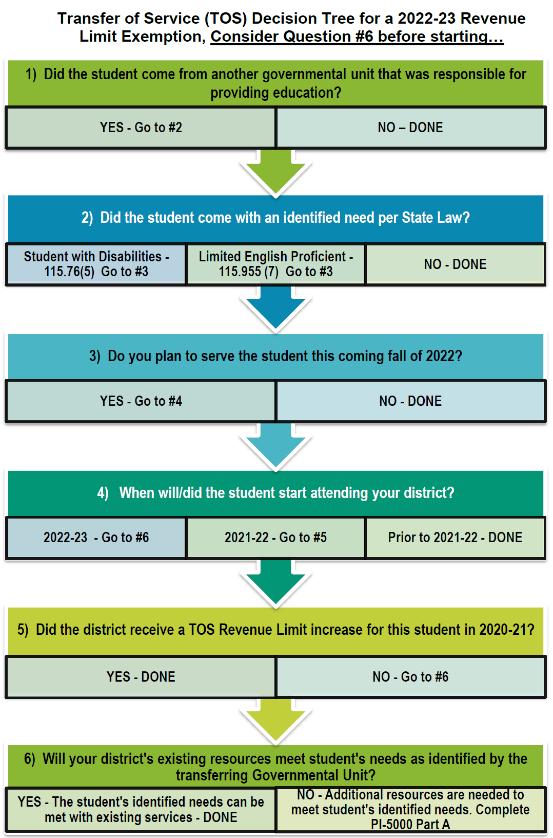
Sample Text Slide
Using the Decision Tree
Please use our Transfer of Service Decision Tree to assist you with the TOS process located on our website at https://dpi.wi.gov/sfs/limits/exemptions/transfer-service

Slide 38
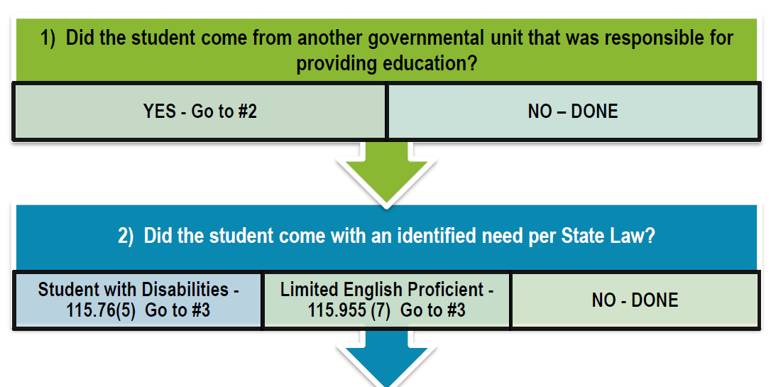
Sample Text Slide
Using the Decision Tree
Someone should be collecting the names of students who move into your school district this school year, where the student came from (another governmental unit school), and did they arrive with:
an identified disability or
participating in a limited English proficiency program.

Slide 39
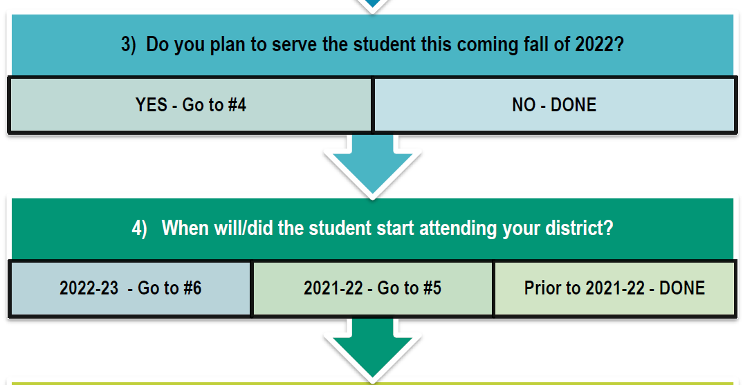
Sample Text Slide
Using the Decision Tree
In late April the district should review the list of students identified and determine the following for each student:
Did the student arrival cause the district to incur a cost that was not budgeted for in the current year?
Does the district believe this student will return in the fall?

Slide 40
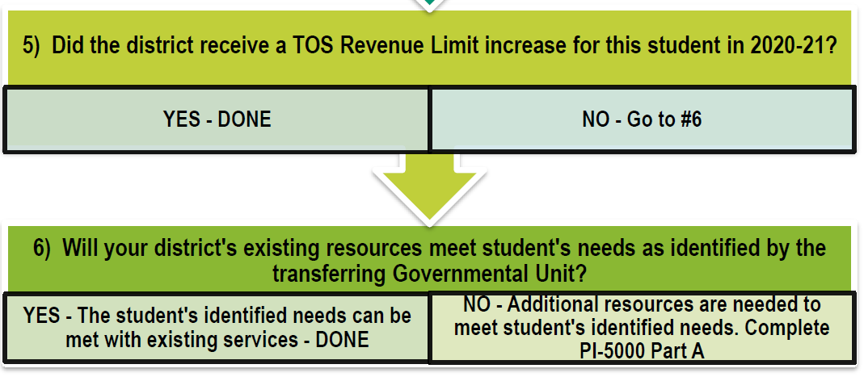
Sample Text Slide
Using the Decision Tree
Determine what additional resources the district needs in the coming year (not including the current year cost) to meet the identified needs the student arrived with?
Review available resources
Resources made available because other students have graduated or relocated
Previous TOS request approved

Slide 41
Transfer of Service 15-Year History

Slide 42
Sample Text Slide
Making a TOS Request
Getting Access to the PI-5000
The TOS online application security is processed through the Application User Management (AUM) system.
District administrators already have access to AUM for Open Enrollment (OPAL) and Homeschool Reporting (HOMER) applications.
Only your district administrator can authorize district staff to have access to Transfer of Service-LEP and/or Transfer of Service-SPED applications.

Slide 43
Sample Text Slide
Making a TOS Request
Completing Part A
Questions similar to the Decision Tree
Where did the student come from
Enrollment dates
Confirming the student is with a disability or limited English proficiency
Verifying the district’s current resources cannot meet the student’s needs and providing financial information to support that
Due date September 16, 2022

Slide 44
Sample Text Slide
Making a TOS Request
Completing Part B
If the student transferred from a WI school district, the other school district now confirms your information from Part A
Confirms the student was a resident in that district
Withdraw date
Withdraw date to enrollment to your district must be within 45 days
Confirms the student is with a disability or limited English proficiency
Verifying there were costs involved to meet the student’s needs
Due date September 23, 2022

Slide 45
Sample Text Slide
Making a TOS Request
Completing Part C
Review your information entered from Part A
You will need to enter values in the New Costs column
The values entered by the district under the New Costs will be the actual transfer amount being requested by the school district
If totals have changed between Part A and Part C, we suggest the district provides a narrative in the text box at the bottom of the screen to further explain reason for the change
Due date September 30, 2022

Slide 46
Sample Text Slide
Making a TOS Request
Narrative Request Process
Explain the program or service that the local municipality will no longer provide to the school district and a brief historical description of this working relationship.
Name the local municipality who was financial responsible for the program or service.
Is the local municipality willing to continue the program or service to the school district for a payment greater than paid in the previous school year? If yes, explain what it cost in the previous school year.

Slide 47
Sample Text Slide
Making a TOS Request
Narrative Request Process
Is the school district able to receive this program or service from another source? If yes, explain.
Provide the Transfer of Service amount being requested and a breakdown on how the value was determined.
If there is financial support available to off-set the cost to the school district, provide an explanation.

Slide 48
Sample Text Slide
Making a TOS Request
Narrative Request Examples
The city used to pay for crossing guards but now they are passing this cost onto the district.
Our CCDEB is dissolving and we need to hire our own SPED teacher.
The city used to pay for the School Resource Officer but now they are passing this cost onto the district.

Slide 49
Sample Text Slide
TOS Frequently Asked Questions
Question:
I understand to qualify for TOS there must be an increased cost but what about shifting costs? For example, we have 5 students with 1:1
aides. One student graduates so we would lay off one of those aides;
however, a new student enters the district from another governmental unit that requires a 1:1 aide. Can I request a TOS; after all if the new student did not arrive the aide would have been dismissed.

Slide 50
Sample Text Slide
TOS Frequently Asked Questions
Answer:
No, in this example the district is not eligible for a TOS. The law states “if a school board increases the services that it provides by adding responsibility for providing a service that is transferred to it from another governmental unit for a child with a disability”. TOS allows a district to increase its revenue limit, if its costs increase because of the need to increase services above the level of services currently provided.

Slide 51
Sample Text Slide
TOS Frequently Asked Questions
Question:
I have a student who moved to our district from another Wisconsin school district, but I learned that student did not actually attend that school district. They opened enrolled to a different school district
during those years. Which district do I identify in my TOS request;
the district the student lived in or the district the student actually
attended?

Slide 52
Sample Text Slide
TOS Frequently Asked Questions
Answer:
Transfer of service always goes to the resident district. A student who was open enrolled out will have student records from a different school district; however for the transfer of service process, enter the school district where the student lived in the previous year even though they may or may not have been the district that served the student.

Slide 53
Sample Text Slide
TOS Frequently Asked Questions
Question:
We have a student who open enrolled to our district with significant special needs; can we do a transfer of service?

Slide 54
Sample Text Slide
TOS Frequently Asked Questions
Answer:
No, when a special education student open enrolls, the nonresident district does collect the basic open enrollment amount. In the second year of open enrollment, the nonresident district can choose to continue to receive the open enrollment basic aid amount or be reimbursed for actual costs of providing FAPE to the pupil in the previous school year, up to $30,000; therefore even though the nonresident district is increasing services, they are being compensated by the resident district.
29

Slide 55
Sample Text Slide
TOS Frequently Asked Questions
Question:
Our district forgot to file the transfer of service last year when it was due; can we do one this year?

Slide 56
Sample Text Slide
TOS Frequently Asked Questions
Answer:
No, while we understand oversights like this can happen, both state law and our transfer of service guidance are clear that requests must be submitted timely with the eligible increase in cost. Transfer of service is based on a cost increase from one fiscal year to next. If you miss submitting your request the year the increase happened, then technically there is no increase from the missed year to the current year and the request no longer meets the requirement of a TOS.

Slide 57
Sample Text Slide
Examples
A high needs 4th grade student from a public school in Ohio enrolls in late January of 2022. This student comes with the IEP calling for a full-time registered nurse (RN).
Your district currently receives standard nursing services from the County at no cost.
The estimated cost will be $80,000 for an additional RN from the County or as a district hire.

Slide 58
Sample Text Slide
Examples
A high needs 4th grade student from a public school in Ohio enrolls in late January of 2022. This student comes with the IEP calling for a full-time registered nurse (RN).
Your district receives standard nursing services from the County at no cost.
However, in March of 2022 the County gives the District formal notice that as of July 1, 2022 they will no longer provide any nursing services.
The estimated cost will be $160,000 to hire two RN positions.

Slide 59
Sample Text Slide
Examples
Two TOS requests can be submitted.
The first request (student’s IEP identifies an RN) was described in the pervious slide and will be made through the PI-5000 portal for the student in the amount of $80,000.
The second request for the standard nursing services would be a Narrative TOS request, submitted in writing following the steps previously outlined in slides 21 & 22 in the amount of $80,000.

Slide 60
Sample Text Slide
TOS Takeaway
Keep track of students moving in and what governmental unit they are coming from.
Do they have an identified disability or participating in a limited English proficiency program?
Will the district continue serving the student into the fall?
Review available resources and determine if more are needed to meet the identified needs for the student.
Use the Decision Tree to help you through the process.
Don’t be afraid to ask questions.
Notes:
Transfer of Service Website:
Transfer of Service | Wisconsin Department of Public Instruction

Slide 61
WISEdata Finance - What’s Next?
Over the next few months, we will be concentrating on the following:
By June 1st:
Working with all districts to ensure they are pushing complete financial data either through their vendor or by utilizing the Alternative Reporting Mechanism (ARM)
Reviewing the submitted 2021-22 Budget data for accuracy by comparing against previous reporting
The 2021-22 Budget is used to calculate the July 1st aid estimate for 2022-23.
Notes:
We are very close and working with the last dozen districts and their vendors
We are reaching out to districts as we identify data that needs to be reconciled
We will be calculating July 1st aid estimate for 2022-23 by the last week in June based on the available data.

Slide 62
WISEdata Finance - What’s Next?
Over the next few months, we will be concentrating on the following:
In preparation for opening the 2021-22 Annual Report, we are asking districts to review Actual data being submitted to WDF.
Check your validation messages in WISEdata Finance (WDF). Addressing validation messages is critical in preparation for annual reporting and the next fiscal year.
Continue to report issues and provide feedback as we continue to improve the portal moving forward.

Slide 63
WISEdata Finance - What’s Next?
Over the next few months, we will be concentrating on the following:
Opening the PI-1505 Calendar and Census reports in mid-June
Opening the rest of the PI-1505 reports around the usual time (mid-July)
Parallel Reporting for 2021-22 Actuals
Annual Report data submitted through the PI-1505 will be verified against WISEdata Finance (WDF)
We will build Annual Report functionality tied to WDF data within WiSFiP
Notes:
Parallel reporting for the coming year to ensure the smoothest transition as possible as we continue to build the new systems. Primary reporting responsibility will be within existing systems

Slide 64
Sample Text Slide
Questions ? and Contact Information
Questions ?
SFS Contact:
dpifin@dpi.wi.gov or 608-267-9114

