Slide 1
A Deep Dive Into School Finance – Equalization Aid
Tom Owens
Debby Schufletowski
Bob Borch
Derek Sliter
Bob Soldner
January 18, 2018
Notes:
1

Slide 2
Equalization Aid
The fundamental purpose of the Equalization Aid formula is to “level the playing field” by providing assistance (distributing State general aid) to make up for what districts can’t get from their property tax base.
Equalizes the revenue. Thus, allows the opportunity for similar educational programming.
In general, districts with a higher property tax base receive less aid from the State.
District property value is a key factor.

Slide 3
Property Value and Fiscal Capacity
A student should not be unfairly disadvantaged as a result of where he or she lives.
Property Tax Base
This example is for hypothetical purposes only

Slide 4
Formula Equalizes Revenue to Mitigate Differences
Equalization Aid
Property Tax Base
This example is for hypothetical purposes only

Slide 5
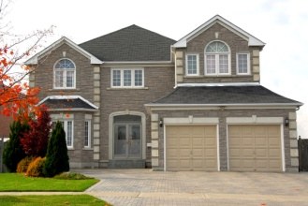
Incorporating the Number of Children to Educate
$1,000,000
$2,000,000
$3,000,000
$4,000,000
$5,000,000
10
10
10
10
10
$100,000
$200,000
$300,000
$400,000
$500,000
The tax base, as a measure of fiscal capacity (wealth), changes after incorporating the number of children to educate.
This example is for hypothetical purposes only

Slide 6
Incorporating the Number of Children to Educate
$1,000,000
$2,000,000
$3,000,000
$4,000,000
$5,000,000
10
5
6
10
20
$100,000
$400,000
$500,000
$400,000
$250,000
Notice how the tax base, as a measure of fiscal capacity (wealth), changes after incorporating the number of children to educate.
This example is for hypothetical purposes only

Slide 7
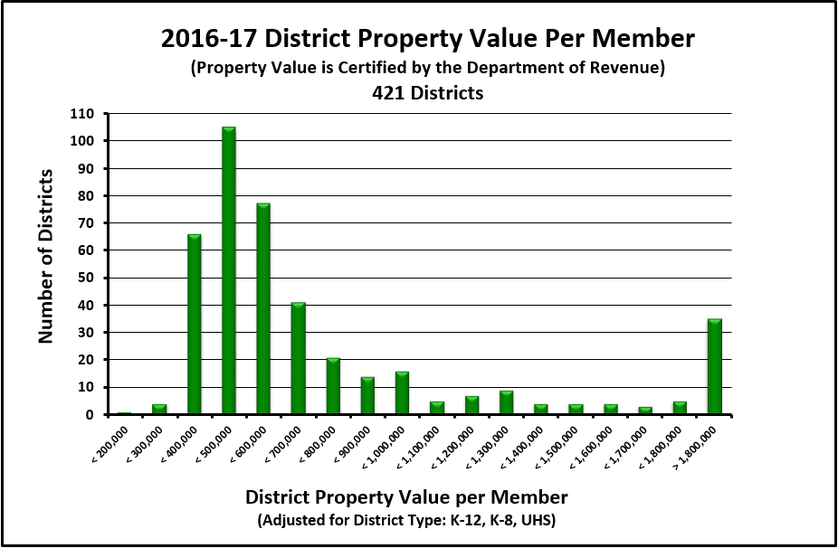
Property Value Per Member
Source: Department of Public Instruction
Notes:
2016-17 Property Value and Aid Membership figures for the 2017-18 General Aid Run

Slide 8
Key Local Factors
Membership
(Student FTE)
Spending (Shared Costs)
Equalized Property Value
Membership converts variables to per-pupil $s.

Slide 9
Factor: Equalized Property Value
Property tax base is used to
determine district wealth and ability to
support district expenditures.
Uses Equalized Valuation
or Fair Market Value.
(NOT Assessed Value)
Property values for each district are
certified in May each year
by the WI Department of Revenue
and used in the subsequent year’s aid
calculations.

Slide 10
Factor: Membership
Who is counted for aid membership?
Generally, residents for which you are financially responsible - i.e. you are paying for the student’s education. Is a “process” to help districts determine who qualifies.
- Start with who is in your seats on the count date.
- Subtract non-residents being educated in your seats.
- Add in your residents who are elsewhere (and for which you are financially responsible).
Assign your best and brightest to do the membership count.

Slide 11
Membership Example – Open Enrollment
1,100 kids counted in your seats on count date
-40 non-resident open enrolled-in kids
+20 resident open enrolled-out kids
1,080 residents you can count for aid (and revenue limit purposes)
Your district will receive Open Enrollment revenue
from the resident districts for the 40 kids attending your district.
Your district will have to pay an Open Enrollment expense to the non-resident districts for your 20 residents attending elsewhere.
This example is for hypothetical purposes only

Slide 12
Factor: Membership
F.T.E. = full-time equivalent
2 halftime (.50) 4K students = 1 F.T.E.
Average of
3rd Friday September Resident F.T.E.
2nd Friday January Resident F.T.E.
+ 100% Summer School F.T.E.
Summer School = 48,600 minutes of instruction = 1 F.T.E.
This example is for hypothetical purposes only

Slide 13
Factor: Membership
Aid membership also includes:
- Challenge Academy Students
- Second Chance Partnership Students
- Part-time Attendance F.T.E. of Resident and Non-Resident Private/Home-Schooled Students
- Foster Group Home Students
- Wisconsin Parental Choice Program Students
- Special Needs Scholarship Program Students
See: http://dpi.wi.gov/sfs/children/enrollment/membership-info-reporting

Slide 14
Factor: Spending (Shared Cost)
A district gets all types of revenue to fund their educational programs:
Local Property Tax
State Equalization Aid
State Categorical Aid (transportation, library, bilingual aids)
Federal Aid (Title Programs, IDEA)
State Grants
Fees (be careful with what fees you charge)

Slide 15
General Fund Shared Cost
Expenditures that are funded by State General Aid and Local Property Tax
$1 in debt service costs is treated the same as $1 in teacher salaries
This example is for hypothetical purposes only

Slide 16
Equalization Aid
State “shares” in district costs funded by state aid and local levy.
Aid is based on a district’s ability to fund expenditures, as measured by its property wealth per member.
Basic premise:
The more property wealth per member a district has, the less equalization aid it will receive…….and vice versa.

Slide 17
Equalization Aid
What determines how much aid a district receives?
District Factors
(prior-year data)
equalized property value
membership
spending (shared cost)
State Factors
cost ceilings
guaranteed valuations per member
Notes:
There are three district-level factors used in the calculation and three state factors.

Slide 18
Equalization Aid
The aid computation is actually 3 individual computations…….
The results of all 3 are summed to get the district’s total Equalization Aid.

Slide 19
Equalization Aid – District #1
District Value per Member
Positive Primary Aid
10%
90%
Notes:
State says we will treat the first $1,000 of cost a certain way. Because secondary cost ceiling is $9,000 per member (90% of average shared cost per member), the next $8,000 another way, and anything above this an even different way.
So, state says If you have less than $2M in property value we will share in your first $1,000 in shared cost. How much? Depends on your property value per member.
Our district is $200,000 per member in property value. $200,000 divided by $2,000,000 primary guarantee equals 10%, so district pays 10% of the first $1,000 in costs or $100. State aid will cover 90% or $900.

Slide 20
Sample District #1
(per-member)
TAX BASE
10% x $1,000 | = | $100
STATE AID
90% x $1,000 | = | $900

Slide 21
Equalization Aid – District #2
District Value per Member
30%
70%
Positive Primary Aid
Notes:
State says we will treat the first $1,000 of cost a certain way. Because secondary cost ceiling is $9,000 per member (90% of average shared cost per member), the next $8,000 another way, and anything above this an even different way.

Slide 22
Sample District #2 (Higher Property Value)
(per-member)
TAX BASE
30% x $1,000 | = | $300
STATE AID
70% x $1,000 | = | $700

Slide 23
Equalization Aid – District #1
District Value per Member
25%
75%
Positive Secondary Aid
10%
90%
Positive Primary Aid
Notes:
State says we will treat the first $1,000 of cost a certain way. Because secondary cost ceiling is $9,000 per member (90% of average shared cost per member), the next $8,000 another way, and anything above this an even different way.

Slide 24
Equalization Aid – District #1
District Value per Member
Positive
Tertiary Aid
50%
50%
Secondary Cost Ceiling
25%
75%
Positive Secondary Aid
Primary Cost Ceiling
10%
90%
Positive Primary Aid
Notes:
State says we will treat the first $1,000 of cost a certain way. Because secondary cost ceiling is $9,000 per member (90% of average shared cost per member), the next $8,000 another way, and anything above this an even different way.

Slide 25
Sample District #1
(per-member)
TAX BASE
10% x $1,000 | = | $100
25% x $8,000 | = | $2,000
50% x $3,000 | = | $1,500
 |  | $3,600
STATE AID
90% x $1,000 | = | $900
75% x $8,000 | = | $6,000
50% x $3,000 | = | $1,500
 |  | $8,400
Total Shared Cost = $6,000,000 (500 x $12,000)
Tax Base = $3,600 State Aid = $8,400
X 500 membership
Tax Base = $1,800,000 State Aid = $4,200,000

Slide 26
Equalization Aid – District #2
District Value per Member
75%
25%
Positive Secondary Aid
Positive Primary Aid
30%
70%
Notes:
State says we will treat the first $1,000 of cost a certain way. Because secondary cost ceiling is $9,000 per member (90% of average shared cost per member), the next $8,000 another way, and anything above this an even different way.

Slide 27
Sample District #2 (Higher Property Value)
(per-member)
TAX BASE
30% x $1,000 | = | $300
75% x $8,000 | = | $6,000
STATE AID
70% x $1,000 | = | $700
25% x $8,000 | = | $2,000

Slide 28
Equalization Aid – District #2
District Value per Member
Positive
Tertiary Aid
$600,000/$400,000 = 150%
150%
-50%
Negative Tertiary Aid
75%
25%
Positive Secondary Aid
Positive Primary Aid
30%
70%
Notes:
State says we will treat the first $1,000 of cost a certain way. Because secondary cost ceiling is $9,000 per member (90% of average shared cost per member), the next $8,000 another way, and anything above this an even different way.

Slide 29
Sample District #2
(Higher Property Value)
TAX BASE
30% x $1,000 | = | $300
75% x $8,000 | = | $6,000
150% x $3,000 | = | $4,500
 |  | $10,800
STATE AID
70% x $1,000 | = | $700
25% x $8,000 | = | $2,000
-50% x $3,000 | = | -$1,500
 |  | $1,200
Total Shared Cost = $6,000,000 (500 x $12,000)
Tax Base = $10,800 State Aid = $1,200
X 500 membership
Tax Base = $5,400,000 State Aid = $600,000

Slide 30
Sample Districts Per-Member Aid Comparison
#1 STATE AID
$900
$6,000
$1,500
$8,400
#2 STATE AID
$700
$2,000
$-1,500
$1,200
X 500 = $4,200,000
X 500 = $600,000

Slide 31
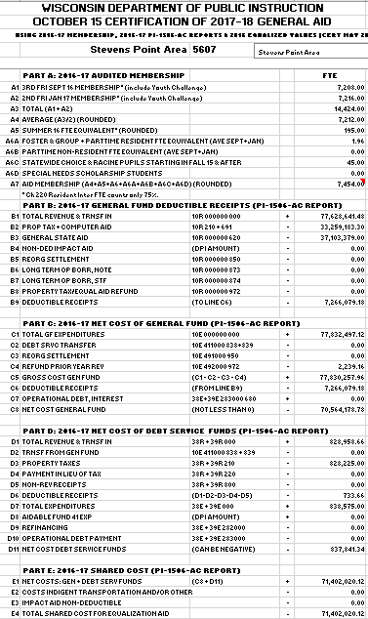
Aid Worksheet
All data is from prior year:
Membership is computed from submitted PI-1563 reports.
(membership reports)
Dollar amounts are from your financial ledger, as verified by your auditor.

Slide 32
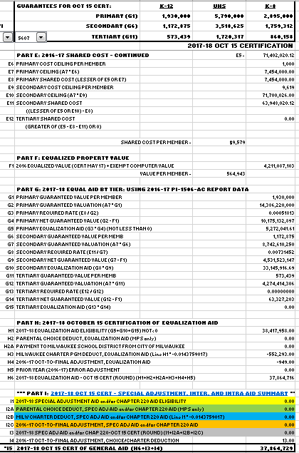
Aid Worksheet
All data is from the prior year (2016-17 data is used to calculate 2017-18 aids):
Property value is certified to the DPI by the Department of Revenue.

Slide 33
Equalization Aid Resources on the School Financial Services Website
http://dpi.wi.gov/sfs/statistical/longitudinal-data/longitudinal-data
“October 15, 2017 Equalization Aid Computation – Percentage Method – Algebraic Format”
“October 15, 2017 Equalization Aid Computation – Percentage Method – Bar Graphs”
SFS Homepage > Statistical > Longitudinal Data > Equalization Aid
*
http://dpi.wi.gov/sfs/aid/general/equalization/worksheets-general-aid
“2017-2018 October 15 Certification of General Aid Worksheet”
SFS Homepage > District Budget Development and Planning > General Aid Worksheets

Slide 34
Equalization Aid – Where is Your District?
249
126
26
20
Positive
Tertiary Aid
Negative Tertiary Aid
Negative Secondary Aid
Positive Secondary Aid
Positive Primary Aid
No Equalization Aid
Notes:
State says we will treat the first $1,000 of cost a certain way. Because secondary cost ceiling is $9,000 per member (90% of average shared cost per member), the next $8,000 another way, and anything above this an even different way.
So, state says If you have less than $2M in property value we will share in your first $1,000 in shared cost. How much? Depends on your property value per member.
Our district is $200,000 per member in property value. $200,000 divided by $2,000,000 primary guarantee equals 10%, so district pays 10% of the first $1,000 in costs or $100. State aid will cover 90% or $900.

Slide 35
Equalization Aid Resources on the School Financial Services Website
http://dpi.wi.gov/sfs/statistical/longitudinal-data/longitudinal-data
“2017-18 Equalization Aid Formula Position”
SFS Homepage > Statistical > Longitudinal Data > Equalization Aid

Slide 36
Equalization Aid – What is Happening Over Time to Your District?
State Average Value Per Member
Positive
Tertiary Aid
Negative Tertiary Aid
Based on $$ in Pot
Negative Secondary Aid
Positive Secondary Aid
In Statute
Positive Primary Aid
No Equalization Aid

Slide 37
Watch Value Per Member Over Time
Crucial Statistic:
Value per Member =
Total Equalized Value ÷ Membership
(Compared to what all other districts are doing over time.)
$200,000,000 ÷ 1,000 = 200,000
$200,000,000 ÷ 800 = 250,000

Slide 38
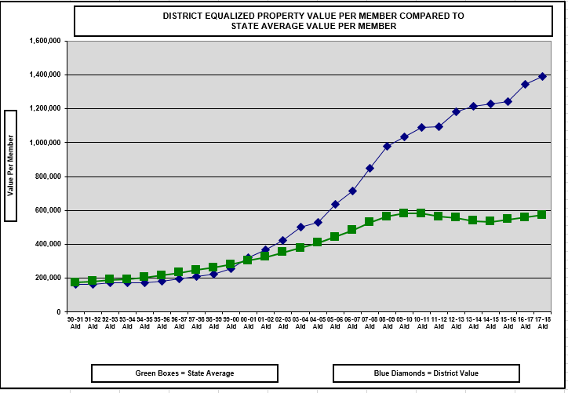
Watch Value Per Member Over Time
1.) Severely Declining Enrollment
2.) Property Value Significantly Increases
Notes:
This is what can happen to a district with severe declining enrollment. No one can predict the future, but watching the trendline for your district can be very informative.

Slide 39
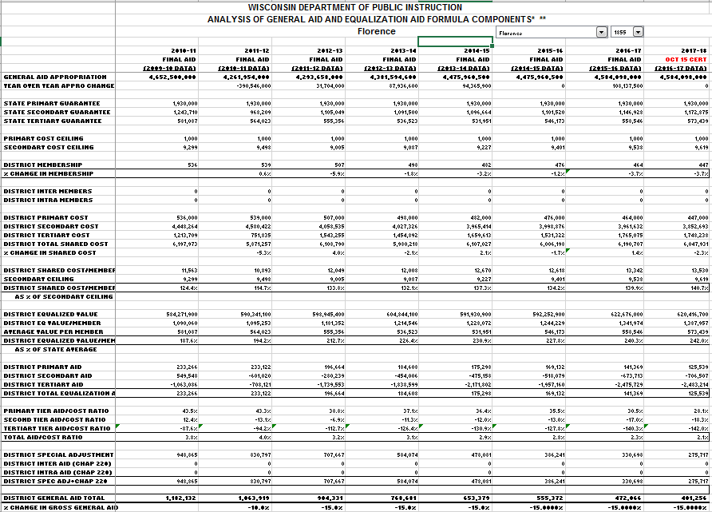
Special Adjustment Aid – can’t lose more than 15 % of prior year aid.

Slide 40
Equalization Aid Resources on the School Financial Services Website
http://dpi.wi.gov/sfs/statistical/longitudinal-data/property-valuation
“Longitudinal Equalization
Aid Value-Per-Member History”
SFS Homepage > Statistical > Longitudinal Data > Property Valuation

Slide 41
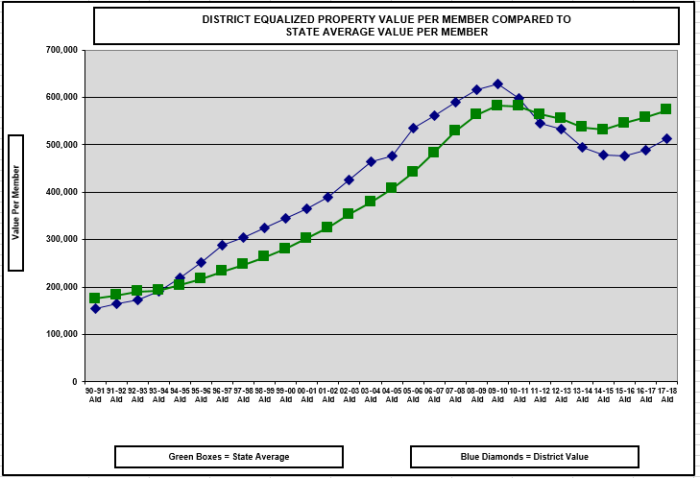
1.) Exploding Enrollment

Slide 42
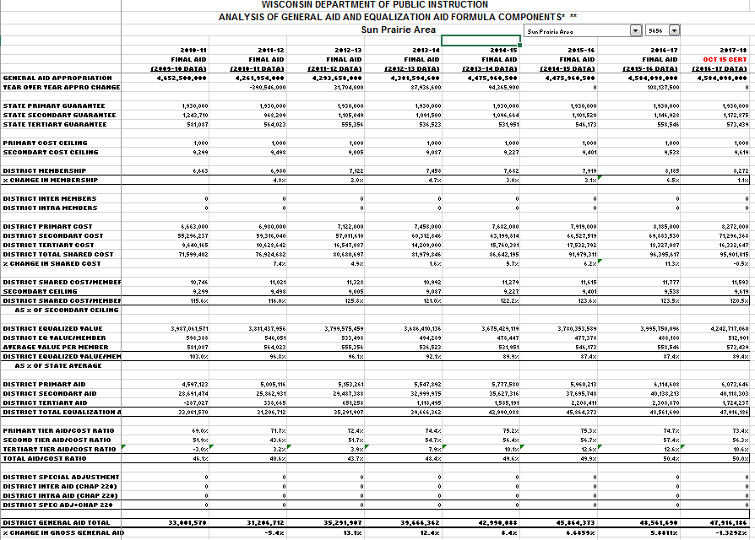

Slide 43
Equalization Aid Resources on the School Financial Services Website
How can I explain changes in my district’s aid?
Multi-Year History on the Website
Longitudinal Excel Spreadsheet
http://dpi.wi.gov/sfs/statistical/longitudinal-data/longitudinal-data
A listing of the pertinent Equalization Aid factors that explain what is happening in your district.

Slide 44
Basic Equalization Aid Concepts
Aid is inversely related to district property value per member.
One pot of money is split over 422 school districts based on district values, membership, and shared costs. Changes in individual district data affect every other district’s aid.
Depending on district value-per-member, some districts’ aid is increased by increasing expenses, while others’ aid is decreased by increasing expenses.
Know where your district is in the formula and be aware of what is happening to your district over time so you can figure out why your aid has changed AND explain why.

