Slide 1
Achievement Gap Dashboard
WISEcoach Training
June 2, 2016
Wisconsin Dells

Slide 2
Welcome
Office of Educational Accountability
http://dpi.wi.gov/accountability
Sam Bohrod – Accountability Policy
Amy Marsman – Accountability Communications
Justin Meyer – Data and Statistics
Laura Pinsonneault – Accountability Director
Notes:
Who we are, our connection to WISEdash and WISExplore.

Slide 3
Today
Introduce the Achievement Gap dashboard
Learn about effect sizes used in the dashboard
Learn how to navigate the dashboard
Explore the dashboard, begin planning how to apply findings, and to lead others through dashboard
Notes:
Today’s agenda. We’ll explain the dashboard in detail, provide time for you to explore the dashboard at your tables, as well as have some table discussions before a large group discussion and address any final questions at the end.

Slide 4
INTRODUCTION & IMPETUS
Achievement Gap Dashboard
Notes:
Why we did it. Problem is well known. What to do about it and understanding the data behind it is not well known.
Make the case for effect size dashboard.

Slide 5
Notes:
We often talk about our state achievement gap. As more attention is drawn to achievement gaps (PEFA), it becomes even more critical to understand the achievement gap data.
Why an achievement gap dashboard?
To enable discussion of achievement gaps across assessments.
-This is one of the values of effect size; it allows for comparisons across different measures
-This is helpful now, as we face three different general education assessments over three years.
-It will remain helpful in the longer term, as we can explore effect size relationships with different data (e.g., graduation)
To help districts focus their school improvement planning.

Slide 6
Achievement Gap Dashboard Resources
Questions & Feedback
About the Data
Notes:
This is new. Released the dashboard last month (4/28/16). Provided two things: Google form for feedback and the About the Data page with some resources, which will include today’s PPT.
About the Data: http://dpi.wi.gov/wisedash/districts/about-data/achievement-gap
Google Feedback Form:

Slide 7
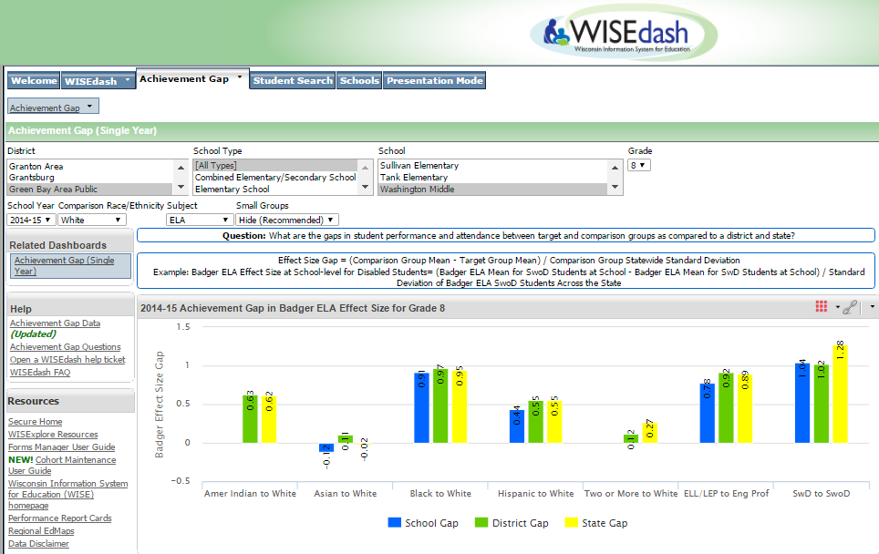
Notes:
Slides showing the navigation or just jump to the demo site.
Show what is new/how it is new
Simple attendance rate example

Slide 8
Understanding effect size
Achievement Gap Dashboard

Slide 9
One Way to Show a Gap
If the mean scale score is 2536 for economically disadvantaged students and 2600 for not economically disadvantaged students we can show the gap as two bars.

Slide 10
One Way to Show a Gap
One group is the “target group.”
The other is the “comparison group.”
Target group
Comparison group
Notes:
Same terminology that is used in Closing Gaps.

Slide 11
One Way to Show a Gap
The gap is calculated by subtracting the target group (economically disadvantaged) from the comparison group (not economically disadvantaged).
The gap is 2600 - 2536 = 64.
64 point gap between the groups

Slide 12
A Second Way to Show a Gap
In this chart, the bar represents the gap instead of group score.
64 point gap between the groups

Slide 13
A Third Way to Show a Gap
In this chart, the bar again represents the gap but is in effect size units (standard deviations) instead of scale score points.
0.67 effect size unit gap between the groups

Slide 14
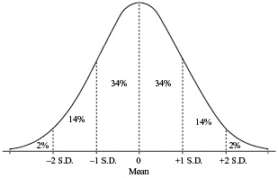
What is an Effect Size?
Effect size is based on standard deviation, a measurement of the spread of a distribution.
A large standard deviation means the distribution is more spread out.
www.sparknotes.com

Slide 15
What is an Effect Size?
To calculate effect size,
subtract the mean of the target group from the mean of the comparison group.
Then divide by the state-level standard deviation of the comparison group.
$$Effect Size=\frac{Mean\left(Comparison Group\right)−Mean(Target Group)}{Standard Deviation(State Level Comparison Group)}$$

Slide 16
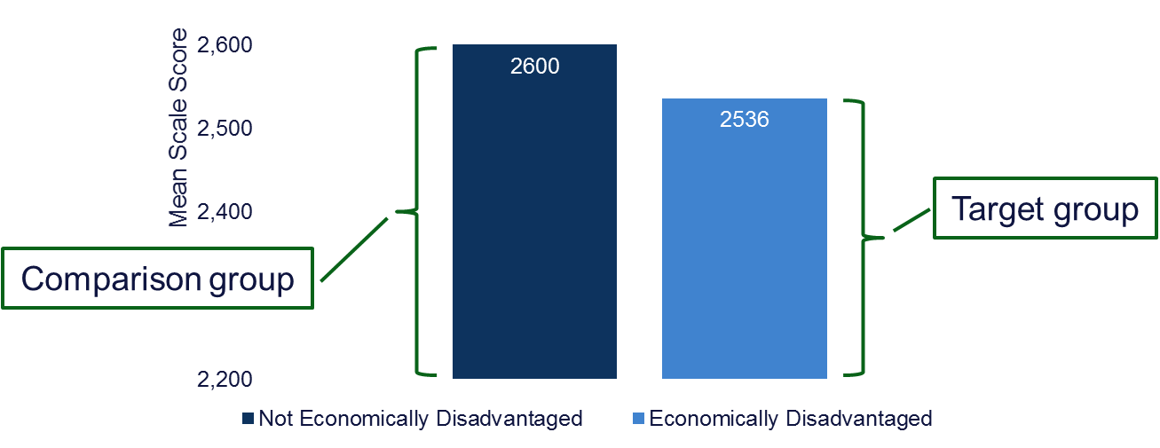
What is an Effect Size?
If the school-level mean of the not economically disadvantaged group is 2600
and the school-level mean of the economically disadvantaged group is 2536
and the state-level standard deviation
of the not economically disadvantaged group is 96:
$$Effect Size=\frac{Mean\left(Not Econ Disadvantaged\right)−Mean(Econ Disadvantaged)}{Standard Deviation(State Level Not Econ Disadvantaged)}$$
$Effect Size=\frac{2600−2536}{96}$ $=\frac{54}{96}=0.67 standard deviations$

Slide 17
A Third Way to Show a Gap
In this chart, the bar again represents the gap but is in effect size units (standard deviations) instead of scale score points.
0.67 effect size unit gap between the groups

Slide 18
Interpreting Effect Size
There are two aspects of effect size to consider:
Direction
Magnitude

Slide 19
Interpreting Effect Size: Direction
An effect size can be positive or negative. Consider the formula:
A positive effect size means that the comparison group is performing better than the target group.
A negative effect size means that the target group is performing better than the comparison group.
$$Effect Size=\frac{Mean\left(Not Econ Disadvantaged\right)−Mean(Econ Disadvantaged)}{Standard Deviation(State Level Not Econ Disadvantaged)}$$
Notes:
Positive effect size reflects the achievement gap (the problem).
Negative effect size means the target group is outperforming comparison group (closing/reversing the gap).
Zero effect size means there is no gap (yay).

Slide 20
Interpreting Effect Size: Magnitude
An effect size can be any real number. Consider the formula:
An effect size of 0 means there is no gap.
A small number means the gap is small.
A large number means the gap is large.
$$Effect Size=\frac{Mean\left(Comparison Group\right)−Mean(Target Group)}{Standard Deviation(State Level Comparison Group)}$$

Slide 21
Effect Size Benchmarks
How do we know if an effect size is small or large?
Jacob Cohen, a statistician associated with effect sizes, suggests:
0.2 to 0.49 is small
0.5 to 0.79 is medium
0.8 or greater is large
These benchmarks are a starting point but are not specific to education data.
Cohen, J. (1988). Statistical power analysis for the behavioral sciences. Hillsdale, NJ: L. Erlbaum Associates.
Notes:
Influential in social sciences but controversial in education circles.

Slide 22
Effect Size Benchmarks
How do we know if an effect size is small or large?
The federal What Works Clearinghouse uses 0.25 as a benchmark to determine if the results of an educational intervention are “substantively important.”
Interventions that achieve an effect size of 0.25 or greater are considered to have had a substantively important impact.
What Works Clearinghouse. (n.d.). Procedures and Standards Handbook Version 3.0. Retrieved from http://ies.ed.gov/ncee/wwc/pdf/reference_resources/wwc_procedures_v3_0_standards_handbook.pdf
Notes:
Mention that Jacob Cohen’s work is influential in social science, but likely not totally appropriate for education purposes. It’s tempting to look for benchmarks. In this case, it’s probably best to reference the What Works Clearinghouse.

Slide 23
Effect Size Benchmarks
How do we know if an effect size is small or large?
John Hattie, an education researcher, compiled a list of education interventions and the effect size associated with each of those interventions.
For example, summer vacation is associated with an effect size of -0.09 while parental involvement is associated with an effect size of 0.51.
Hattie, J. (2009). Visible learning: A synthesis of over 800 meta-analyses relating to achievement. London: Routledge.

Slide 24
Effect Size Comparisons
School-level effect size can be compared to district- and state-level effect size to provide context.
Imagine a school where:
School gap = 0.67
District gap = 1.27
State gap = 0.78
The school has a medium gap according to Cohen but has a smaller gap than the district or state.

Slide 25
Why Effect Size?
Effect sizes allow for comparisons across different outcomes.
For example, effect sizes allow us to determine if a gap is larger on the Badger Exam or on the ACT even though their scores are not on the same scale.
A typical ACT score might be 22 while a typical Badger Exam score might be 2322.
Notes:
Scale scores are not comparable across tests so it allows us to make comparisons across tests (different measures).
Then it also allows users to compare the effect size to literature (like Hattie) so that it can users can take appropriate action.
Can make misjudgments especially when changing tests.
Good thing to do but it is complex.

Slide 26
Why Effect Size?
Effect sizes allow us to compare the gaps in our school to research on interventions.
A knowledge of what to expect from various interventions helps us to select the appropriate intervention for a given situation.
Notes:
Scale scores are not comparable across tests so it allows us to make comparisons across tests (different measures).
Then it also allows users to compare the effect size to literature (like Hattie) so that it can users can take appropriate action.
Can make misjudgments especially when changing tests.
Good thing to do but it is complex.

Slide 27
Navigation & interpretation
Achievement Gap Dashboard
Notes:
Sam to switch over to WISEdash

Slide 28
Exploration & PLANNING
Achievement Gap Dashboard
Notes:
Amy [30 mins total]
Now that we all know how to navigate and interpret the achievement gap dashboard, we’d like you to explore the dashboard and begin some planning as coaches.

Slide 29
Table Activity
Find one school you’d like to focus on. For that school, find one gap you’d like to draw attention to for that school.
Perhaps a new data inquiry journal, or addendum to existing entry
Begin planning how you will introduce this gaps dashboard to the school.
What questions do you anticipate?
How will this inform continuous improvement planning?
Notes:
At your table, please walk through these two tasks. We’ll take 15 minutes to do this. Please note that we will be asking you about what you might need to know from us after these activities, so feel free to note those off to the side. OEA will circulate and then I’ll call you back together.
As we circulate – possible ideas:
Try changing the comparison group. Remember you can back your way out if you’re getting confused – just check the assessment dashboards.
Try finding an example where no gap exists (zero effect size)? Can you find an example of negative effect size?

Slide 30
Table Discussion
How will you incorporate this dashboard into your coaching?
Consider starting the conversations from assets based model (appreciative inquiry). Coaches could begin with zero or negative effect size success stories.
How should this inform continuous improvement planning efforts in your schools/districts?
How will you incorporate this into the data inquiry process, so it is not an isolated data discussion?
Notes:
5 mins

Slide 31
Large Group Discussion
Do you understand why effect size matters?
Do you understand what the bars mean in the achievement gap dashboard?
Do you know where to get more information about effect size?
What additional resources would be helpful?
Notes:
[10 mins]
In order to introduce and explain this dashboard as coaches, what else do you need from us?
Any final questions?

Slide 32
Thank You!
Contact us with any questions:
http://dpi.wi.gov/accountability/staff-directory
Office of Educational Accountability
oeamail@dpi.wi.gov
Notes:
Our contact information if you have questions.

