Slide 1
Career Education and Coursework Data Elements (WBL, IRC, Adv Opps, DE, and Arts)
Jessie Sloan
CTE Data Consultant
jessica.sloan@dpi.wi.gov
March 2024
Notes:
Greetings! This presentation is the Career Education and Coursework Data Elements for Work Based Learning, Industry Recognized Credentials, Advanced Opportunities, Dual Enrollment, and the Arts.
My name is Jessie Sloan and I am the DPI CTE Data Consultant. jessica.sloan@dpi.wi.gov
Also with me today are:
Mark Schwingle, Gifted and Talented Teaching and Learning Consultant, mark.schwingle@dpi.wi.gov
Chris Gleason, Arts and Creativity Teaching and Learning Consultant, chris.gleason@dpi.wi.gov

Slide 2
Agenda
Reporting
Data Element definitions Work-Based Learning (WBL) Industry-Recognized Credentials (IRC) Advanced Opportunities (Adv Opp) Dual Enrollment (DE)
Arts and Creativity - subject areas
Notes:
We will cover Reporting and data element definitions of the these 4 Career Education data elements - Work-Based Learning, Industry-Recognized Credentials, Advanced Opportunities, Dual Enrollment and Arts coursework.
Arts - these are the courses that come from the following subject areas:
Art and Design
Dance
Media Arts
Music
Theatre

Slide 3
Reports
Career Education Data Elements are used for:
School and District Report Cards
Carl Perkins Accountability Reports and grant application
Local review - viewable in WISEdash for Districts
Arts and Creativity course data is used for:
School and District Report Cards
Wisconsin Arts Education Data Project
Data points are recorded in the student information system (SIS)
WBL, IRC, AP, IB, DE, the Arts are associated with courses
Recorded in the course setup
Flows to DPI through WISE, usually each night
Learn from your SIS how to resync data if it needs to be changed
Notes:
You will hear Career Education and the Arts data elements used in the following areas: School Report Cards, Carl Perkins Accountability Reports and grant, Roster and Coursework Collection, local review in WISEdash for District, and other state/federal reports.
All of this reporting pulls directly from each districts Student Information System. That means, what is entered into your Student Information System is sent each night to DPI through the WISE reporting system. We call this live data. It is viewable in WISEdata Portal, usually the next day, and then viewable in WISEdash for District 24 hrs later.
Work Based Learning, Industry Recognized Credentials, Advanced Opportunities, Dual Enrollment, and the Arts are data elements are associated with the course setup in your Student Information System. So, it is very important that a system is created to collect this information from each teacher and provide it to the Data Entry person that sets up courses within the course master of your Student Information System. These current opportunities should also be described in your student course handbook.
Learn from you SIS how to resync data if it needs to be changed. Only new data automatically flows to WISE. Changed data needs a resync.

Slide 4
CTE Data Team
Create a Data Team to record these data elements for each course.
Use the Roster Work Plan to write down each data element, for each course.
Identify who creates/edits courses for your school.
Editing courses is usually done when the course master is being made for scheduling each year (December-ish).
Roster data is recorded at DPI on the December SNAPSHOT.
Notes:
To begin this work, create a Data Team and record these data elements for each course being taught.
Use the Roster Work Plan to write down each data element, for each course. It is really difficult to visualize all the data elements or fields that go into creating a course. The only way to think about this work is to write it down. Writing it down also helps with solving errors in reporting a year later and staff turnover.
Identify who creates/edits courses for your school. Often this is only 1 or 2 individuals with high level of student management/office access into the SIS.
Within your school system, create deadlines for editing courses each year. TIP: do this before the course master is cloned for future scheduling. It takes a chunk of time to update courses for future schedule cloning. Usually, Data Entry personnel are working on this in December’ish.
22.23 SY data was recorded at DPI on December 5, 2023. This is called the SNAPSHOT. This is when DPI literally takes a picture of your data submitted from the 22.23 SY. Snapshot data we will be used for any report that comes out of DPI with 22.23 SY data. That means the December Snapshot data will be used for School Report Cards and Perkin Accountability Reports. If you change any of your Roster/course data after a Snapshot, it will not be reflected in data that DPI is using to fulfill reporting requirements.
You may notice that districts get about 6 months to update last school years data, before it is due. TIP: keep your courses up to data with data elements and students. Also, review WISEdash for District for accuracy in the same school year that the data is collected. This helps your brain understand the data reported in the correct school year and not go between years.

Slide 5
Reporting
Roster Work Plan
Notes:
This is Row 1 of the Roster Work Plan. DPI collects data elements on all courses in our schools. To begin accurate reporting of your courses we need to identify the courses and their associations. The Roster Work Plan allows you to record the information and give it to your Student Information System-Data Entry person.
DPI receives many inquires about how this data is recorded in WISEdash, School Report Cards, and Perkins Accountability Reports. The data comes directly from what is entered into your SIS vendor and arrives in WISEdash for the December Snapshot. So, the information you give your SIS Data Entry person is key! It is also helpful to write it down because it is very easy to get confused year to year, during staff changes, curriculum updates, cloning course, etc…
When you access the Roster Work Plan, the columns represent the information that your Student Information System-Data Entry person needs to create a course and accurately reflect the data.
The blue text is a hyperlink to the DPI data element webpage for easy access. I am circling Roster, School Department, DE, Adv Courses, IRC, and WBL for this presentation. These data elements will keep you organized in setting up your courses.
The Roster/Courses box has a hyperlink to the courses download that helps with identifying the Roster code and generic definition of the course.
For example, all Arts, CTE, AP, IB and PLTW courses have specific Roster codes to use. I can use the Courses download to sort by columns F-J.
Arts Category is easy to report! It is based on the Roster code. AP, IB and PLTW is also easy reporting based on the Roster code. However, career dducation data adds additional data elements.
Some SIS vendors have the courses download built into their software. Keep in mind that teachers do not usually have access to the course setup to see that. So, DPI and whomever we present to uses the courses download to select Roster codes.
School Department - Basically, this is a note to help keep yourself organized for data entry and to know which department teaches the course. This can be the CTE-we have 6 departments (Ag, Bus, Ma, FCE, TE, Health Science), Art, Music, World Language…
Blue boxes are additional data elements for these specific areas: Dual Enrollment, Advanced and Arts Courses, Industry Recognized Credentials, and WBL. These data elements are all used in report cards.
The bottom snippet is of the Course Offerings dexport in WISEdata Portal. You can use this export to check how your data is reporting before it goes into WISEdash for District.

Slide 6
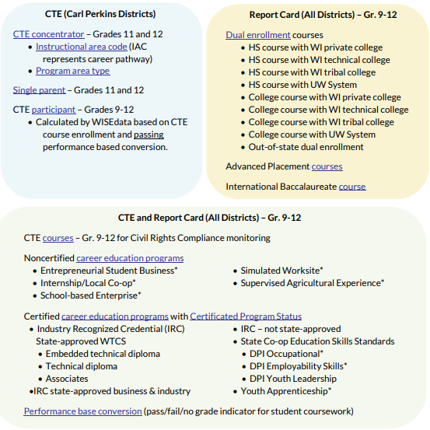
Data Element Definition
Career Education Data Reporting - graphic
Career Education Data Reporting
Certified Career Education - courses or programs that have an outside organization guiding the curriculum, specific list
Non-Certified Career Education - local control of curriculum, specific list
Work-Based Learning - 6 criteria
Industry Recognized Credentials - credentials that are earned by taking a course(s)
Advanced Opportunities - Advanced Placement or International Baccalaureate courses
Dual Enrollment - college/university courses taken while in high school
Notes:
Here are the data element definitions for topics covered in this presentation. We are not going to go into all of these links but you have them as a resource.
On the screen is a graphic organizer for career education data.
It is divided into 3 reports categories: CTE[Carl Perkins districts], Report Card, [which is all districts], and CTE & Report Card [all districts].

Slide 7
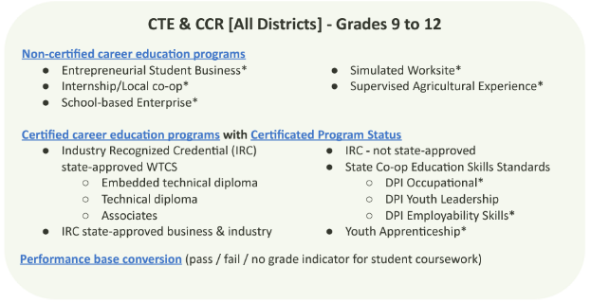
Certified vs Non-Certified
Non-Certified Career Education (outlined in green) are these specific 5 WBL types.
6 Criteria of WBL must be met to utilize these WBL “programs.”
Wisconsin Guide to Implement Career-Based Learning Experiences
Certified Career Education (outlined in red) consists of all IRC’s and 3 types of WBL.
Certified Career Education requires a final step in data reporting, Certificated Program Status Type. This is to be completed for each student enrolled in Certified Career Education programs, completed after the final grade is submitted.
Courses can be identified as Certified for IRC or specific WBL type in the course setup.
DPI highly encourages schools to create WBL courses to schedule students who are working toward the WBL portion.
Notes:
We are going to start with understanding the 2 groupings within CTE & and Report Card program data.
That Certified vs. Non-Certified.
So, the green box identifies Non-Certified courses. And, the Red box identifies the programs that are in the certified group.
Non-Certified are Work Based Learning courses developed by your school. The definitions of these courses are outlined in the Wisconsin Guide to Implement Career-Based Learning Experiences.
The red box is the list of Certified Work Based Learning and IRC’s. These are certified because an outside organization dictates the curriculum. The list of Certified Work Based Learning courses and IRC’s require that the school takes and extra data step, at the conclusion of final grading, to add the Certificated Program Status Type to each student in that course. Certificated Program Status Type informs if the student: Completed with Certificate, Continuing, Exited, or Completed without Certificate.
With Course setup - you can identify the type of IRC or specific WBL.
DPI highly encourages schools to create WBL courses to schedule students that are in your WBL program. A course for the WBL time the student is at work, helps keep the school organized and can report on the student transcript.
SAE example

Slide 8
Work-Based Learning
22.23 Work-Based Learning
Entrepreneurial Student Business (Non-Certified)
Internship/Local co-op (Non-Certified)
School-based Enterprise (Non-Certified)
Simulated Worksite Supervised (Non-Certified)
Supervised Agricultural Experience (Non-Certified)
State Co-op:
Education Skills Standards (Certified)
DPI Occupational DPI (Certified)
Employability Skills (Certified)
Youth Apprenticeship (Certified)
6 criteria of WBL (Non-Certified)
1. Involves sustained interactions, either paid or unpaid, with industry or community professionals.
a. Sustained = minimum of 90 hours, can be rotated among employers and/or positions, the employer is engaged throughout the experience. Can take place in one semester, an entire year, the summer, or even a six-week period.
b. Interactions must be more than just observing and include direct communication and involvement with industry or community professionals
2. Takes place in real workplace settings (as practicable) or simulated environments at an educational institution.
3. Fosters in-depth, firsthand engagement with the tasks required in a given career.
4. Aligns with a course (generally speaking should be a minimum of one semester). It is highly encouraged to provide credit for the work-based learning experience as well as credit for the school-based course.
5. Must include a training agreement between the student, employer/business, and school that defines the roles and responsibilities of the student, the employer, and the school.
6. Business and education partners work together to evaluate and supervise the experiences, which must be documented with training or learning plans and evaluation forms.
Certified already meets 6 criteria for WBL
Certified Career Based Learning means that an outside organization creates the requirements that schools follow.
Certificated Program Status Type is the final step to send this data.
Notes:
On this slide we will focus just on Work-Based Learning.
The Non-Certified Work Based Learning programs are:
Entrepreneurial Student Business
Internship/Local co-op
School based Enterprise
Simulated Worksite Supervised
Supervised Agriculture Experience
These 5 programs must meet the 6 criteria of WBL. If your program does not meet the 6 criteria, name it something else. It is not Work Based Learning and may not be submitted as any of these Non-Certified program types. It would be considered a Career Based Learning Experience and needs further development to be considered Work based Learning. Experiences that do not meet the 6 criteria may not be submitted as WBL via WISE.
State Co-op - Education Skills and Occupational, Employability Skills, and Youth Apprenticeship already meet the 6 criteria of WBL. All you have to do is go into the course setup, and within the “Certified” field select the type of WBL or IRC….. and after final grading, submit Certificated Program Status Type for each student.

Slide 9
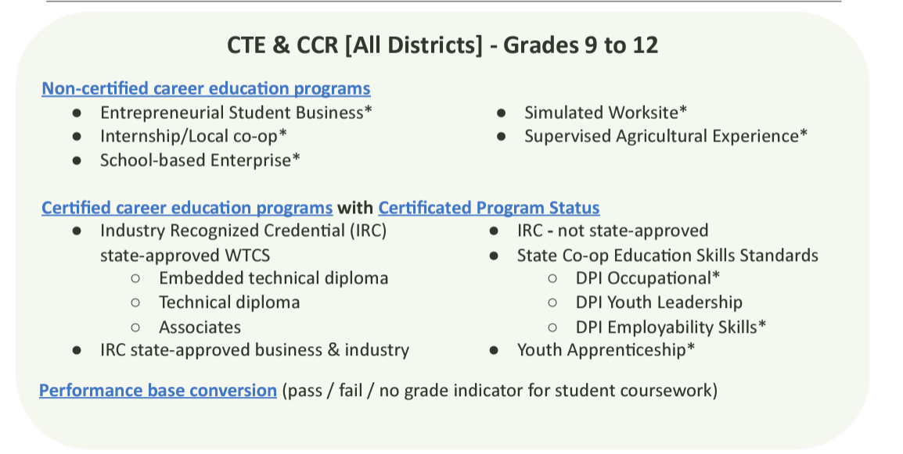
Industry Recognized Credential
Industry Recognized Credentials are Certified Career Education Programs.
IRC’s are a credential that a student earns in a course or multiple courses.
SIS vendors have directions on how to identify a course or add the Certified career education program individually to each student. This is an organization method.
Just like Certified- WBL (previously presented) each student earning an IRC will need to have a Certificated Program Status Type added to their record at the conclusion of the course.
CTE teachers should provide Data Entry with a list of students, earned certificated program status, and institution.
Enter Certificated Program Status Type for each student, after final grading.
Career Education: Info, Help and FAQs
Notes:
Industry Recognized Credentials are all Certificated career education programs.
Students earn these credentials through a single course or multiple courses.
SIS vendors have directions on how to identify a course or add the Certified career education program individually to each student. This is an organization method.
Just like Certified- WBL (previously presented) each student earning an IRC will need to have a Certificated Program Status Type added to their record at the conclusion of the course.
CTE teachers should provide Data Entry with a list of students, earned certificated program status, and institution.
Enter Certificated Program Status Type for each student, after final grading.

Slide 10
WBL & IRC (1 of 2)
Check WISEdata Portal>Exports>Certified/Non-Certified export
Review columns J-Program Name and M-Certificated Program Status
Notes:
You can check WBL and IRC’s two ways.
First, work with the Data Entry person who has access to WISEdata Portal.
Review the export Certified/Non-Certified. This is aggregate data and will give you a list of students and the course sections that have been identified as a type of WBL or earning a IRC.

Slide 11
WBL & IRC (2 of 2)
Check WISEdash for Districts - this is the source of the DECEMBER SNAPSHOT!
Snapshot>Career Education and Coursework>Outcome Count and Student Participation Count>Technical Skills Attainment Student Participation - Current View>Program Name, Program Type, Certificated Program Status, and Work Based Learning Program crosstab
Notes:
Second, review the data in WISEdash for District, through the Snapshot>Career Education and Coursework>Outcome Count and Student Participation Count dashboard. You will use the Technical Skills Attainment Student Participation Current View and use the crosstabs: Program Name, Program Type, Certificated Program Status, and Work Based Learning to check your current data.
Note the dashboard defaults to the Student Participation Count -- which mirror report card headcount calculations.
The December Snapshot is taken from WISEdash for District. So, the Totals and students within these views needs to be checked for accuracy before the Snapshot.

Slide 12
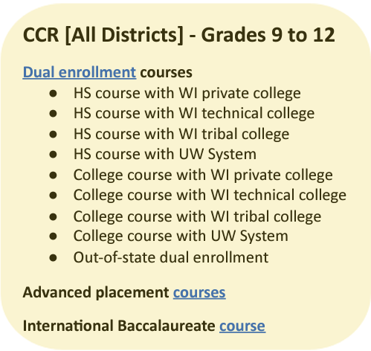
Dual Enrollment
All reporting of Dual Enrollment comes from the student information system and the course setup.
Within the course setup, select “Dual Enrollment” and the type of institution within the course setup.
The institutions options are listed in the yellow box.
Assign a Roster/State/SCED code to the course that matches the curriculum.
Ensure that each section of the course is reporting correctly for dual enrollment.
Read the course description.
Enroll students into the course.
Courses should be created for Early College Credit Program, Start College Now, Transcripted, Articulated, and other college agreements.
Submit a final grade for students in the course.
Notes:
Dual Enrollment is collecting college courses with high school students enrolled.
All reporting of Dual Enrollment comes from the high school Student Information System and the course setup.
Within the course setup, select “Dual Enrollment” and the type of institution within the course setup.
The institutions options are listed in the yellow box.
Assign a Roster/State/SCED code to the course that matches the curriculum
Read the course description
Enroll students into the course
Courses should be created for Early College Credit Program, Start College Now, Transcripted, Articulated, and other college agreements.
Submit a final grade for students in the course.

Slide 13
Advanced Courses & Arts
All reporting of Advanced Courses (AP and IB) and Arts comes from the student information system and the course setup.
All of these course types require specific Roster/State/SCED codes for the data to be included properly on Report Cards.
Assign a Roster/State/SCED code to the course that matches the curriculum. Use the specific year Courses download to select the specific AP, IB, or Arts Roster/State/SCED code.
Sort the Courses download by column titled “Course Program.”
Read the course description.
Enroll students into the course.
Submit a final grade for students in the course. Only courses with passing grades are included in Report Card counts.
Notes:
Next is Advanced Opportunities and Arts courses. These are are each included in Report Cards, but are not part of CTE reporting.
The Advanced Coursework category on the school report card collects Advanced Placement and International Baccalaureate courses.
All reporting of Advanced Courses and Arts comes from the Student Information System and the course setup.
Advanced Placement, International Baccalaureate, and Arts courses require specific Roster/State/SCED codes for the data to included properly in Report Cards.
Assign a Roster/State/SCED code to the course that matches the curriculum. Use the specific year Courses download to select the specific AP, IB, or Arts Roster/State/SCED code.
Sort the Courses download by column titled “Course Program.”
Read the course description
Note that all IB program types (Diploma, Middle Years, and Career Related) are included in Report Card counts.
Enroll students into the course.
Submit a final grade for students in the course. Only courses with passing grades are included in the Report Card counts.

Slide 14
AP/IB, DE, & Arts Courses (1 of 2)
Check WISEdata Portal>Exports>Roster: Course Offerings
Sort by column “P” to check your AP/IB courses
Sort by column “W” to check your Dual Enrollment courses
Sort by AA to check your Arts Category courses
Notes:
Work with the Data Entry person who has access to WISEdata Portal.
First, review the export Roster: Course Offerings. This is aggregate data and will give you a list of the courses in your school.
Check WISEdata Portal>Exports>Roster: Course Offerings
Sort by column “P” to check your AP/IB courses
Sort by column “W” to check your Dual Enrollment courses

Slide 15
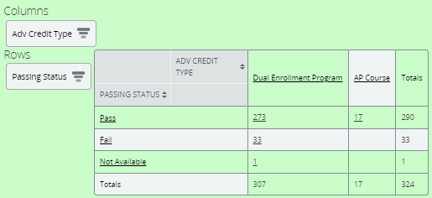
AP/IB, DE, & Arts Courses (2 of 2)
Check WISEdash for Districts - this is the source of the DECEMBER SNAPSHOT!
Snapshot>Career Education and Coursework>Advanced Credit Opportunities Student Participation Count/Outcome Count - Current View>Adv Credit Type and Passing Status crosstabs
*Pay attention to student details “Passed.”
Two different dashboards:
Student Participation Count - student counted one time
Outcome Count - student may be counted more than once
N/A-no grade was sent, no count for completion (report cards count completion)
Topics>Coursework>any subtopic (course enrollment, course student enrollment by subgroup, arts participation by subgroup, postsecondary preparation by subgroup>find AP Course on the left and drag
Notes:
Second,
Check WISEdash for District - this where the DECEMBER SNAPSHOT is taken from!
Snapshot>Career Education and Coursework>Advanced Credit Opportunities >Student Participation Count/Outcome Count- Current View>Adv Credit Type and Passing Status crosstabs
*pay attention to student details “Passed.”
Two different dashboards:
Student Participation Count - student counted one time
Outcome Count - student may be counted more than once
N/A-means no grade was sent, and no count for completion (report cards count completion)
Another dashboard to use is Topics.
Topics>Coursework>any subtopic (course enrollment, course student enrollment by subgroup, arts participation by subgroup, postsecondary preparation by subgroup>find AP Course on the left and drag

Slide 16
Tips
Each student information system vendor has training!
WISEdata Portal>Vendor Resources has a CTE Data webinar to explain each SIS vendor directions.
Data must be reporting in WISEdash for Districts before December Snapshot. Reviewing data in WISEdash is the only way to ensure accuracy before a snapshot.
Data changed in the SIS after the Snapshot will not be used for school report card or Perkins calculation for that reporting year.
Notes:
Each student information system vendor has training!
There is also a recorded training with each vendor located in WISEdata Portal>Vendor Resources called CTE Data webinar. It is a 2 hour recording of your SIS vendor and myself going through the Roster Work Plan and how-to in the SIS.
Data must be reporting in WISEdash for District before December Snapshot. It is very important to review your data in WISEdash for District to ensure accuracy!
Data changed in the SIS after the Snapshot will not be used for school report card or Perkins calculation for that reporting year.

Slide 17
More Tips
Create a Data Team - multiple staff have their hands in the data.
Who creates the coursemaster?
Who schedules students into courses?
How do you collect information from teachers that teach WBL, IRC’s, AP, IB, DE, and Arts?
How do you collect information about Dual Enrollment courses off campus utilizing Early College Credit Program or Start College Now?
Identify who checks WISEdata Portal.
Certified/Non-Certified Export
CTE Participants
CTE Concentrators
Roster: Course Offerings
Identify who checks WISEdash for Districts.
Snapshot>Career Education and Courses
Snapshot>Perkins
Roster Work Plan - to organize your Career Ed data elements for each course
Notes:
Create a Data Team - multiple staff have their hands in the data
Who creates the coursemaster?
Who schedules students into courses?
How do you collect information from teachers that teach WBL, IRC’s, Adv Opps, DE?
How do you collect information about Dual Enrollment courses off campus utilizing Early College Credit Program or Start College Now?
Identify who checks WISEdata Portal?
Certified/Non-Certified Export
Participants
Concentrators
Roster: Course Offerings
Identify who checks WISEdash for District
Snapshot>Career Education and Courses
Snapshot>Perkins
Roster Work Plan - to organize your Career Ed data elements for each course

Slide 18
Resources
CTE Data Resources - CTE and Career Education Data WISE Guide
Report Card Resources - Course & Program Data Guide
Please reach out if you have questions!
Jessica Sloan, CTE Data Consultant, jessica.sloan@dpi.wi.gov
Mark Schwingle, Gifted and Talented Teaching and Learning Consultant, mark.schwingle@dpi.wi.gov
Chris Gleason, Arts and Creativity Teaching and Learning Consultant, chris.gleason@dpi.wi.gov
reportcardhelp@dpi.wi.gov for questions specific to School and District Report Cards
DPI Help Ticket for questions about WISE data submission and troubleshooting
Notes:
Here are resources to assist with this data collection.

Slide 19
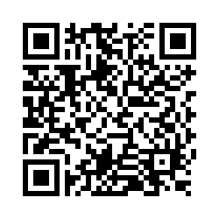
Questions?
Thank you! Thank you!
Please scan the QR code to provide us with your feedback!

