Slide 1
Get it Right! Validate Your Data With WISExplore Tools
2024 WISEdata Conference
Mary Ann Hudziak, CESA 6
Lisa Arneson, CESA 3 March 7, 2024

Slide 2
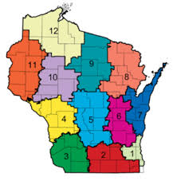
The WISExplore Team
For more information contact your local CESA Data Specialist.
Notes:
You know about us – WISExplore is a collaborative project between DPI and the CESA Statewide Network (CSN) that works to develop a common data inquiry process for teachers and school leaders statewide. In our 11th year!
WISExplore partners help educators to actively engage with the data available through state and local sources in order to inform continuous improvement.

Slide 3
Session Focus
The Need for Data Quality
Snapshot Dashboard Navigation
Snapshot Dashboard for Data Validation
Strategies to Improve Data Quality
Notes:
This session will focus on how to use WISEdash for Districts to validate data accuracy used in accountability and other reporting.
Designed for district data leadership teams, this session elevates the need for effective data stewards.
Particular focus will include demonstrations and guidance in navigating Snapshot dashboards and functionality to review and prevent future data errors.
Participants will leave with strategies and resources for improved data quality.

Slide 4
The Need for Data Quality
Data quality impacts:
State and federal funding
Accountability
Public reporting
Stakeholder perception
Planning
Notes:
There are several reasons why we must be vigilant about data quality--several are listed here.
Accountability usually warrants the most attention, but the others are just as important.

Slide 5
Data Quality & Accuracy
Data accuracy is key to meaningful data use.
Inaccuracies and low data quality lead to ...
data invalidation
misleading analysis
faulty conclusions
loss of confidence
abandoning its use
return on investment is destroyed
Notes:
A word of caution to promote the value of data accuracy.
Data is valuable for all the reasons mentioned on the previous slide.
Because data is used for a variety of purposes, if the data is not accurate or not of high quality, the usefulness and value unravels quickly.

Slide 6
Turn and Talk
What are the current practices in your district to ensure data accuracy?

Slide 7
Elements of Data Quality
Duplication (no duplicate records)
Conformity (to standard data definitions)
Consistency (data across the system are in sync)
Accuracy (true representation)
Integrity (valid & logical)
Timeliness (availability)
Definition (business rules)
Notes:
Several data quality elements are important to review.
We want to specifically look for:
Quality data that has no duplications.
Data that Conforms to a set of standard data definitions.
Data that is Consistent, so that data across the system reflects the same information and are in sync.
When data is Accurate-- it truly represents the “element” being described.
Quality data has Integrity -- meaning that data across all relationships are valid and the connections are logical.
Timeliness -- ensures that the data is timely, available when it is expected and needed.
Finally, Quality data meets the Definition and business rules around each component.

Slide 8
Data Flow Diagram
Accurate local data entry is key!
Notes:
Schools collect the data about students. That information is entered into the Student Information System (SIS).
It then moves into the WISEdata Portal which assures that the data conforms to the business rules of reporting and generates reports indicating errors that need fixing. This is called data validation.
At specified dates during the year a snapshot of the data is taken that is used for reporting purposes. WISEdash for Districts provides a means to view how the data is displayed. At specified dates, data from WISEdash for Districts is pulled to complete accountability reports such as; the State Report Card, Joint Federal Notification reports and the Racial Disproportionality report.

Slide 9
It Takes Teamwork
To ensure data quality, collaborative team practices should be in place at district and school levels.
Teams …
meet at regular and critical times
collaborate to establish data protocols
work together to continually improve the system that supports data quality
Do we have data quality teams?
Notes:
Throughout our session -- you will hear about the importance of every educator taking on responsibility for data quality -- and about the importance of a data quality team.
A data quality team includes a variety of staff roles.
This team meets regularly and at critical times throughout the year.
The team adheres to collaboratively established data protocols and work together to continually improve the system that supports data quality.
Use the emotions feature of Teams to share if your district has data quality teams. (pause)

Slide 10
Data Team Members
Data Team Members Include:
Administrators
Data entry staff
Program leaders
Technology staff
What role do teachers play in data quality?

Slide 11
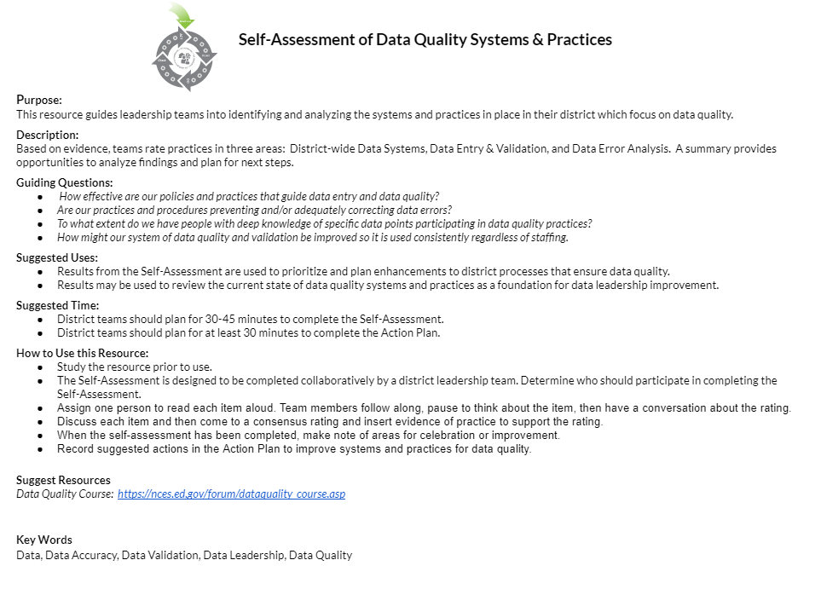
Self-Assessment of
Data Quality & Accuracy
Use the Self-Assessment tool to identify effective practices.
The tool will help you assess:
District-wide Data Systems
Data Entry & Validation
Data Error Analysis
Notes:
We have created a tool that might be helpful for improving the data quality and accuracy in your district.
This is a self-assessment tool designed to be used collaboratively as a district-wide data team.
Click the “Self-Assessment” link on this slide and make a copy to get started.
We encourage you to open this tool and explore as we walk you through its contents.
Pause. Give us a “thumbs up” reaction when you’re ready.

Slide 12
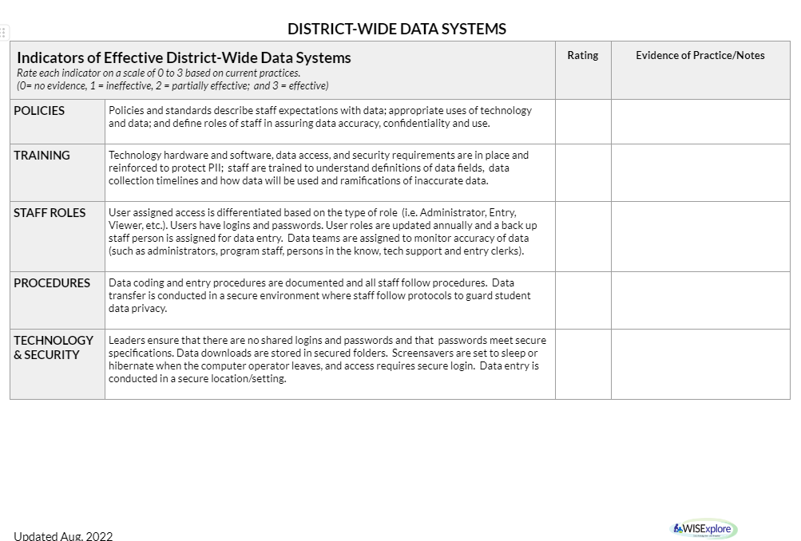
Part 1: District-wide Data Systems
Considerations include:
Policies
Training
Staff roles
Procedures
Technology and security
Notes:
When digging into the first part of the self-assessment, the focus is district-wide data systems.
This first section asks you to look at the policies and practices established at the district level to ensure data quality in a broad sense.
Things like policies, training, staff roles, procedures, and technology & security.
As you read each item, highlight parts of the item you may want to explore more. The tool encourages you to provide a rating for each item ranging from 1 to 5. (1 = minimal and 5 = exceptional)
Use the self-assessment to initiate discussion about current state and desired state for each item.
You will find an Action Plan section at the end of the self-assessment to record action steps for moving toward desired state.

Slide 13
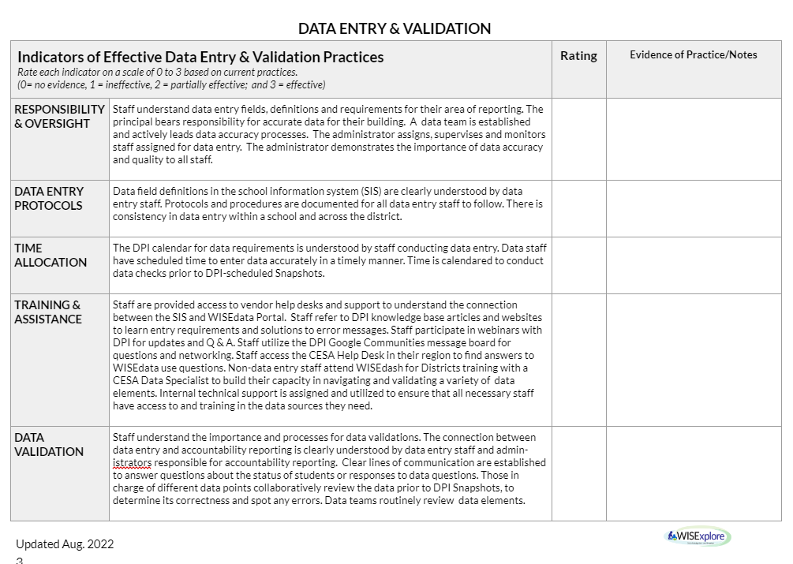
Part 2: Data Entry & Validation
Considerations include:
Responsibility and oversight
Data error protocols
Time allocations
Training and assistance
Data validation
Notes:
The second part of the self-assessment helps you examine specific practices around data entry and validation.
What systems are in place to make this routine?
You’ll consider things like roles and responsibilities, time allocations, training, and actual validation processes.

Slide 14
Part 3: Data Error Analysis
Considerations include:
Errors
WISEdash
Corrections
Improvement
Notes:
Finally, part 3 emphasizes data error analysis.
What systems are in place in anticipation of finding and correcting data errors?
In this section, you’ll consider how you identify errors, using WISEdash, making corrections, and improvement.
Again, this self-assessment is designed to bring teams together to think about data quality and accuracy practices that may or may not be in place. It provides enough description in the items for teams to be able to develop any missing practices. Use the action plan at the end to help you do this important work.

Slide 15
Activity: Self-Assessment
Directions
Make a copy of the Self-Assessment of Data Quality Systems & Practices.
Choose one of the three parts to review.
How do the practices in your district rate?
What changes might you make?

Slide 16
WISEdata
Check for L1 & L2 errors
Identify errors easily
Ensure alignment with SIS
Drill into individual students and summary data
Notes:
Our Focus for today is how to use WISEdash effectively to prepare for a snapshot.
WISEdash and WISEdata are both portals that can be used for data review and accuracy.
WISEdata is where the data entry staff check to be sure the data is flowing and where general comparisons can be made between the Student Information System (SIS) and the flowing data.
Some error flags are communicated here as well as a search and find feature for individual student data summary analysis.
WISEdash is where those that are poised to validate the data can go to review and compare this current data to previous snapshot data, trend data, and summary data. Data entry staff should have access to both portals, however they cannot be the only one(s) verifying the flowing data.
There is a need for BOTH tools to be used to monitor data quality and accuracy. We will continue to emphasize that due to the amount and variety of data flowing into these tools, it takes more than one set of eyes to evaluate the accuracy and completeness of the data.

Slide 17
WISEdash
Captures data flow from WISEdata
Compare current to prior data snapshot
Review trend data
Engage multiple reviewers with various roles
Houses data for Snapshot

Slide 18
Annual Snapshots: December
December: What Is Collected?
School | Previous Year’s Discipline | Previous Year’s Roster and CTE Data | Previous Year’s Year-End** Completion | Current Year’s Third Friday of September | Current Year’s Demographics * / *** | Current Year’s District Library Plan | Current Year’s Digital Equity (NOT REQ’D) Strongly Recommended | Current Year’s Grad Plan/ HS Grad Requirements | Current Year’s Oct 1 Child Count
Public | ✔ | ✔ | ✔ | ✔ | ✔ | ✔ | ✔ | ✔ | ✔
Choice |  |  | ✔ | ✔ | ✔ |  | ✔
***Both Choice and Public Demographics: Race/Ethnicity, Gender, Grade level, Disability Status, Economic Disadvantaged Status, Food Service Eligibility ** Year-End Completion Data Includes: Previous Year’s Attendance, Completion, Credential Type and Transcripts * Public Only Demographics: Migrant Status, ELL Status, Homeless, Parent in Military
Notes:
(Snapshot Calendar)
https://dpi.wi.gov/wisedata/schools/snapshot-prep
Snapshots occur twice a year, and here we can see what data is collected for each one. Mark your calendars for this year’s snapshots: Spring demographic snapshot data will be collected in May, and student snapshot data was collected in December.
We’ve mentioned several times the importance of teamwork in the data validation process. The data elements listed here and on the following slide should certainly reinforce that! We cannot stress enough how having the right people at the table who can help validate the data they’re familiar with is essential! For example, I wouldn’t consider sending my Career Education data without having my CTE teachers review it first.

Slide 19
Annual Snapshots: May
Spring: What Is Collected?
All Data Collected is from Current School Year School | Disability Status | Gender | Grade Level | Economic Disadv | ELL | Food Service Eligibility | Homeless | Migrant Status | Parent in Military | Race / Ethnicity
Public | ✔ | ✔ | ✔ | ✔ | ✔ | ✔ | ✔ | ✔ | ✔ | ✔
Choice | ✔ | ✔ | ✔ | ✔ |  | ✔ |  |  |  | ✔
Notes:
(Snapshot Calendar)
Now, we invite you to network with your colleagues by sharing the strategies used in your district to empower teams to validate data for snapshots.

Slide 20
Turn and Talk
What are some ways staff in your district prepare for DPI snapshots?

Slide 21
Strategies for Success
Compare prior year with current year data
Examine and review all data points that will be captured (that’s why a team is helpful).
Examine the current view periodically, to ensure accurate numbers. How would you know they are accurate?
Examine data behind accountability reports to understand a score or identification
Notes:
There are a number of reasons why users could/should use the Snapshot Dashboard to ensure data quality.
You can
Compare prior year with current year data in preparation for a snapshot.
Examine all data points that will be captured and review them all (that’s why a team is helpful!)
Periodically, examine the current view to determine if those numbers look accurate.
Examine the data behind accountability reports to better understand a score or identification
Doing these things regularly will help eliminate data errors and calls to the help desk.

Slide 22
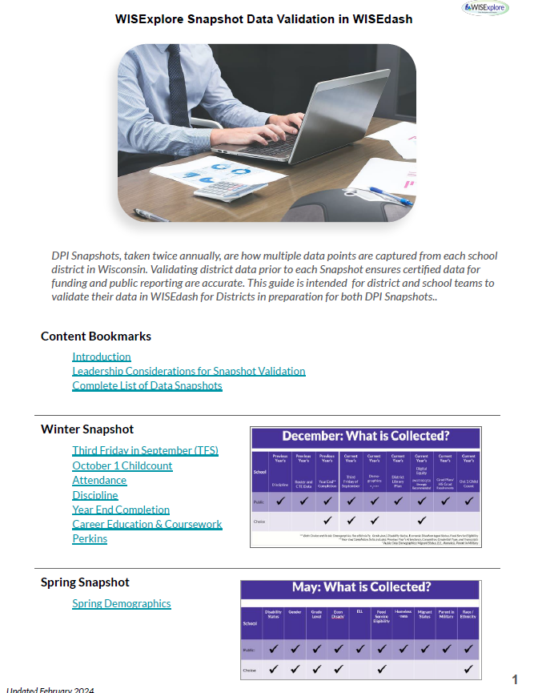
Resource to Guide the Work
Using data snapshot tools within WISEdash for Districts to help study data for accuracy.
Snapshot Investigation Guide 8.5x11

Slide 23
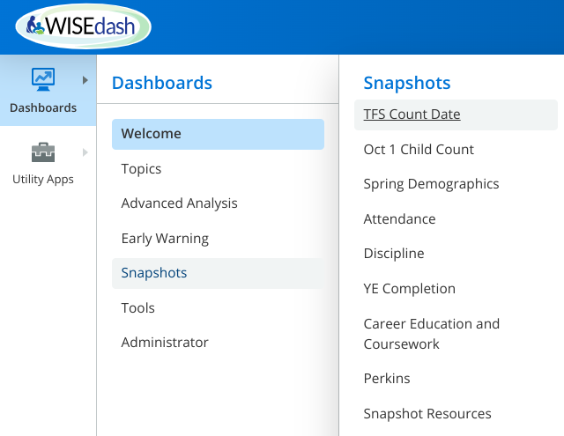
Snapshot Dashboards
Snapshot dashboards for a variety of data types
Multiple purposes
Provide Current and Snapshot Views
Notes:
To locate the Snapshot dashboards, login into WISEdash for Districts.
(click) Select the Dashboard Menu icon in the upper left hand corner of the WISEdash Home page to open the main menu and reveal a list of dashboards.
(click) Select snapshots from the dropdown.
From the Snapshot menu choose the snapshot topic you are interested in exploring.
For example, Third Friday in September or TFS Count Date. When the TFS dashboard opens you will notice that there is a green current view and a purple snapshot view.
As of today there are eight different snapshot menu options. Each menu option displays different data elements collected through the snapshots taken throughout the year. These data elements are the ones that are currently being collected; however, more are added as reporting requirements change.
For example, most recently, Career Education Coursework data and Perkins (or Career and Technical Education) data was added during the past couple of years.
(click) Note the handy link to Snapshot Resources.

Slide 24
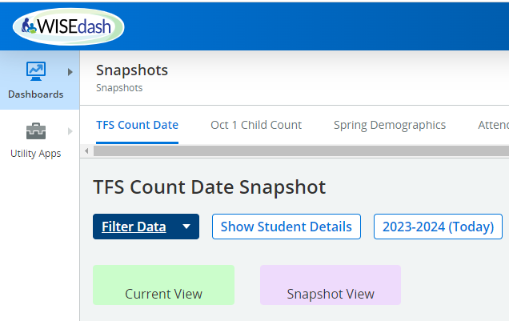
Current View vs Snapshot View
To examine data choose:
Current View (green) or
Snapshot View (purple)
Notes:
Current view (green background charts) means that the data shown is what WISEdash currently has on record from your district. In other words what does the data look like today for the data element and year selected?
If you are in the current year, this will be the data most recently pushed from your district into WISEdata.
If you have selected a different year of data, the current view displays the latest data for that year shared through the WISEdata portal. This is one reason it is so important to always look at the year indicated on the chart of data you are seeing.
Snapshot view (purple background charts) shows what the data looked like when the snapshot was taken and certified for the required data reporting element. The snapshot view (purple chart) will only display after the snapshot has been taken and certified. For example, if a snapshot is taken on December 8, the data will not be available in this snapshot view until it has been certified. There are quality checks that the data team at DPI conducts before activating this snapshot view.
Prior to a snapshot, use the current view to verify how data from your Student information system or SIS is flowing through WISEdata into WISEdash for Districts.

Slide 25
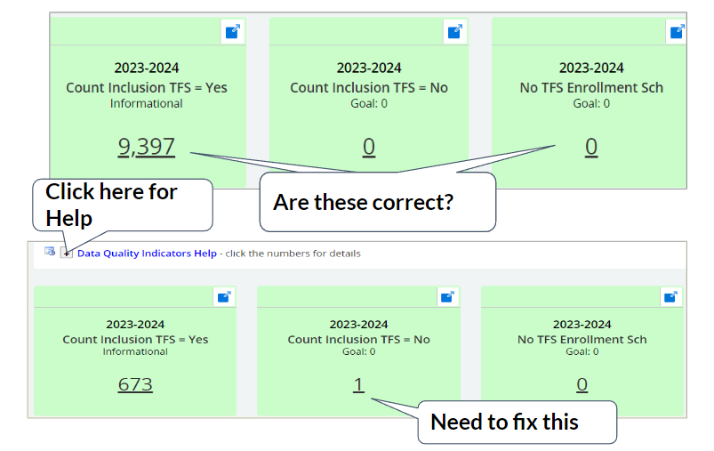
Data Quality Indicators
Data Quality Indicators
Informational
Caution
Goal
Notes:
Data Quality Indicators provide information and flags for potential data errors.
There are three types of Data Quality Indicators.
Informational indicators give you an easy way to see important counts or percentages for the topic at hand.
Caution indicators show you data that may be in error or may be questionable but may also be valid. Review the data more closely to see if it is correct.
For the Goal indicator: The goal is to have a 0 displayed. When a number other than 0 is displayed in the “Goal” box, it is likely that there is an error. You should review the data more closely to see if it is correct.
Here are two examples to illustrate what the user will see when examining data quality indicators. (click)
In the first example, the user will want to look at what is shown and verify for accuracy. (click)
Similarly, the second example identifies seven potential errors under Goal. Further investigation is warranted.
See the Data Quality Indicators Help document linked at the top of the chart for details.

Slide 26
Using the Guide
Explanations of snapshot dashboards
Inquiry questions
Navigation and investigation tips
Snapshot Investigation Guide 8.5x11

Slide 27
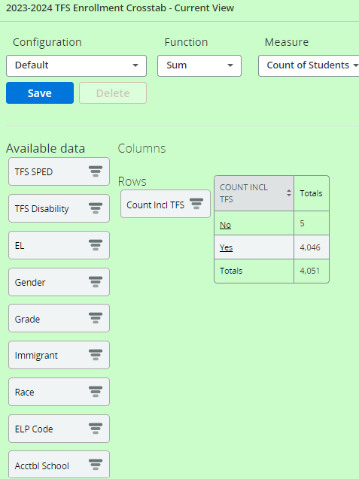
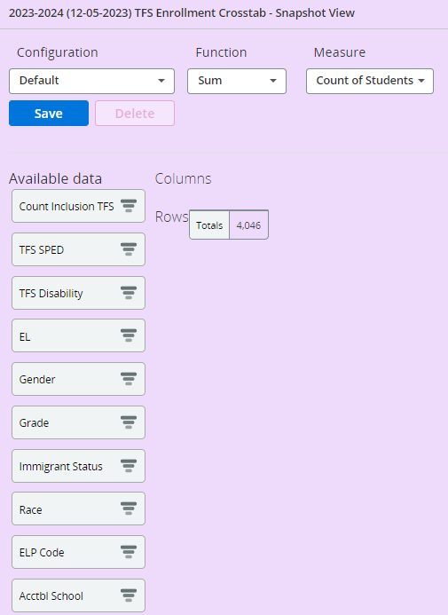
Comparing Data in Snapshot Dashboards
Use the Snapshot dashboards to compare current data to prior snapshot data.
Notes:
As you explore Snapshots, you’ll encounter a tool called Dynamic Crosstabs. It allows you to drag and drop the different data points you wish to examine, thus building your own data table.
When working in a Snapshot dashboard, users must remember to scroll down. Charts appear vertically, beginning with current view. They are shown side-by-side here for our discussion only.
Once again, we want to emphasize the difference between the green and purple charts. The green is the most current view--it might be data as of today if no year filters are applied.
Remember that school information systems from districts push data to WISEdata at least once per week, and this is what is reflected in the green table. For this reason, it may change often as data is entered into the SIS in your district.
The purple view displays the data that was part of the snapshot for the year indicated on the table. This example indicates that no data is found, which means it has not been certified and posted yet. There is a time lag for the DPI to verify the snapshots, so you may find no data on one day, such as this example, and it may suddenly appear the next. Data appears only when it is certified.
Remember to check the Welcome Screen for WISEdash announcements on new data postings.

Slide 28
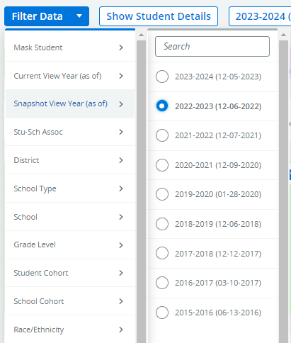
Comparing Data in Snapshot Dashboards with Filters
Filters change the year displayed in each table.
Notes:
Filters allow users to determine specific data points, including year, as shown here. Sometimes, when comparing current views and snapshot views of the same year, differences in the data appear. The numbers don’t add up. This happens frequently and is a common question.
Remember, that a snapshot is just that--a point in time where the data is captured. Any changes that may have occurred after that capture will still be reflected in that year’s Current View. Note that the year at the top of the chart describes the data year being shown. On the purple chart there is also the date the snapshot was taken in parentheses.

Slide 29
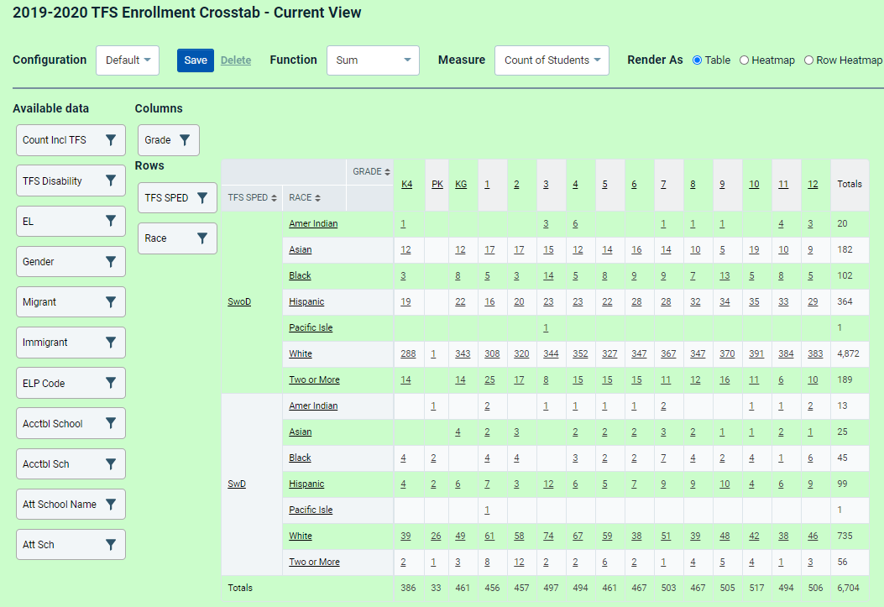
Crosstab Basics
Drag and Drop Data Fields from the Available Data list
to Columns and Rows
Notes:
If you know how to drag and drop with your mouse, you can master Dynamic Crosstabs!
Essentially, users choose the data fields for the rows and columns of their own data table and drag them into place.
Crosstabs are very forgiving because you can simply move the tab back if you want to change it.
In the example shown here, we examine the current view for a district’s Third Friday Count. Notice that grade labels the column.
Race and third Friday in September special education status are both in Rows. Our table, then, shows the number of students by race at each grade level for students with disabilities and without.
Having the flexibility to combine data elements helps to examine the data more carefully to identify potential errors or validate its accuracy.

Slide 30
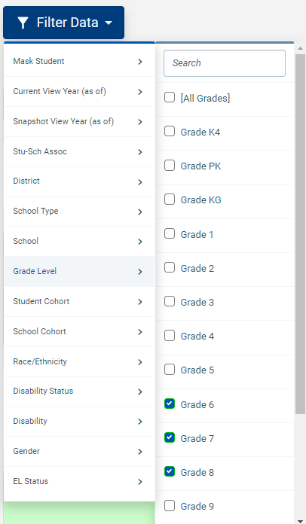
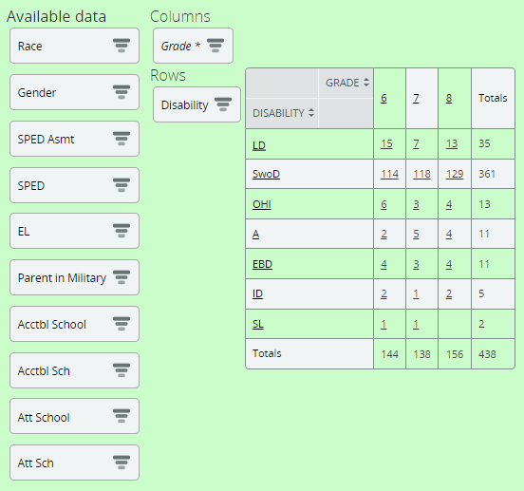
Using Filters
Filtering can be done using the blue filter button on top or within the available data in the crosstab metric.
Notes:
Using filters is another way to create tables. For example, users could use the blue “Filter Data” button at the top of the page to choose grade, or even choose specific grades, as shown here. The result would be the same--an individualized data table.
Filters do allow users to narrow down their criteria (ie. choose specific grades to view) more than the drag and drop. There are some additional data options listed with the blue filter button at the top of the page that are not shown as draggable tabs. When using the blue Filter Data option at the top of the page, you are deciding the parameters for the data that will be available in the crosstab tables.
When applying filters in the available data options of the crosstab table, you will see an * to indicate the filter has been applied.
It is important to note that when you apply one or more filters at the top, you will need to scroll back to the top of the page to review the filters that have been applied.
Also be aware that the data fields available for each Snapshot dashboard are unique for that topic (For example: Perkins, Attendance and Oct. 1 Child Count will have different data fields)

Slide 31
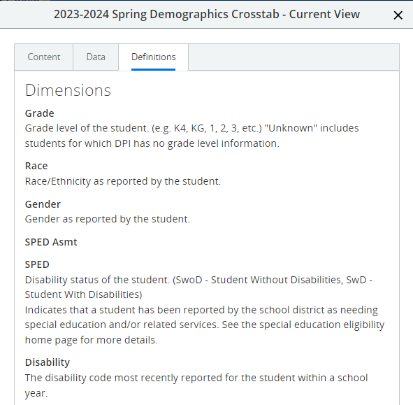
Defining Data Fields
Use the pop-up window icon.
Find details about the data and definitions of data fields.
Notes:
Notice the pop up window icon--in the upper right corner of the crosstab table. This will open a pop-up window that provides three options for further details
- the chart tab displays the table you created,
- the data tab shows the data included in the chart, and
- the definitions tab explains each of the data fields available within that snapshot.
This is a very helpful reference to learn more about the data available.

Slide 32
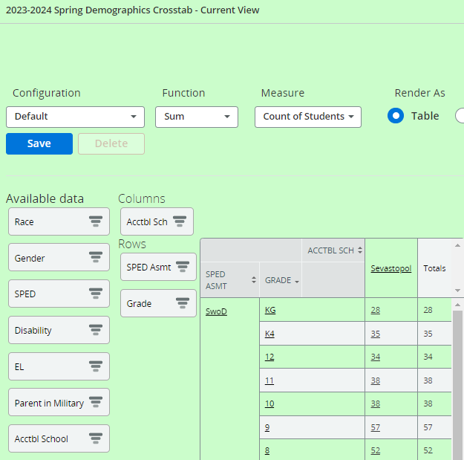
Snapshot Dashboards - Crosstabs
Important demographics to check for all snapshots include:
Race/Ethnicity
SPED / Disability
Econ Code (if you have the role)
EL / ELP
Notes:
The dynamic crosstab also allows you to review all of the students displayed in one list. Simply click on a link (an underlined number or word) and a new window will open with the student list. This can be very helpful when examining accuracy of student demographics and aligning the total numbers of your population with, say, an accountability report.
The list of demographics shown on the slide, are linked to more information about that data element.
You’ll only be able to see “Econ Code” if you have this access to that role. Economic data is highly sensitive. There should be limited people with access to the Economic Indicator Analyst role in WISEdash for Districts. Only those with that role can see data on students’ socioeconomic status.

Slide 33
Next Steps
We invite you to use the slides, self-assessment and the WISEdash validation guide as communication tools with your leadership teams.
How will you use these resources back in your district?
Who will you share it with?
Notes:
Wow! We’ve shared a lot of information with you today, and we encourage you to think about ways to use what you’ve learned back in your district.
We invite you to use the slides and self-assessment as communication tools with your leadership teams.
We have included a resources slide with some key documents and webpages at the end of this slide deck.

Slide 34
Wrap Up and Questions
Contact: wisexplore@cesa7.org
Notes:
(stop the recording if it has not been stopped already)
We would like to provide a few minutes for your questions.
Please post your questions in the chat. I would ask our DPI friends to please share any questions that have been posed in the chat that we have not already answered.
(Q/A)
Thank you for participating with us today. Don’t forget to reach out if you have any questions for the WISExplore team.
Our email is posted on this slide wisexplore@cesa7.org.

Slide 35
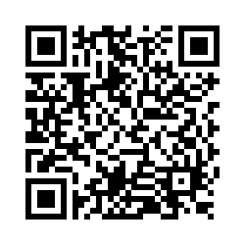
Questions?
Thank you! Thank you!
Please scan the QR code to provide us with your feedback!

Slide 36
Additional Resources
DPI Resource: Collaborate with School and Data Experts for High Quality Data Reporting
DPI Resource: WISEdata and WISEdash Snapshot Reference Guide for WISEdata Contacts
DPI Snapshot Preparation Detailed Guide
WISExplore Snapshot-Related Resources:
Self-Assessing Data Quality
Snapshot Investigation Guide 8.5x11
WISExplore CESA Data Specialists
Thank you!

