Slide 1
Play in the Sandbox!
WISEdata Conference ‣ Thursday March 7, 2024 2:45pm - 4:00pm
Shelby Renoos, Zach Johnston, Wyatt Berglund

Slide 2
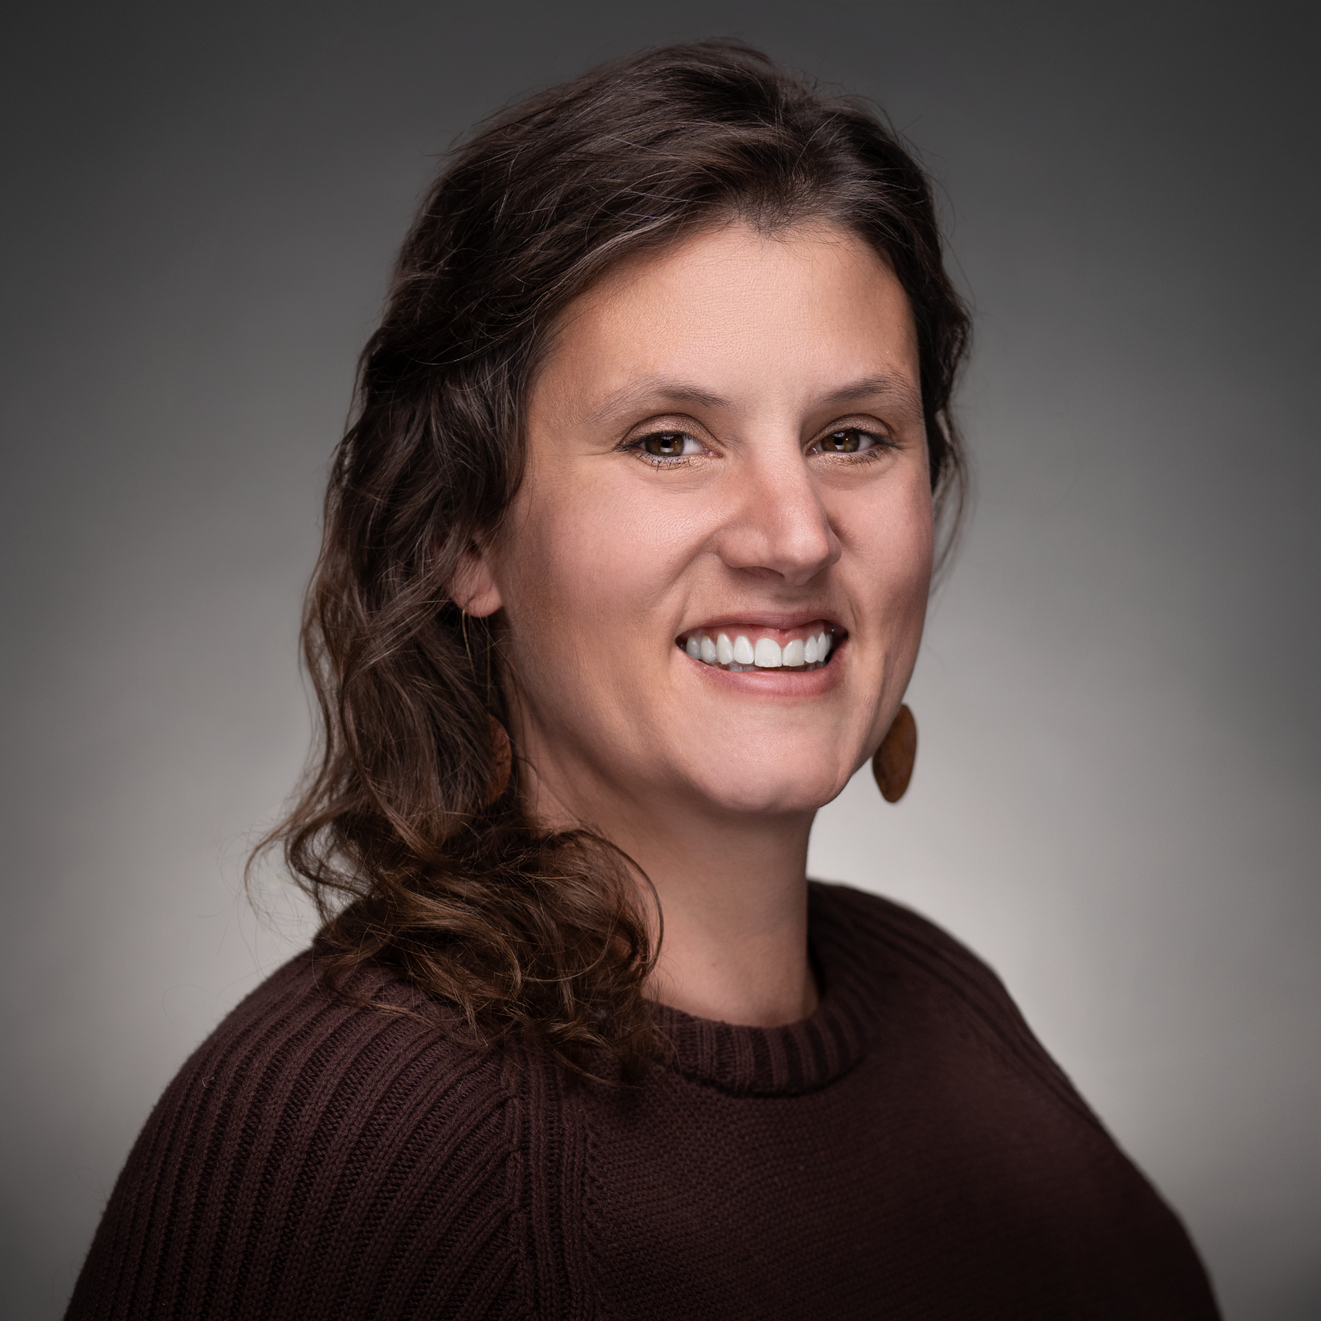
Introductions
Shelby Renoos
Customer Success Coordinator
Zach Johnston
Database Administrator
Wyatt Berglund
Database Technician
Notes:
4 min Introductions: Shelby, Zach, Wyatt

Slide 3
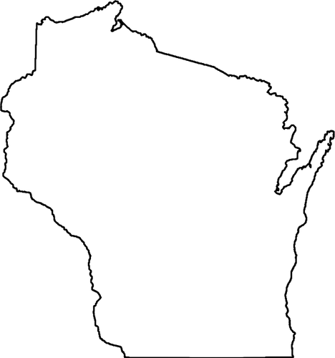
What is WISEdash Local?
WDL Consortium and Governance
WISEdash Local (WDL) is a consortium of innovative WI school districts working together to create a single location data warehouse and dashboard reporting system for your school and student data. Data from your student information system and statewide/local assessments integrate onto WDL dashboards, giving teachers, principals, administrators and board members access to daily-updated comparisons, and helping you visualize your progress toward school-wide initiatives and district goals.
Board of Operations: 9 seats filled by member district representatives
2024: 39 member districts
2014:
5 member districts
Fiscal Agent:
Notes:
3 min The consortium, governance structure Shelby

Slide 4
Give it a try!
https://dashboard.wisedashlocal.org/DashboardDemo/
Please login with the following format, according to the month of your birthday so that we can spread users out across our sample accounts:
Username: Password:
user1 | user2 | user3 | user4
user5 | user6 | user7 | user8
user9 | user10 | user11 | user12
WISEdata2024!
Notes:
12 min:Q& A

Slide 5
Contacts
Wisedashlocal.org
Shelby Renoos
Customer Success Coordinator
srenoos@wisedashlocal.org
(715) 413-2456
Zach Johnston
Database Administrator
zjohnston@wisedashlocal.org
(608) 572-6912
Wyatt Berglund
Database Technician
wberglund@wisedashlocal.org
(715) 413-1614
Notes:
1 min Contacts Shelby

