Slide 1
WISEdash for District: Perkins
Jessie Sloan
CTE Data Consultant
jessica.sloan@dpi.wi.gov
March 2024
Notes:
Welcome to CTE: WISEdash for District Dashboards
This is Jessie Sloan, CTE Data Consultant

Slide 2
Agenda
Snapshot vs Current View
Perkins Dashboard
Cohorts
Career Education and Coursework Dashboard
Topics Dashboard
Resources
Notes:
This presentation will cover
Snapshot vs Current View
Perkins Dashboard
Cohorts
Career Education and Coursework Dashboard
Topics Dashboard

Slide 3
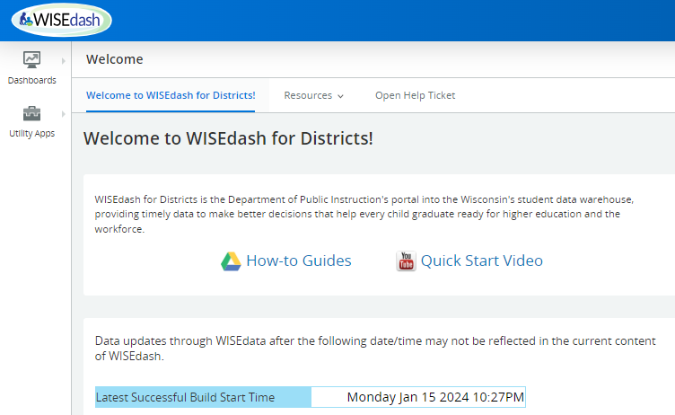
WISEdash for District: Snapshot
Notes:
Career Education and CTE data can be reviewed in the Snapshot dashboards.
Snapshot dashboards are those with frozen data from specific snapshot dates.
This snippet shows you how to navigate to the Snapshot dashboards. Pending on the size of your screen, sometimes there is a navigation carrot on the right hand top corner.
There is a link to How-to-Guides and a Quick Start Video.
Also, notice the Last Successful Build Start Time. This tells you the last time data was updated in your district's WISEdash. It does not tell us what specific data but just the last build of data.
Click on Snapshots to bring you to the next dashboard screen.
DPI uses Snapshot data from WISEdash to complete Perkins Accountability Reports and report cards.

Slide 4
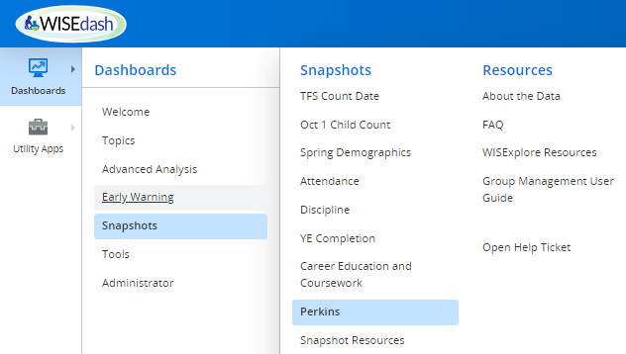
WISEdash for Districts

Slide 5
WISEdash for District
Perkins dashboard has two graphs: green (current) and purple (snapshot)
Green - Current view will show data for the selected school year
Purple - Snapshot view is data that is certified/frozen from the last snapshot. We will be using Snapshot view to analyze 2022-2023 certified data. Certified means that the data was sent from the district and is used in state and federal reporting.
Filter Data - these selections apply a filter to both views
Notes:
This is a view of the Snapshot dashboards.
We are going to focus on Perkins and Career Education & Coursework.
Perkins is used for data analysis in the Perkins grant.
Career Education & Coursework is for report cards.
Each dashboard has 2 views or graphs for current data and snapshot data.
Snapshot data is always a purple view.
Current view is green and pending on the time of year may not be complete data. For example, not too many schools have their 22.23 Concentrators selected today. So viewing Concentrators in current, green graph, will not be accurate. You should review this work when helping your data entry check for accuracy.
The purple view is from the snapshot on December 6, 2022….or you can use the filter to change the Snapshot year.
You can use the Filter Data to apply a filter to both views. Or you can use a crosstab, in the next slide. It will depend how you want to slice and dice your data view.

Slide 6
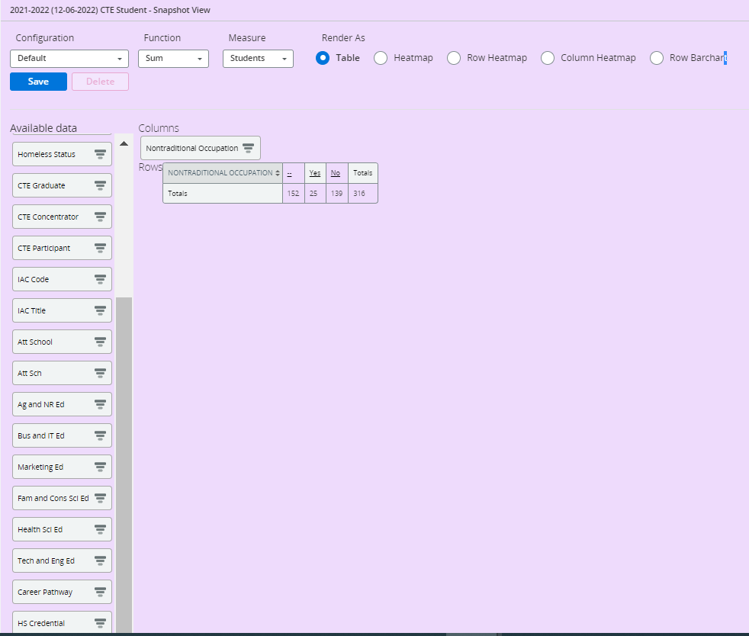
Perkins (1 of 5)
School year and date of Snapshot
Non-Traditional Occupation Filter:
Click on “Yes” to see students. Yes - means students are in a Non-traditional Career Pathway. This is determined by the IAC used to group sequence of courses together for a Career Pathway.
No - means the student is not in an NTO Career Pathway
Crosstabs to show data
Click and drag onto the graph under columns or rows.
Can add multiple crosstabs
Notes:
This is a Perkins dashboard for Non-Traditional Occupations.
Notice the School year and date of Snapshot.
There are multiple crosstabs on the left to show data. I dragged and placed Nontraditional Occupations into the Columns for this example.
Click on “Yes” to see students. Yes - means students are in a Non-traditional Career Pathway. This is determined by the IAC used to group sequence of courses together for a Career Pathway.
No - means the student is not in a NTO Career Pathway

Slide 7
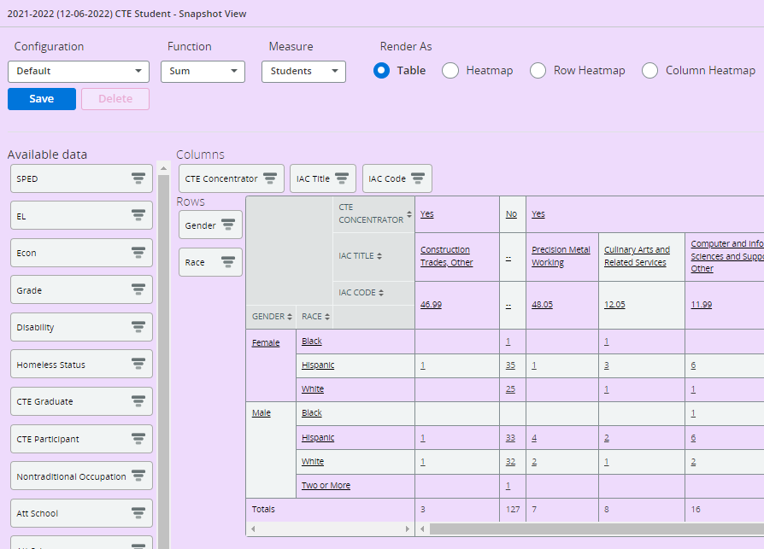
Perkins (2 of 5)
This is a pivot table using IAC Title, IAC Code, and Race. It shows the breakdown by IAC Title.
You can select the individual IAC Title and download a spreadsheet of student details.
Not enough information to be a Concentrator. Could be a Participant, or missing data.
Notes:
This is a pivot table using IAC Title, IAC Code, and Race. It shows the breakdown by IAC Title.
Based on your level of access, you can click on the underlined words to see groups of students.
For example, clicking on the Yes for CTE Concentrator, would show you student level data for all CTE Concentrators in 21.22 SY.
Clicking on the IACT Title, Construction Trade, Other would show you all the students in that Career Pathway.
If I read down the Construction Trades, Other career pathway, I can see the number of females by race and the number of males by race. At the end I can see total students in that pathway.

Slide 8
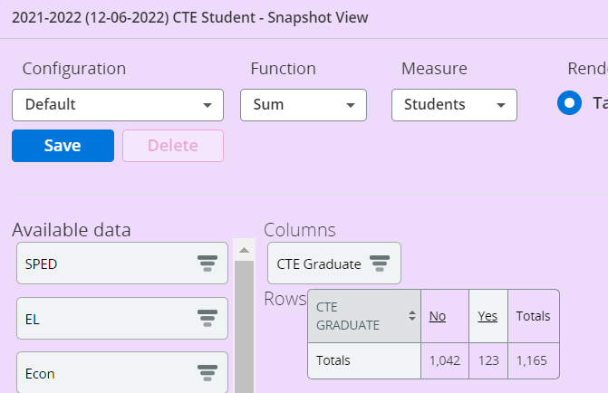
Perkins (3 of 5)
Notes:
CTE Graduates are those Concentrators that graduated in a school year.
We use CTE Graduates to complete the CTE Concentrator Graduate Follow-up Survey. You have access to your CTE Graduates.
Each spring CTE Coordinators and their teams will be collecting follow-up information from CTE Graduates, those students that have graduated and where Concentrators. We collect this data a minimum of 6 months after graduation.
You can get your CTE Graduate Concentrators by setting up this view, clicking on the Yes, and download the students into an Excel file. You will need to know the student names, to make contact with these students to complete the 4 questions.
Be very aware that the Excel file contain Sensitive Personal Identifying Information about students and should not be emailed around. You would need to delete all of the data, except student name, if it needs to be sent to you CTE Coordinator.

Slide 9
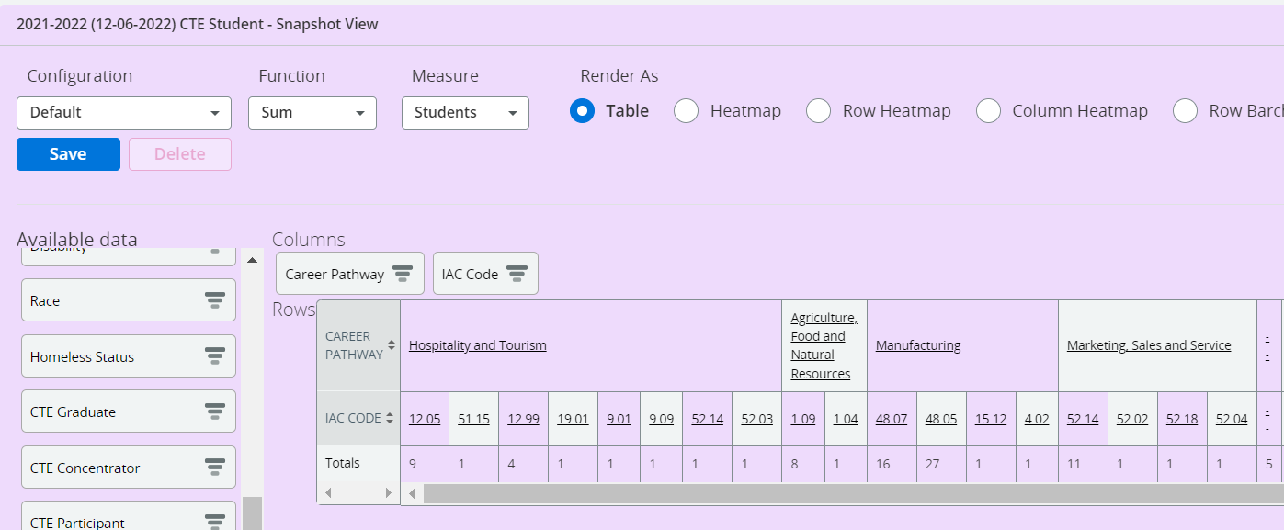
Perkins (4 of 5)
Notes:
In this view, I wanted to check how many career pathways/IAC codes are being used for each Career Pathway.
This is important to check because the the IAC code should match the Career Pathway that CTE/Perkins team developed. How many Career Pathways does your team have?
You can see in this example that Hospitality and Tourism is using 8 different IAC codes. Which one represents the Career Pathway?
The totals, show the number of Concentrators. I did not need to use the CTE Concentrator crosstab for this demo because IAC is associated with Concentrators. If I add the CTE Concentrator crosstab, it will add another Row that duplicates the Totals.

Slide 10
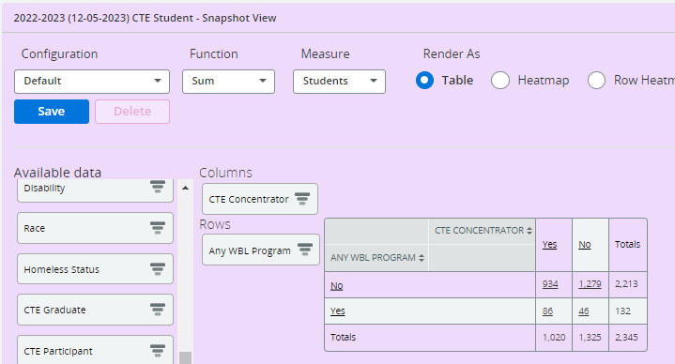
Perkins (5 of 5)
Notes:
This is a Snapshot view of CTE Concentrators that participated in WBL at any time during HS.

Slide 11
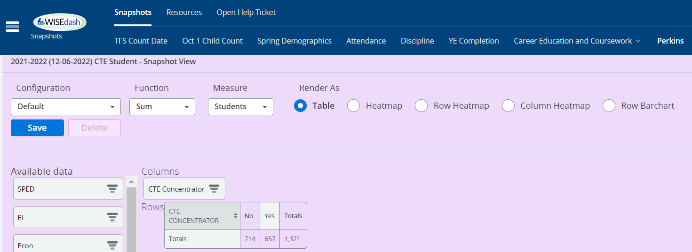
Cohorts (1 of 3)
Start on Perkins dashboard to view Concentrators, CTE Graduate…
Snapshot>Perkins
The Snapshot view auto-defaults on the last Snapshot. If you want to change the Snapshot year, do so by using the Filter Data button>Snapshot View Year (as of).
Drag CTE Concentrator crosstab to either columns or rows (depending on your style).
Other helpful documents:
How-to: CTE Students (Participants, Concentrator, Graduates)
How-to: IAC Codes
How-to: Two Subgroups
Notes:
I like to create Concentrator Cohorts to group my Concentrators for the year together, and then use the Cohort in the Topics dashboard for ACT data analysis.
Creating a yearly Concentrator Cohort, also lets me do some data trending across year for ACT.
Perkins uses ACT for three of our Indicators (Reading, Math, Science)
I am using the purple - Snapshot view, because I want to create a cohort based on Snapshot data. So, it matches the snapshot Concentrators that DPI used in Perkins Accountability Reports.
Start on Perkins dashboard to view Concentrators, CTE Graduate…
Snapshot>Perkins
The Snapshot view auto defaults on the last Snapshot. If you want to change the Snapshot year, do so by using the Filter Data button>Snapshot View Year (as of).
Drag CTe Concentrator crosstab to either columns or rows (depending on your style)
Other helpful documents:
How-to: CTE Students (Participants, Concentrator, Graduates)
How-to: IAC Codes
How-to: Two Subgroups

Slide 12
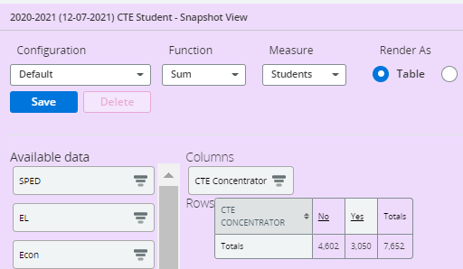
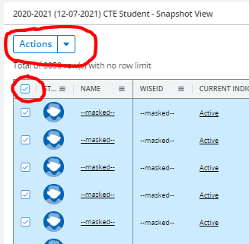
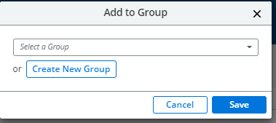
Cohorts (2 of 3)
Create a Concentrator Cohort for each school year.
Snapshot>Perkins>CTE Concentrator crosstab
Click on “Yes” to see student details.
Click on the box to select all students.
Click on Actions>Add to Group>Create New Group
Name your cohort>Save
Notes:
Create a Concentrator Cohort for each school year.
Snapshot>Perkins>CTE Concentrator crosstab
Click on “Yes” to see student details.
Click on the box to select all students.
Click on Actions>Add to Group>Create New Group
Name your cohort>Save

Slide 13
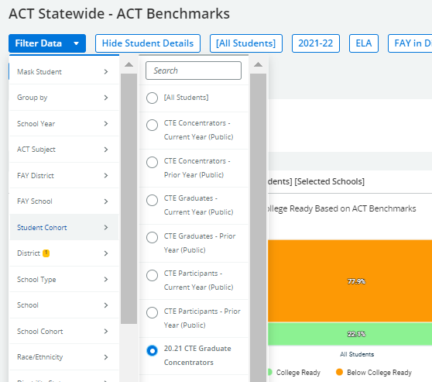
Cohorts (3 of 3)
Use the Topics dashboard
Topics>Assessments>ACT Statewide>ACT Statewide-ACT Benchmarks or Performance Levels
Use your CTE Concentrator Cohort to view assessment results (cohort found in Filter Data>Student Cohort)
Links to background information about:
Perkins Performance Indicators
Academic Proficiency in Reading/Language Arts, Math, Science: CTE Concentrator proficiency in the challenging State academic standards adopted by the State under ESEA, as measured by the academic assessments described in ESEA.
ACT Data Proficiency
Wisconsin’s ACT Performance Level Cut Scores
Notes:
Creating a Concentrator Cohort by school year is best practice.
You may notice that there are some already established filters that represent Prior Year or Current Year - CTE Concentrator, Graduate or Participant cohorts. DPI made these for quick access.
If you created your own cohort, you would see it listed here, under Student Cohort. I like to make my own cohort because I look at data beyond the prior year. I usually look at trends over 3-5 years.
Use the Topics dashboard
Topics>Assessments>ACT Statewide>ACT Statewide-ACT Benchmarks or Performance Levels
Use your CTE Concentrator Cohort to view assessment results (cohort found in Filter Data>Student Cohort)
Links to background information about:
Perkins Performance Indicators
Academic Proficiency in Reading/Language Arts, Math, Science: CTE Concentrator proficiency in the challenging State academic standards adopted by the State under ESEA, as measured by the academic assessments described in ESEA.
ACT Data Proficiency
Wisconsin’s ACT Performance Level Cut Scores

Slide 14
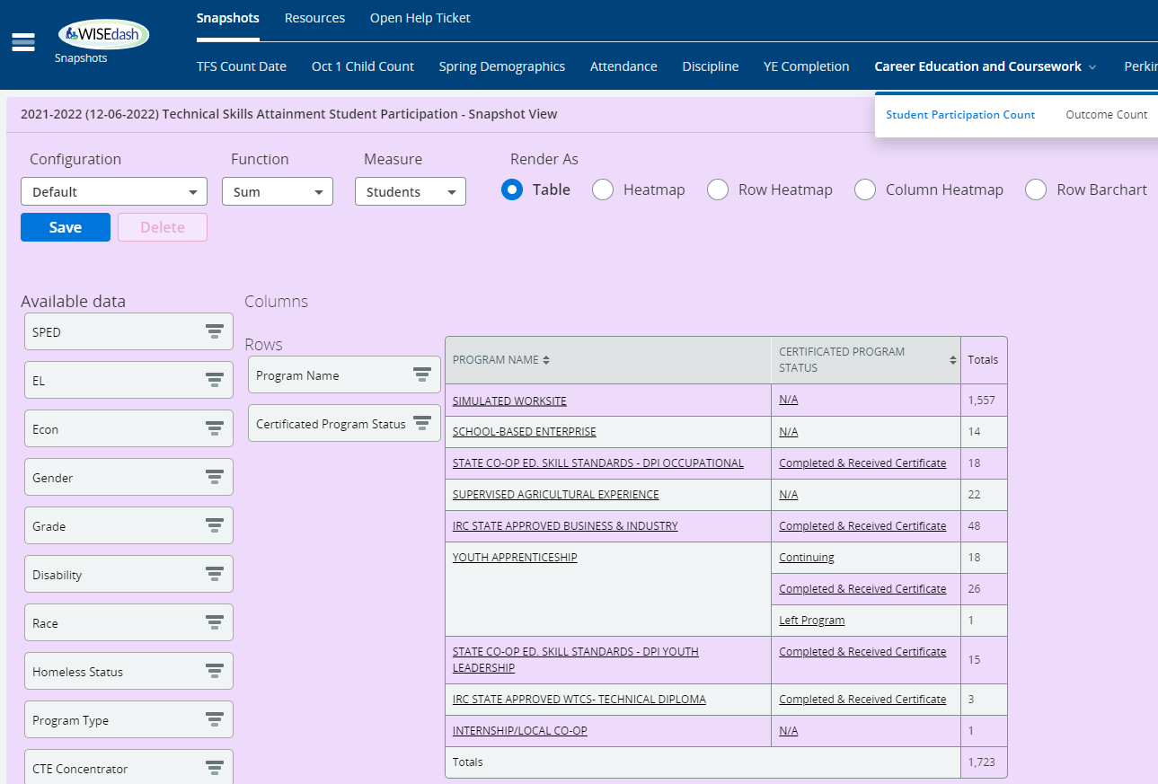
Career Education and Coursework (1 of 2)
Use the Snapshot>Career Education and Coursework dashboards to view report card Postsecondary Preparation.
Auto-defaults on Program Name BUT you need to apply Certificated Program Status for accurate counts.
Career Education and Coursework has 2 dashboards
Student Participation Count (students counted one time only)
Outcome Count (students may be counted more than once)
4 graphs in these dashboards (current & snapshot):
Technical Skills Attainment - provides information on membership and completion status, when available, in one of the following Program Types: "Non-Certified Career Education Program" or "Certified Career Education Program".
Advanced Credit Opportunities - shows information about student enrollment in Advanced Placement (AP), International Baccalaureate (IB), Dual Enrollment courses, and Passing Status.
How-to: Filtering
How-to: Snapshot Data
Notes:
The Career Education and Coursework dashboard is used for report card data. These are student grades 9-12 that have participated in advanced courses (AP or IB), dual enrollment, industry recognized credentials or work based learning. If a student has not participated in any of these categories, they will not show up in this dashboard. This slide is an example of the Technical Skills Attainment Student Participation Snapshot data. It is showing Work Based Learning and IRC data.
Use the Snapshot>Career Education and Coursework dashboards to view Work Based Learning and IRCs…
Auto defaults on Program Name BUT you need to apply Certificated Program Status for accurate counts. You need to add Certificated Program Status because of the way DPI calculated Certified work based learning and IRCs. We only include “Completed & Received Certificate” in reports. You can use the green current view to check your current year work on reporting these students.
Career Education and Coursework has 2 dashboards
Student Participation Count (students counted one time only)
Outcome Count (students may be counted more than once)
4 graphs in these dashboards (current & snapshot):
Technical Skills Attainment - provides information on membership and completion status, when available, in one of the following Program Types: "Non Certified Career Education Program" or "Certified Career Education Program".
Advanced Credit Opportunities - shows information about student enrollment in Advanced Placement (AP), International Baccalaureate (IB), Dual Enrollment courses, and Passing Status.
How-to: Filtering
How-to: Snapshot Data

Slide 15
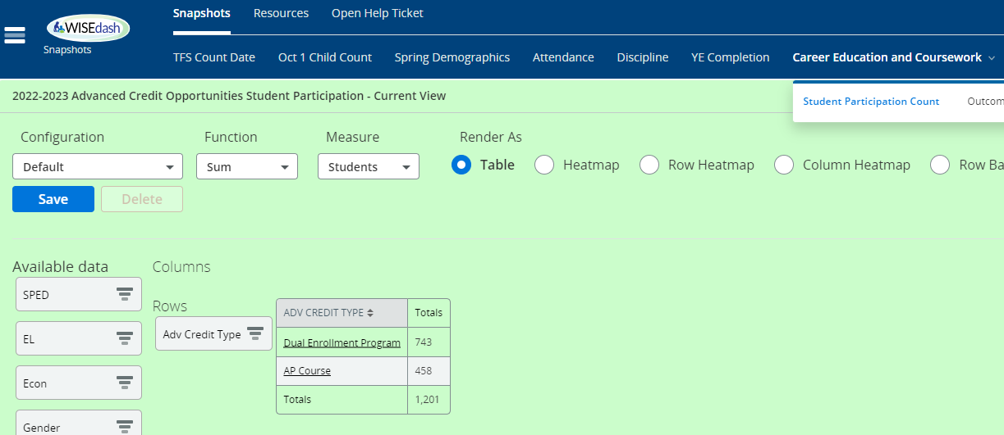
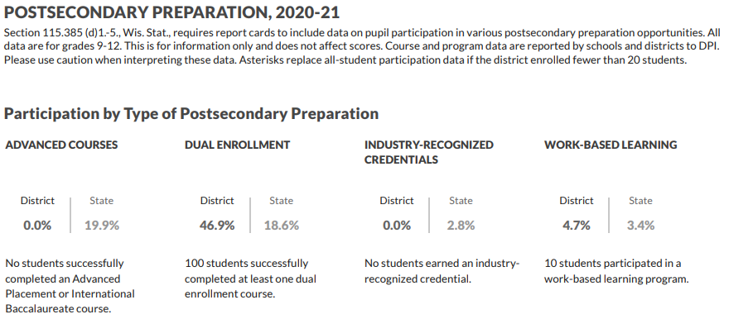
Career Education and Coursework (2 of 2)
Advanced Credit Type shows Dual Enrollment Program, Advanced Placement, and International Baccalaureate.
Student must pass the course to be counted.
Notes:
This is an example of Current View data for Advanced Credit Opportunities. This table shows Dual Enrollment Program, Advanced Placement, and International Baccalaureate. However, in this example, the schools does not have International Baccalaureate, so nothing shows up.
Advanced Credit Type are Non-certified programs. So, the student is included in the count when they are scheduled in a course that has the appropriate Roster code for AP or IB OR the course is appropriately identified for Dual Enrollment.
The student must also pass the course to be included in the count.

Slide 16
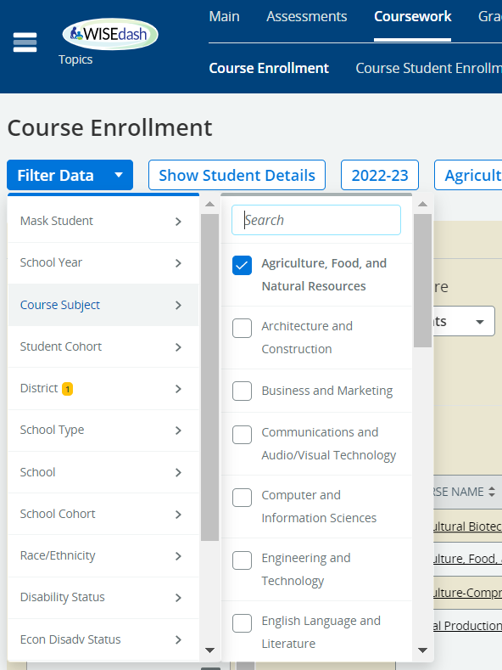
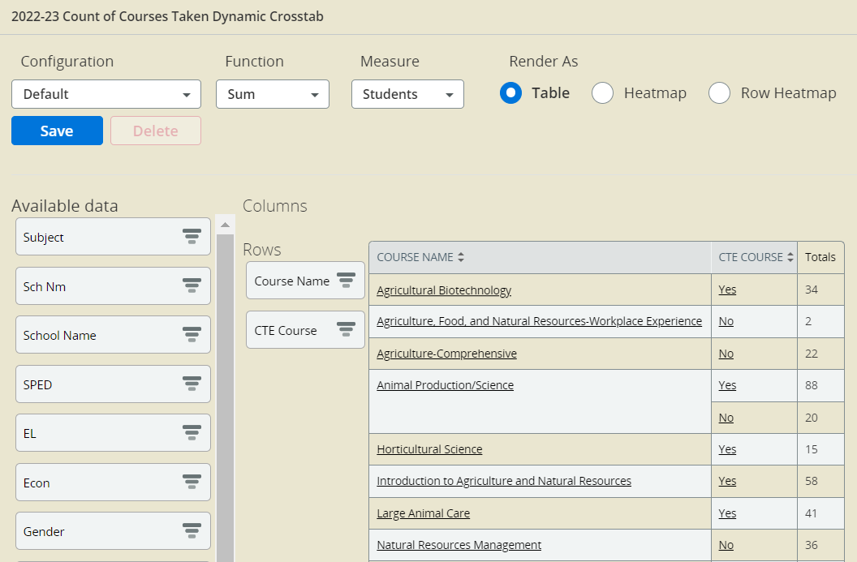
Topics
Topics> Course Enrollment> Filter Data> Course Subject> Agriculture, Food, and Natural Resources
Use crosstabs, Course Name and CTE Course to review how many CTE courses you have and how many students are enrolled.
Investigate why some of the CTE Courses are not coming through as CTE but are in a CTE Subject.
Wrong Roster Code?
No licensed CTE teacher?
Updated Roster data needs a resync from SIS?
Notes:
The Topics dashboard has many uses to review course data. It defaults on current year and you can change the year by using the Filter Data>School Year.
To see data, you will need to select a Course Subject in the Filter. For CTE, the subjects are by Career Cluster/pathway.
In this example, I selected Agriculture, Food, and Natural Resources from the Filter Data>Course Subject.

Slide 17
Resources
CTE Data Resources
CTE and Career Education Snapshot Preparation Guide
CTE and Career Education Data WISE Guide
Career Ed and Coursework Data Quality Check (DEMO) –
Career Ed and Coursework Data Quality Check (blank)
Wisconsin Guide to Implement Career-Based Learning Experiences
WISEdash Course User Guide

Slide 18
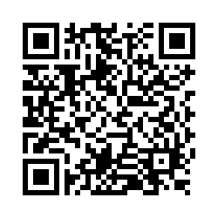
Questions?
Thank you! Thank you!
Please scan the QR code to provide us with your feedback!

