Slide 1
Educator Effectiveness & Implementation Tools
Jacob Hollnagel, Education Consultant
Licensing, Educator Advancement & Development (LEAD) Team
Thursday, March 7, 2024

Slide 2


A Little Bit About Me
Jacob Hollnagel
Education Consultant
Licensing, Educator Advancement
and Development Team
jacob.hollnagel@dpi.wi.gov
(608) 266-5195
2
Notes:
Joined DPI and Educator Effectiveness in 2013 since before full implementation
Worked on policy, evaluation, and communications for the EE System since 2015
Recently completed a Masters of Public Affairs at the Robert M. La Follette School of Public Affairs at UW-Madison.

Slide 3
Agenda
Wisconsin Educator Effectiveness (EE) System Foundations
Tools Supporting EE Implementation
Questions
3
Notes:
DPI provides the Frontline Education Employee Evaluation Management platform to state EE model districts & independent charters to support the processes, record-keeping, and data analysis to improve local systems.

Slide 4
Who Are You?
What are your roles?
Do you currently use Frontline Education for EE?
What is your vision for EE in your school or district? How can a data tool help get you there?
4
Notes:
If large crowd, use hand raises.
If small crowd, go around the room.

Slide 5
What is Educator Effectiveness?
The Wisconsin Educator Effectiveness System is a
learning-centered, continuous improvement system designed to improve the education of all students in
the state of Wisconsin by supporting guided,
individualized professional growth and
development of educators.
5

Slide 6
Why Educator Effectiveness?
6

Slide 7
Why Educator Effectiveness? (1 of 2) 1
  Teachers are the most important school-based factor contributing to student outcomes.
  School Leadership is the second most important school-based factor contributing to student outcomes.
Notes:
Teachers are the most important school-based factor contributing to student outcomes. (Opper, Isaac M. 2019 Teachers Matter: Understanding Teachers’ Impact on Student Achievement. Rand Corporation.)
School Leadership is the second most important school-based factor contributing to student outcomes. (Grissom, Jason A., Anna J. Egalite, and Constance A. Lindsay. 2021. “How Principals Affect Students and Schools: A Systematic Synthesis of Two Decades of Research.” New York: The Wallace Foundation. Available at http://www.wallacefoundation.org/principalsynthesis .)
School leaders make that contribution to student achievement through their effects on the school environment, teacher effectiveness, and other factors. (Grissom, Egalite, and Lindsay 2021).
Teacher effectiveness is not fixed and can be improved, and school leaders have a role to play in that professional growth.

Slide 8
Why Educator Effectiveness? (2 of 2) 2
  School leaders make that contribution to student achievement through their effects on the school environment, teacher effectiveness, and other factors.
  Teacher effectiveness is not fixed, can be improved, and school leaders have a role to play in that professional growth.
Notes:
Teachers are the most important school-based factor contributing to student outcomes. (Opper, Isaac M. 2019 Teachers Matter: Understanding Teachers’ Impact on Student Achievement. Rand Corporation.)
School Leadership is the second most important school-based factor contributing to student outcomes. (Grissom, Jason A., Anna J. Egalite, and Constance A. Lindsay. 2021. “How Principals Affect Students and Schools: A Systematic Synthesis of Two Decades of Research.” New York: The Wallace Foundation. Available at http://www.wallacefoundation.org/principalsynthesis .)
School leaders make that contribution to student achievement through their effects on the school environment, teacher effectiveness, and other factors. (Grissom, Egalite, and Lindsay 2021).
Teacher effectiveness is not fixed and can be improved, and school leaders have a role to play in that professional growth.

Slide 9
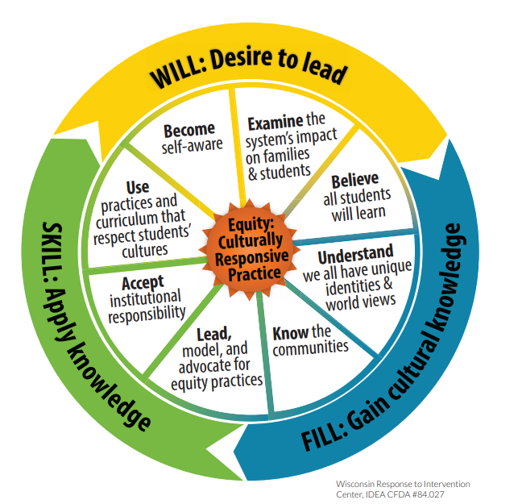
Educational Equity
Educational equity means that every student has access to the resources and educational rigor they need at the right moment in their education, across race, gender, ethnicity, language, ability, sexual orientation, family background, and/or family income.
WI Department of Public Instruction (2017)
Equity: Wisconsin’s Model to Inform Culturally Responsive Practices.

Slide 10
Five Learning-Centered Principles
  A foundation of trust that encourages educators to take risks and learn from mistakes
  A common, research-based framework on effective practice
  Regular engagement in educator-developed goals (Student/School Learning Objectives and professional practice goals)
  Cycles of continuous improvement guided by timely, specific feedback
  Integration with district and school priorities and practices

Slide 11
Trust Matters
  Trust is necessary for effective learning communities.
  Trusting school cultures encourage risk-taking and learning from mistakes.
  Trust strengthens professional culture.
  In schools where professional culture is organized for improvement, improvement is also seen in teacher retention, job satisfaction, and commitment to the school in which they serve.

Slide 12
Integration
When integrated with other school and district improvement strategies, the EE System becomes the organization improvement system:
  Goals inform professional learning and vice versa
  Frameworks guide all professional conversations
  Hiring, mentoring, and career ladder development are aligned
  Classroom-school-district goals align and drive growth
  across the system
  EE supports other initiatives (curriculum implementation, Universal Design for Learning, professional learning communities, etc.)
12

Slide 13
Data Reports in Frontline
Customizable filters, savable, shareable districtwide or school building reports
Report Writer – text fields
Example use cases
SLO goal review for all teachers in a building or principals in district
- trends in standards alignment
- goals reflective of baseline data and other data sources
indicated Focus Areas
- evident trends
- supports might be put in place for frequently identified areas
Rubric Explorer – rubric fields
Example use cases
What are the 3 Danielson components most self-identified as Areas for Growth by new teachers?
- can inform areas for needed support for new teachers (through coaching, mentoring, professional development, etc.)
Which Danielson components are most identified as areas of strength in Professional Conversations?
Growth Explorer – dropdown lists, checkboxes
Example use case
What are some trends in feedback using the critical attributes for "engaging students in learning" (Danielson 3c) during observations of teachers?
Notes:
Local policies and initiatives/SIP (curriculum implementation, Universal Design for Learning, professional learning communities, etc.) can be fostered, supported, and monitored through the EE System processes that support professional practice (where the rubber meets the road)
Frontline is a documentation tool that supports the EE processes, communication, and provides useful data that can be utilized with other data sources for systemic reviews/tracking.

Slide 14
Educator Effectiveness Process Data
14

Slide 15
Elements of the System in Practice (1 of 2)
Observer Certification Training and Calibration
Orientation and Ongoing Training
Regular Self-Review
Educator-Developed Goals
Observations, Evidence, and Feedback
Regular Conferences
Notes:
Focus on 4 of the elements
Self-review
Educator-developed Goals
Observations, Evidence, and Feedback
Regular Conferences
Evaluator certification training and calibration an important part of the system but takes place outside of Frontline using other tools.

Slide 16
Elements of the System in Practice (2 of 2)
Observer Certification Training and Calibration
Orientation and Ongoing Training
Regular Self-Review
Educator-Developed Goals
Observations, Evidence, and Feedback
Regular Conferences
Notes:
Focus on 4 of the elements
Self-review
Educator-developed Goals
Observations, Evidence, and Feedback
Regular Conferences
Evaluator certification training and calibration an important part of the system but takes place outside of Frontline.

Slide 17
Supporting System Processes with Tools
Frontline Education Employee Evaluation Management (EEM) Platform
Google and Microsoft Templates
Other, locally-developed options

Slide 18
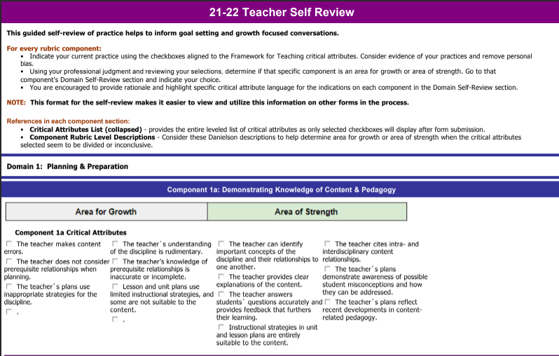
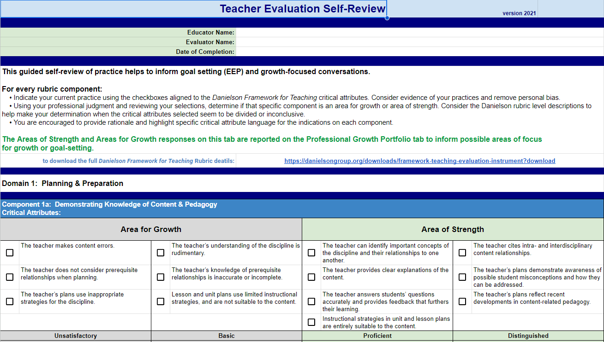
Supporting System Processes with Tools 2
Frontline and Google forms mirror each other

Slide 19
Regular Self-Review
Regular engagement in a self-review based on a shared framework of effective practice:
  Reinforces educator self-efficacy
  Encourages reflective practice
  Informs student learning and professional goals

Slide 20
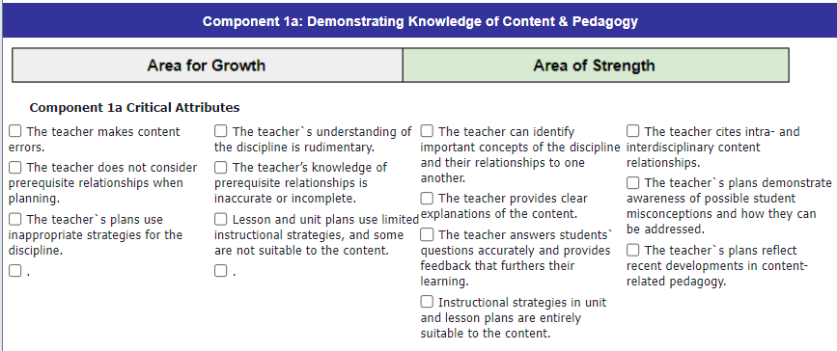

Self-Review

Slide 21
Educator-Developed Goals
The development of annual, educator-led student and school learning objectives:
  Regularly assess and guide instruction
  Can be thoughtfully aligned to school and district goals, such that the educator can monitor and adjust strategies at the school and classroom level
  Increase ownership and engagement in the process
  Focus the work on using adult practices to affect student learning

Slide 22
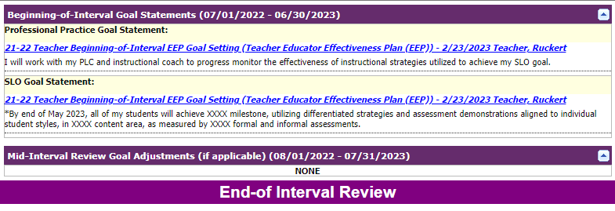
Goal Setting & Review
Set, Review, Revise, Assess Success
Beginning-of-interval
Mid-interval review
End-of-Interval
Customize requirements
& use
Information from previous goal forms is pulled and displayed to streamline processes.
Notes:
Flexible field requirement settings = Customize to local policy, educator tenure, down to individual educator/evaluator communication needs

Slide 23
Observations, Evidence, and Feedback
The direct observation of and collection of evidence about educator practice informs feedback:
  Regular observation and evidence collection ensures accurate evidence
  Accurate observation and other evidence informs personalized feedback
  Feedback provides input into the continuous improvement process for student learning and professional practice goals
  Frequent observation and feedback create stronger relationships between evaluators and educators
Notes:
Many available options for setup of documentation tools in the platform to support your local policies/procedures, documentation preferences, and communication styles between all parties (educator, evaluator, district administration)

Slide 24
Regular Conferences
Regular conferences between evaluators and educators creates:
  Opportunities to provide and receive feedback
  Opportunities to check-in on student learning and professional practice goals
  Opportunities to assess effectiveness of prior feedback
  Regular and more frequent conferences create stronger relationships between evaluators or peers and educators

Slide 25
What’s Good Feedback?
Accurate Feedback
Useful Feedback
Opportunities to
Use Feedback
Based on evidence aligned to common frameworks
Evidence be collected by trained observers
Utilizes the common language of the framework
Identifies specific criteria for improvement
Aligned to priorities of the educator based on
  Self-review
  SLO
Connects to educator’s specific context (i.e., classroom or building, personalized goals)
Connects the educator with resources
  Mentors
  Coaches
  Professional Learning Communities
  Professional Development Opportunities
Jones, C., Gilman, L. (2019) The Impact of the WI Educator Effectiveness Process on Student Achievement
25
Notes:
Feedback is essential. But for feedback to be effective, it must be actionable, it must be in a form that educators can receive, understand, and turn into improved practice. To be actionable, feedback must be:
Accurate
Based on evidence aligned to common frameworks
Evidence be collected by trained observers
Useful
Utilizes the common language of the framework
Identifies specific criteria for improvement
Aligned to priorities of the educator based on
Self-review
SLO
There must be opportunities to use feedback
Connects to educator’s specific context (i.e., classroom or building, personalized goals)
Connects the educator with resources
Mentors
Coaches
Professional Learning Communities
Professional Development Opportunities

Slide 26
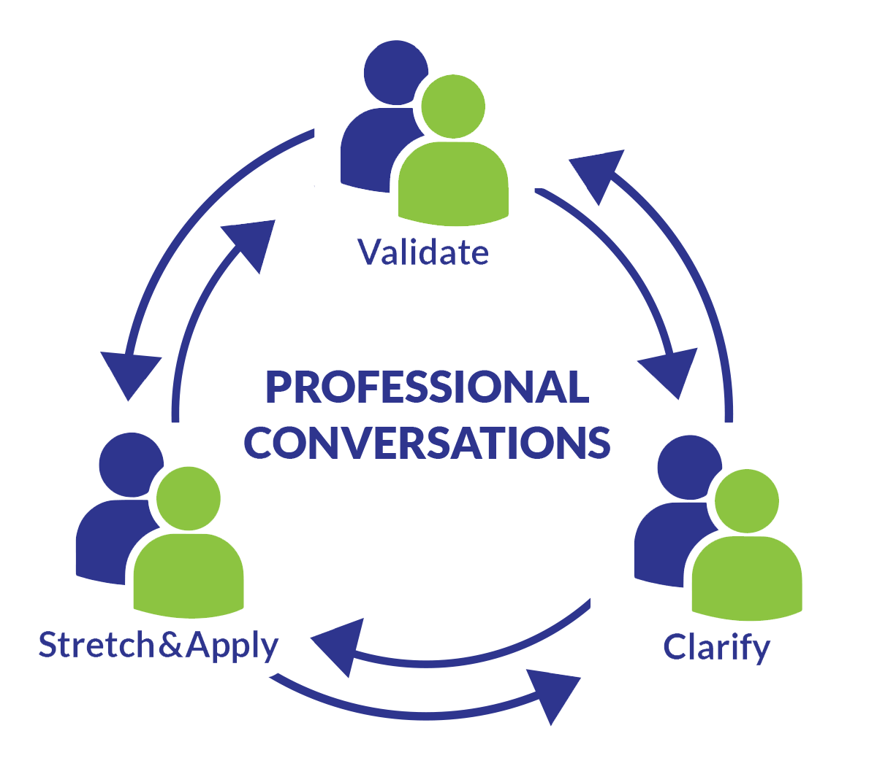
Simple, Collaborative Approach
What’s working? (Validate)
What’s challenging? (Clarify)
What are your next steps? (Stretch & Apply)
What support might I provide?
What feedback do you have for me?
Notes:
As important as providing feedback, is considering how to effectively provide that feedback. In EE, we recommend and provide guidance on using a simple feedback protocol when conducting professional conversations between educators and evaluators, educators and instructional support staff like coaches, or even just educators and their peers.
Start by validating the educator receiving feedback. What when well? What are their areas of strength? Then, clarify what the educator understands about their own practice. What were the challenges they experienced? The feedback provider should ask questions to elicit self-reflection and understanding from the educator, rather than just declaring what was observed. Finally, stretch and apply the feedback and the educator’s thinking. Ask “what are your next steps?” “How might you improve on that?” “How can you leverage your strengths to compensate for difficulties?” Encourage the educator to find solutions through questioning.
Ultimately, the feedback provider should be prepared to offer support (additional resources or feedback opportunities) and to receive feedback from the educator about their approach to the conversation, too.
This professional conversations protocol can be adapted or amplified with other models of feedback.

Slide 27
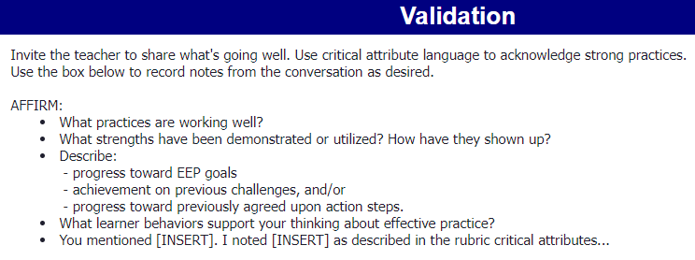
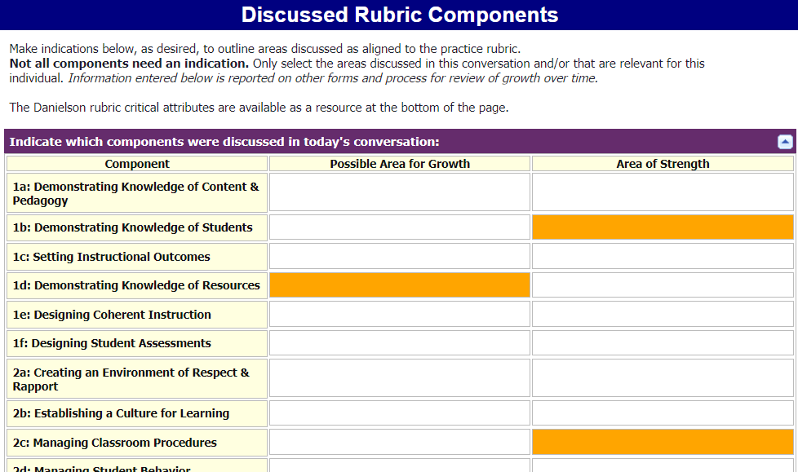
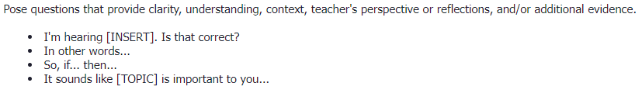
Professional Conversations Log
Professional Conversation Log: any conversation, very flexible completion
Notes:
The Professional Conversation Log can flexibly support record-keeping, growth tracking, and action steps. It can be used to document any conversation purpose (before or after an observation, beginning/middle/end-of-year)
No required fields – evaluators can determine what to include
Includes Discussed Rubric Components sections – again great flexibility in completion, but can provide a wealth of building and district data that show trends which can inform supports (coaching, mentoring, professional development)
Or tapping into local experts/leaders
Possible root causes for slow traction on SIP or continuous improvement plans

Slide 28
Professional Growth Review
Professional Growth Portfolio: "one stop shop" of current year's entries
  This Year's Goals & Focus
    Displays reports of:
    Self-review
    Goal, goals adjustments, uploaded supporting files, end-of-year self-summary on the SLO rubric
  Professional Conversation Log reports
  Artifact and observation evidence (sorted by rubric component)
  Fields to document End-of-Year Summary & Next Year Planning
Notes:
No need to open different forms to review entered information – one stop shop
Mostly reports from entries on other forms pulled together in one place

Slide 29
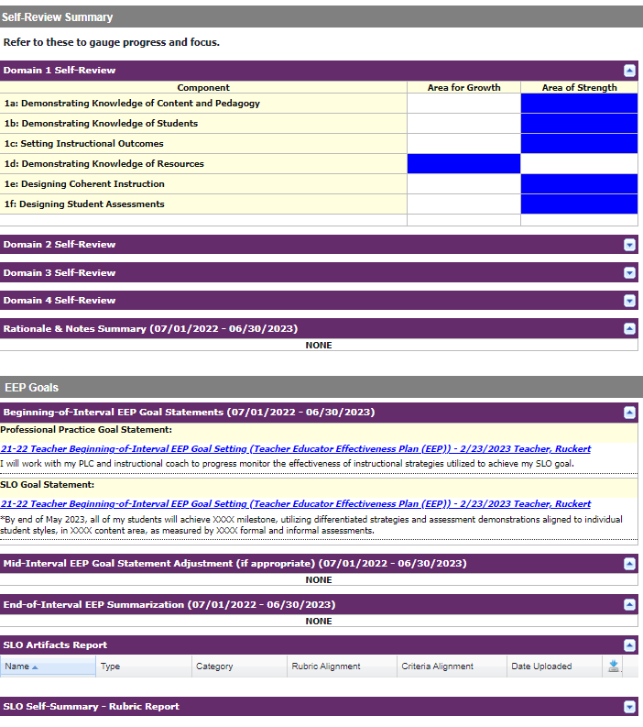
Professional Growth Portfolio (1 of 3)
This Year's Goals & Focus
Displays
Self-Review
Goal,
Goal adjustments,
Uploaded files,
End-of-year SLO summary
Enter Focus Components

Slide 30
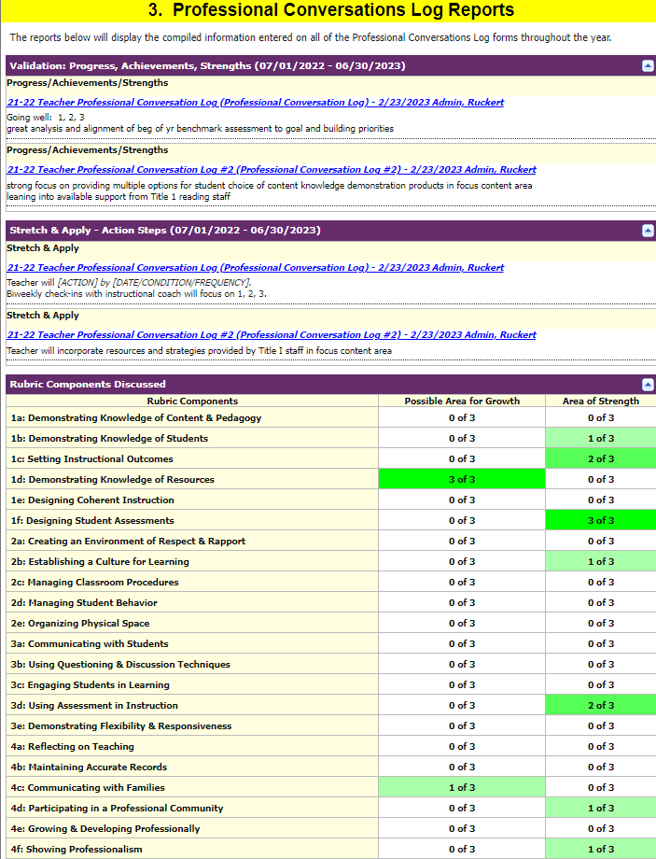
Professional Growth Portfolio (2 of 3)
Ongoing Evidence Collected
Displays
Professional Conversation Log reports
Artifacts & Observations

Slide 31
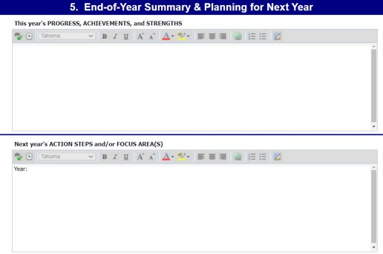
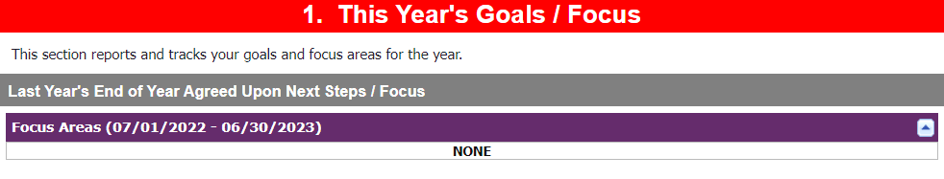
Professional Growth Portfolio (3 of 3)
End-of-Year Summary & Next Year Planning
Notes:
As you can see, this Professional Growth Portfolio puts an individual's professional growth tracking from beginning of year to end of year in one place.

Slide 32
EE Data Collection (1 of 4)
Districts must retain and be able to provide evidence of the following required EE practices.
Notes:
Per the EE Grant.
Using Frontline through DPI or CESA 6 accomplishes this requirement without additional work on the part of districts.
Districts not using Frontline or using other alternative models of EE must develop their own system for documenting evidence of compliance with the system.

Slide 33



EE Data Collection (2 of 4)
Provide WI EE System orientation and training for educators and evaluators.
Evaluators certify in the relevant rubric and districts provide ongoing monitoring of inter-rater agreement (aka calibration).
Educators complete a self-review during their evaluation cycle.
Notes:
Per the EE Grant.
Using Frontline through DPI or CESA 6 accomplishes this requirement without additional work on the part of districts.
Districts not using Frontline or using other alternative models of EE must develop their own system for documenting evidence of compliance with the system.

Slide 34



EE Data Collection (3 of 4)
Educators develop and complete at least one SLO annually.
Evaluators conduct required EE conferences, including Planning, Mid-year, and End-of-cycle conferences.
Evaluators conduct required observations of professional practice for each evaluation.
Notes:
Per the EE Grant.
Using Frontline through DPI or CESA 6 accomplishes this requirement without additional work on the part of districts.
Districts not using Frontline or using other alternative models of EE must develop their own system for documenting evidence of compliance with the system.

Slide 35
EE Data Collection (4 of 4)
Districts using Frontline have EE data collection & compliance taken care of.
Districts implementing their own EE management system (e.g., Google Classroom, etc.) or an alternative model must create a data collection management independently.

Slide 36
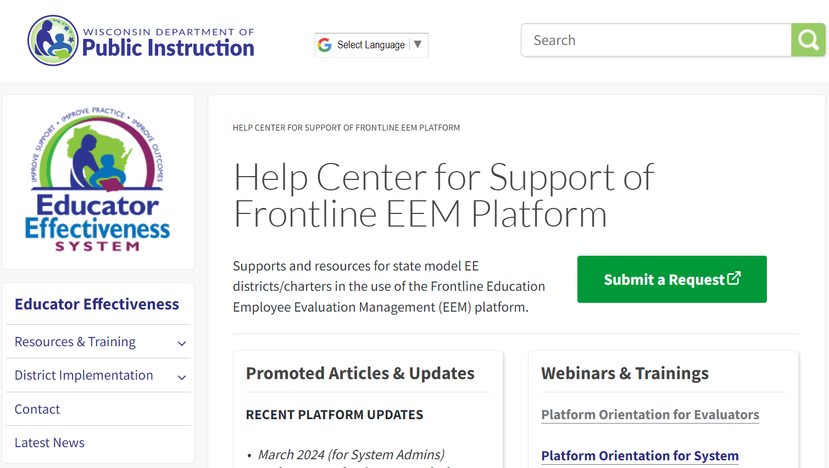
Platform Supports & Resources
DPI Help Center to Support the Frontline Platform)
Articles sorted by role
WI-specific setup and use guidance
Announcements & upcoming training opportunities
Request submission
Frontline Learning Center (must be logged in to Frontline account to access)
36

Slide 37
Next Steps for EE
DPI continues to refine and improve EE
  Recently implemented new flexibilities in 2022 to support educators and overall system improvement
  Publishing revised guidance and training this summer
  Expanding on new, robust, and time-saving training for evaluators available this summer
  Providing Free Professional Development Resources: LinkedIn Learning
37

Slide 38
Resources for Educator Effectiveness
DPI Educator Effectiveness webpage
Process Guides for Teachers and Principals
Required Evaluator of Teachers Training
Recommended Training for Principals and Evaluators of Principals
Mentoring and Induction Resources
  Mentoring and Induction Guidebook
  Mentor Training
Coaching and Professional Learning Communities
Notes:
There are many resources available for teachers, principals, and other working to implement Educator Effectiveness in their schools and districts, including:

Slide 39
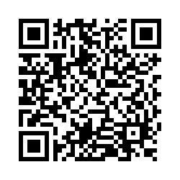
Questions?
Thank you! Thank you!
Please scan the QR code to provide us with your feedback!

