Slide 1
Free Cookies: How I Lured You to a Talk on Incident Response Best Practices
Ross Lemke
Privacy Technical Assistance Center (PTAC)

Slide 2
Incident Response

Slide 3
Why Incident Response is Important?

Slide 4
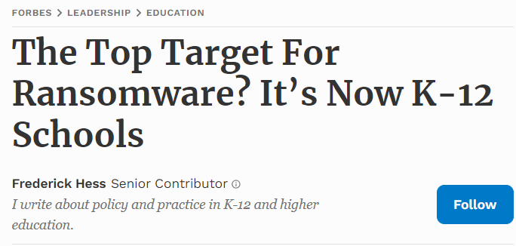
Education: THE Most Targeted Sector
30% increase in cyberattacks on schools
~650k students impacted in 2021 alone
Targeted more than healthcare and government
Notes:
According to a recent article in Forbes, studies have shown that education is targeted at a higher rate than any other industrial sector, edging out finance, healthcare, and even government sectors. The CIS reported that they are seeing 30% quarter over quarter increases in cyberattacks on K12 schools since last year.
The GAO reported that in 2021 alone more than 600k students were impacted by ransomware attacks on schools. These attacks cost schools billions of dollars and, more importantly, valuable instruction time as many schools were forced to close their doors for days or sometime weeks to recover.
Depending on whose study you look at, education has become the preferred target of sophisticated cyber actors like ransomware gangs. And the numbers don’t indicate that this trend is reversing anytime soon… especially when education is such a target rich environment.

Slide 5
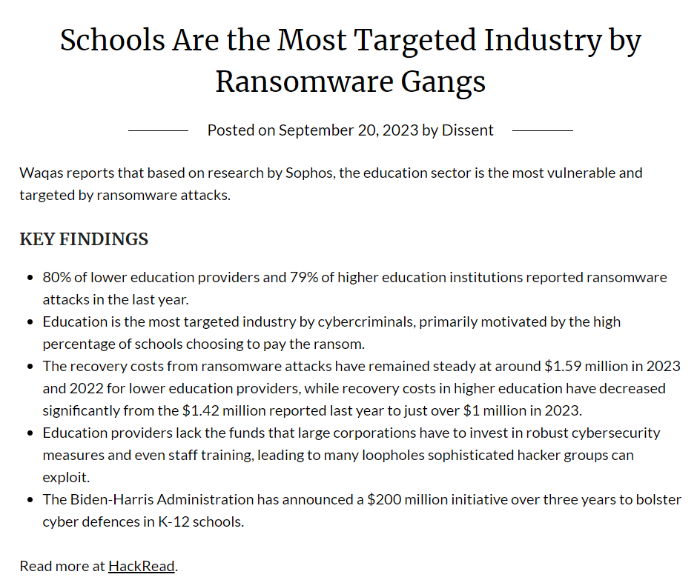
Article on Ransomware

Slide 6
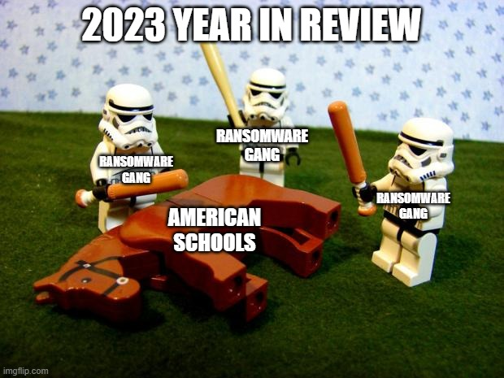
2023 year in review

Slide 7
Cliff’s Notes: You’re Gonna Get Hit
Education == Retail and Finance
Employees and Staff are going to be the way in
If it isn’t Ransomware, its going to be DDoS
Spend Time and Resources on training
Response plans and processes better be tailored to meet these threats

Slide 8
Schools are not JUST Schools
More than just student data
Health, family, financial data
Employee data
Sensitive Research data
Other agencies’ data
Payment / Commerce data

Slide 9
Data Breach Impacts to Education
Billions of dollars in costs
Downtime from days to weeks
Legal liabilities & regulatory penalties
Further targeting and attacks
Reputational harm

Slide 10
Many Laws May Apply
FERPA
IDEA
Higher Education Act (HEA)
GLBA implications & other applicable financial laws
State Laws

Slide 11
Building Robust Incident Response Capabilities

Slide 12
Incident Response is like Doomsday Preppers

Slide 13
Incident Response: What’s Inside the Box?
Key phases typically include:
Preparation: Defining the response team, roles and responsibilities, developing communication plans, and resourcing
Identification: Detecting and determining the nature of the incident.
Containment: Containing the incident, mitigating further damage
Eradication: This involves removing the threat from the affected systems
Recovery: Restoring and returning systems and networks to normal operations
Lessons Learned: Post-mortem analysis and lessons learned for process improvement
Notes:
Preparation: This is about being ready before an incident occurs. It involves setting up the response team, defining the various roles and responsibilities, developing communication plans, and ensuring that tools and resources are available to handle a cyber incident.
Identification: This step involves figuring out exactly what happened and validating the facts that are understood about the incident. The key is having the right tools and processes in place to quickly identify a security breach or threat, and enough information available to formulate a plan to address it.
Containment: Once an incident is identified, the next step is to contain it. This could be as simple as removing an infected computer, or a complicated multi-stage effort or series of efforts to get ahead of the incident. This could involve short-term or long-term strategies to containment. Short-term containment may involve isolating the affected system to prevent the spread of the incident, while long-term containment focuses on finding a permanent fix.
Eradication: This involves removing the threat from the affected systems, severing command and control channels for attackers, deploying patches or hotfixes, or deleting malicious files and closing security gaps that were exploited.
Recovery: In this phase, the affected systems and devices are restored and returned to normal operations. This phase can often be the most difficult, as it is sometimes impossible to fully return to pre-incident functionality, or it may take quite a while to fully restore these systems. This phase also typically involves intensive monitoring for any signs of recurrence of the threat.
Lessons Learned: After managing the incident, the team reviews and analyzes what happened, how it was handled, and what could be improved. This stage is crucial for evolving the response plan and improving overall security posture.
Note on Communication: Effective communication is vital throughout all stages of incident response. This includes internal communication within the team and organization, as well as external communication with stakeholders, customers, and possibly the public or regulatory bodies.
A well-crafted cybersecurity incident response plan is tailored to the specific needs and risks of the organization. It's not a static document but rather a living one that should be regularly reviewed and updated to reflect the evolving cyber threat landscape and changes within the organization.

Slide 14
Step #1: Have a Plan
Failure to plan is planning to Fail…
You Need an Incident Response Plan

Slide 15
Incident Response Plans
“An Incident Response Plan is a written document, formally approved by the senior leadership team, that helps your organization before, during, and after a confirmed or suspected security incident.” -CISA
Defines the Purpose / Mission
Identifies Roles & Responsibilities
Sets organizational priorities
Determines response thresholds
Outlines response processes
Creates standards for documentation & metrics
Establishes compliance & review timelines

Slide 16
Putting a Plan Together
Preparation
Identification
Containment
Eradication
Recovery
Lessons Learned
Notes:
The purpose of an incident response plan is to ensure that you are prepared to quickly and methodically address a potential incident in a manner that is expedient, meticulous, compliant, and manageable. The plan is the playbook for how and organization will respond and should have elements which provide structure, set expectations, aid in communications, and establish the metrics for success at each phase of the incident response process.
The plan should, for example:
Lay out the reporting process, defining an incident and establishing metrics
Identify the structure, composition, and authority of the incident response team
Define timelines, provide communications and

Slide 17
Putting a Plan Together
Determine the “Musts”
Define your Stakeholders
Obtain leadership buy-in
Understand what you have
Evaluate the threat
Perform a risk-assessment

Slide 18
Perform Annual Risk Assessments
“The process of identifying the risks to system security and determining the probability of occurrence, the resulting impact, and the additional safeguards that mitigate this impact.”
-National Institute of Standards and Technology (NIST)
Notes:
Every organizations systems change over time, and threats evolve continuously. What is secure today may not be secure tomorrow and will certainly not face the same risks in a year’s time. Therefore it is critical for organizations to continually re-assess the risks to their systems and data and leverage these opportunities to make changes in policy, processes and security / privacy controls to address the ever changing threat landscape.
Risk assessments not only give you the ability to adapt your defenses to changing conditions, they also provide a great natural point in which to conduct cyber exercises and outreach to users to address privacy and security threats. We recommend performing risk assessments annually, or when major system changes occur. Performing these assessments is HOW the organization gains an understanding of risk. Without this understanding, you might as well be pulling cybersecurity solutions out of a hat at random.

Slide 19
What is a Risk Assessment?
Formal organizational process involving leadership, IT, and organizational stakeholders
Four stages:
Identification – finding, documenting, and categorizing risks
Analysis – ascertaining the nature of the risks and determining their potential impact and effects
Evaluation – applying organizational risk tolerance and existing controls to the risk to determine significance
Control – identifying and applying mitigating controls to reduce the risk based on analysis

Slide 20
Continuous Re-Assessment
Incident response plans are tailored to threats
Threats change over time
Risk-assessments drive understanding of the threat
Periodically perform risk assessments and leverage the results to enhance incident response
Tie these processes together with training and awareness to supercharge your preparedness and resilience

Slide 21
Incident Response Teams
There are two key success factors to good Incident Response Team performance.
The right Team
&
Somebody in-charge
Notes:
Identify the Core members of the team by name or by position
Name an Incident Manager who is responsible for all aspects of the process

Slide 22
Incident Response Team
Incident Response Teams are groups tasked with the response, management, and recovery of security and privacy incidents.
CORE
AD-HOC
Leadership
Legal
Communications / PA
IT
Vendors / Partners
Law Enforcement
Facilities
State Agencies

Slide 23
Incident Response Team Responsibilities
Assess, analyze, and manage incidents from initial reporting to out-brief
Speed recovery, ensure threat data flow, contain the incident
Coordinate with stakeholders, decisionmakers, regulatory bodies, and communicate
Documentation & reporting of response actions
Post-incident analysis, prevention, education, and training
Notes:
Incident Detection and Analysis: One of the foremost roles of the CIRT is to monitor the organization's networks and systems for signs of security incidents. They use various tools and techniques to detect, log, and analyze incidents to understand their nature and scope.
Incident Containment: Upon detecting an incident, the team works swiftly to contain it. This can involve isolating affected systems or networks to prevent the spread of the incident and to minimize damage.
Eradication and Recovery: The team then focuses on eliminating the threat from the organization's environment. This could involve removing malware, closing security gaps, and applying patches. Following eradication, the CIRT works on restoring systems and services to full functionality, ensuring that they are free from threats.
Communication and Coordination: Effective communication is essential during a cybersecurity incident. The CIRT communicates with relevant stakeholders, including management, IT staff, and potentially external parties like law enforcement, vendors, or customers. They provide updates, instructions, and reports about the incident’s status.
Documentation and Reporting: Documenting the incident and the response actions is critical for legal, regulatory, and learning purposes. The CIRT prepares detailed reports about the incident's nature, the response actions taken, and the lessons learned.
Post-Incident Analysis: After resolving the incident, the CIRT conducts a post-mortem analysis to understand what happened, why it happened, and how similar incidents can be prevented or better managed in the future. This analysis leads to improvements in security policies, procedures, and technologies.
Prevention and Education: The CIRT is often involved in developing strategies to prevent future incidents, including recommending security enhancements and conducting awareness training for employees.
Legal and Regulatory Compliance: In many cases, the CIRT is responsible for ensuring that the organization’s response to an incident complies with legal and regulatory requirements, which may involve reporting incidents to relevant authorities and managing any legal implications.

Slide 24
Who’s in Charge Here? The Role of the Incident Manager
Acts as the coordinator and focal point for the response efforts
Key Responsibilities Include:
Incident Coordination & Mgmt
Communication
Decision Making
Strategy & Planning
Resource Allocation
Post-Incident Review
Compliance Considerations
Process Improvement
Training & Awareness
Notes:
The Incident Manager plays a critical role in the cybersecurity incident response process, acting as the coordinator and focal point for the response efforts. Their responsibilities are extensive and pivotal to the effective management of a cyber incident. Key roles of an Incident Manager in cybersecurity incident response include:
Incident Coordination and Management: The Incident Manager oversees and coordinates all aspects of the incident response. This includes activating the incident response team, delegating tasks, ensuring that team members have the resources they need, and managing the overall response to ensure it's efficient and effective.
Communication and Information Flow: They are responsible for ensuring clear and effective communication within the incident response team and with external stakeholders. This includes providing regular updates to management, liaising with external partners (such as law enforcement or cybersecurity firms), and coordinating with other departments in the organization.
Decision Making: The Incident Manager makes crucial decisions during the response process, such as determining the severity of the incident, deciding on containment strategies, and when to escalate the issue to higher management or external agencies.
Strategy and Planning: They develop and implement strategies for responding to the incident, often making rapid decisions based on the evolving situation. This involves understanding the nature of the incident and determining the most effective approach to manage it.
Resource Allocation: The Incident Manager assesses and allocates the necessary resources – which could be technical, human, or financial – to effectively address the incident. This includes ensuring that the response team has the tools and support needed to perform their tasks.
Monitoring and Reporting: They monitor the progress of the incident response, track the effectiveness of the actions taken, and report on the status and outcomes of the response efforts to relevant stakeholders.
Compliance and Legal Considerations: Ensuring that the incident response complies with legal and regulatory requirements is a key part of their role. This might involve coordinating with legal counsel, handling evidence correctly, and ensuring that reporting obligations are met.
Post-Incident Review and Improvement: After the incident is resolved, the Incident Manager leads the post-incident review process. This includes analyzing what happened, what was done to respond, what worked well, and what could be improved. They then work on updating the incident response plan and processes based on these insights.
Continuous Improvement: They are responsible for continuously improving the incident response process. This involves staying informed about new threats, trends in cybersecurity, and evolving best practices.
Training and Awareness: The Incident Manager often plays a role in training and awareness activities within the organization, helping to educate employees about cybersecurity risks and the importance of incident reporting.
In essence, the Incident Manager is the orchestrator of the incident response, ensuring that the response is swift, effective, and coordinated, and that the organization can recover and learn from the incident.

Slide 25
Let’s Talk IR Secret Sauce
Secrets to *less Painful Incident Response:
Not Owned by IT
Includes Legal Counsel & Public Affairs
Starts with Validation
Continuous review & testing
Incorporates lessons learned

Slide 26
Privacy & IT Security Training
Annual threat awareness training for all employees, faculty, administrators, students
Focusing on cyber-hygiene, social engineering awareness, and threat reporting
Great time to revisit AUP and employee expectations for security

Slide 27
Leadership Involvement
Formal policy & plan
Publicized and socialized throughout the organization
Supported by reporting & feedback mechanisms
Policy should assign roles and responsibilities, including leadership presence on IRT
Absolutely NOT just an IT thing!

Slide 28
Legal Eagles
Legal Counsel is a huge benefit in incident response. This could be your local counsel, outside counsel (or even cyber-insurance company).
Often confusing legal requirements
Need to protect organizational interests
Interfacing with Law Enforcement & State entities

Slide 29
Communications is KEY
Think about including Public Affairs / Communications representatives in your IRT. Message is the often the hardest part of a response
Ransomware & DDoS require some ‘splaining
Need concise, clear, consistent messaging both internally and externally
Frees up critical response resources
Consistency of messaging conveys reassurance that the response is under control

Slide 30
Start Strong….
Not everything is a data breach (see legal counsel)
Every response should begin by VALIDATING the incident
Ensure the reports are correct and accurate
Establish the basis of fact before you begin to throw switches and sound sirens
Jumping the gun is as bad as being slow to react

Slide 31
Would you like to play a game?
Threats evolve, so should your Incident Response plan!
Periodic risk assessments
Annual IR exercise
Involve third-parties, vendors, and partners
Use as an opportunity to talk to law enforcement, cyber-insurance reps, contractors, etc.

Slide 32
Tabletop Exercises
Simulated incident response based on carefully selected scenarios, where the IRT sits down and walks through a response.
Build IRT cohesiveness and confidence
Establish lines of communication
Identify problem areas and streamline the IRP
Ensure process and plans are extensible to the widest spectrum of incidents

Slide 33
Data Breach Resources
Downloadable Data Breach Training Kits
https://studentprivacy.ed.gov/resources/data-breach-scenario-trainings
New Expansion
Pack Available!

Slide 34
Feedback Loops
“The most neglected part of the incident response plan is the part where you remember all the mistakes you made and fix them for next time”
-Me

Slide 35
Feedback Loops
Every organization should document their process and capture important data for process improvement:
What worked well?
What didn’t work at all?
Did we miss something?
What can we do better?

Slide 36
Let’s Talk Over Some Examples

Slide 37
Example #1
LA Unified School District
LAUSD attacked by Vice Society in September 2022
Superintendent held a press conference downplaying rumors that highly sensitive information had been released on the Dark Web
Only some “outliers” of critically sensitive PII
Senior IT managers put out statements claimed “Los Angeles Unified takes student, family and employee privacy very seriously and has been implementing enhanced protections and procedures to ensure our data security,”

Slide 38
Example #1
The truth of the matter was that around 500 Gigabytes of highly sensitive PII was released
Some estimated put the tally at thousands of students’ psychological evaluations were included in the data dump
Additionally, the data included:
Scanned Social Security cards
Passport information
Financial records
Personnel files
Notes:
“We have seen no evidence that psychiatric evaluation information or health records, based on what we’ve seen thus far, has been made available publicly,” said Alberto Carvalho (LAUSD Superintendent)

Slide 39
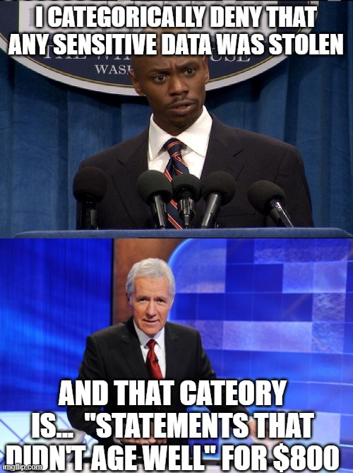
Example #1 – What can we take away
Communications is the key
You can’t un-ring the bell
Concise, honest, transparent, unspeculative statements are the best policy
Obfuscating, downplaying, or withholding information is a recipe for disaster

Slide 40
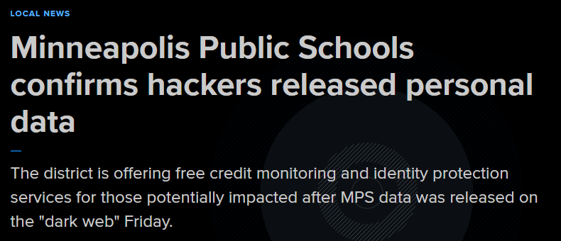
Example #2
Minneapolis Public Schools

Slide 41
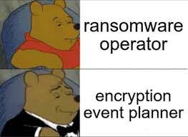
Example #2
MPS systems went down due to what they termed an “Encryption Event”
The school claimed it paid no ransom and that there was no evidence that any data accessed was used to commit fraud

Slide 42
Example #2
Don’t invent cutesy terms to obfuscate what you know to be true. Calling it an “encryption event” doesn’t fool anyone and sounds awful
Just because you can’t point to a specific instance of fraud and determine that it was the result of data from breach… doesn’t mean people don’t need to know about it.
Notes:
One week later… it’s not longer just technical difficulties dealing with an “encryption event”, but a full fledged ransomware attack where the attackers not only accessed private data, but posted it on the dark web for everyone to see.

Slide 43
Example #2
Notes:
This is another example of the communications piece of incident response tarnishing what would have otherwise been a very quick and timely recovery effort. The technical tasks were accomplished quickly and efficiently, restoring critical systems to use and getting students back to school.
Instead, the cybersecurity blogosphere coined a new term “unplanned encryption event” and the memes (while awesome and funny) mean that things did not go so well.

Slide 44
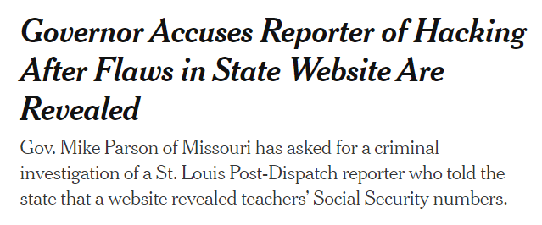
Example #3
Dear Missouri,
CTRL + U is NOT a crime

Slide 45
Example #3
The web page in question contained social security numbers in the source code of the website
Reporters were able to access this information by simply viewing the HTML source code in the browser
The Gov. of the State of Missouri is seeking the criminal prosecution of a reporter who literally pressed “Control + U” and read the code
Notes:
This is NOT how you win at data breach response. There are a few things wrong with this example… well, way more than three but we’ll stick to the biggest.
Data in the HTML code of a website is INTENDED to be read by the receiving browser, it is not and SHOULD NEVER BE considered secure unless you apply some other forms of protection to it.
A reporter looking at the HTML code is NOT hacking… and anybody who thinks it is has a fundamentally incorrect understanding of data security
I better solution would have been to express regret over the incident, thank those who brought it forward for disclosing in a responsible way by notifying the school first before running the story. And then to lay out corrective steps that were taken and what processes or procedures have been altered or improved to ensure that this doesn’t happen again.

Slide 46
Example #4
San Benito Schools
Around November 1, 2022, the district was successfully attacked by the Karakurt ransomware gang
The incident resulted in the breach of 25-30k students’ and employees’ data
According to reports, the schools IT director was fired after reporting the breach to authorities

Slide 47
Example #4
After some time investigating, the school had still not made any statements notifying the victims that their information was stolen.
This led to the District Attorney to get involved. Once again, its hardly ever the technical response that gets you in trouble.

Slide 48
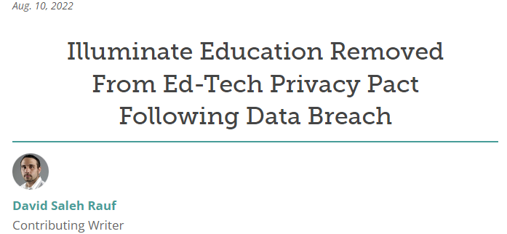
Example #5
You didn’t think we would forget this one, did you?

Slide 49
Example #5
What happened?
In early January 2022, the company identified unauthorized access to applications in its environment
These applications hosted databases that contained PII from students including names, grades, behavior information, special education data, and demographic data.
Ultimately, almost 2 million students across the country were impacted by the breach
The company waited nearly two months to make its first notifications and went nearly radio silent after that
Notes:
This is an example of why continued communications is important. As the scope grew, the company became quieter. The notifications and specifics were so thin that many were wondering if this impacted them and to what extent. People didn’t know what it meant, or if their information was really stolen.

Slide 50
What Went Wrong
Communications
Incident response is not an exercise in marketing
The fastest way to snatch defeat from the jaws of victory is to try to spin your way out of a breach
Be Clear, Be Concise, Be Transparent, State the FACTS!
The technical response in these cases was great, but the overall response was a failure because of the communications problems

Slide 51
Example #6

Slide 52
Example #6
LRSD suffered a ransomware attack on November 11, 2022
They quickly implemented their incident response teams and obtained outside experts to assist
Within two weeks they had notifications thoroughly explaining what happened, and a website with Q&A for impacted individuals

Slide 53
Example #6
They immediately began a comprehensive and open dialog with the public explaining what happened
Their technical response worked in parallel to restore services
Their website was frequently updated and spokespeople representing the school made statements regularly with updates
While there was some controversy around the decision to pay the attackers being held in confidence, the victims were aware and involved
Notes:
Now we like to use this as a example of a good response communications job, but even here it is not without controversy. The school board met in secret to decide to pay the attackers 250k to end the attack, a decision that was subsequently and vigorously debated in public. But even this event was well within a single month of the incident itself.
Where some of our examples and many others happening out there right now take months upon months to make any notifications at all.. This incident was all happening within the span of a single month from the date of the attack. Individuals impacted were aware within days of the attack and were able to take action.
And that is the key here. Successful response isn’t about getting away with things… its about remediating the threat… not only to you and your organization, but to the victims themselves. It is no help when attackers have had your financial data for six months and only then do you find out. Victims need to know as early as possible to ensure that they can protect themselves.

Slide 54
What Are the Takeaways?
Incident response is about competing priorities:
You want to protect your reputation and look out for your organization’s interests
But you have a responsibility to protect those people impacted by the breach as well

Slide 55
What Are the Takeaways?
Incident response is about competing priorities:
The “investigation” is often used as an excuse to avoid airing the bad news
Weigh the harms and determine if there is a need to delay notifications, or if more investigation is really needed to avoid speculation

Slide 56
Final Food for Thought
You should have an incident response plan in place and train to it
Data privacy & security awareness training for all employees, as well as contractors, researchers, and other 3rd parties
Clearly understand the legal requirements for compliance with all applicable federal, state and local laws
Consider calling PTAC, we can help!!!

Slide 57
PTAC Resources
Data Breach Response Checklist
https://studentprivacy.ed.gov/resources/data-breach-response-checklist
Downloadable Data Breach Training Kits
https://studentprivacy.ed.gov/resources/data-breach-response-training-kit
PTAC Student Privacy Training
Videos - https://studentprivacy.ed.gov/content/guidance-videos
Online Training Modules - https://studentprivacy.ed.gov/content/online-training-modules

Slide 58
Contact information
United States Department of Education,
Privacy Technical Assistance Center
(855) 249-3072
(202) 260-3887
privacyTA@ed.gov
https://studentprivacy.ed.gov
Notes:
Here is the contact information for PTAC. If you ever have a question regarding FERPA or student privacy, please do not hesitate to give us a call or send us an email. Our website is also a great resource for guidance on a variety of FERPA and student privacy issues that may answer questions you have. Thank you all for joining us for this webinar.

