Slide 1
Pupil Count for Membership
Reporting Data Through WISEdata API
Jennifer Buros - Presenter
Assistant Director
Jaidaa Shafaei
Scrum Master / Product Owner
March 2024

Slide 2
Agenda
What is the Reporting Requirement in 2024-25?
Why the Pilot Project?
How Does the Pupil Count Module in WiSFiP Work?
Reminders
Resources

Slide 3
What is the Reporting Requirement in 2024-25?
Official reporting will occur via the State Aid Financial Reporting (SAFR) portal.
Data quality issues should be addressed in source system (SAFR) and data should be resubmitted to WiSFiP and SAFR
Notes:
Matt

Slide 4
Extended Timeline
Timeline | Details
July 1, 2022 – June 30, 2023: | Phase 1 of Pilot
July 1, 2023 – June 30, 2024: | Phase 2 of Pilot; performance benchmarks must be met to move to dual reporting; decision late spring 2024
July 1, 2024 – June 30, 2025: | Tentative: Dual Reporting between PI-1563 and WiSFiP Pupil Count module
July 1, 2025 – June 30, 2026: | Tentative: PI-1563 retired and collection through WiSFiP Pupil Count module and additional WiSFiP reporting

Slide 5
Why the Pilot Project?
To ensure that all the data elements in WISEdata are perfectly aligned with the Membership Pupil Count reporting requirements
To provide LEAs an opportunity to compare systems
To provide SIS vendors an opportunity for their LEAs to use their product and provide feedback
To provide DPI feedback on the WiSFiP interface and usability
Notes:
Matt

Slide 6
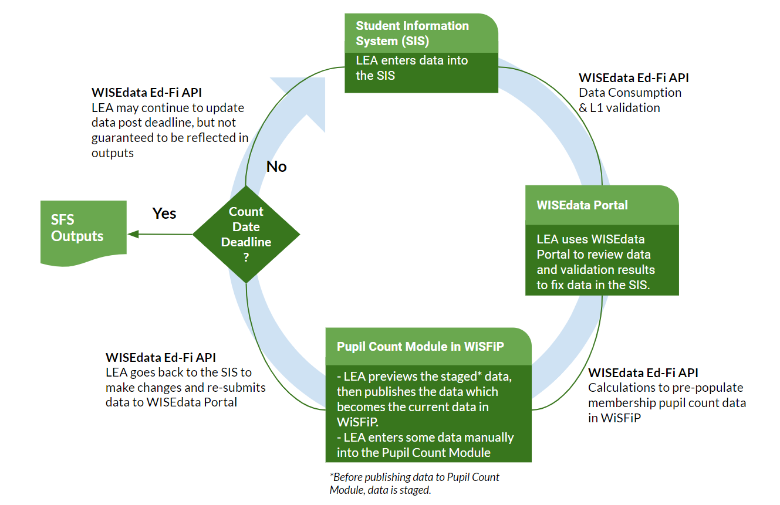
How Does the Pupil Count Module in WiSFiP Work?
Notes:
Jaidaa
DPI will be retiring the old way for collecting the PI-1563 report through SAFR Portal, and we’re introducing a new way of collecting membership pupil counts from LEA’s through the SIS and in the Pupil Count Module in WiSiFiP, Wisconsin School Finance Portal.
In the new process, LEAs will submit membership related attributes to WISEdata Portal and the counts are going to be pre-filled in WiSFiP.
Once data is sent from the SIS, it’ll land in WISEdata Portal. In the Pupil Count Module, the LEA gets to stage the data and preview it before they publish their counts to WiSFiP. Once the data is published, the counts become current and will be reflected by grade level and categories.
There are some data that the LEAs will need to enter manually in the Pupil Count Module in WiSiFiP.

Slide 7
How Does the Pupil Count Module in WiSFiP Work? Steps 1-4
Step 1, Student Information System (SIS): LEA enters data into the SIS (student information system).
Step 2, WISEdata Ed-Fi API: If invalid or incomplete data is submitted, level 1 validation rules will reject the data before it can be displayed on the WISEdata Portal.
Step 3, WISEdata Portal: Once LEA submits data from the SIS to the WISEdata Portal, the data undergoes analysis for accuracy through a validation cycle. Business rules are applied to the data and processed by DPI. Depending on data quality, validation messages are generated to provide feedback on items requiring review and/or correction.
Step 4, WISEdata Portal: LEA utilizes the WISEdata Portal to review data and validation results, making necessary corrections in the SIS.
Notes:
Jaidaa
DPI will be retiring the old way for collecting the PI-1563 report through SAFR Portal, and we’re introducing a new way of collecting membership pupil counts from LEA’s through the SIS and in the Pupil Count Module in WiSiFiP, Wisconsin School Finance Portal.
In the new process, LEAs will submit membership related attributes to WISEdata Portal and the counts are going to be pre-filled in WiSFiP.
Once data is sent from the SIS, it’ll land in WISEdata Portal. In the Pupil Count Module, the LEA gets to stage the data and preview it before they publish their counts to WiSFiP. Once the data is published, the counts become current and will be reflected by grade level and categories.
There are some data that the LEAs will need to enter manually in the Pupil Count Module in WiSiFiP.

Slide 8
How Does the Pupil Count Module in WiSFiP Work? Steps 5-8
Step 5, Pupil Count Module (in WiSFiP): LEA previews the staged* data, then publishes it, becoming the current data in WiSFiP. Some data is manually entered. *Before publishing data to Pupil Count Module, data is staged.
Step 6, WISEdata Ed-Fi API: Calculations are performed to pre-populate membership data in the Pupil Count Module in WiSFiP.
into the Pupil Count Module
Step 7, Pupil Count Module (in WiSFiP): LEA reviews data in various screens within the Pupil Count Module and returns to the SIS to make changes. Subsequently, they re-submit data to the WISEdata Portal as needed.
Step 8, Count Date Deadline:
Yes! SFS Outputs.
No! (Back to Step 1) LEA may continue updating data in the SIS, sending it to the WISEdata Portal, and staging and publishing changes in the Pupil Count Module.

Slide 9
Needed Data for Membership Pupil Count
The student enrollment record (StudentSchoolAssociation)
Enrollment Type: Primary, Coursework, Membership
Primary School: Yes, No
Residency Period:
Residency Status
Resident District
Begin Date
End Date
Full-Time Equivalency
Part-Time Instructional Minutes (for less than full-time enrollment)
Count Date Name:
3rd Friday of September - Membership
2nd Friday of Jan - Membership
First Friday of May (MPS only)
Count Date Receiving Service: Present, Absent, and Not Receiving Services
Specific student program data (StudentProgramAssociation)
Program Type: Other
Program Name: Challenge Academy, and 5 yr old Blended
Notes:
Jaidaa

Slide 10
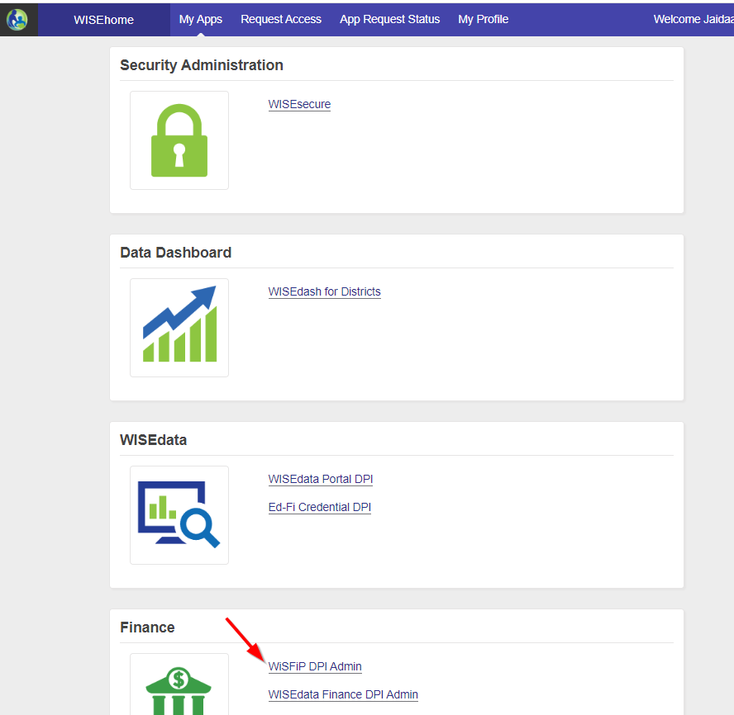
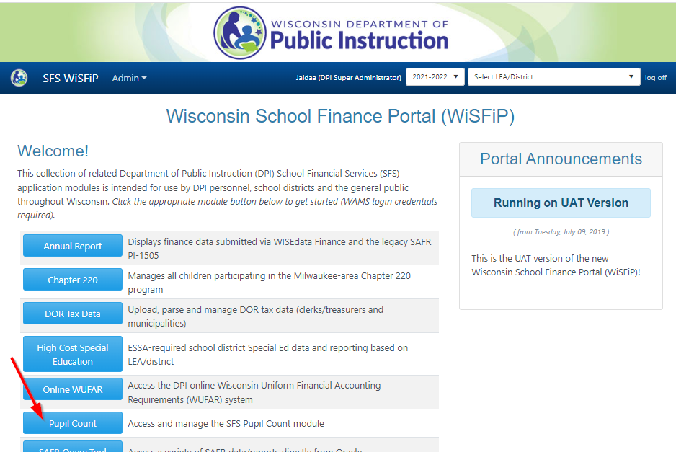
WiSFiP Application
Notes:
Log into WISEhome, then navigate to WiSFiP DPI. Once you’re in the Wisconsin School Finance Portal (WiSFiP), click the Pupil Count tile.

Slide 11
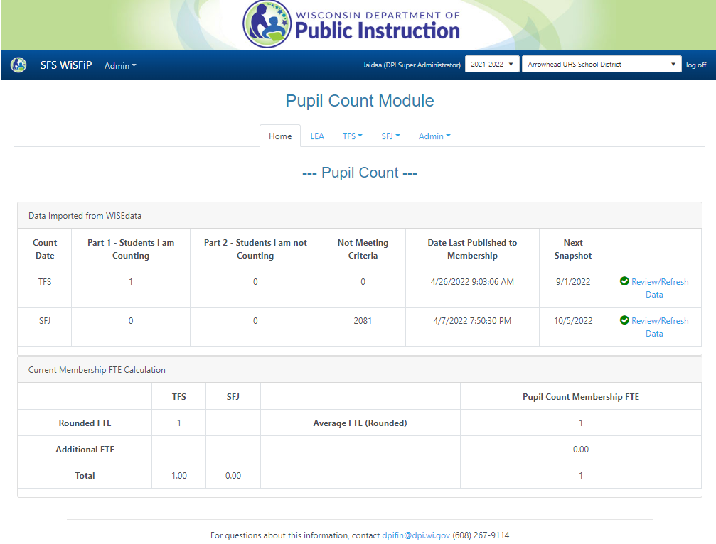
WiSFiP: Home Screen (1 of 3)
The ‘Home’ screen displays data imported from WISEdata and some key metrics.
LEAs may review new data before they publish it to be the current membership FTE for each count date.
Notes:
The Home screen:
Data Imported from WISEdata: displays data that comes from WDP (through the SIS). It shows the Students I am Counting, and Students I am Not Counting for each Count Date.
In the old process, LEAs reported counts by: [Step 1 - Step 2 - Step 3 + Step 4 + Step 5 = Total Pupil Headcount]
Step 1 (head count): counts all the students attending the district including residents enrolled in. This Step is adjusted in WiSFiP
Step 2 (non-resident enrolled-in reduction): deducts residents enrolled in counts from step 1. This is because these students are counted by the resident district and not the attending district.
Step 3 (resident reduction): calculates the actual student head count and deducts from step 1, and deducts students who are outside of max age who are counted in step 1.
Step 4 (resident enrolled-out): adds students who are enrolled out, but not counted in step 1.
Step 5 (non-resident addition): adds students who attend non-resident districts but primarily homeschooled.
The new process, we eliminated the need to add all and then deduct them. Instead, LEAs only count the students that qualify to be counted for membership, else don't count them.
DPI shows the LEA membership counts in two parts: Part 1 - Students I am counting, and Part 2 - Students I am not counting
Current Membership FTE Calculation: shows the FTE calculation for each count date. This grid is similar to how the data is displayed in the FTE Reports in SAFR.
When LEAs first log into WiSFiP you’ll see zeros. When you click on “Review/Refresh Data” you’ll go to a page in which you can stage and publish your data. (Click)

Slide 12
WiSFiP: Home Screen (2 of 3)
When LEAs first log into WiSFiP you’ll see zeros. When you click on “Review/Refresh Data” you’ll go to a page in which you can stage and publish your data.
Notes:
The Home screen:
Data Imported from WISEdata: displays data that comes from WDP (through the SIS). It shows the Students I am Counting, and Students I am Not Counting for each Count Date.
In the old process, LEAs reported counts by: [Step 1 - Step 2 - Step 3 + Step 4 + Step 5 = Total Pupil Headcount]
Step 1 (head count): counts all the students attending the district including residents enrolled in. This Step is adjusted in WiSFiP
Step 2 (non-resident enrolled-in reduction): deducts residents enrolled in counts from step 1. This is because these students are counted by the resident district and not the attending district.
Step 3 (resident reduction): calculates the actual student head count and deducts from step 1, and deducts students who are outside of max age who are counted in step 1.
Step 4 (resident enrolled-out): adds students who are enrolled out, but not counted in step 1.
Step 5 (non-resident addition): adds students who attend non-resident districts but primarily homeschooled.
The new process, we eliminated the need to add all and then deduct them. Instead, LEAs only count the students that qualify to be counted for membership, else don't count them.
DPI shows the LEA membership counts in two parts: Part 1 - Students I am counting, and Part 2 - Students I am not counting
Current Membership FTE Calculation: shows the FTE calculation for each count date. This grid is similar to how the data is displayed in the FTE Reports in SAFR.
When LEAs first log into WiSFiP you’ll see zeros. When you click on “Review/Refresh Data” you’ll go to a page in which you can stage and publish your data. (Click)

Slide 13
WiSFiP: Home Screen (3 of 3)
In the old process, LEAs reported counts by: [Step 1 - Step 2 - Step 3 + Step 4 + Step 5 = Total Pupil Headcount]
The new process, we eliminated the need to add all and then deduct them. Instead, LEAs only count the students that qualify to be counted for membership, else don't count them.
Notes:
The Home screen:
Data Imported from WISEdata: displays data that comes from WDP (through the SIS). It shows the Students I am Counting, and Students I am Not Counting for each Count Date.
In the old process, LEAs reported counts by: [Step 1 - Step 2 - Step 3 + Step 4 + Step 5 = Total Pupil Headcount]
Step 1 (head count): counts all the students attending the district including residents enrolled in. This Step is adjusted in WiSFiP
Step 2 (non-resident enrolled-in reduction): deducts residents enrolled in counts from step 1. This is because these students are counted by the resident district and not the attending district.
Step 3 (resident reduction): calculates the actual student head count and deducts from step 1, and deducts students who are outside of max age who are counted in step 1.
Step 4 (resident enrolled-out): adds students who are enrolled out, but not counted in step 1.
Step 5 (non-resident addition): adds students who attend non-resident districts but primarily homeschooled.
The new process, we eliminated the need to add all and then deduct them. Instead, LEAs only count the students that qualify to be counted for membership, else don't count them.
DPI shows the LEA membership counts in two parts: Part 1 - Students I am counting, and Part 2 - Students I am not counting
Current Membership FTE Calculation: shows the FTE calculation for each count date. This grid is similar to how the data is displayed in the FTE Reports in SAFR.
When LEAs first log into WiSFiP you’ll see zeros. When you click on “Review/Refresh Data” you’ll go to a page in which you can stage and publish your data. (Click)

Slide 14
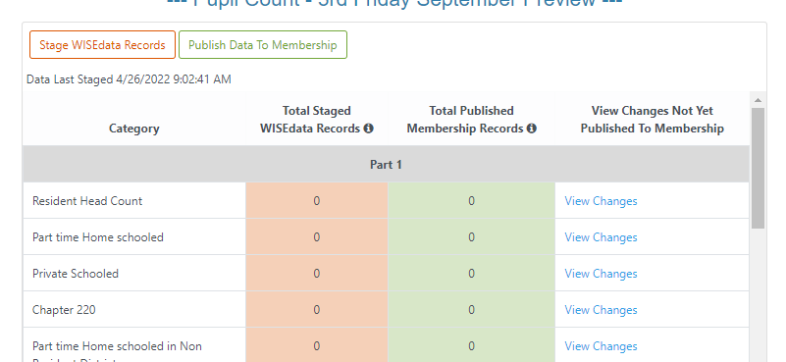
WiSFiP: Staged Data
Stage: pulls the data from WDP into WiSFiP and it breaks it down by category (e.g. Resident Head Count, Part-time Home-schooled, etc.)
Notes:
Data view with ability to sort and filter on columns.
Export to Excel

Slide 15
WiSFiP: Published Data
Publish: updates the Home screen to show the counts there. The data on the Home screen is what will be used for reporting.
Notes:
Data view with ability to sort and filter on columns.
Export to Excel

Slide 16
WiSFiP: View Changes (1 of 2)
View Changes: provides differences between what is in ‘Staged’ data and ‘Current’ to allow users to easily see differences prior to committing to pushing staged data to current.
Data view with ability to sort and filter on columns.
Export to Excel
Notes:
Data view with ability to sort and filter on columns.
Export to Excel

Slide 17
WiSFiP: View Changes (2 of 2)

Slide 18
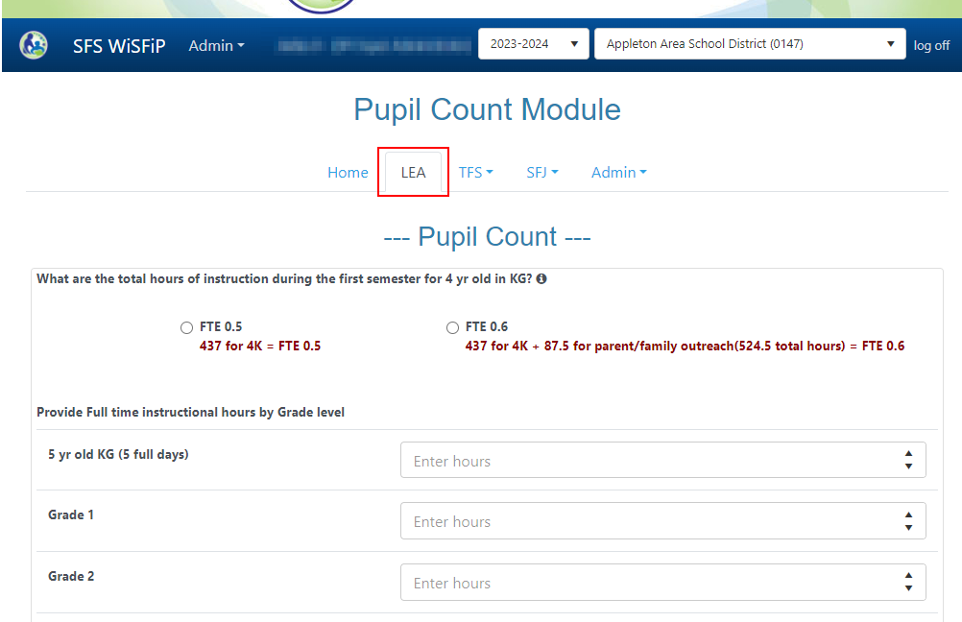
WiSFiP: LEA Screen
The LEA screen: is where LEAs enter the hours for grades, which are used for part-time instruction minutes.
This data is manually entered by LEAs

Slide 19
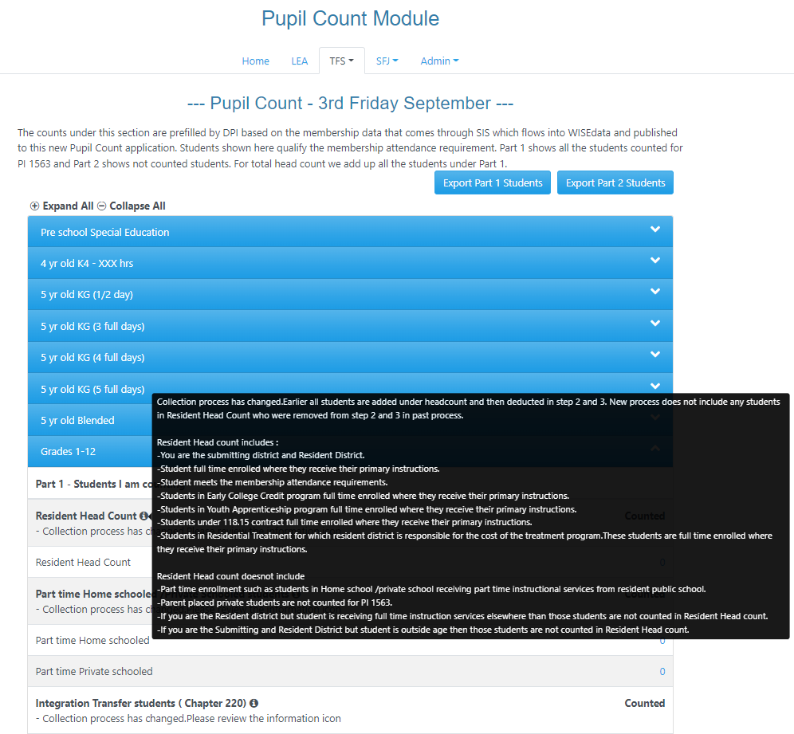
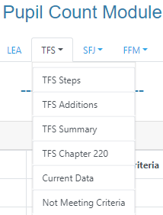
WiSFiP: LEA Screen, TFS Steps
The Steps page for the count date (TFS, TFJ, FFM) includes data for each grade level.
The grade level panels are collapsed by default. Expanded views include pupil count categories under Part 1: Students I’m counting, and Part 2: Students I’m not counting.
SFJ and FFM will have the same functionality replicated.

Slide 20
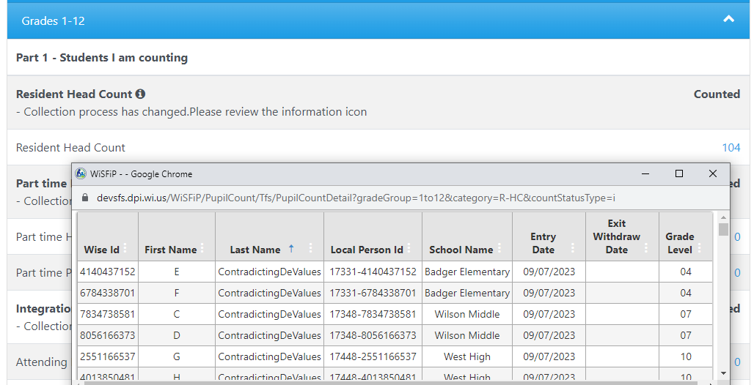
WiSFiP: TFS Steps, Drill Down
You can click on the count hyperlink to drill down to see the specific students.
Columns can be filtered and sorted.
Notes:
The TFS screen – TFS Steps:
You can click on the count hyperlink to drill down to see the specific students. (Click)
Columns can be filtered and sorted.

Slide 21
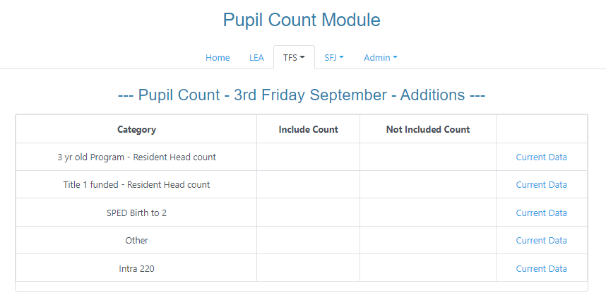
WiSFiP: LEA Screen, TFS Additions
The Additions screen includes students who are 3 yr-old not SPED, students enrolled in title I funded program, SPED birth -2 program, and others are not reported to WISEdata, but are required for membership reporting.
Intra 220 is only applicable for MPS.
This data is not coming from WDP; therefore, LEAs will have to manually enter/upload the WISEids or Local Person IDs.
Make sure duplicates are not submitted in manual entry.
If WISEid doesn't exist, then provide the local person id
Notes:
The TFS screen – TFS Additions:
Students who are 3 yr-old not SPED, students enrolled in title I funded program, SPED birth -2 program, and others are not reported to WISEdata, but are required for membership reporting.
Intra 220 is only applicable for MPS.
This data is not coming from WDP, and LEAs will have to manually enter the WISEids or Local Person IDs. (Click)
Make sure duplicates are not submitted in manual entry.
If WISEid doesn't exist, then provide the local person id

Slide 22
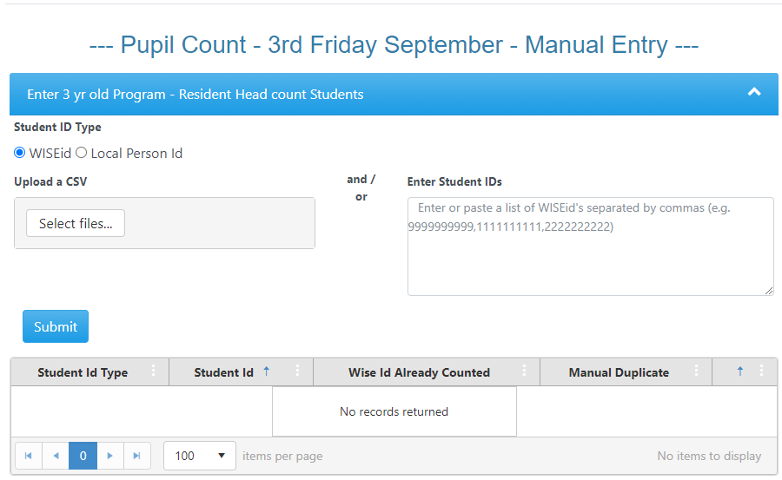
WiSFiP: TFS Manual Entry
LEAs will have to manually enter/upload the WISEids or Local Person IDs.
Make sure duplicates are not submitted in manual entry.
If WISEid doesn't exist, then provide the local person id
Notes:
The TFS screen – TFS Additions:
Students who are 3 yr-old not SPED, students enrolled in title I funded program, SPED birth -2 program, and others are not reported to WISEdata, but are required for membership reporting.
Intra 220 is only applicable for MPS.
This data is not coming from WDP, and LEAs will have to manually enter the WISEids or Local Person IDs. (Click)
Make sure duplicates are not submitted in manual entry.
If WISEid doesn't exist, then provide the local person id

Slide 23
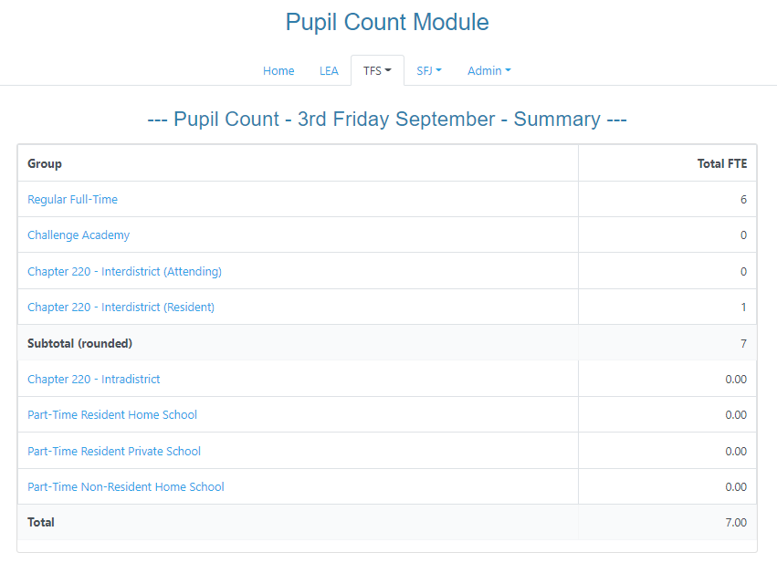
WiSFiP: TFS Summary
The Summary page displays pupil count by program categories. The summary count is the head count.
All the student counts under part 1 (students I am counting ) + Resident Chapter 220 + Intra 220 counts are summed up to total pupil count.
The Subtotal (rounded FTE) should match the Total in the Home screen
Notes:
The TFS screen – FTS Summary:
The pupil count summary is by program categories. The summary count is the head count.
All the student counts under part 1 (students i am counting ) + Resident Chapter 220 + Intra 220 counts are summed up to total pupil count.
The Subtotal (rounded FTE) should match the Total in the Home screen

Slide 24
WiSFiP: TFS Chapter 220
The Chapter 220 page displays students in Chapter 220 (or Interdistrict)

Slide 25
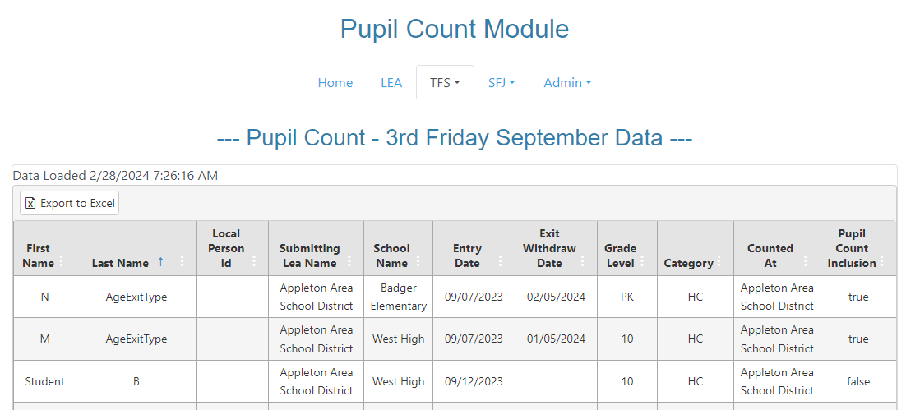
WiSFiP: TFS Current Data
The Published Data page shows all counted students
Can be exported to Excel

Slide 26
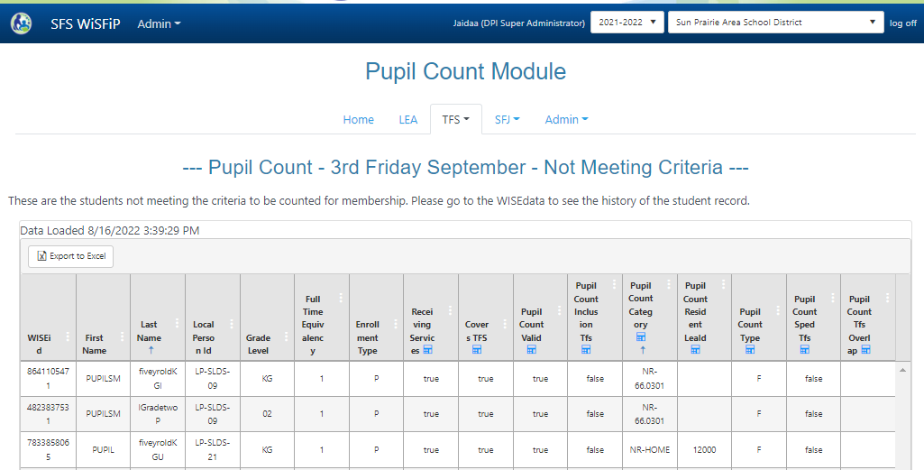
WiSFiP: TFS Not Meeting Criteria (1 of 2)
The Not Meeting Criteria page displays students who fail to meet the attendance criteria, have overlapping enrollment, lack a required membership attribute, possess an inappropriate membership attribute, or are simply not qualified to be included in the count.
This page allows LEAs to reconcile the actual student count in the SIS to the membership pupil count in WiSFiP.
Notes:
The TFS screen – Not Meeting Criteria:
Who are shown under Not meeting Criteria:
Your district has enrollment for student, but the student is not meeting the membership attendance requirement
Your district has enrollment for student, but there is an overlapping enrollment with another district
Your district has enrollment for student, but some of the required membership attributes are missing
Your district has enrollment for student, but membership attributes submitted does not qualify the student to meet the membership count inclusion requirements

Slide 27
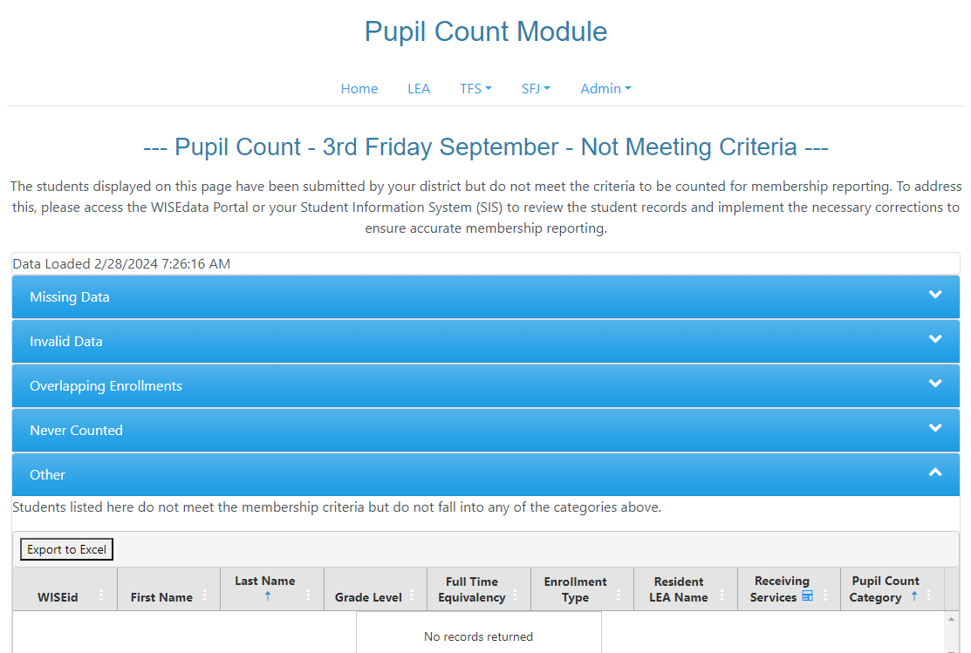
WiSFiP: TFS Not Meeting Criteria (2 of 2)
The Not Meeting Criteria will undergo a redesign, incorporating five categories to aid LEAs in in understanding the data and facilitating the required corrections.
Notes:
Jaidaa
The TFS screen – Not Meeting Criteria: Students falling outside the membership criteria may be categorized as follows:
Never Counted: Students in this category are excluded from the membership report. This may include students whose enrollments do not cover the count date, those for whom Receiving Services information is set to 'N - Not Receiving Services.', or those marked as NR-JUV, NR- TP, NR-9-18ST, NR-CCDEB, NR-OUTSIDEAGE, R-OUTSIDEAGE, or NR-CH.
Missing Data: Students in this category lack essential data properties crucial for the count date inclusion calculation. For instance, the Full-Time Equivalent (FTE) may be missing, the Resident Local Education Agency (LEA) information is absent, or the Receiving Services details are not provided.
Overlapping Enrollments: Students listed here have enrollment records that overlap either across two schools within the same district or in two different districts.
Invalid Data: Students in this group possess data properties that are either invalid or contradictory. Examples include an incorrect FTE in relation to the grade level, an invalid enrollment type, an inappropriate primary school indicator, an invalid grade level, or an erroneous pupil count category.
Other: Students listed here do not meet the membership criteria but do not fall into any of the categories mentioned earlier.

Slide 28
Paradigm Shift
Current reporting (PI-1563) is manually entered through SAFR with LEAs using multiple data points including SIS data.
New Pupil Count report consists entirely of SIS data submitted through WISEdata.
SFS needs to develop additional reporting in WiSFiP to collect statutorily required student categories that are not collected through the SIS.
Due date for current reporting would require enrollment data to be submitted to WISEdata Portal before Oct 5th.
Notes:
Matt

Slide 29
Reminders
Remember to run the WISEdata Validation queue before pushing data in WiSFiP.
Bring up anything that doesn’t seem right by using the Qualtrics form.
Notes:
Jaidaa

Slide 30
Resources
Data Element Pages:
Enrollment type
Residency status
Full time equivalency
Part time instructional minutes
Count date name
Programs
Other Data Pages:
Pupil count pilot program introduction
Membership
Students receiving off-site services
Students taking a limited number of classes in another school/district
Pupil Count PI-1563
User Guide for Requesting Access
Send questions about the Pupil Count for Membership Data Collection to membershippupilcountpilot@dpi.wi.gov

Slide 31
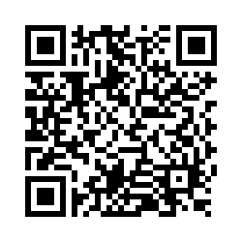
Questions?
Thank you! Thank you!
Please scan the QR code to provide us with your feedback!

