Slide 1
Wisconsin School Directory Management Portal
Kari Tenley
School Directory Administrator
March 6 & 7, 2024

Slide 2
Session Overview
School Directory Overview & History
Where School Directory Data Is Used
New Wisconsin School Directory Management Portal Training
Q&A

Slide 3
Overview
The Wisconsin School Directory has two portals.
Wisconsin School Directory Public Portal: viewable for the general public
Wisconsin School Directory Management Portal: viewable and editable only by authorized school staff

Slide 4
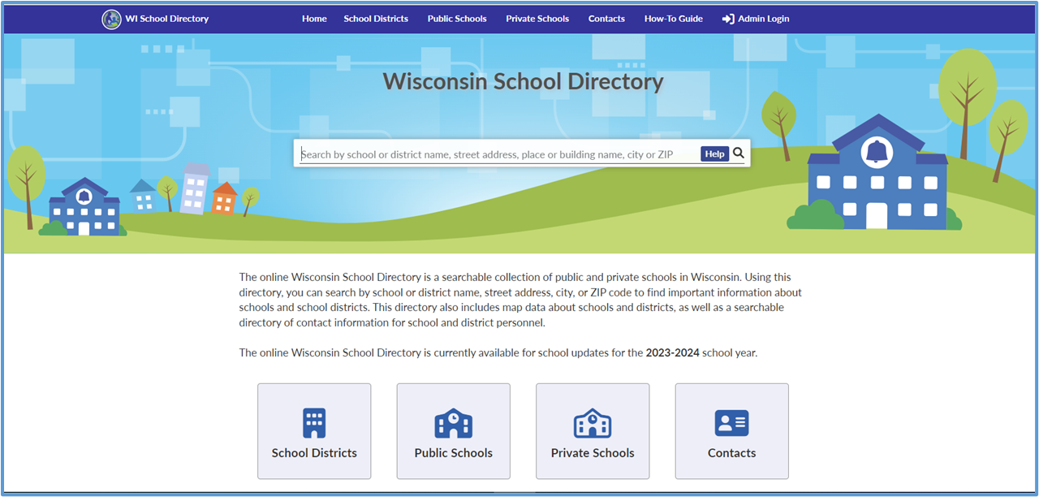
Overview – Public Portal (1 of 2)

Slide 5
Overview – Public Portal (2 of 2)
The School Directory Public Portal:
Is a searchable collection of public and private schools in Wisconsin.
Can be accessed by anyone and does not require a login.
Quick Search Features! using intuitive keywords resulting in comprehensive profiles of schools, school districts, and other educational organizations.

Slide 6
Overview – Public Portal
Highlights! NEW LEA Profiles are intuitive & feature:
Interactive Maps
Mobile Friendly
Links to GIS Maps
Links to Local Resources
Information Icons
Contact Lists
School Lists
Exportable (Excel or PDF)
Enhanced Filters

Slide 7
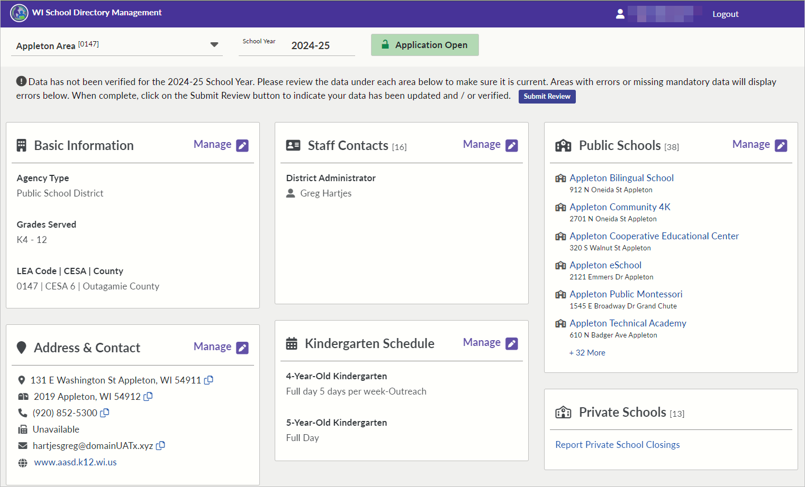
Overview – Management Portal (1 of 2)

Slide 8
Overview – Management Portal (2 of 2)
Same features with a great new look
Dynamic Screens for each agency type with tiles that have messaging
Consistency with School Directory Public Portal, both in appearance and content
Focus on full functionality at launch
Expect upgrades and small changes for the first year.

Slide 9
History (1 of 2)
Historically, changes to School Directory data would be submitted to DPI using paper forms for the Department of Public Instruction (DPI) to enter. Since 2012-13, School Directory has replaced the following paper forms:
PI-1201 Verification of Private Schools within Public School Districts
PI-1203 School District Statistical Report
PI-1280 Public School Update
PI-1281 Private School Update

Slide 10
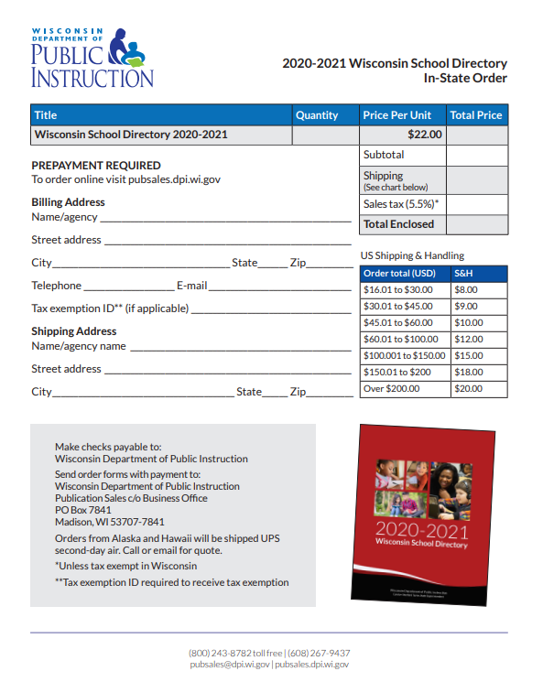
History (2 of 2)
Printed Version of the Wisconsin School Directory
TODAY:
Online!
Print or download only necessary information on demand
Up-to-date information

Slide 11
Data Usage of School Directory
The Wisconsin School Directory is a searchable collection of Wisconsin public and private schools designed to quickly provide information through flexible and intuitive search features.
District and school profiles provide ‘the big picture’ and showcase agency-specific information, including school contacts, addresses, and interactive Google maps.
Source of school and district data that is used across many WISE applications and DPI databases

Slide 12
Data Usage: SD User Statistics
From January 1, 2023, to December 31, 2023:
Total Users: 17,125
Total Page Views: 193,156
Average Daily Users (Weekdays): 90-110
Average Daily Page Views (Weekdays): 500-600

Slide 13
Data Usage: External Data Requests (1 of 2)
Laura Gregor, MS VPD Epidemiologist Wisconsin Immunization Program: Lists of public/private/ICS for immunization assessment
Sarah E. Koske, DVM, MPH, Epidemiologist Communicable Diseases Epidemiology Section Wisconsin Department of Health Services, Division of Public Health: DHS is looking to create a dictionary of all schools in WI that will be integrated into WEDSS, our electronic disease surveillance system.
Sue Gratz from the UW Madison: requested a list of high schools that taught a
French class and the educator(s) full name to use for a mailing.

Slide 14
Data Usage: External Data Requests (2 of 2)
Johanna Epperson , Dun & Bradstreet: A NEW SCHOOL listing for 2022-2023 SY, those opening after June 2022. Please include: District Name, School Name, Address and any other school related data. Please include a closed school list if possible.
Patrick Kays, Quest Food Management Services: Could I request a current list of all public and non-public school districts with information of their food service contact?

Slide 15
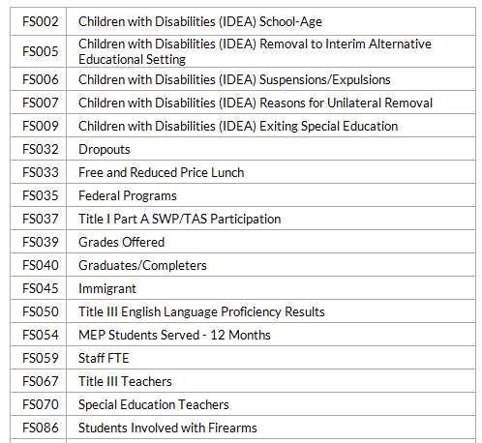
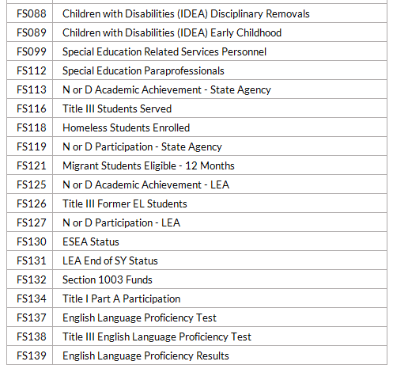
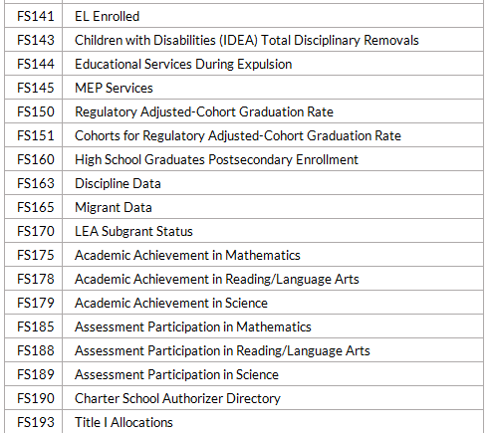
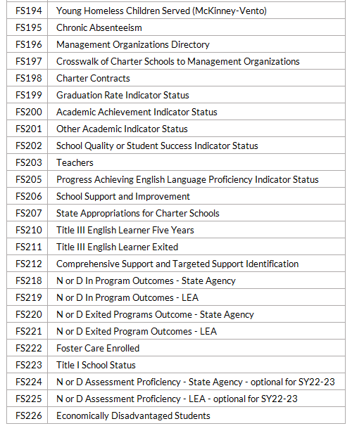
Data Usage: US Department of Ed Files
Over 80 files
FS029 Directory
FS129 CCD School
FS052 Membership
FS039 Grades Offered
FS059 Staff FTE
Enhanced Validation!

Slide 16
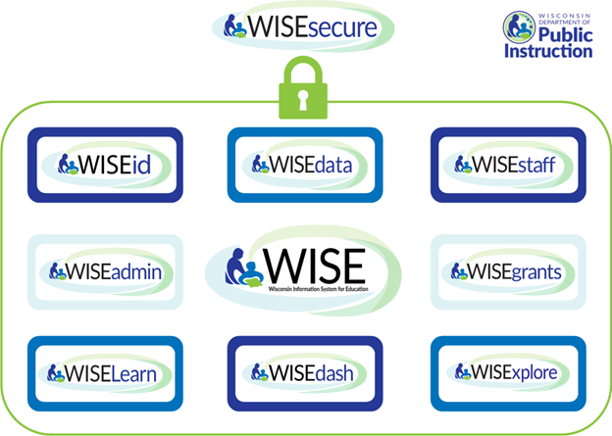
Data Usage: School Directory and WISE
Source of all LEA school and district data that is used across our WISE (Wisconsin Information System for Education) applications and other DPI databases

Slide 17
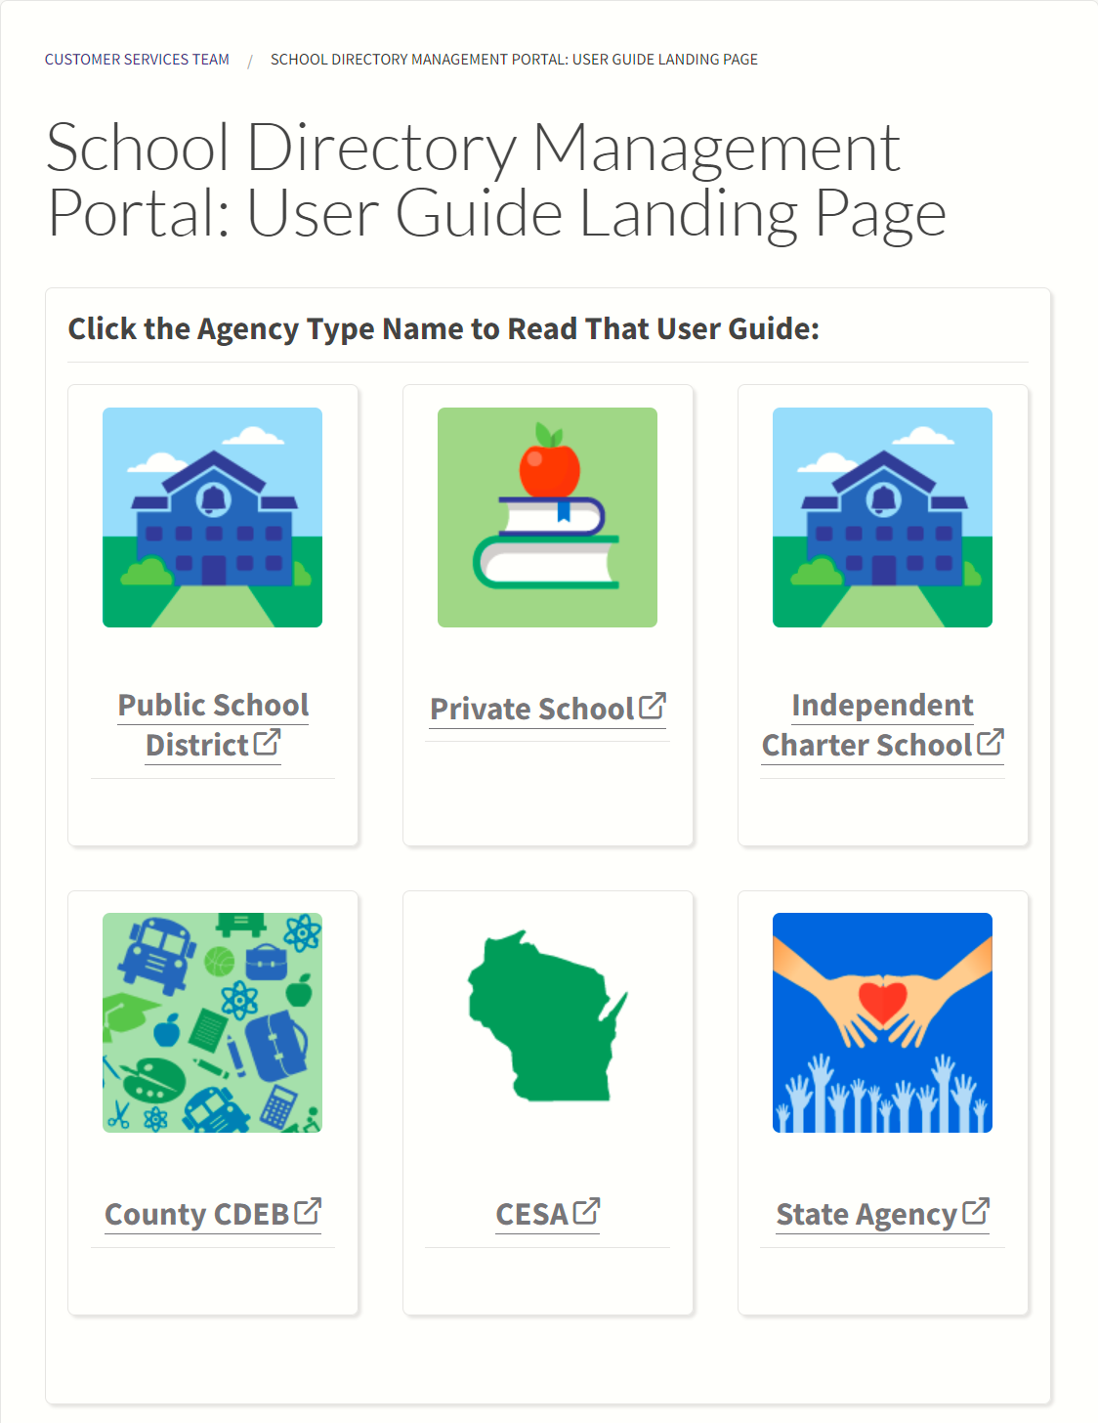
Training
Wisconsin School Directory Management Portal User Guides

Slide 18
Resources
DPI webpages with School Directory Support
School Directory Public Portal landing page
School Directory Management Portal User Guides
School Directory Management Portal Annual Required Updates
School Directory data element collection
School Modification Form: only used to open or close a school
Help Ticket – select School Directory Updates

Slide 19
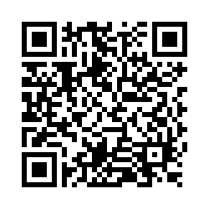
Questions?
Thank you! Thank you!
Please scan the QR code to provide us with your feedback!

