Slide 1
Title Slide
From Student Data in SIS to Report Cards and Federal Identifications
Britt Mueller – WISE Relationship Manager, Customer Services Team
Jonathan Wong – OEA Education Consultant, Data Analysis and Reporting
Courtney Jenkins – Assistant Director, Special Education
March 7, 2024
Notes:
Hello, and thank you for joining us today. My name is Britt Mueller, and I am the WISE Relationship Manager on the Customer Service Team, and I’m joined today by Emily Colo, an Educational Consultant, Data Analysis and Reporting from the Office of Educational Accountability. In this session, we are going to take you through the life cycle of your student data, from your local student information system to the WISE reporting and review systems, and finally to the student report card.

Slide 2
Sample with XL chart or image
Agenda
Data Flow
Vendor Resources
Enrollment
TFS (Third Friday of September) Count Inclusion
Economic Disadvantaged Status
Graduates
Notes:
There a number of items we are going to touch, starting with the flow of your data – once entered in your local system, where does the data flow, how often, and why. Next, we are going to go over some vendor resources available to you from those vendors that provided them to us. Finally, the topics we are going to cover are the Enrollment record, Third Friday of September count inclusion value, Economic Disadvantaged Status, and Graduates.

Slide 3






Data Flow
LEA / School / District
Student Information System
WISEdash for Districts
WISEdata Portal
Report Card/ Joint Federal Notification Packets
Notes:
This graphic is a very simplified version of your data flow. You can see you here on the left at the LEA/School/or District. This is where you collect the data and enter it into your local Student Information System. Once entered, your vendor tool will push that data into WISEdata Portal. Please be aware of how your data pushes from your SIS to WISEdata – for many vendors this is an automatic process any time a new record is created or modified, however, that is not always the case and this step may require a manual push on your end. Please work with your SIS support to ensure you are aware of how and when your data flows so you know if and when your data is transferring to WISEdata.
Once the data is in the WISEdata Portal, it will run against our validation logic and throw any errors or warnings needed. The WISEdata Portal is seen as a working application for your to review and correct your data in near-real time. If you are seeing errors or warnings for your data, you will want to address those by making the appropriate changes within your SIS and re=pushing any updates back into WISEdata Portal to correct the validation message. It is important to note that WISEdata does not pull any information from your SIS – all data is pushed to WISEdata from your SIS so if you are ever seeing a discrepancy between what your SIS is showing and what WISEdata is showing – please work with your SIS support to address the data flow issue.
Next, once the data is in WISEdata and is not impacted by any validation messages, it will push into WISEdash for Districts. This happens on a nighly sync, meaning any changes you make in your SIS and push to WISEdata can be seen almost real-time, while that change won’t be seen in WISEdash until the next day. It is also important to know that WISEdash for Districts is where the Snapshot and Report Cards pull from. So while reviewing and correcting the data in WISEdata is important, ultimately WISEdash for Districts for public LEAs and the WISEdash Extract files for choice schools is where you need to be doing your final review for accuracy prior to the Snapshot.
Lastly, we have the report card. Again, the report card data is pulled from what is captured in WISEdash during the Snapshot so that is the final review available to you to ensure your report card data is going to be reported correctly.

Slide 4
Sample Text Slide
Vendor Resources
Infinite Campus
Skyward
PowerSchool, MBA
JMC
Notes:
These are the four vendors that were kind enough to provide some resources for their users within this session. I won’t go through each vendor within each topic but the resource information they provided for each topic will have its own slide for you to take a look at from our WISEdata Conference webpage for this session.

Slide 5
Enrollment – Infinite Campus
Enrollments | Infinite Campus – General enrollment information for all states
Enrollments (Wisconsin) | Infinite Campus – Wisconsin-specific enrollment information
Notes:
Again, I won’t be going into each vendor slide but as an example, you can see the Infinite Campus provided links to their website you can log into with information on the topics…

Slide 6
Enrollment - Skyward
Enrollment record: Student Management > Students > Student Profile > Entry/With
    Ent-With to begin an enrollment
    Status Change to end one enrollment and begin a new one with different information
    Withdraw to end an enrollment
    Edit to update an enrollment
    Delete to remove an enrollment
Notes:
…Skyward gave a breadcrumb path and explanation of their values within that screen…

Slide 7
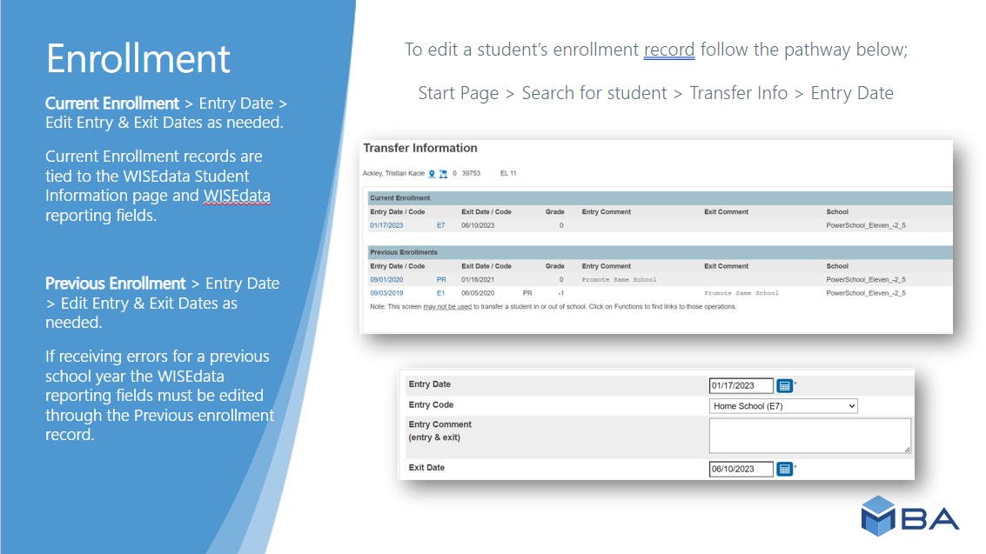
Enrollment – PowerSchool, MBA
Notes:
…MBA provided their own slide with screenshots…

Slide 8
Enrollment - JMC
Preferred changes in enrollment: via Drop, Add, and Re-enter options
  Attendance > Student > Add Student (only necessary if a student enrolls after day 1)
  Attendance > Student > Drop Student
  Attendance > Student > Re-enter Student (subsequent enrollment in same SY)
At a later time, if minor corrections need to be made to enrollment records:
  View Student Data - Enrollment tab
There are articles for these pages/processes in our in-app documentation.
Notes:
…and JMC shared some of their pathway and explanations.

Slide 9
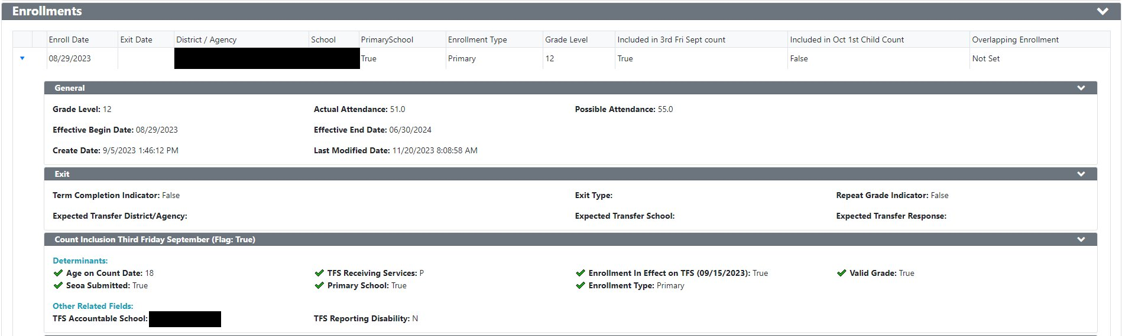
Enrollment – WISEdata Portal (1 of 3)
How-to: Audit for Enrollment Data
Notes:
Now, saying you know where this data is located in your SIS and you’ve pushed that data to WISEdata, here’s what you should be seeing. In this example, we have the standard enrollment record… start date, open ended exit date, primary school value, grade level, all the normal values expected for a traditional, primarily, and currently enrolled student enrollment record.

Slide 10
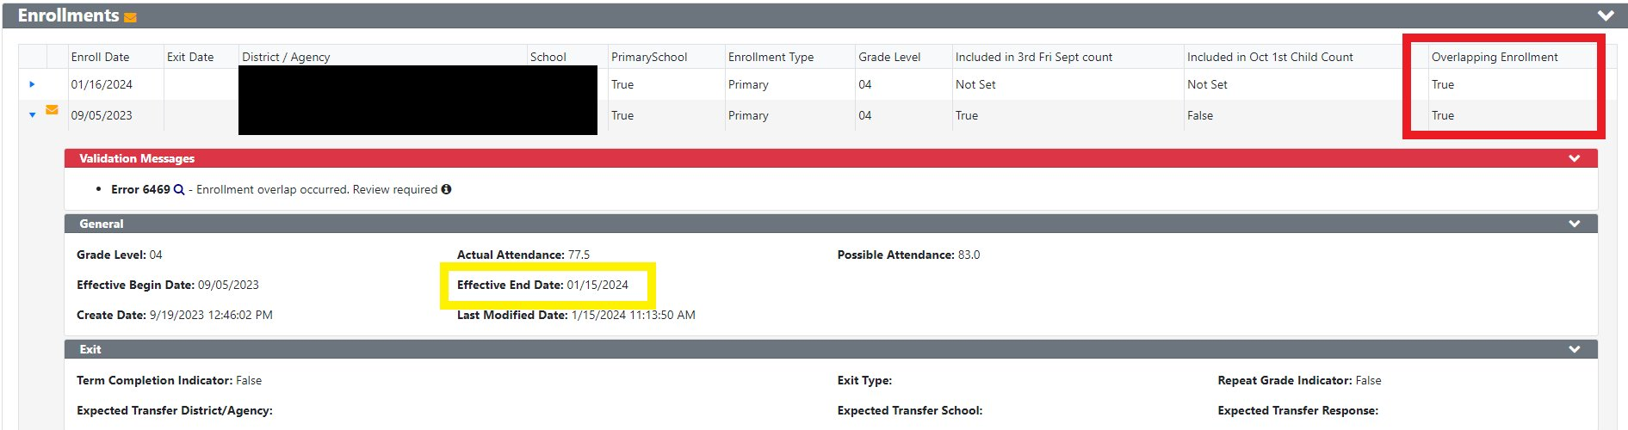
Enrollment – WISEdata Portal (2 of 3)
Effective End Date is the system reporting an end date for your record based on additionally submitted records
Notes:
Here’s what it looks like when you have an overlapping enrollment. Two enrollments with conflicting dates, overlapping enrollment value = True.
Discuss Effective End Date logic and how that impacts how a student ends up reported.
Discuss Effective Begin Date logic

Slide 11

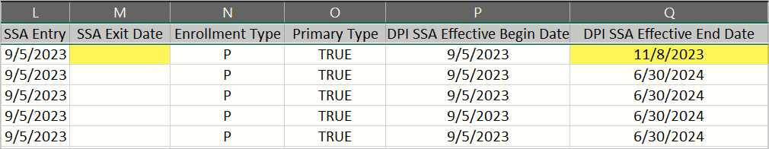
Enrollment – WISEdata Portal (3 of 3)
Exports > Mass Enrollment > column M vs Q
SSA Exit Date – what the district reports as the student’s exit date
DPI SSA Effective Dates – what the system overwrites as the exit date based on additional records submitted
How-to: Audit for Enrollment Data
Notes:
Cont overlapping enrollment logic and impact
Point out SSA = Enrollment Date

Slide 12
Enrollment – WISEdash for Districts
Student will report current enrollments, possibly last enrollment depending on what data is being captured.
Overlapping enrollments may impact count dates or year end reporting if not resolved prior to Snapshot.
FAY (Full Academic Year) is calculated in WISEdash.
  Students who have been enrolled in the same school or district from third Friday of September until time of statewide assessment.
Notes:
Explain “last enrollment” logic

Slide 13
Enrollment – Report Card
Enrollment dates and length affect whether students are included in certain parts of the report card:
Achievement and Growth: only full academic year (FAY) students are included.
Chronic Absenteeism: only students enrolled for 90 days or more are included. Note this does not have to be one continuous stretch of enrollment.
Notes:
EMILY

Slide 14
TFS – Infinite Campus
Wisconsin Ed-Fi Data v3.5 - Student School Association | Infinite Campus – Go down to the Array section for Receiving Services for information on how we send this data.
We do have overrides for TFS and Oct 1 on Enrollment, which can be found in the State Reporting Fields area in Enrollments (Wisconsin) | Infinite Campus

Slide 15
TFS - Skyward
Ed-Fi Configuration:
Student Management > Federal/State Reporting > Ed-Fi > Setup > Configuration > New Ed-Fi Setup > highlight Ed-Fi Setup and expand arrow > Profile-Specific Setup > WI Count Dates > 3rd Fri (Sept)
3rd Friday (September) Overrides:
Student Management > Students > Student Profile > Entry/With
      Exclude from 3rd Friday Sept Count
      3rd Friday Count Date Override
Logic: Student has a WISEid and an enrollment in an Ed-Fi reportable school that overlaps the third Friday of September.

Slide 16
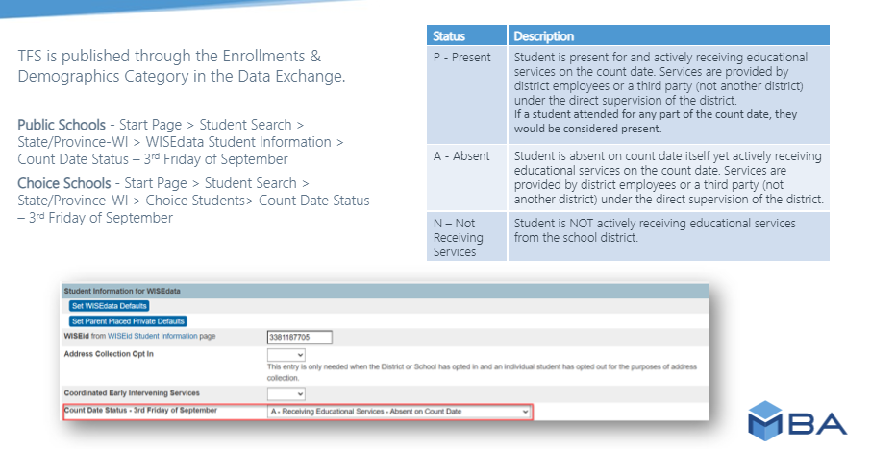
TFS – PowerSchool, MBA (1 of 2)

Slide 17
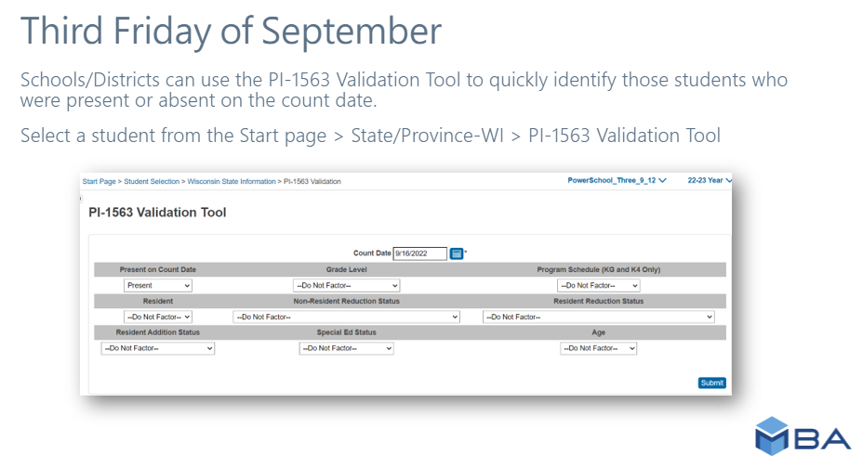
TFS – PowerSchool, MBA (2 of 2)

Slide 18
TFS - JMC
Set the date for the school year:
  Edit > Edit School Data
There is an article in our in-app documentation titled Editing school data for Wisconsin start year state reporting.
TFS is normally a calculated value; however, there is an override option available at:
    View Student Data - Enrollment tab

Slide 19
TFS – WISEdata Portal (1 of 3)
How-to: Audit for TFS Data
Notes:
Now again, we have a standard enrollment record with the TFS value = True, This is what we want all our start of year enrollments to look like. If the TFS inclusion value does not say True, check for validation messages and your SIS for correct value

Slide 20
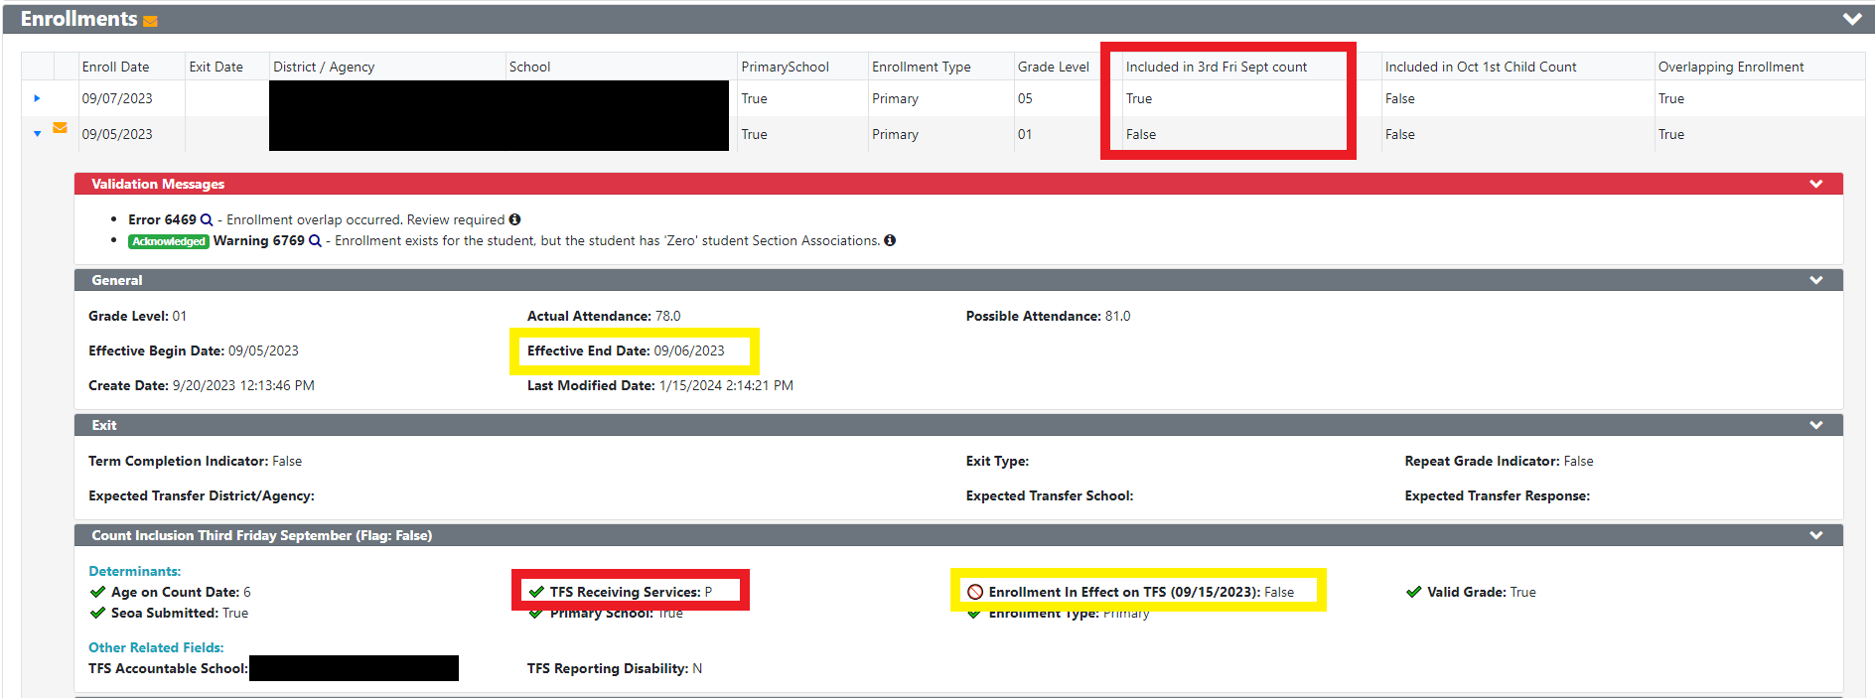
TFS – WISEdata Portal (2 of 3)

Slide 21
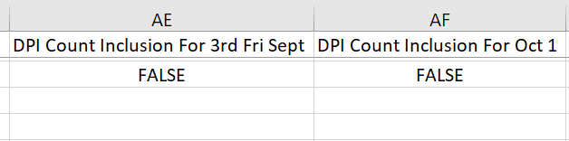
TFS – WISEdata Portal (3 of 3)
Exports > Mass Enrollment > column AE and AF
DPI Count Inclusion – what the system overwrites as the inclusion value based on additional records submitted
Notes:
Count TFS inclusion impact in exports
Example, SIS sends Yes for Oct 1 but no sSEPA records submitted to show “proof” – DPI calculation will be No

Slide 22
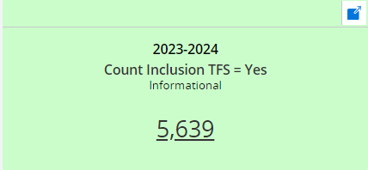
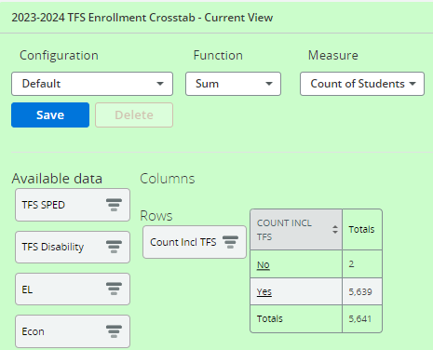
TFS – WISEdash for Districts
Notes:
Make sure these totals match what you are expecting. Investigate “No” inclusion value shown here – could be a validation message blocking the Yes, could be SIS isn’t sending to WISE correctly
Also discussion Accountable vs Attending

Slide 23
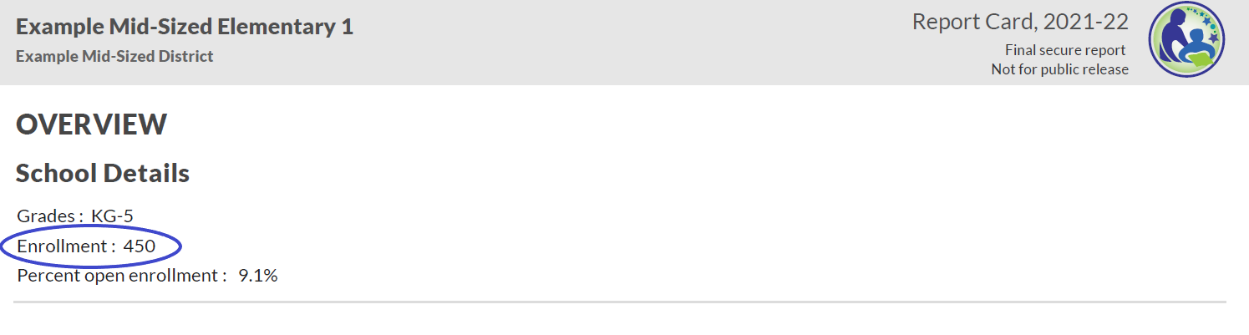
TFS – Report Card
Students with TFS Count Inclusion = Yes
included in enrollment number and demographic calculations displayed on the front page
Notes:
EMILY

Slide 24
TFS/CC - IDEA Accountability
Racial Equity in Special Education
Identifications require plan, 15% reservation, CCEIS flags in WISEdata

Slide 25
Econ Disadv Status – Infinite Campus
Wisconsin Ed-Fi Data v3.5 - Student Education Organization Associations | Infinite Campus – Economically Disadvantaged information is found in Student Characteristics section
Wisconsin Ed-Fi Data v3.5 - Student School Food Service Program Associations | Infinite Campus

Slide 26
Econ Disadv Status, CEP Schools - Skyward
Regular Schools:
The Economically Disadvantaged Student Characteristic in the SEOA is determined by the student’s Lunch Code.
Free/Reduced sends a descriptor code of ED.
Paid, Adult, Other sends a descriptor code of Not ED.
Student Management > Students > Student Profile > Special Programs > Econ Disadv

Slide 27
Econ Disadv Status - Skyward
CEP Schools:
When a School Code is checked as CEP, all students get a Free Lunch Code and send an SSFSPA with a status of Free.
This is not always accurate to the student’s actual Economic Status, however.
To accurately report the ED/Not ED student characteristic in the SEOA, a Special Programs Economic Disadvantaged record can be created for all students who qualify for Free/Reduced meals.
Ed-Fi will check to see if a student has a Special Programs Econ Disadvantaged record and then report ED in the SEOA if the student does.
If there is no Special Program Econ Disadvantaged record, the student will report Not ED.
Student Management > Students > Student Profile > Special Programs > Econ Disadv

Slide 28
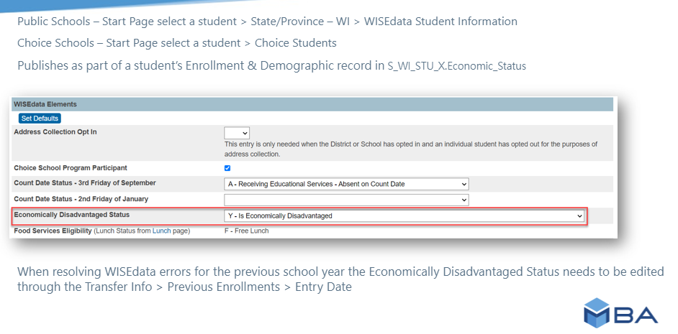
Econ Disadv Status – PowerSchool, MBA (1 of 2)

Slide 29
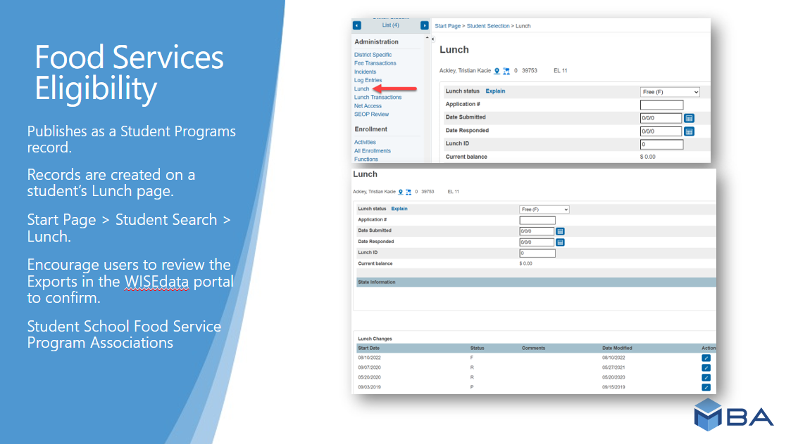
Econ Disadv Status – PowerSchool, MBA (2 of 2)

Slide 30
Econ Disadv Status - JMC
Economic Indicator
View Student Data - Sensitive tab (user must have Sensitive data privileges)
and/or Lunch > Data > Edit Student Lunch Data (if client uses our lunch module)
Food Service Eligibility
Most changes for this data come from 2 processes
Lunch > Free/Reduced > Import Direct Certification
Lunch > Free/Reduced > Determine Free or Reduced Status
OR in our online parent app they can also submit a free or reduced lunch application data lives and can be tweaked at
Lunch > Data > Edit Student Lunch Data
There are articles for these pages/processes in our in-app documentation.

Slide 31
Econ Disadv Status – WISEdata Portal (1 of 4)
DPI calculated Econ Disadv Status is made up of two values:
Econ Status in Demographics
Food Service Eligibility
Notes:
DPI Econ Status is made up of two different reported values…
Econ Status in demographcis reported by the student’s Direct Certification or Alternative Household Income Form
Reported Food Service Eligibility record you report

Slide 32
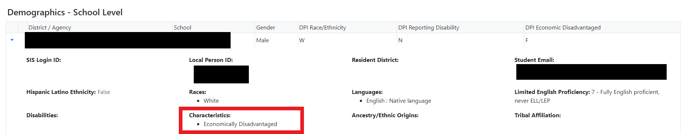
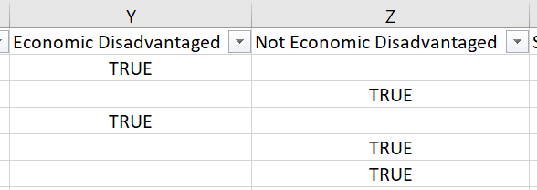
Econ Disadv Status – WISEdata Portal (2 of 4)
Demographics > Demographics – School Level > Characteristics
Exports > Student Characteristics > column Y and Z
How-to: Audit for Econ Disadv Data
Notes:
For the demographic value, here’s where you review in the Student Details screen and the Student Characteristics export

Slide 33
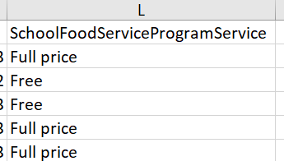
Econ Disadv Status – WISEdata Portal (3 of 4)
Exports > Programs > Student School Food Service Program Associations > Column L
Notes:
For Food Service Eligibility, here’s where to review in Student Details Program and Food Service Program export

Slide 34
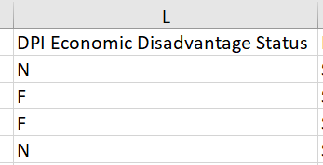
Econ Disadv Status – WISEdata Portal (4 of 4)
Exports > Enrollment – 3rd Friday of September > Student School Food Service Program Associations > Column L
Part 1: Food Services Eligibility | Part 2: Economically Disadvantaged Status | Result: Economically Disadvantaged Type (FRAN)
Free Lunch | Yes | F: Eligible for Free Lunch
Reduced-Price Lunch |  | R: Eligible for Reduced-Price Lunch
Full-Price Lunch |  | A: Economic Disadvantaged - Alt Mechanism
Unknown |  | A: Economic Disadvantaged - Alt Mechanism
Free Lunch | No | N: Not Economically Disadvantaged
Reduced-Price Lunch
Full-Price Lunch
Unknown
Notes:
Combined, these two values submit the DPI Econ Disadv Status. These combined values result in what gets reported for FRAN.
CEP schools should NOT report all students Econ Disadv. If you are a CEP school, report Free Lunch but No econ disadav = Not Economically Disadvantaged

Slide 35
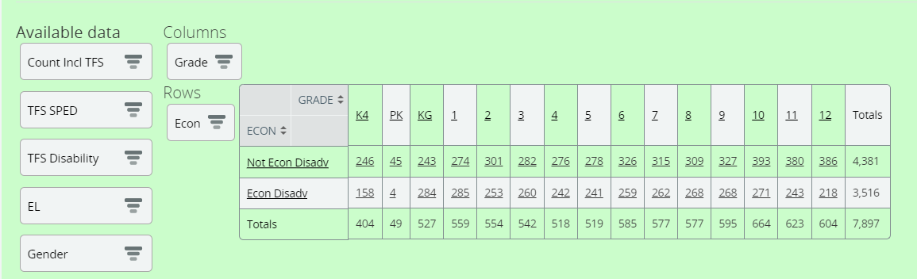
Econ Disadv Status – WISEdash for Districts
Notes:
In WISEdash for Districts, if you have the Econ Analyst user role, you can use the Econ filter in any dashboard to review your counts. Use the TFS dashboard to review Econ Status since this pulls into Report Cards.

Slide 36
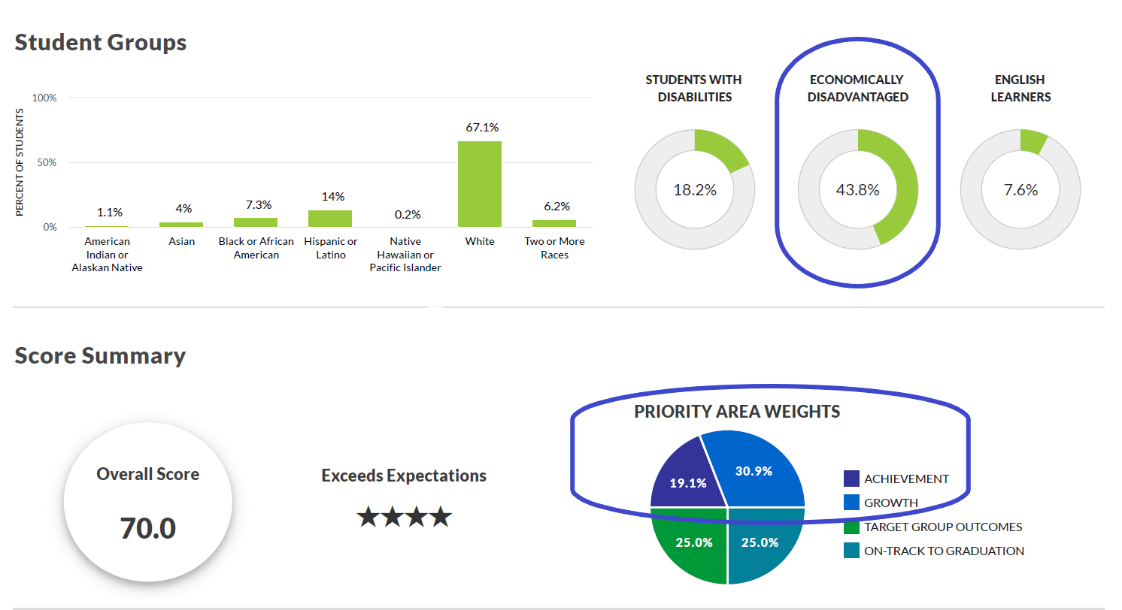
Econ Disadv Status – Report Card
Percentage displayed = econ disadvantaged among those with TFS Count Inclusion = ’Yes’.
This percentage also determines the relative weight of Achievement and Growth in calculating the report card overall score.
See the report card weighting calculator.
Notes:
EMILY

Slide 37
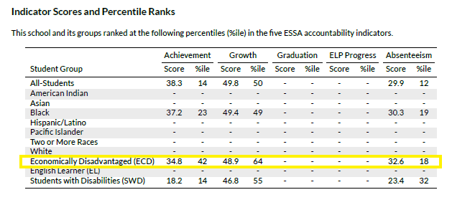
Econ Disadv Status –
ESSA student group calculations
Econ disadvantaged status for students is also used for student group level accountability calculations of achievement, growth, absenteeism, and graduation.
This is especially important for ESSA Targeted Support (TSI) and Additional
Targeted Support (ATSI) identifications.
Notes:
EMILY

Slide 38
Graduates – Infinite Campus
Wisconsin Ed-Fi Data v3.5 - Student Academic Records | Infinite Campus – See Arrays > Diplomas for information on Diploma Type

Slide 39
Graduates - Skyward
Withdrawal Code Crosswalk: Student Management > Students > Setup > Codes > Withdrawal Codes
Chose HSC in the State Withdrawal Type
Choose type of diploma or completion credentials in Credential Type
  Regular High School Diploma
  High School Equivalency Diploma
  Other High School Completion Credentials
Logic: Selecting a Withdrawal Code that is crosswalked to HSC will report the student as graduated in Ed-Fi and will send a StudentAcademicRecord based on the code’s Credential Type.

Slide 40
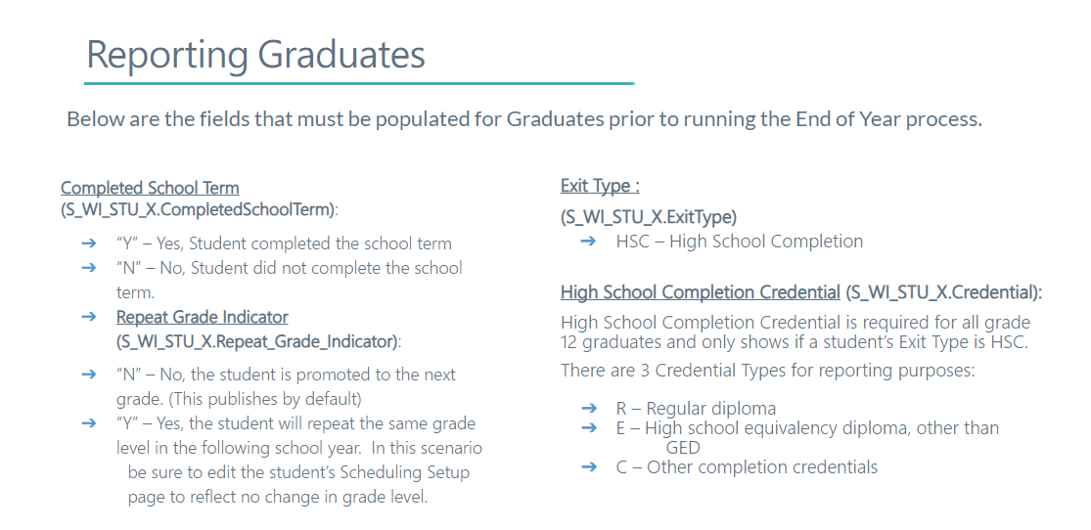
Graduates – PowerSchool, MBA (1 of 3)

Slide 41
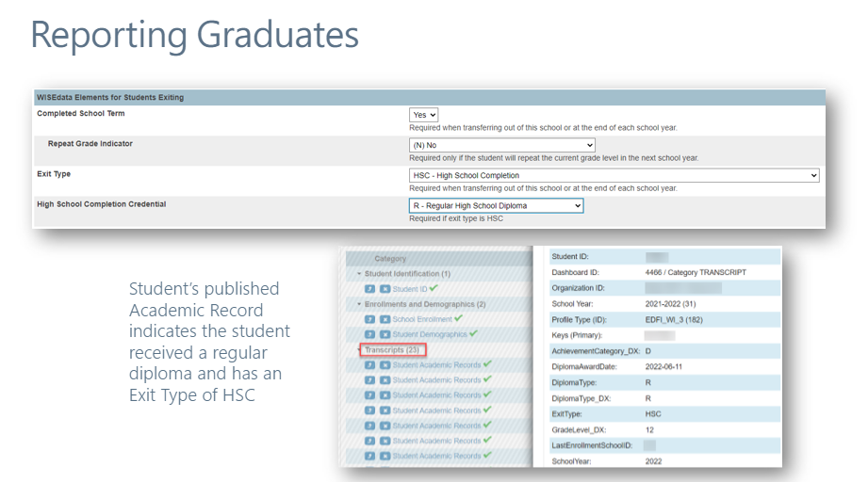
Graduates – PowerSchool, MBA (2 of 3)

Slide 42
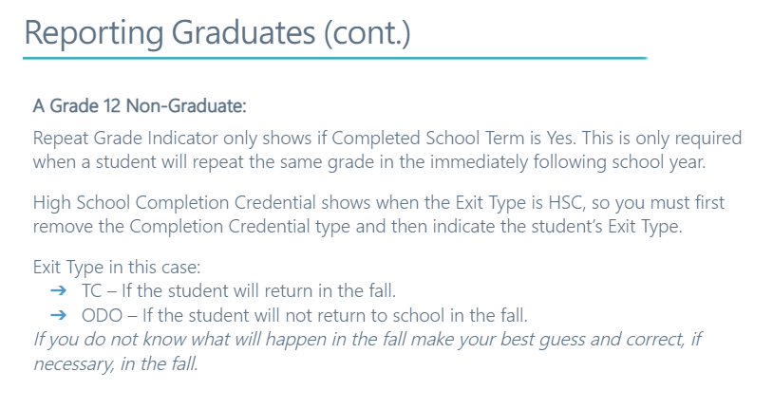
Graduates – PowerSchool, MBA (3 of 3)

Slide 43
Graduates - JMC
There is an article for this process in our in-app documentation called Wisconsin End Year: Checklist tab that details the data elements and sequence for setting these correctly

Slide 44
Graduates – WISEdata Portal (1 of 3)
DPI collects Graduates using two values
HSC exit type
Academic Credential
Notes:
Graduation data is collected based on two values…

Slide 45
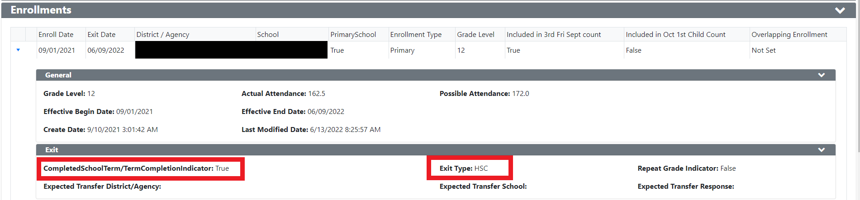
Graduates – WISEdata Portal (2 of 3)
How-to: Audit for Grad Data (public)
How-to: Audit for Grad Data (Choice)
Notes:
HSC exit type and Academic Credential Record. Common missing value that impacts Grad Rates is the missing Credential Type.

Slide 46
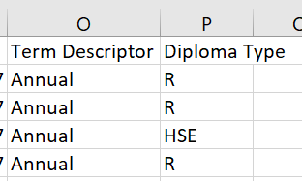
Graduates – WISEdata Portal (3 of 3)
Exports > High School Completion > Columns O and P
Term Descriptor – when did the student complete their requirements
Diploma Type – credential type student earned
Notes:
Review the export to ensure all Diploma Types (Credential Type from prior slide) are reported

Slide 47
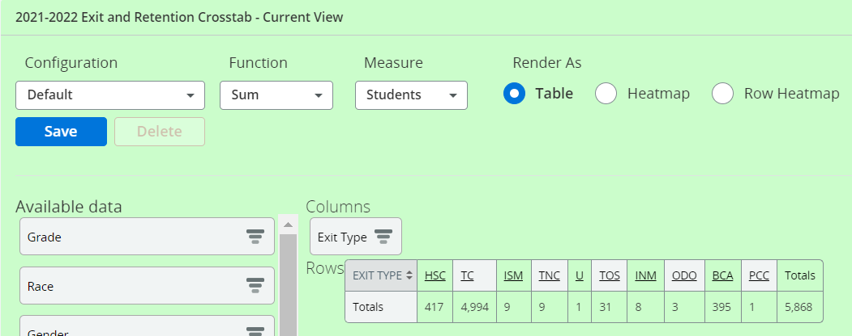
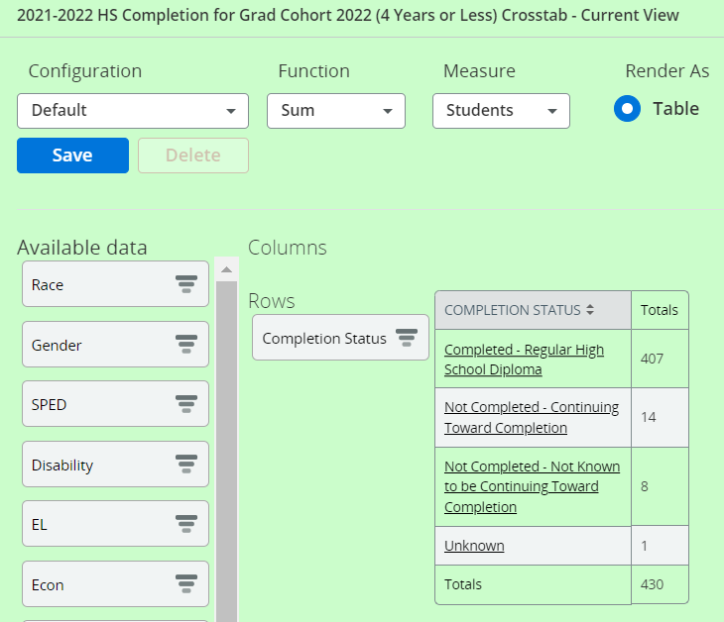
Graduates – WISEdash for Districts (1 of 2)
Notes:
Review the HSC exit total in Year-End Exit’s dashboard and the Completion status of your cohort.

Slide 48
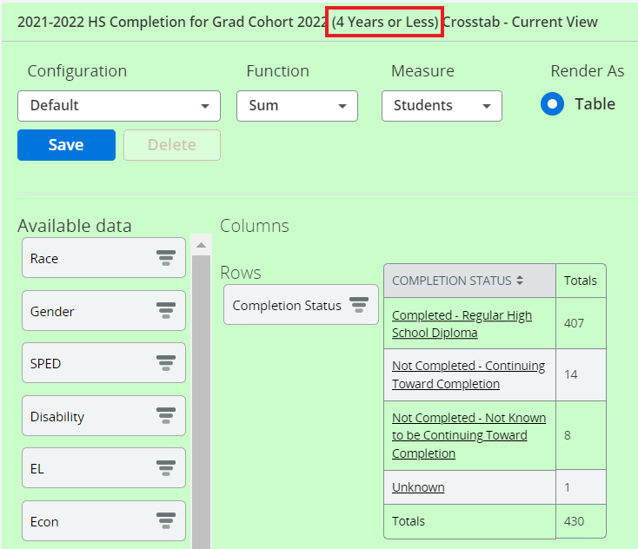
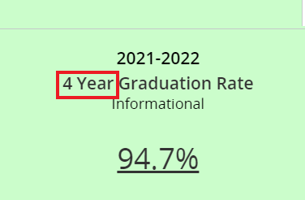
Graduates – WISEdash for Districts (2 of 2)
Year-End Data Quality Indicator 4 Year Graduation Rate
HS Completion for Grad Cohort (4 Year or Less) Dashboard
  The Snapshot dashboard data only include the 4-year or less rate for that year’s graduating cohort
Review students who graduate after their cohort in the
Menu >Topics > Graduation >
HS Completion Rates dashboards
Grad Rate percentage includes all students when you click it, so you will need to filter column Completion Status for non-completer student list to review.
Notes:
I want to specifically point out the Year End Dashboards only include the 4-year cohort, so the students graduating within the cohort for that year. If you have a student that takes an extra year to graduate, they will not show up in the grad rate or HS Completion dashboard for Snapshot. This data here is only for those 4-year or less grads. If you want to see your five, six, or seven year grads, you can see those in another area of WISEdash, but I want to make sure you’re aware they will not be shown in these dashboards. We get this question a lot so wanted to mention it.

Slide 49
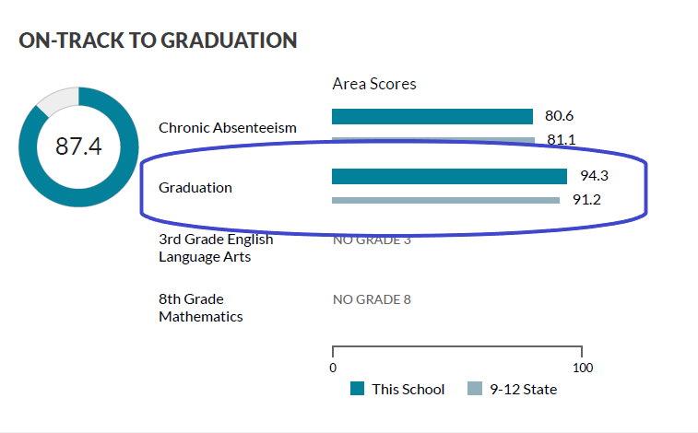
Graduates –
Report Card & ESSA Accountability
Only Diploma Type = Regular included
As with the WISEdash data quality indicator, only students in the appropriate cohort will be included in the graduation rate.
Students are included in rates for the district/school of accountability -- those in detention center/jail or placed by their IEP outside the district (for example WCBVI or WSD) appear in graduation rates at their resident district/school.
4-year or 7-year rates averaged in scoring
Notes:
EMILY

Slide 50
Graduates – IDEA Accountability
LEA Determinations
Meets Requirements, Needs Assistance, Needs Intervention, Needs Substantial Intervention
NOTE: the special ed exit date and enrollment date need to match (sSEPA end date same as enrollment end date)

Slide 51
Final Thoughts
If at any point your total counts or data do not look correct, go back to the prior application to begin your review.
Review WISEdash for Districts counts – this is what will pull into the Report Card.
Review WISEdata Portal validation messages.
Review how the values are reported in WISEdata student detail screens and export downloads.
Review your SIS and do a re-sync to push mismatched data.

Slide 52
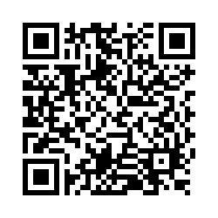
Questions?
Thank you! Thank you!
Please scan the QR code to provide us with your feedback!

