Slide 1

Choice School WISEdata Snapshot Preparation
Carrie Boe and Emily Colo
DPI Customer Services Team and Office of Educational Accountabilty
Last update: January 2024
Notes:
Welcome to the WISEdata Snapshot Preparation workshop! In this workshop, we are going to go over some important information as it pertains to the December 6th Snapshot, including why the data is collected, how to best prepare within your district or school, and how to use your WISEdata and WISEdash tools for review.

Slide 2
Reporting Deadlines and Snapshots
May 21, 2024
  Spring Demographic Snapshot
Summer Data Quality Review - August 2024
  2023-24 Year End Attendance
October 2024 - ~6-8 weeks prior to snapshot
  DPI Data Quality outreach begins
See the WISEdata Events page
for the most up-to-date information on
snapshot training opportunities near you!
Notes:
Talk about the data being collected on the Dec 6th snapshot, read through each part of the tuesday 6th
August is a good time to have the prior years data wrapped up to better get a start on the new school years data
In october & november we start data outreach calls, these are to touch base with districts that may be missing large pieces of data, or have major issues. We dont reach out for every error or warning
December 6th - read slide, These are some of the bigger data elements, this is not an all inclusive list, for a list of all data elements collected during the december snapshot, go to the annual tasks checklist page, which we will talk about a bit later

Slide 3
Snapshot Reporting Requirements
December 10, 2024 Snapshot
  2023-24 Year End Attendance & Completion
  2024-25 Third Friday of September Enrollment
  2024-25 Digital Equity Data (recommended, not required)
May 21, 2024 Snapshot
2023-24 Spring Demographics
Snapshot Preparation Guidance webpage
Notes:
Talk about the data being collected on the Dec 6th snapshot, read through each part of the tuesday 6th
August is a good time to have the prior years data wrapped up to better get a start on the new school years data
In october & november we start data outreach calls, these are to touch base with districts that may be missing large pieces of data, or have major issues. We dont reach out for every error or warning
December 6th - read slide, These are some of the bigger data elements, this is not an all inclusive list, for a list of all data elements collected during the december snapshot, go to the annual tasks checklist page, which we will talk about a bit later

Slide 4
Snapshot Purpose
Why We Collect the Data
The snapshots will serve as the permanent data source for certified reporting by DPI. Snapshot data is used for:
School and District Report Cards
Notes:
Why do we collect data? We collect data for a number of reasons. (read slide).
Because WISEdata is continuously collecting data throughout the year from your SIS, we need to take a picture of that data at a certain point in time in order to use for reporting. We call this a snapshot.
The snapshot is always taken at the same time of year. The main snapshot is in early December, the second smaller spring snapshot is in May. You’ll have the opportunity to clean up any the errors and warnings on your data prior to the snapshot date. As this is tied to funding and public reporting outside of just report cards, It is VERY important that this data is correct at the time of the snapshot. Incorrect data can delay funding and impact the accuracy of reporting viewable by the public.
The December snapshot is for all data where as the spring snapshot focuses on demographic information.

Slide 5
Data Flow for Snapshot
Data is:
entered into your student information system (SIS)
pushed to WISEdata and run through data quality checks (validations)
validated in the system on the day and time of the snapshot, loaded to WISEdash, and “snapped” for reporting purposes
Users can review WISEdata Portal validation results to go back to their vendor tool to make corrections and push the corrected data to WISEdata until the scheduled data snapshot. Best practice is to have data submitted days before snapshot occurs.
Notes:
-The school or district enters the student data into their SIS.
-That information pushes to WISEdata for validation and the user can monitor it there. Its important to note that each SIS has their own schedule for sending data to WISEdata. You will want to work with your SIS to know when this happens.
**If the data needs to be corrected, the user will correct it in their SIS and then be re-pushed back to WISEdata. DPI does not have the ability to edit or modify your data. WISEdata is basically a read only application and changes to the data must be made in your SIS.
-Once the data is submitted correctly it will flow to the data warehouse, also known as WISEdash.
-There are two versions of WISEdash, there is WISEdash for Districts and WISEdash public portal.
-The WISEdash Public Portal is a redacted version of WISEdash for Districts used for public reporting.
- WISEdash is not available to Choice schools at this time.
-Next we will see a visual representation of this process.

Slide 6
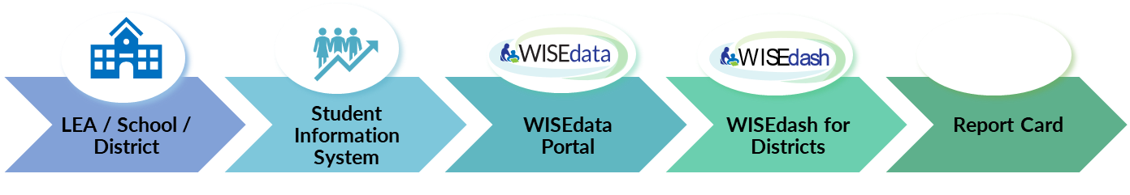

Data Flow Diagram
WISEdash Extracts
LEAs:
Data Entry
School/district collects student data and enters into the local SIS.
WISEdata Portal Submission
LEAs push data from their SIS to the WISEdata Portal for validation.
Validation Review
LEAs monitor and review the errors and warnings and make any necessary corrections in their SIS.
WISEdash Extracts for Choice Schools
Data flows into WISEdash. WISEdash Extracts are available in WISEdata Portal for Choice schools, since WISEdash is not available to private schools.
School and District Report Card calculations are based on the data in WISEdash.
Notes:
-The school or district enters the student data into their SIS.
-That information pushes to WISEdata for validation and the user can monitor it there. Its important to note that each SIS has their own schedule for sending data to WISEdata. You will want to work with your SIS to know when this happens.
**If the data needs to be corrected, the user will correct it in their SIS and then be re-pushed back to WISEdata. DPI does not have the ability to edit or modify your data. WISEdata is basically a read only application and changes to the data must be made in your SIS.
-Once the data is submitted correctly it will flow to the data warehouse, also known as WISEdash.
-There are two versions of WISEdash, there is WISEdash for Districts and WISEdash public portal.
-The WISEdash Public Portal is a redacted version of WISEdash for Districts used for public reporting.
- WISEdash is not available to Choice schools at this time.
-Next we will see a visual representation of this process.

Slide 7


Goals for Data Snapshot
All errors should be fixed, and
All warnings either acknowledged or fixed prior to a snapshot
This ensures the best possible data for reporting purposes.
Any data with a validation message
has the potential to impact the
snapshot data and subsequent reporting!

Slide 8
Snapshot Preparation Steps
Step 1: Your Vendor System
Step 2: WISEdata Portal Tasks
Step 3: WISEdash Extracts
Step 4: WISEadmin Portal
Step 5: Final Tasks
Notes:
Here is how to best prepare for the Snapshot…

Slide 9
Step 1: Your Vendor System
At the beginning of the school year or earlier:
Ensure the latest version of the SIS platform is installed; we recommend making any changes at least 6 weeks prior to the snapshot.
Make sure that your vendor can transmit the required data to DPI for required collections. Confirm using the Vendor WISEdata Status webpage.
Be sure to attend any vendor provided training, so you are clear on how to send required data to the DPI within the vendor tool and basic troubleshooting steps (e.g., full synchronization).

Slide 10
Step 1: Your Vendor System
Begin Submitting Data
Make sure all needed data is entered into SIS.
Begin submitting data from your vendor tool (i.e., SIS) to WISEdata via Ed-Fi.
Resolve validation messages, errors, or alerts located in your SIS vendor tool.
Missing data cannot be validated!

Slide 11
Step 1: Your Vendor System and WISEdata
Review and Resolve L1s
Review Level 1 (L1) errors using your vendor report, vendor error logs, or the WISEdata Portal Home Page.
  These errors prevent the data from getting to DPI. If these errors aren’t cleared, you will need to request assistance from your vendor.
  You can find more information about using the WISEdata Portal Home Page features in this mini tutorial.
Resolve the L1 errors in your vendor system and re-submit the data to WISEdata. Repeat as needed.
Correct ALL data with errors in your vendor system.

Slide 12
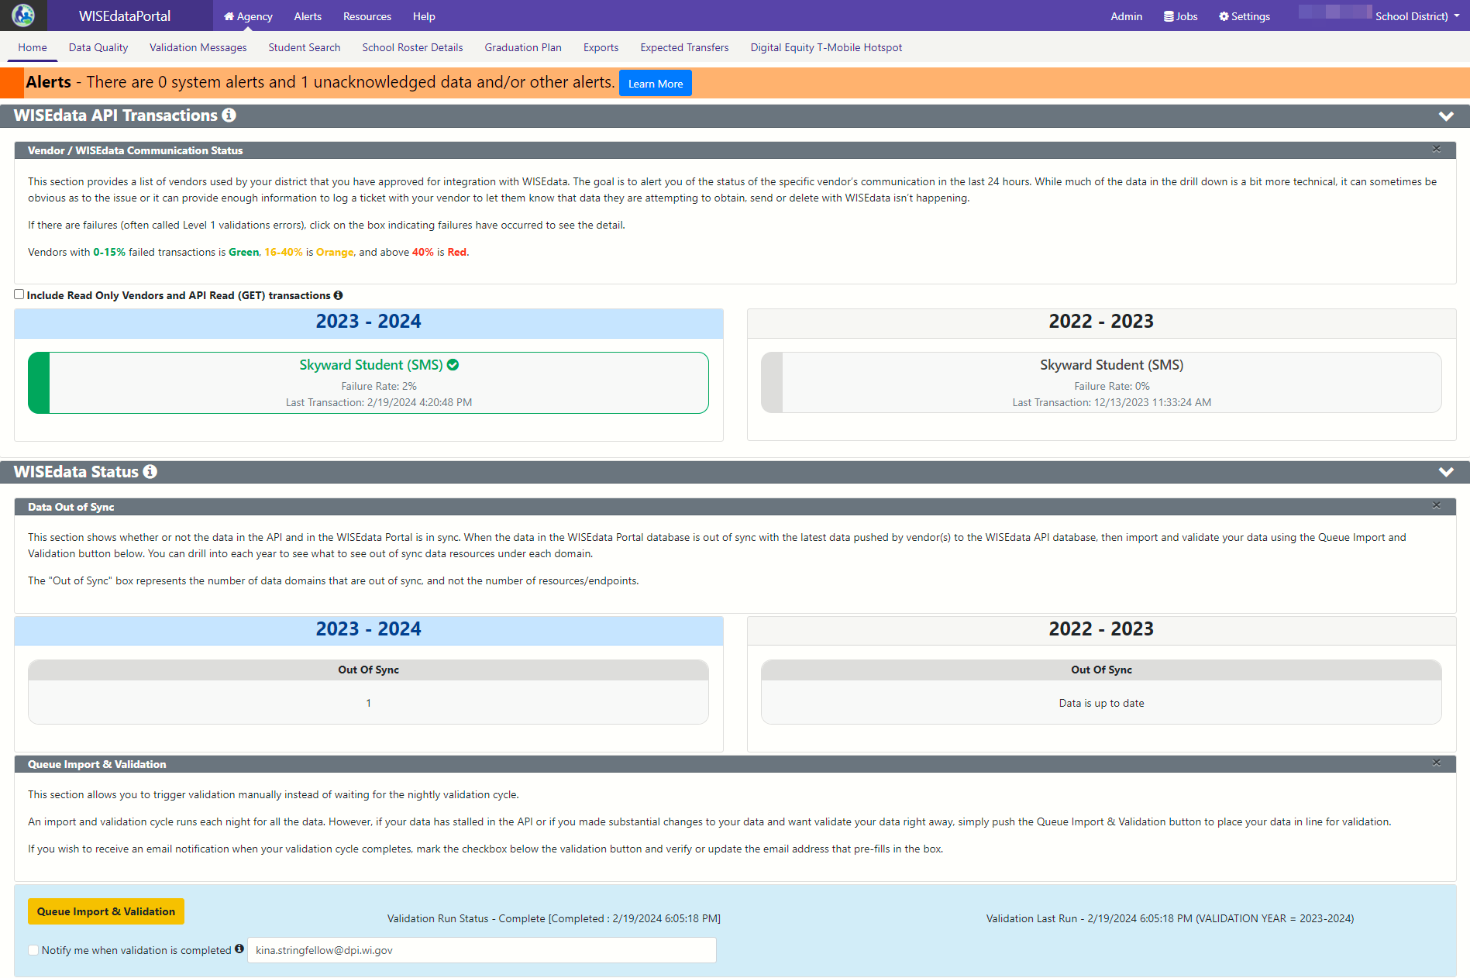
Step 1: Your Vendor System to WISEdata
New Design, WISEdata Home Screen:
WISEdata, API Transactions
WISEdata Status, Data out of Sync
Queue Imports and Validations

Slide 13
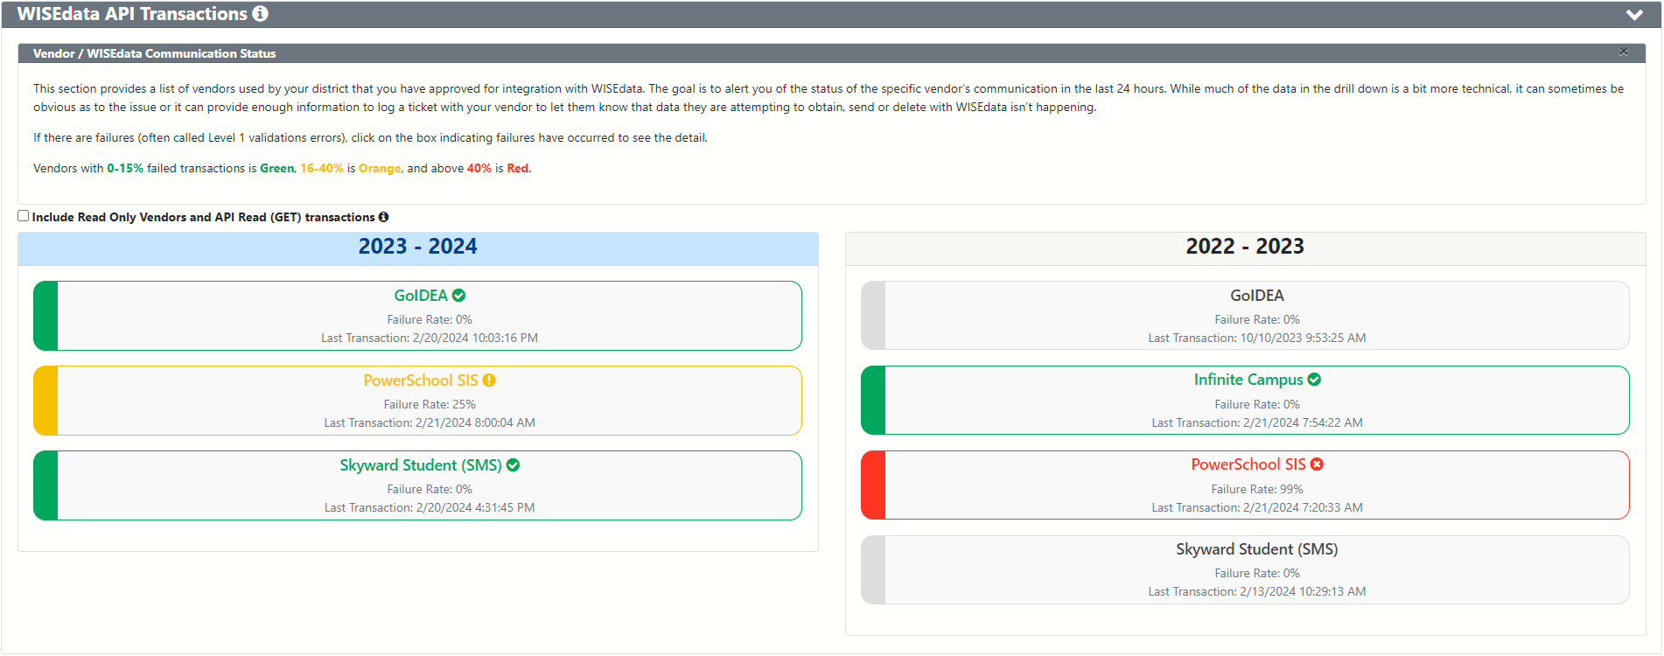
Step 1: Your Vendor System to WISEdata
Home Screen: Vendor Communication Status
Failed Transaction Rate: Green = 0-15%, Orange = 16-40%, Red = < 40%

Slide 14
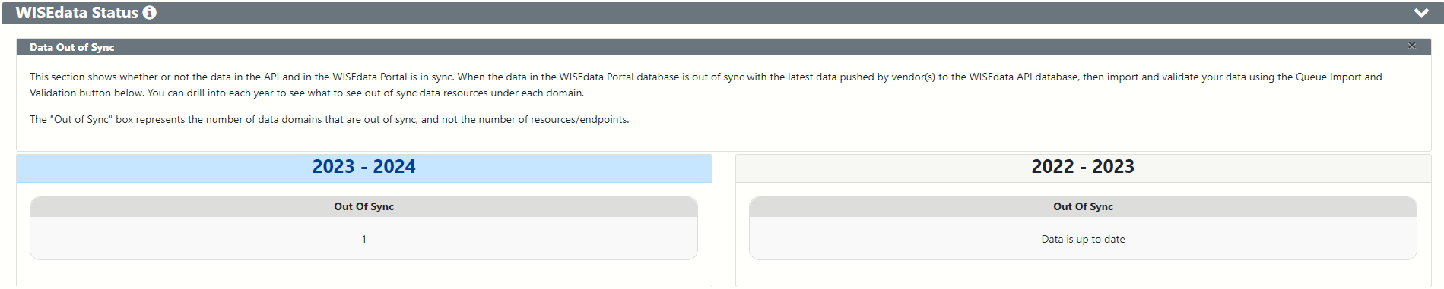
Step 1: Your Vendor System to WISEdata
WISEdata Status: Data Out of Sync

Slide 15
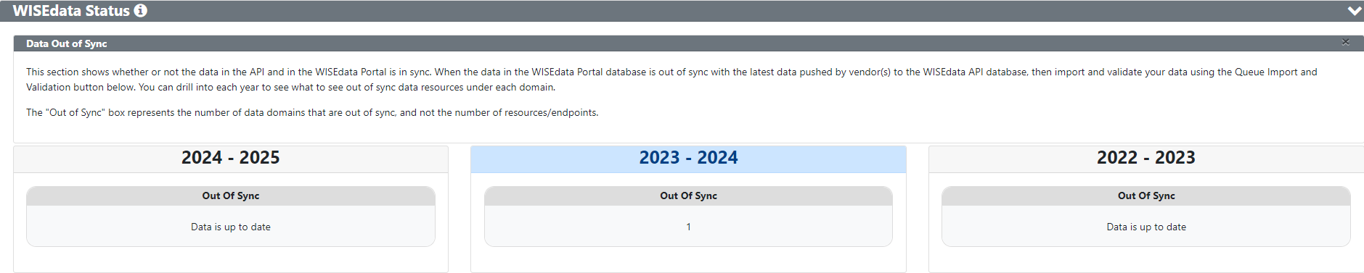
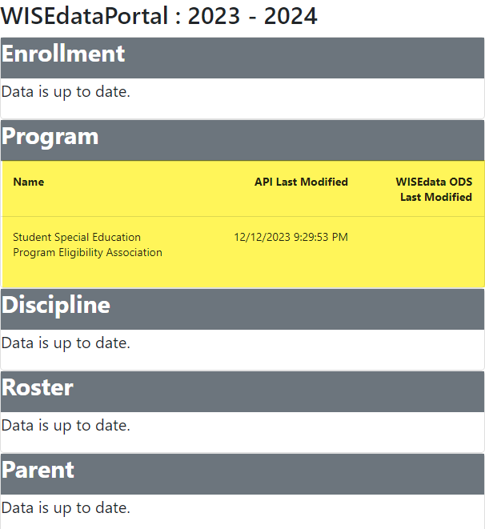
Step 1: Your Vendor System to WISEdata
WISEdata Status: Data Out of Sync with API

Slide 16
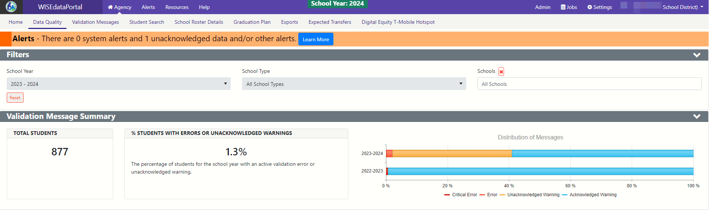
Step 2: WISEdata Portal Tasks
New Design, Data Quality Screen:
Filters, Validation Message Summary (Distribution of Messages graphic), Data Quality Indicators

Slide 17
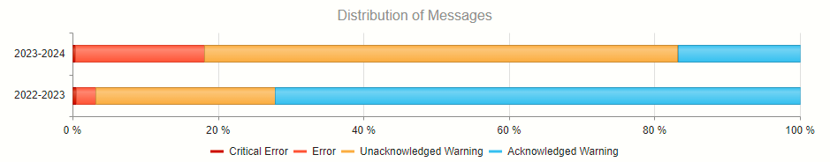
Step 2: WISEdata Portal Tasks
Data Quality Screen: Distribution of Messages
Critical Error: Dark Red
Error: Red
Unacknowledged Warning: Orange
Acknowledged Warning: Green/Blue

Slide 18
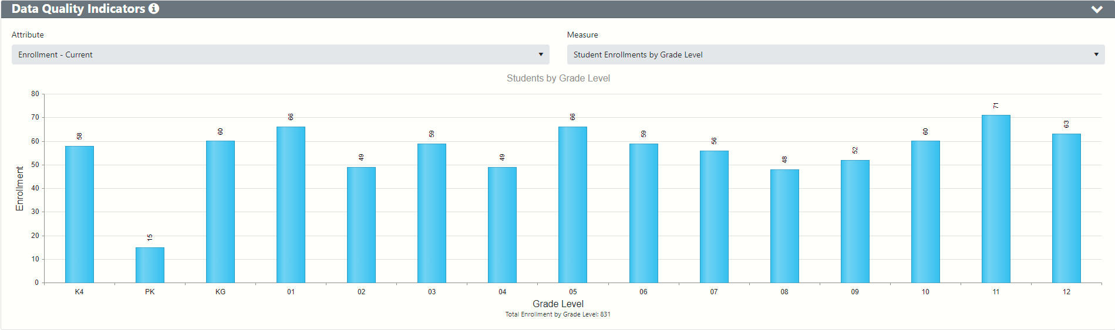
Step 2: WISEdata Portal Tasks
Data Quality Indicators (1 of 2)
Notes:
Use the Data Quality page and the Data Quality metrics to verify that all of the steps mentioned so far have been successful. If the high level metrics are not matching what is expected, your next steps are to identify individual students that may be missing or being sent with incorrect values.
On the screen, you can see there are two Enrollment graphs. The first on the left is for current enrollment counts - these counts can change based on the students exiting and entering your district. The second on the right is only for count dates - TFS and Oct 1. These counts should remain the same once you have these count inclusion values finalized and should not change throughout the year.

Slide 19
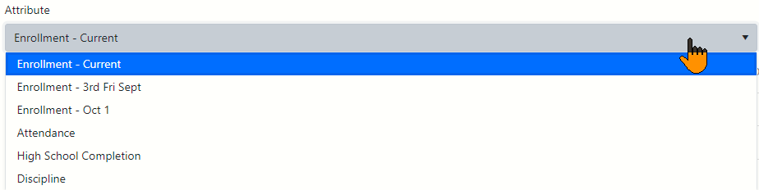
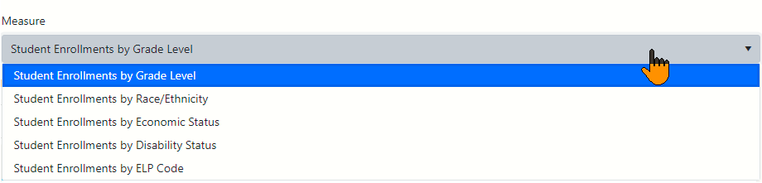
Step 2: WISEdata Portal Tasks
Data Quality Indicators (2 of 2)
Click the icon (information) next to the Data Quality Indicator to get in-line help about the graphs. This help is specific to each Attribute that is selected.
Notes:
Use the Data Quality page and the Data Quality metrics to verify that all of the steps mentioned so far have been successful. If the high level metrics are not matching what is expected, your next steps are to identify individual students that may be missing or being sent with incorrect values.
On the screen, you can see there are two Enrollment graphs. The first on the left is for current enrollment counts - these counts can change based on the students exiting and entering your district. The second on the right is only for count dates - TFS and Oct 1. These counts should remain the same once you have these count inclusion values finalized and should not change throughout the year.

Slide 20
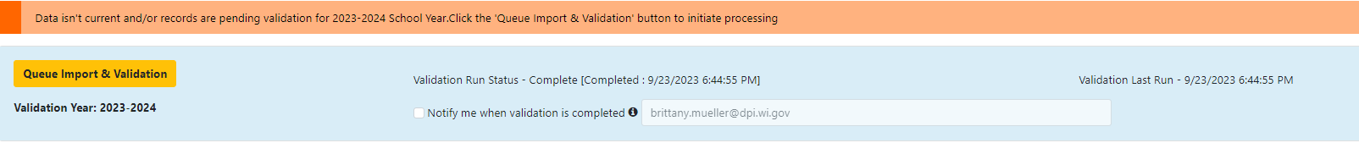
Step 2: WISEdata Portal Tasks
Imports and Validations (1 of 2)
Run Import & Validation in the WISEdata Portal (on WDP Home Screen)
This will import the data from WISEdata Ed-Fi into the WISEdata Portal and then run validations.
If the Import & Validation job is not manually queued, it runs for all agencies around 5 p.m.
Notes:
Pior to running a validation, make sure your data is current from your SIS. This can be done on the home screen. It's important to work with your SIS to know how to manually push data and when the data is schedule to flow if not manually pushing. Example, different years may push at different times from your SIS.
When you run a validation, it will only run the validation for the school year you are on, so make sure if you are working on multiple years you run the validation for each year.

Slide 21
Step 2: WISEdata Portal Tasks
Imports and Validations (2 of 2)
A validation request is queued with a projected time of processing
  Look to see that validation has completed…
  Or use the email feature!
Import & validation can be requested in WISEdata Portal from either of the below:
  Home page
  Validation Messages page

Slide 22
Step 2: WISEdata Portal Tasks
Review Validations
Once the validation step is complete
  Review data quality metrics and validation errors in the WISEdata Portal on the Validation Messages page.
  Repeat as necessary

Slide 23
Step 2: WISEdata Portal Tasks
Correct Validations in SIS
In your vendor system, correct the data containing validation errors and warnings. Some tips for that process:
  Visualize the numbers of errors & warnings on the WISEdata Portal Data Quality page. And utilize the metrics to look for unusual patterns.
  Prioritize critical errors. Data with critical validation errors may not be loaded to WISEdash or will otherwise have a large impact on data reporting (i.e., Report Card results).
  Utilize the Validation Category filter (on the WISEdata Portal Validation Messages page) to focus on validations relating to the school years and topics the snapshot is capturing.

Slide 24
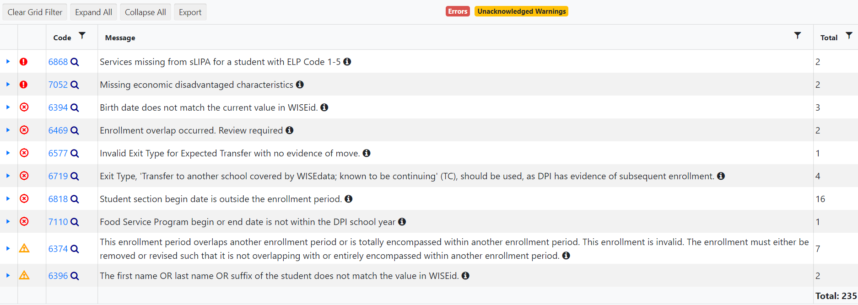

Step 2: WISEdata Portal Tasks
Validation Messages (1 of 2)
Click the black icon to see more information about the validation!
Notes:
message type - critical error, regular error, warning
Critical: Data doesnt flow to WISEdash
Regular Error: Data will flow to WISEdash, but will be incorrect
Warning: Data will flow but is unexpected from what our system is expecting, data MAY be correct or incorrect, can acknowledge if reviewed or un-acknowledge
i - short - long - KBA code
Short Text
Long Text
Here you will also see a blue hyperlink. This blue hyperlink is for the KBA relating to the error or warning. The KBA will explain the issue in more detail then the short and long text. The majority of KBAs also contain scenarios to help you understand the situation.
When you click the little drop down arrow on the left, it will show you the students affected by the error/waring. You can then click the details button which will bring up the student detail page. (go to next slide)

Slide 25



Step 2: WISEdata Portal Tasks
Validation Messages (2 of 2)
~200 validation rules
User can manually trigger validation, or it runs overnight
List of Validations
Critical icon indicates a severe error that will greatly impact snapshot data
Error icon indicates data is submitted incorrectly
Warning icon indicates something may be wrong with the submitted data but not necessarily
Notes:
message type - critical error, regular error, warning
Critical: Data doesnt flow to WISEdash
Regular Error: Data will flow to WISEdash, but will be incorrect
Warning: Data will flow but is unexpected from what our system is expecting, data MAY be correct or incorrect, can acknowledge if reviewed or un-acknowledge
i - short - long - KBA code
Short Text
Long Text
Here you will also see a blue hyperlink. This blue hyperlink is for the KBA relating to the error or warning. The KBA will explain the issue in more detail then the short and long text. The majority of KBAs also contain scenarios to help you understand the situation.
When you click the little drop down arrow on the left, it will show you the students affected by the error/waring. You can then click the details button which will bring up the student detail page. (go to next slide)

Slide 26
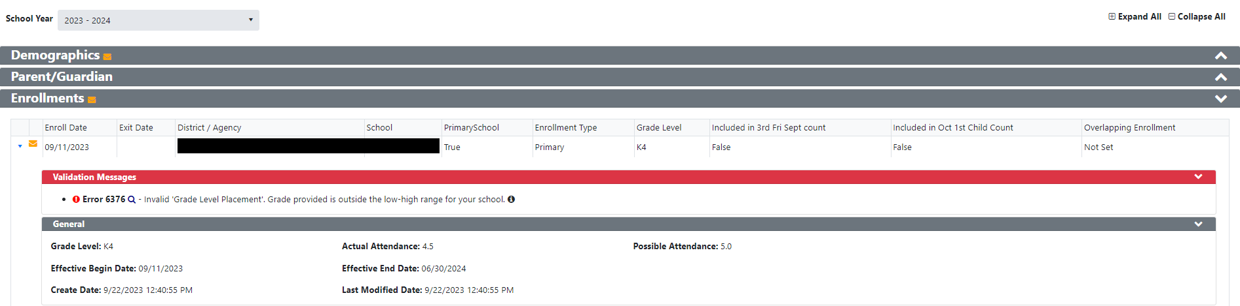
Step 2: WISEdata Portal Tasks
Student Detail Validations
Notes:
This is the student details page, which again you can access by clicking the details link under a specific error or warning. You can also get here by doing a student search and clicking the details button.

Slide 27
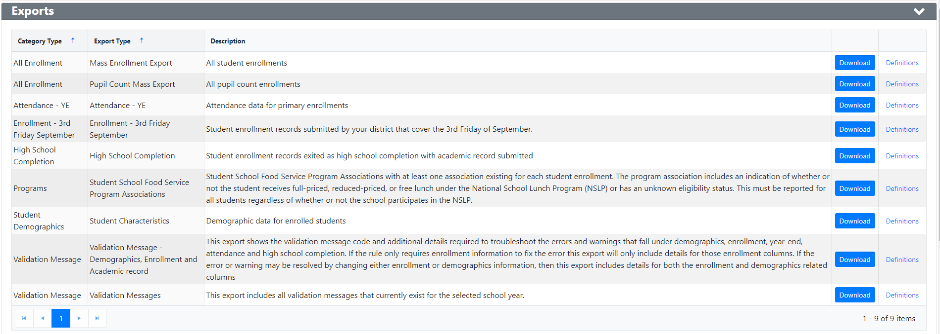
Step 2: WISEdata Portal Tasks
Exports (1 of 2)
Exports help you make data comparisons
Multiple exports available,
organized by data collection (Category Type)
Notes:
This is the exports page, accessible in WISEdata in the blue bar. This is a very helpful page that is somewhat underutilized.
Now before pulling an export, its important to make sure that the data your going to pull is current. You can do this by checking on the home screen for the last time data was pushed from your sis, and the check the last time the data was validated in wisedata. These reports are only as fresh as your last validation.
The best way to identify individual students with issues is to compare the export files provided by the WISEdata Portal to reports that are generated by your SIS. Learning to compare data tables in Excel can quickly help you to find records that should be reviewed, through all the steps we have discussed.
Having specific lists of students with a particular issues will also dramatically speed up support requests with DPI or your SIS vendor.

Slide 28
Step 2: WISEdata Portal Tasks
Exports (2 of 2)
Exports of particular interest for Choice schools
Mass Enrollment Export: for viewing all enrollments submitted along with each student's Choice Student Indicator
Enrollment – 3rd Friday of September Export: ensure Count Inclusion & Choice Student indicator are submitted correctly (feeds into front page of report card, counts should match OAS)
Student Demographics – Student Characteristics: view all characteristics for accuracy (econ disadv, disability status, ELP code, etc.)
Notes:
This is the exports page, accessible in WISEdata in the blue bar. This is a very helpful page that is somewhat underutilized.
Now before pulling an export, its important to make sure that the data your going to pull is current. You can do this by checking on the home screen for the last time data was pushed from your sis, and the check the last time the data was validated in wisedata. These reports are only as fresh as your last validation.
The best way to identify individual students with issues is to compare the export files provided by the WISEdata Portal to reports that are generated by your SIS. Learning to compare data tables in Excel can quickly help you to find records that should be reviewed, through all the steps we have discussed.
Having specific lists of students with a particular issues will also dramatically speed up support requests with DPI or your SIS vendor.

Slide 29
Step 2: WISEdata Portal Tasks
Data Quality Alerts (1 of 3)
Data quality alerts display in WISEdata Portal
Using them cuts down on number of emails from the Customer Services Team
Click the ‘Learn More’ button. It will take you to the Alert page to see details about data quality alerts for your school.
Notes:
WISEdata Alerts were just turned on recently so if you have not already taken a look at this banner in your WISEdata Portal, please do so ASAP. These are generated by DPI reports based on the data you’ve submitted to WISEdata and will indicate data issues that you will need to review.

Slide 30
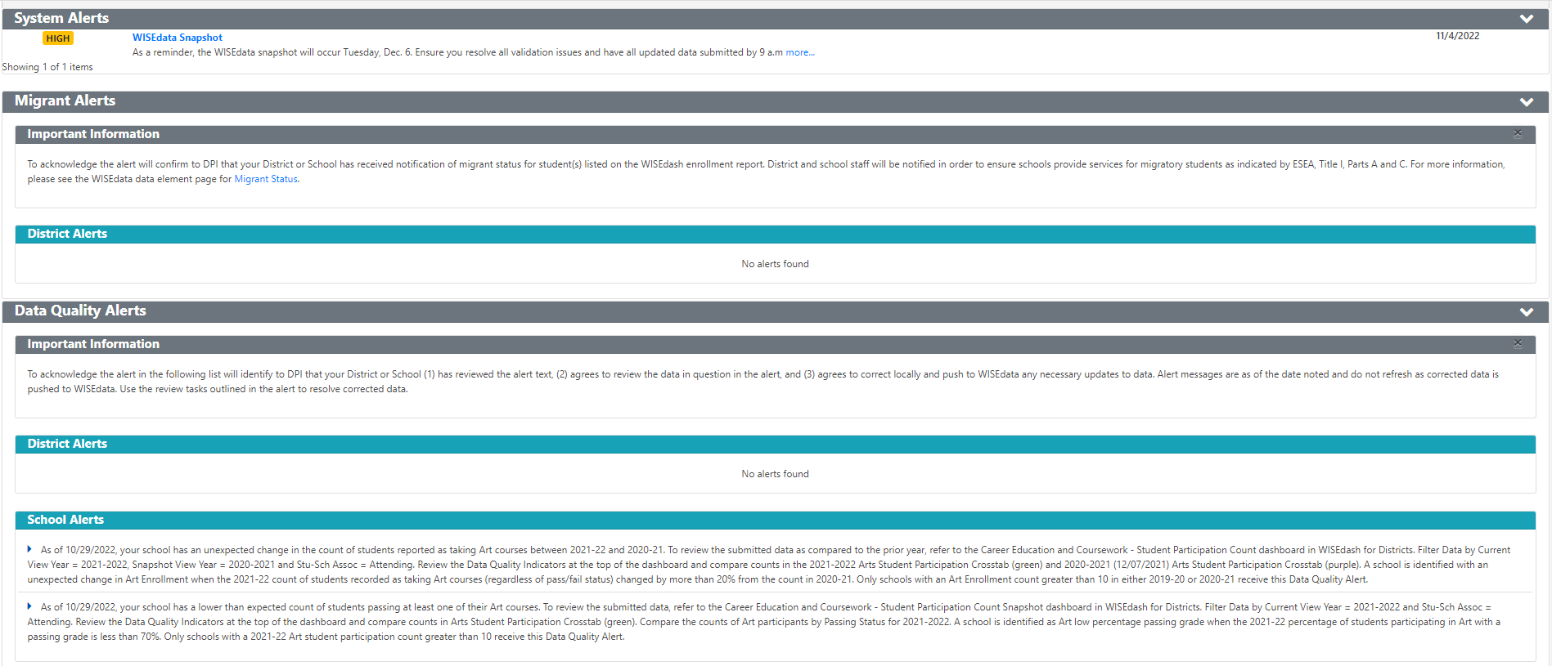
Step 2: WISEdata Portal Tasks
Data Quality Alerts (2 of 3)
Follow the instructions to investigate, review, and/or correct your data.
Notes:
This is what the alerts look like once you click the orange banner.
You will see System Alerts, such as the Snapshot Date reminder, Migrant Alerts, and Data Quality Alerts. Alerts will also be broken down into District level and School Level.
Each alert will tell you exactly where to go, usually in WISEdash, to review the information we’ve flagged as needing review.
Please be aware that when looking at the School Level alerts, you will need to open the alert using the little triangle on the left side, similar to opening a validation message for the student list, this will open the alert so it shows you the specific school with the issue. This is often overlooked.

Slide 31
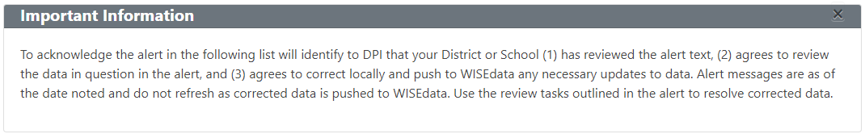
Step 2: WISEdata Portal Tasks
Data Quality Alerts (3 of 3)
Follow all instructions in the Important Information box.
Once you have addressed the data quality issue, acknowledge the alert.
(Note: Only Primary or Secondary WISEdata contacts can acknowledge the alerts)
Notes:
Once you have reviewed the information indicated in the alert, you will Acknolwedge the alert. Be aware, these alerts do not refresh the way Validation messages do, so the alerts will not disappear or correct themselves after you acknowledge or correct the data in your SIS.
Acknowledging can only be done by the Primary or Secondary WISEdata contact, so if you do not see an acknowledge button available to you, that is why. Acknowledging the alert tells us you are aware and reviewing the issue so it can either be resolved and acknowledged as correct.
*Quick note on contacts, this is a good example on why you should be listing the primary contact as the person actually working in WISEdata. Please dont list admins or DSA’s as your primary contact if they are not the person working in the portal.

Slide 32
Step 2: WISEdata Portal Tasks
In Review...
Prior to a snapshot make sure that:
  All errors are resolved
  All warnings are either acknowledged or resolved
  All data quality alerts are either acknowledged or resolved
Look for and read notifications from the DPI Customer Services Team
  Regarding operational data quality checks
  Providing help with specific issues they find.
  Generally sent during the ~6-8 weeks leading up to the snapshot
Notes:
Read side
I would also highly recommend attending the weekly user group calls, which are on tuesdays at 1:30. Information on those can be found on the wisedata events calendar.

Slide 33
Snapshot Preparation Summary
Use WISEdata Portal Regularly | Use WISEdata Portal to Prep for a Snapshot
You and your team should be checking the WISEdata Portal weekly, if not daily. It’s critical that this is a team process, not just one person in the office. Remember! Frequent, regular review means less burden at snapshot time! | In the 6-8 weeks prior to a snapshot, review the data weekly. Include anyone who has reason to use or know about the data: assessment, accountability directors, principals, food service directors, special ed directors, etc.
Notes:
Read slide…
There is no way to lock in your data prior to the Snapshot so it is important to be reviewing it daily leading up to the Dec 6 deadline. Even if your data looks good and all errors are cleared, data is still flowing and can be changed at any time so make sure you are paying attention and aware of your Portal until the Snapshot is taken.

Slide 34
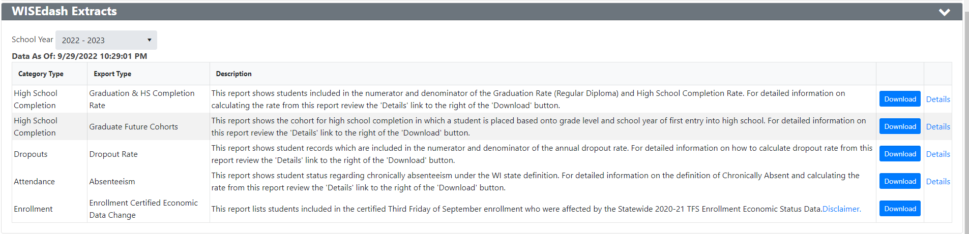
Step 3: WISEdash Extracts

Slide 35
Step 4: WISEadmin Portal
Are you a Choice Administrator or DSA?
Log into WISEhome, then
Select “WISEadmin Portal.”

Slide 36
Step 4: WISEadmin Portal
Purpose
For District and Choice administrators
A centralized location for reviewing
  administrative snapshot acknowledgments
  agency contacts
  key performance indicators
Also the place for submitting data errata letters

Slide 37
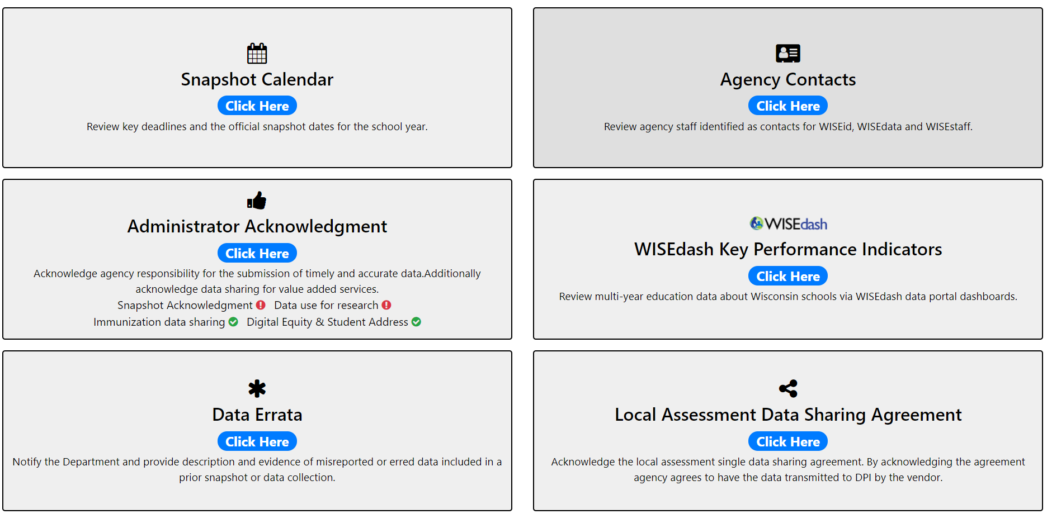
Step 4: WISEadmin Portal
Home Screen
Notes:
Remember: Data Errata is a last resort! It is extremely important that your data is correct at the time of the snapshot.

Slide 38
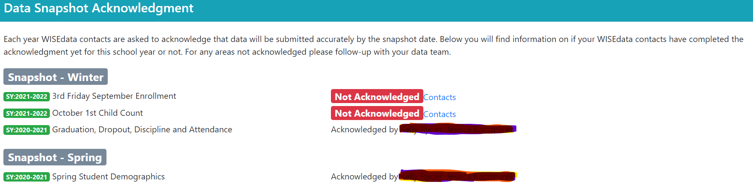
Step 4: WISEadmin Portal
Data Snapshot Acknowledgment
On the Administrator Acknowledgment page
Review your snapshot responsibilities as district/Choice administrator
Review which contacts have acknowledged each data snapshot

Slide 39
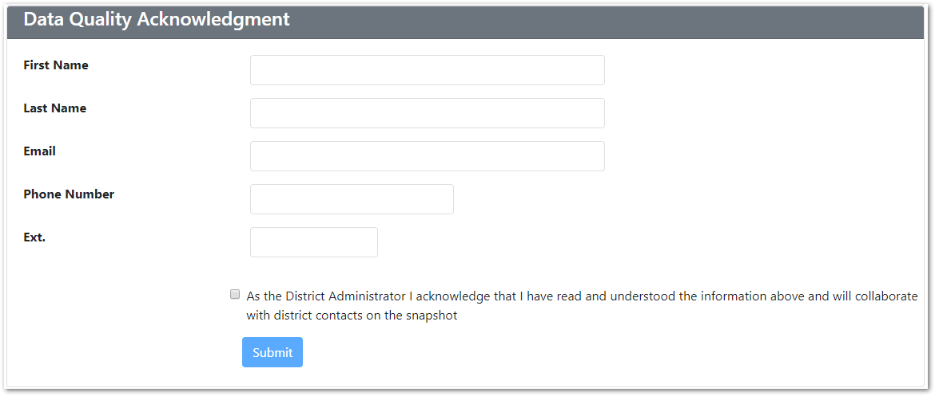
Step 4: WISEadmin Portal
Data Quality Acknowledgment
At the bottom of the page, fill out the Data Quality Acknowledgment form to:
  Acknowledge your administrative responsibilities for the snapshot
  Click the check box
  Then click Submit

Slide 40
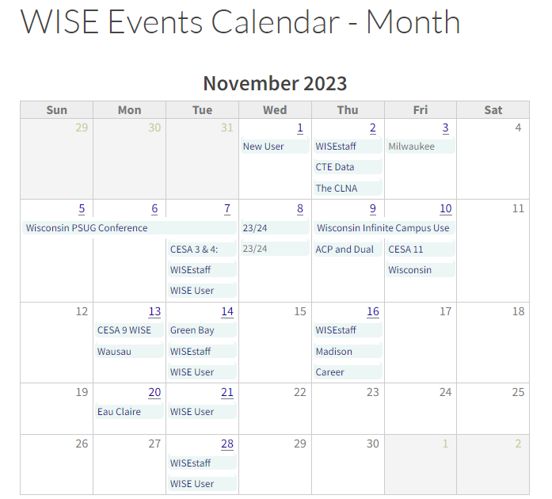
Step 4: WISEadmin Portal
Snapshot Calendar
A quick link to the snapshot calendar on the DPI website.
Allows for quick check-ins on upcoming important dates for annual snapshots.

Slide 41
Step 5: Final Tasks
Acknowledgment
Collection Acknowledgment
  Acknowledge each data collection in the WISEdata Portal before the snapshot of that particular data collection.
  Acknowledgments are important to ensure you have taken all the steps needed to send DPI correct data.
Notes:
As a WISEdata Portal user, you acknowledge your responsibility in making sure your data is being reported correctly and completely within the WISE systems for the Snapshot. Going through the review steps and tool available to you is an important part of that process.

Slide 42
Step 5: Final Tasks
Final Days
In the final days prior to the snapshot:
Double check that your errors and warnings are resolved.
  Even if all errors were resolved previously, continue to check daily in the days just before the snapshot.
  Changes other agencies make may change your data.
Double check that you have enrollment (and Choice participant values) for all schools and in all grade levels in WISEdata. Do this for both the current year and the prior year.

Slide 43
Step 5: Final Tasks
‘Watch For’
Some common issues include:
Choice participant indicator incorrect or missing
Economically Disadvantaged status incorrect or missing
TFS & Count Inclusion status missing
ELL status missing (encouraged for all, but must be provided by schools administering the ACCESS for ELLs exam)
Notes:
Econ Disadvantage Status is calculated based on the Econ Status reported in the student’s Demographics and their Food Service Eligibility record, so making sure both of those values are correct is important.
TFS and Oct 1 inclusion values - making sure those values report out of your SIS to WISEdata and then making sure there are no validation errors blocking those values form reporting to WISEdash is also important.
Additionally, making sure your ELL data and SPED data is entered correct, as these can also cause issues with your data being captured correctly for the Snapshot.
All important issues to be reviewing and ensuring are correct.

Slide 44
Step 5: Final Tasks
Snapshot Help Docs
WISEdata Annual Tasks Checklist webpage: An organized checklist of items that need to be completed for WISEdata reporting annually.
Knowledge Base Articles (KBAs): Useful articles on validations and other related topic
Mini Tutorials: Cover a variety of topics you may have questions on
Snapshot Preparation Guidance webpage: Provides in-depth guidance on snapshot information
Notes:
Data elements included in each collection listed at the bottom of the webpage.

Slide 45
Step 5: Final Tasks
Getting Help
Notifications from the DPI Customer Services Team
  ~6-8 weeks before snapshot DPI will begin program area data quality checks and may find specific issues to reach out to you on.
  Review Data Quality alerts in WISEdata Portal
Help Tickets
  Create a Help Ticket, so the DPI Customer Services Team can help you resolve issues, including those that may be vendor related.
Notes:
Data Quality Notifications from the DPI Customer Services Team (CST) - 6 to 8 weeks prior to the snapshot, DPI CST will begin to contact districts regarding data quality items. In addition, review and attend to any Data Quality alerts present in the WISEdata Portal. Data Quality alerts are generated once or two prior to snapshot, and are not updated daily.

Slide 46
Post-Snapshot: Data Errata Letters
Once the snapshot is taken, the data in the WISEdash database cannot be changed.
Data errors after snapshot are addressed with a Data Errata letter submitted via the WISEadmin Portal.
Remember: do not include personally identifiable information (PII)!
More info: https://dpi.wi.gov/cst/data-collections/data-errata

Slide 47
Data Privacy
We take data privacy very seriously!
Data Privacy Resources
Data Privacy Overview
Data Privacy Parent Checklist
Data Privacy Training
Safeguarding Data Privacy
Student Data Privacy Resources
WISEsecure and WISEhome Resources
Notes:
We have many resources on our data privacy page available to you to use and reference in your districts and schools. Please use these resources in your districts!

Slide 48
More Helpful Resources
WISEdata Flyer: High level overview describing how WISEdata has improved our data collection process, data quality, and system integration.
Info for Schools: Basics of getting started with WISEdata
WISEdata Help: Links to WISE help pages and useful resources
Data Elements: List of links to all WISEdata data elements and their descriptions, uses, and codes
Google Currents/Workspaces is switching over to Teams!
Stay tuned for communications from the Customer Services Team.
Platform change will occur next week

Slide 49
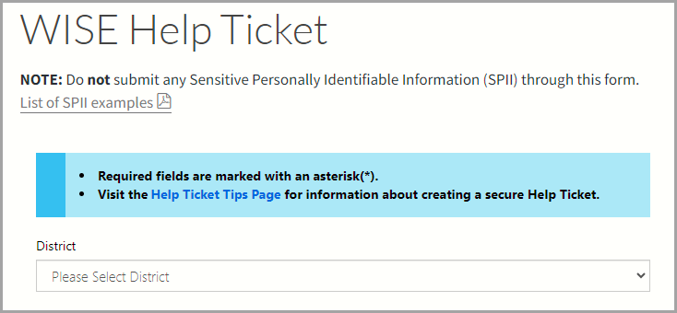
Help Ticket
Help Ticket
Notes:
Have a question, comment, and/or suggestion? Submit a help ticket and someone will respond to your question.

Slide 50
Giving Feedback
  Within most DPI applications, you can
  Provide feedback directly
  Enter a new suggestion
  Vote on suggestions made by other people
feedback.dpi.wi.gov

Slide 51
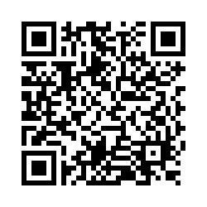
Questions?
Thank you! Thank you!
Please scan the QR code to provide us with your feedback!

