Slide 1
WISEdash - Assessment Data
Informing interpretation and use of scores and reports
Office of Educational Accountability
March 6, 2024
Notes:
Good morning! Let’s look at what goes into making our statewide assessments in order to help inform decisions about how to use the scores and reports in your districts.

Slide 2
Agenda
The Wisconsin Student Assessment System
Standards and Assessment
Item development and review
Reporting
New for 2024
Notes:
We’ll start with a quick overview of the Wisconsin Student Assessment System, then look at how the assessments measure the state academic standards, using the Forward Exam and the Wisconsin Standards for Mathematics to illustrate. We’ll also discuss a little bit about how items are developed and reviewed before they’re used on tests, how we report results, and, finally, what’s new for the 2024 assessments.

Slide 3
Wisconsin Student Assessment System
Forward Exam
Dynamic Learning Maps (DLM)
PreACT Secure
ACT with writing
Notes:
These exams are part of the Wisconsin Student Assessment System. Additional assessments administered in your district may include ACCESS for ELLs for English learners, the National Assessment of Educational Progress, or NAEP, for selected schools, assessments selected by your district or school, and of course, teacher-made assessments. We encourage the strategic use of assessment, including local benchmark assessments, and formative assessment practices.

Slide 4
Statewide Assessments - Purposes
Statewide test results provide data that is comparable across districts and across time. The test results must be used along with other data for a more complete picture to inform, for example:
Accountability
Improvement efforts
Curriculum planning and evaluation
Education research and policy making
https://dpi.wi.gov/assessment/forward/data#purpose
Notes:
Data from statewide assessments can be used for a variety of purposes. The assessment data provide information that is most useful when considering big-picture questions like these. However, the bottom line is that the assessment system is intended to support learning for all students. Educators should consider the statewide assessment data in the context of other available data.

Slide 5
Standards and Assessment
Standards are the foundation of assessments.
Notes:
Wisconsin Academic Standards specify what students should know and be able to do at each grade level. They serve as goals for teaching and learning, and define for students, parents, educators, and citizens what students should have learned at each grade level or grade band.
While standards provide the goals for learning, curriculum is the day-to-day activity that helps a student meet those goals. Curriculum creates the student's overall classroom experience and includes lesson plans, classroom assessments, textbooks, and more.
The Forward Exam is designed to gauge how well students are doing in relation to the Wisconsin Academic Standards. All questions on the Forward Exam are linked directly to a Wisconsin Academic Standard for each tested grade-level and content area.
The exam provides a broad measure of achievement that should be used along with local measures such as report cards, schoolwide assessments, grades, and other information about a student’s progress in school. Students receive a score based on their performance (demonstrating their knowledge and skill in relation to the grade-level standards) in each content area.
Federal law requires that States must implement assessments in Mathematics, Reading or Language Arts, and Science for all public school students, which must be aligned with the State's academic standards and provide information on whether a student is attaining those standards and performing at grade level.

Slide 6
Test and Item Development
Test designs and blueprints are developed to assess student knowledge of the Wisconsin Academic Standards.
Items are developed to meet the test designs and blueprint.
Notes:
The tests are designed, and items (test questions) are developed, specifically to assess student knowledge of the Wisconsin standards. We develop a test plan, or blueprint, and make this available on our website. This blueprint guides test construction and item development. Every test question is designed to measure student knowledge of a standard. Let’s take a look at Mathematics for an example of how this works.

Slide 7
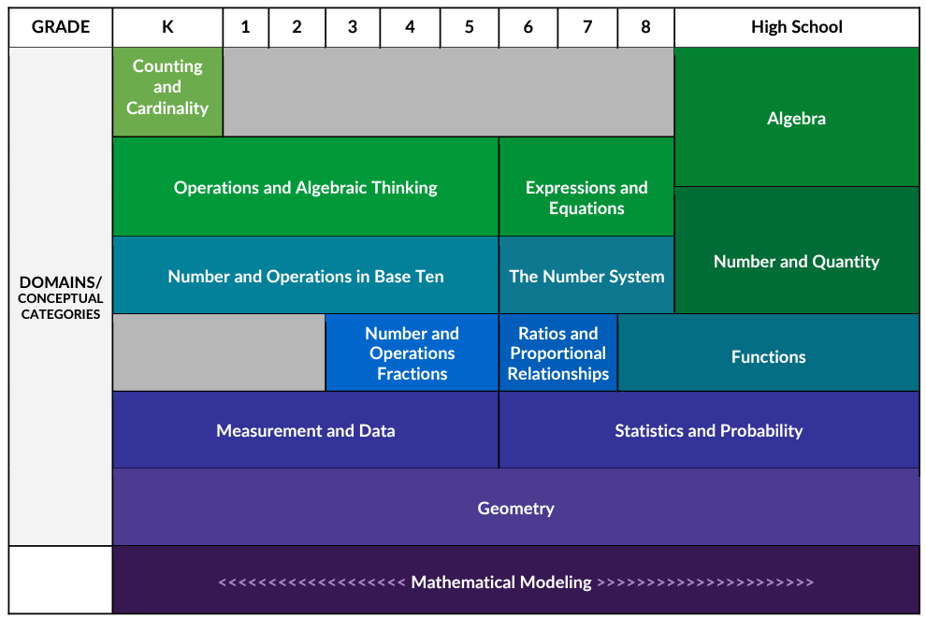
Wisconsin Standards for Mathematics
Wisconsin Standards for Mathematics, page 15
Notes:
Here is a section from the Wisconsin Mathematics Standards. We can see there are a number of conceptual categories, for example, the blue one in grades K through 5, “Measurement and Data”.

Slide 8
Test Blueprint - Mathematics Grade 3
Domain and Cluster Statements | Focus | Possible Points
Measurement and Data (Reporting Category) |  | 10-12
A. Solve problems involving measurement and estimation of intervals of time, liquid volume and masses of objects. | M
B. Represent and Interpret Data | S
C. Geometric measurement: understand concepts of area and relate area to multiplication and to addition. | M
D. Geometric measurement: understand perimeter as an attribute of plane figures and distinguish between linear and area measures. | A
https://dpi.wi.gov/assessment/forward/resources#development
Notes:
Here is what the test blueprint looks like for Measurement and Data in third grade. The number of points in each reporting category reflects a focus on the major work of each grade (M=Major work; S=Supporting work; A=Additional work).

Slide 9
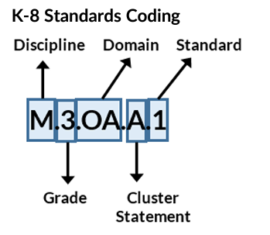
Wisconsin Mathematics Standards Notation
Wisconsin Standards for Mathematics, page 14
Notes:
This slide shows how the Mathematics standards are coded. In the example, the domain is OA, for “Operations and Algebraic Thinking”.

Slide 10
Sample Mathematics Standard
Measurement and Data (3.MD) | Data (3.MD)
Cluster Statement | Notation | Standard
B. Represent and Interpret Data | M.3.MD.B.3 | Draw a scaled picture graph and a scaled bar graph to represent a data set with several categories. Solve one- and two-step “how many more” and “how many less” problems using information presented in scaled bar graphs. For example, draw a bar graph in which each square of the bar graph might represent five pets.
Wisconsin Standards for Mathematics, page 64
Notes:
In a previous slide we looked at the conceptual categories in the Mathematics standards. Here’s an example of a specific standard in the third grade measurement and data category. Unpacking the notation, we can see this is a Mathematics standard for grade 3, relating to Measurement and Data, and specifically to “Represent and Interpret Data”.

Slide 11
Items Align to Standards
Number 12
Alignment | M.3.MD.B.3
Depth of Knowledge | 1
Notes:
Let’s look at an item from the Forward Exam practice test that was developed specifically to assess students’ knowledge of that standard. The item information includes the standard the item is aligned to, and the Depth of Knowledge, DOK, or cognitive complexity, of the item.

Slide 12
Depth of Knowledge (DOK) - Mathematics
Recall (fact, definition, procedure)
Skill or Concept (decision making)
Strategic Thinking (reasoning, planning, using evidence)
Extended Thinking (complex reasoning, most likely over an extended period of time)
Notes:
Depth of Knowledge is related to the type of thinking needed, and is not the same as difficulty. Some tasks requiring extended time are more appropriate for classroom assessment than for a point-in-time standardized state assessment. The sample item we’re going to look at is a DOK 1 item, requiring the application of a procedure.

Slide 13
Sample Grade 3 Mathematics Item
https://dpi.wi.gov/assessment/forward/sample-items
Notes:
And here is the item itself. Here is the first half of the item, which would all be on one page on the actual test.

Slide 14
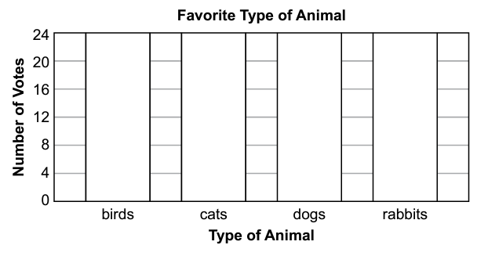
Sample Mathematics Grade 3 Item, cont.
Notes:
This is the section where the student would create the bar graph.

Slide 15
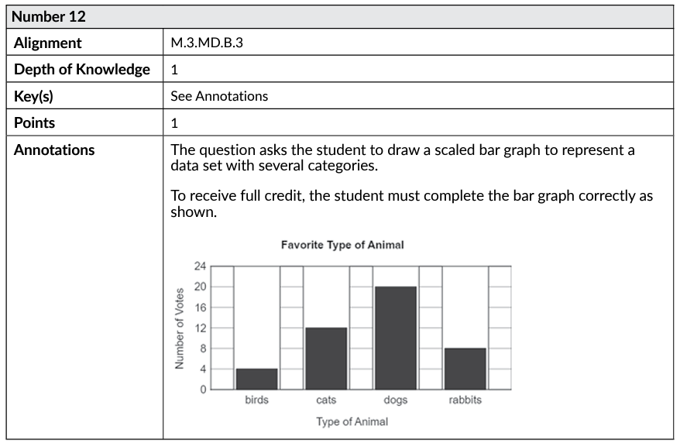
Sample Item Scoring Guide
Notes:
The Practice Test includes item annotations such as this. We’ve already seen the top part of this annotation, the rest includes the number of points for the item, the correct answer, and sometimes explanatory text about what a student would need to do for full credit, or the purpose of the wrong-answer choices for a multiple choice question.

Slide 16
Item Review
Items are reviewed by DPI staff and educator panels.
Items that pass this review are field tested on the exam (they don’t count toward a student’s score).
Item performance data is reviewed by DRC and DPI.
Items that pass the data review are included on future operational forms (they count toward a student’s score).
Notes:
All items undergo several steps of review to ensure their quality, alignment to standards, fairness and freedom from bias, difficulty, and so on. Wisconsin educators review all new test questions created for the exam for content, grade level appropriateness, alignment to the correct standard, cultural inclusivity, and bias/sensitivity issues prior to placement on the exam. After field testing, item performance data is reviewed.

Slide 17
Examples of Item Data Review Flags
P-value less than 0.2 or higher than 0.9
Positive point-biserial correlation for a distractor
Large Differential Item Functioning value
High omit rates
Notes:
These are among the statistics reviewed for each item after field testing to help us determine whether the item performs the way we want it to. There are other “flags” as well, but this provides a sense for the kinds of data we look at. Items that don’t perform the way they are supposed to are rejected and are never used on the test.
P-value is the proportion of students who answered an item correctly and is a measure of item difficulty. A p-value of 0 means that no students answered the item correctly, while a p-value of 100 indicates that all students answered the item correctly. In other words, the higher the p-value, the “easier” the item. Items outside the target range can be accepted if the content is appropriate.
A positive point-biserial correlation for a distractor (incorrect answer choice) indicates that students who did well on the test tended to choose that incorrect answer. The basic idea is that the distractors shouldn’t be more attractive to students than the correct answer. The distractors should represent common misconceptions or errors that students might make if they don’t fully understand the concept that the question is assessing.
Differential Item Functioning is used to identify items that function differently for different groups of students (focal group vs. reference group). The idea is that students who perform similarly on the rest of the test should perform similarly on an item. Items are flagged if they don’t behave the same for different groups of students, after controlling for student performance on the test.
Items that are omitted by large numbers of students may be rejected.

Slide 18
Reporting
Where to view your data:
WISEdash for Districts
WISEdash Public
Vendor portals
Individual Student Reports (ISRs)
District Student Information System (SIS)
Notes:
We have covered test and item design, now let’s look at reporting. Test results are reported in a variety of places.

Slide 19
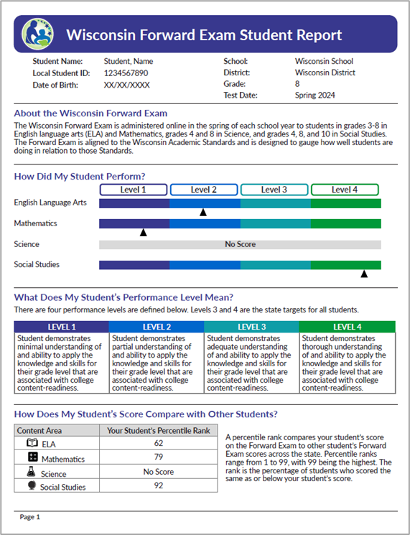
New Look for the ISR - Page 1
More parent friendly
Updated performance level categories
Asset-based language for performance level descriptions
Percentile ranks (no change)
Notes:
Here’s a sample first page from the new Forward Exam Individual Student Report, ISR, which is still in development. Note that student performance is reported on this page in terms of performance levels and percentile ranks. The performance levels on this draft are labeled “level 1”, etc., while we finalize new asset-based terminology for these levels. We felt that the current terms, such as “below basic,” don’t promote an asset-based, growth mindset. We surveyed educators on the topic and received 800 responses. We have analyzed the survey results and held cross-agency discussions to arrive at some new terminology, which is still in the final stages.

Slide 20
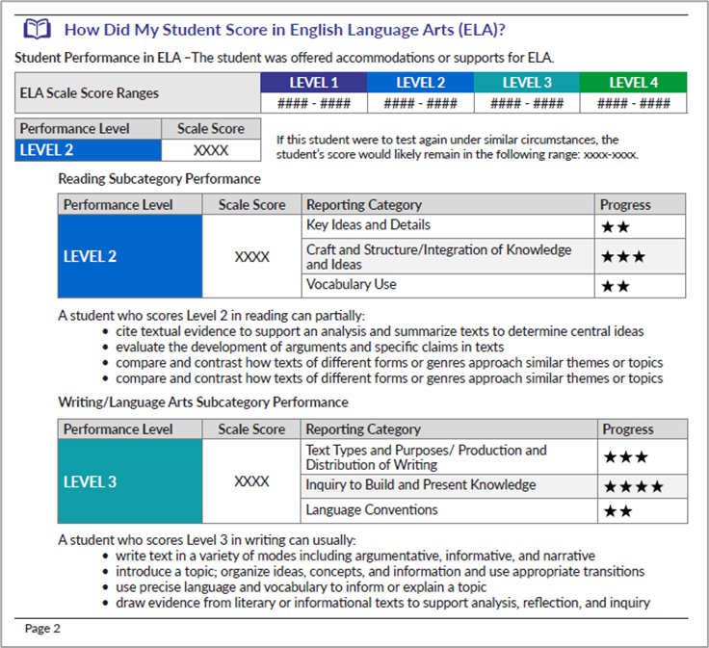
New Look for the ISR - Page 2
Scale scores (TBD)
Separate Reading and Writing scores
More information for parents
Notes:
On page two of the ISR we see student performance reported in terms of scale scores. In English Language Arts and Mathematics, the scales will change and the scale score ranges for each performance level will also change as a result of a standard setting in June - more on that later. Other new features include separate reading and writing scores on the same scale as ELA, and including standards-based descriptions of what students at the identified level can typically do.

Slide 21
Scale Scores
Grade | Minimum | Maximum
3 | 360 | 760
4 | 405 | 800
5 | 430 | 830
6 | 440 | 870
7 | 450 | 880
8 | 470 | 890
Forward Exam Mathematics Scale Score Ranges
https://dpi.wi.gov/assessment/forward/data#scores
Notes:
The Forward Exam uses vertical scales for each subject area. Here, for example, is the old scale for Mathematics. As I mentioned previously, there will be a new scale in 2024.

Slide 22
Percentile Ranks
Scale Score | Percentile Rank
520 | 25
543 | 40
557 | 50
589 | 75
617 | 90
Forward Exam Mathematics Grade 3,
Spring 2023
https://dpi.wi.gov/assessment/forward/data#percentile
Notes:
The Forward Exam Individual Student Report (ISR) includes information about how a student ranks compared to other students in the state at the same grade-level. If a student has a percentile rank of 40%, this indicates the student performed at the same level or better than 40% of students at that grade level on the exam, or that 60% of the students performed at a higher level.
The results in this scenario answer the question, “How well did the student perform in comparison to their peers?”. Yearly percentile tables show the correlation between score ranges and percentile rank for each content and grade-level. Reporting results in terms of percentiles, however, does not provide information on whether students are meeting grade-level expectations. Rank ordering the student scores does not necessarily reflect the amount of knowledge and skills demonstrated by students on the test.

Slide 23
How Performance Standards are Established
A standard setting occurs when a statewide assessment is created or academic standards have been revised.
Typically, a diverse panel of Wisconsin educators make recommendations for the cut scores for each performance level.
https://dpi.wi.gov/assessment/forward/data#resources
Notes:
Typically, educators and assessment professionals have made recommendations to the State Superintendent to establish the performance levels. The most common process for arriving at these recommendations involves a standard setting where panels of educators review the standards, performance level descriptions, and test items. The performance levels help answer the question, “How does this student’s learning compare to the expectations for their grade level?”

Slide 24
Percentile Rank vs. Performance Standard
Forward Exam Grade 3 Mathematics, 2022-23
Scale Score | Percentile Rank | Performance Level
520 | 25 | Basic
543 | 40 | Basic
557 | 50 | Basic
589 | 75 | Proficient
617 | 90 | Advanced
https://dpi.wi.gov/assessment/forward/data#resources
Notes:
The percentile ranks associated with a particular scale score change from year to year, while the cut scores associated with the scale scores change only when there is a new standard setting. Summing up the previous two slides, the percentile ranks compare a student’s score to the scores of other students in the same grade in the same year, while the performance levels compare a student’s score to grade-level expectations in the academic standards. This example is from last year’s Forward Exam Mathematics test. The numbers may be different after the standard setting - remember, in the standard setting educator panels look at test items and the academic standards, not at how one student’s score compares to other students.

Slide 25
New for 2024
Ed-Fi API Pilot
Changes to the Forward Exam
Standard Settings
Reporting Timeline
Notes:
Let’s end by discussing some changes for 2024.

Slide 26
Ed-Fi Applications Programming Interface Pilot
District Student Information System
Standards facilitate education data sharing.
Ed-Fi API
WISEdata
Assessment Vendor
Notes:
The Office of Educational Accountability and the DPI Collections team are working with our assessment vendors on a new, better way to exchange student demographics and assessment information for Forward, Pre-ACT Secure and ACT. We are working with a few districts to conduct a pilot this spring. Districts will still do all of the regular processes, the only extra work is that volunteer districts will also receive a student data file from the vendor to compare with their enrollments throughout the test window. We are interested in determining whether districts and choice program schools are keeping their WISEData information complete and up-to-date throughout the test window. The outcome goal of the project is to have a single place (WISEData) where demographics and enrollments are updated so that DPI can share these data directly with vendors.

Slide 27
Forward Exam ELA Test Design Changes
Removal of listening session
Three sessions instead of four
Removal of Text Dependent Analysis (TDA)
Two new short-write tasks
https://dpi.wi.gov/assessment/forward/resources#development
Notes:
In addition to the new ISRs for the Forward Exam that we looked at earlier, there are other changes.

Slide 28
Standard Settings
In June, Wisconsin educators will recommend cut scores for the Forward Exam in English Language Arts (ELA) and Mathematics.
In July, Wisconsin educators will recommend cut scores for the ACT ELA, Mathematics, and Science.
The standard settings will require starting new trendlines.
Notes:
We will conduct a standard setting for the Forward Exam in June. We will also conduct a standard setting for the ACT in July. In addition, we’ll reset cut scores for the PreACT Secure. As a result of these standard settings, proficiency rates in 2024 are not likely to be comparable to rates from earlier years.

Slide 29
Reporting Timeline
Standard settings will impact some of the reporting timeline.
Notes:
District reports from the vendor, Data Recognition Corporation (DRC), should be available in late July for the Forward Exam. Individual student reports for the ACT are available 5-8 weeks after test administration, with district reports available in June in Success. For the PreACT Secure, individual student reports will be available in May, with school and district reports available in late May in Success. WISEdash for District reports are most likely to be available after August. (It was mid-August in 2023).

Slide 30
Educator Involvement Opportunities
Forward Exam
Range finding - April 15-18 (apply by March 15)
Standard setting - June 11-14 (apply by April 19)
Item review - July/August (apply by May 10)
ACT
Standard setting - July
Notes:
This year there are several opportunities for educators to be part of test development and standard setting activities. Educator participation is vital for our assessment system, and we also find that participants themselves learn a lot from the experience. Range finding is an important step in the development and scoring of the Forward Exam ELA short write tasks. New Item Review is an important step in the development of the Forward Exam. Educators review all new items created for the exam for content, grade level appropriateness, alignment to correct standard, cultural inclusivity, and bias/sensitivity issues. These are great opportunities to be a part of assessment development, provide valuable feedback, have detailed input about the items on the Forward Exam, and take knowledge back to your district about the process.
In standard settings, typically panels of educators will participate in training; review the Wisconsin Academic Standards, performance levels, and test questions; and engage in multiple rounds of discussion to arrive at recommended cut scores. The State Superintendent reviews these recommendations and establishes the final cut scores for each performance level. This activity is also a great way to dig deeper into the standards and assessments, share expectations for student learning with educators from other districts, and take knowledge back to your district about the process.

Slide 31
Thank You!
Viji Somasundaram (Director) visalakshi.somasundaram@dpi.wi.gov
Phil Olsen (Assistant Director) philip.olsen@dpi.wi.gov
Nikki Braconier (ACT/PreACT Secure) nicole.braconier@dpi.wi.gov
Phil Cranley (data) philip.cranley@dpi.wi.gov
Duane Dorn (test security) duane.dorn@dpi.wi.gov
Angela Dugas (NAEP) angela.dugas@dpi.wi.gov
Alison O’Hara (Forward Exam) alison.ohara@dpi.wi.gov
Mike Peacy (DLM) michael.peacy@dpi.wi.gov
Jesse Roberts (ACCESS for ELLs) jesse.roberts@dpi.wi.gov
Jennie Teasdale (Forward Exam) jennifer.teasdale@dpi.wi.gov
Notes:
Thank you for your time today! Please reach out to our assessment staff listed on this slide with any questions or concerns you might have about the statewide assessments. Are there any questions or comments you would like to share?

Slide 32
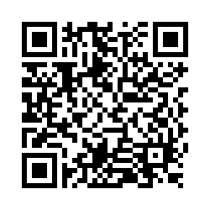
Questions?
Please scan the QR code to provide us with your feedback!

