Slide 1
Title Slide
WISEdash Navigation Intermediate
Curtis Maples
WISEdash Developer
March 6-7, 2024

Slide 2

Agenda
Agenda
What’s New
Snapshots and Snapshot Dashboards
Data Flow, Sourcing and Load Schedule
Advanced Analysis
  Cohort Trends
  Achievement Gap
Managing Cohorts

Slide 3

What’s New
What’s New
New Menu Interface
Resources and Notes
Assessment Analysis
PreACT Secure Statewide Assessment
Dynamic Student Cohorts

Slide 4
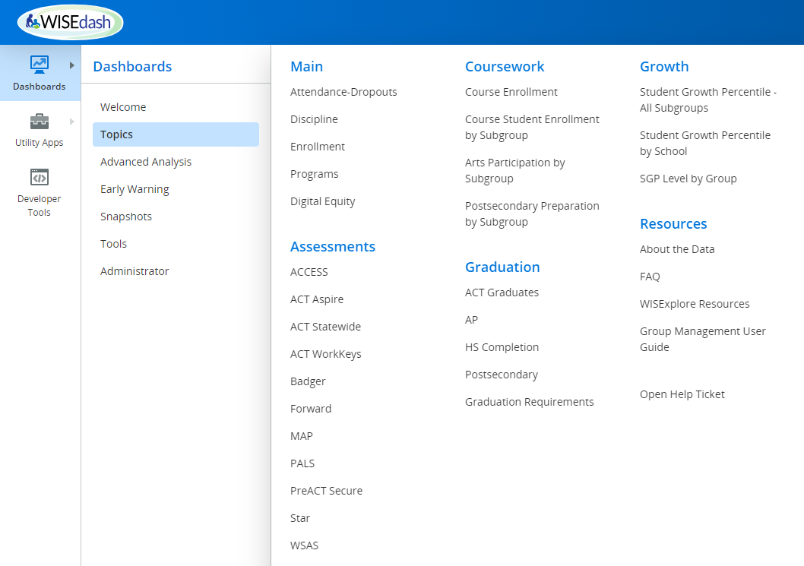
New Menu Interface
New Menu Interface (1 of 2)

Slide 5
New Menu Interface (2 of 2)
New Menu Interface (2 of 2)
Why the Change
    Ease in navigating the menu as all menu options are now on one screen
    Less of a chance for a disappearing menu as menu options are no longer at the top of the screen

Slide 6
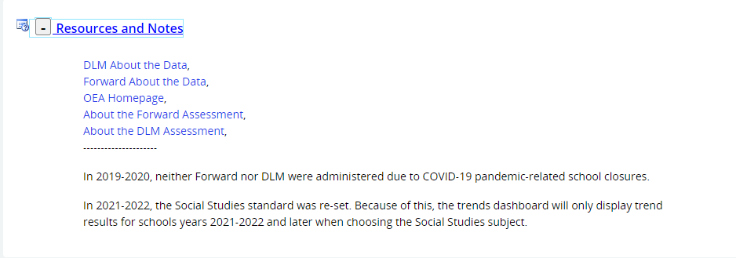
Resources and Notes( 1 of 2)
Resources and Notes (1 of 2)

Slide 7
Resources and Notes (2 of 2)
Resources and Notes (2 of 2)
Why the change
    Simplify the menu by taking off the Resource Menu option
    Makes adding and deleting links associated with a dashboard much easier

Slide 8
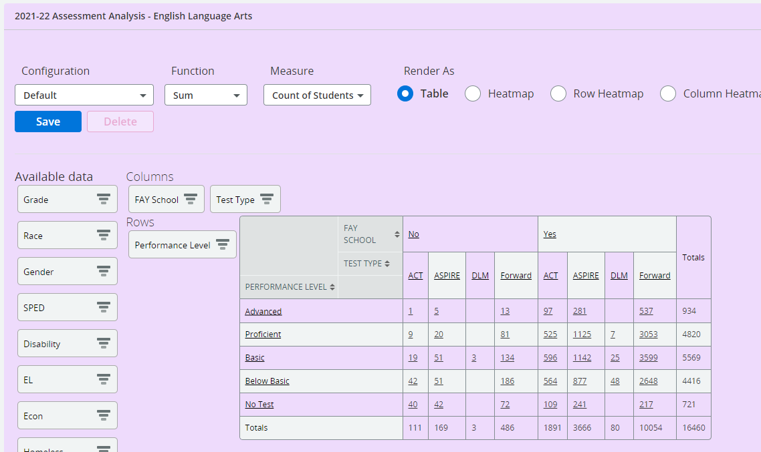
Assessment Analysis
Assessment Analysis (1 of 2)

Slide 9
Assessment Analysis (2 of 2)
Assessment Analysis (2 of 2)
Why the change
    Allows for the advanced analysis of statewide assessment takers across assessments
    Allows for counts by FAY, Performance Category, non-test code, as well as demographics
    Uses Certified data rather than Current data

Slide 10
PreACT Secure
PreACT Secure
Why the change
    ACT Aspire was retired as a Statewide Assessment for 9th and 10th graders
    PreACT was its replacement

Slide 11
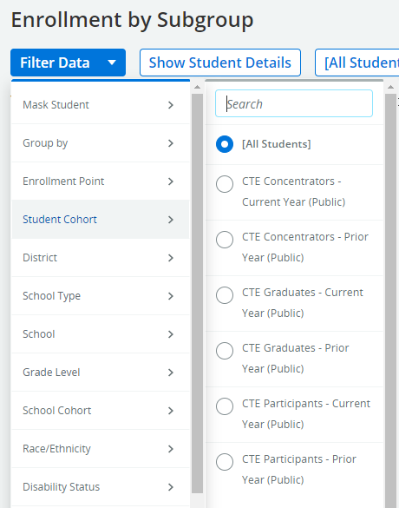
Public Dynamic Student Cohorts
Public Dynamic Student Cohorts (1 of 2)

Slide 12
Public Dynamic Student Cohorts (2 of 2)
Public Dynamic Student Cohorts (2 of 2)
  CTE Concentrators is just a use case of this new feature.
  We can make Public Student Dynamic Cohorts for different indicators.
  This creates a huge advantage, as we can filter and disaggregate by cohorts in most every topic dashboard.
  As these are easy for us to create, this expands our ability to disaggregate by unique indicators.

Slide 13
What’s a Snapshot
What’s a Snapshot
Reliable -Static- Results - As we report a school year’s enrollments, attendance, graduation rates, dropouts, discipline, demographics, we need that data to remain “Static” so that we can reproduce results and rely on those results over time.
Copied from Data Flow - To create a “static” or “certified” version of data, we copy (or snapshot) data that flows into WISEdash on given snapshot dates.
Snapshot Definition - The set of current data that is frozen at a given time is referred to as a “snapshot” and forms the basis of this “static” or “certified” data used for reporting.

Slide 14
Snapshot Process (1 of 2)
Snapshot Process (1 of 2)
Dates Communicated- Typically 2 snapshot dates are chosen and communicated to districts every school year
    WISEdata Spring Demographic Snapshot (May-June)
    WISEdata Student Snapshot (December)
Districts Monitor Data - Using the Snapshot Dashboards as a tool, districts monitor their district-level data as the snapshot approaches to make sure it is complete and accurate.

Slide 15
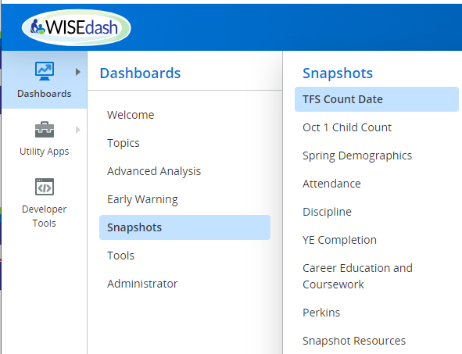
Snapshot Process (2 of 2)
Snapshot Process (2 of 2)
DPI High-level Monitoring - DPI also monitors the data as a snapshot approaches using data quality reports to determine the state of the data at a high level (i.e. are all districts reporting).
Snapshot Taken - Just before the snapshot, new data flowing through the system is stopped. Data in process is posted and snapshot is taken by copying select tables.

Slide 16
Snapshot -> Snapshot Dashboard
Snapshot to Snapshot Dashboard
External Snapshot Reference | Internal Snapshot | Snapshot Dashboard
WISEdata Demographic Snapshot | ASMT (Spring Current Year | Spring Demographics
WISEdata Student Snapshot | CDCC (Current Year) | TFS Count Date October 1 Child Count
 | YEA (Prior Year) | Attendance Discipline
 | YEC (Prior Year) | YE Completion
 | YER (Prior Year) | Career Education Perkins

Slide 17
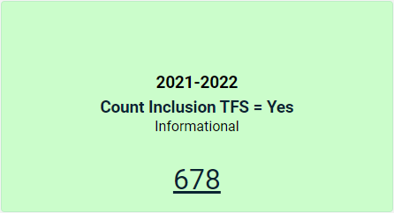
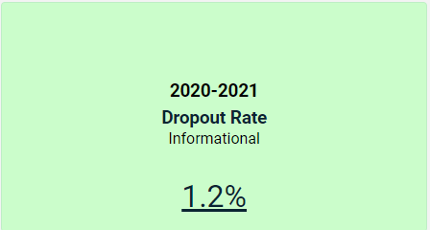
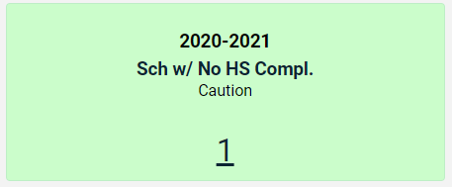
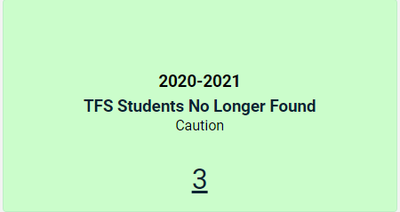
Components of Snapshot Dashboards
Components of Snapshot Dashboards
Data Quality Indicators - Single boxes with numbers at the top of each dashboard that shows potential anomalies in the data that users should review to determine a problem

Slide 18
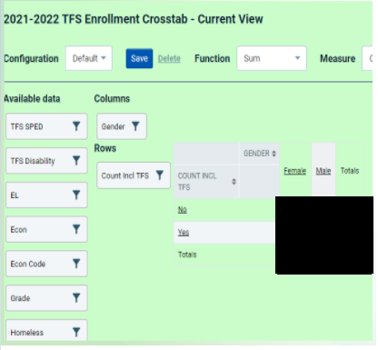
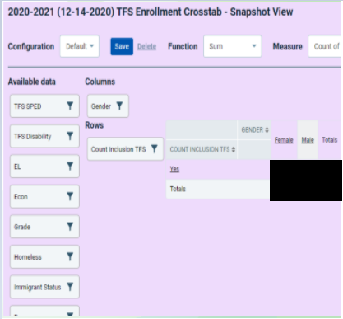
Cohort Trends
Dynamic Crosstabs
<- Compare Current data
with past -> Snapshot data

Slide 19
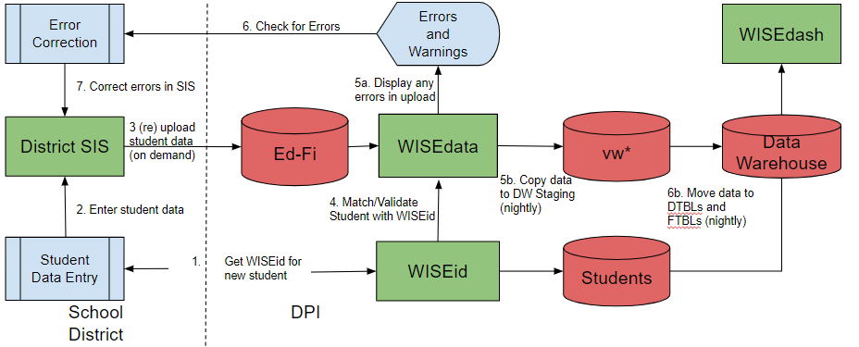
WISEdash Data Sources-WISEdata
WISEdash Data Sources-WISEdata

Slide 20
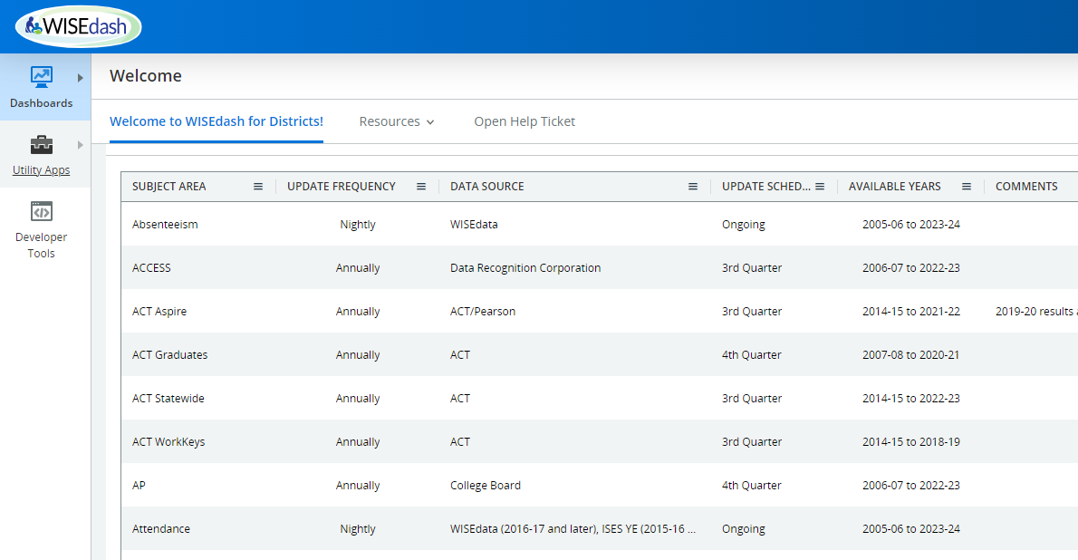
Data Load Schedule
Data Load Schedule

Slide 21
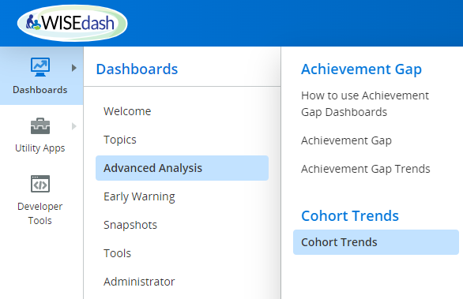
Cohort Trends (1 of 2)
Trend in Same Student Group - All other trend metrics in WISEdash measure a different set of students every year. Only Cohort Trends displays metrics on the SAME set of students throughout the student’s career.
Look at Variables Other Than the Set of Students-Educators can better track performance of groups of students over time to identify issues and problem areas.
Cohort Growth - Evaluating growth without student variability

Slide 22
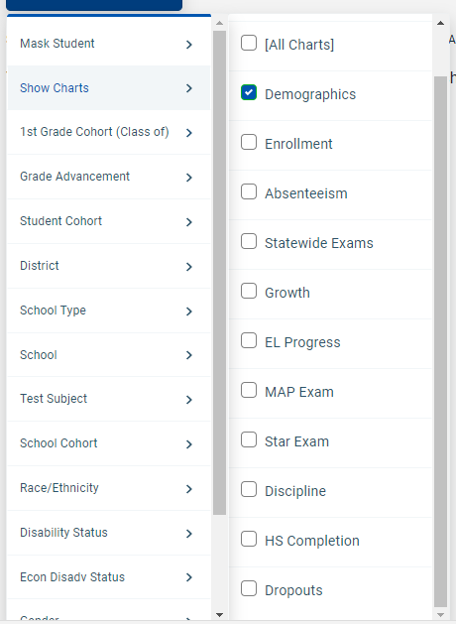
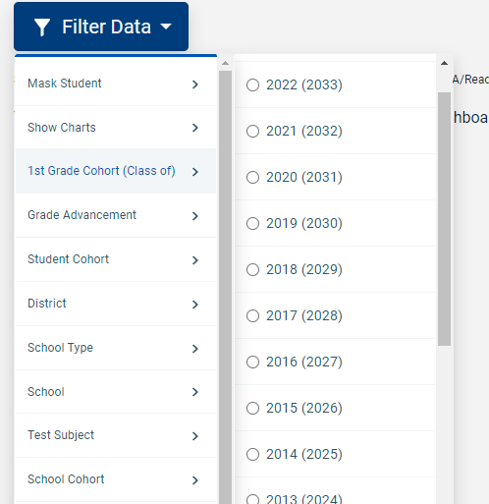
Cohort Trends (2 of 2)
You pick the measures you want to see as a filter
You pick the 1st grade cohort you want to track

Slide 23
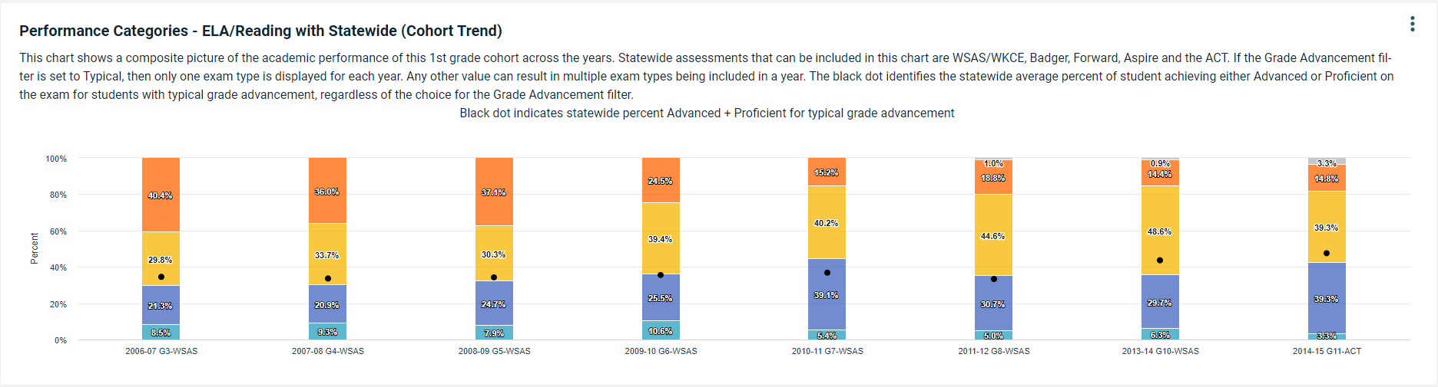
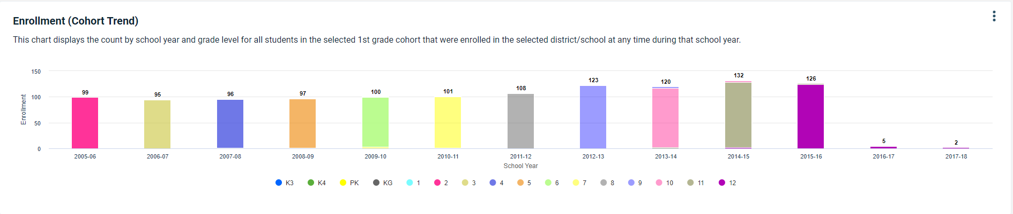
Cohort Trends – Sample Graphs
Cohort Trends – Sample Graphs

Slide 24
Achievement Gap
Achievement Gap (1 of 2)
Derived
    Dropouts
    Graduation Rates
    Achievement Gap
    DEWS/CCREWS
    Growth
WISEdata
    Enrollments/Attendance/Absences
    Student Demographics
    Special Education (IEP)
    Coursework & Career Education
    Grad Requirements
Vendor
    Other - Postsecondary, FAFSA
    Local Assessments - PALS, MAP, Star
    Statewide Assessments - Aspire, ACCESS, DLM, ACT, AP, Forward

Slide 25
Achievement Gap (2 of 2)
Also, under Advanced Analysis like Cohort Trends
Displays gaps across disaggregations by Single Year or Yearly Trends
Shows gaps in
    Forward Assessment Performance
    ACT Assessment Performance
    Attendance Rates
    Graduation Rates

Slide 26
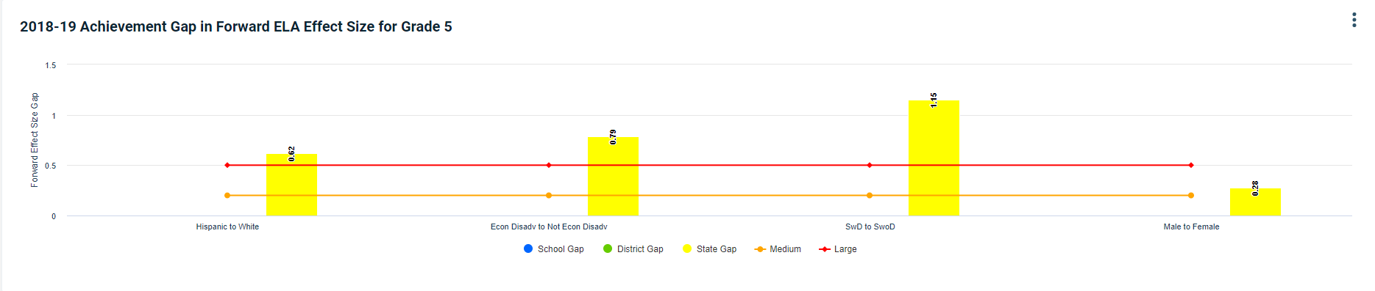
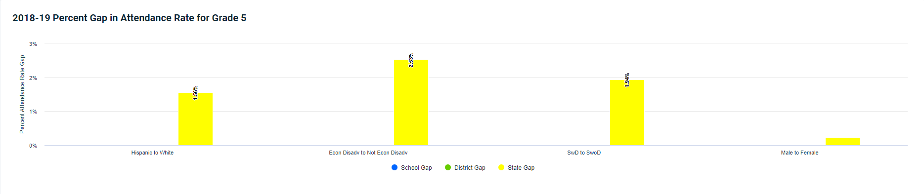
Achievement Gap - Single Year Samples
Achievement Gap - Single Year Samples

Slide 27
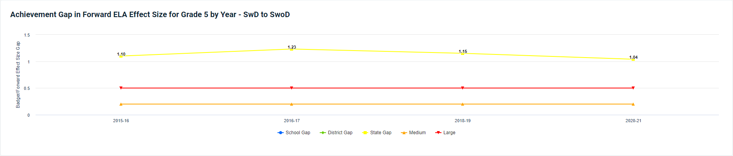
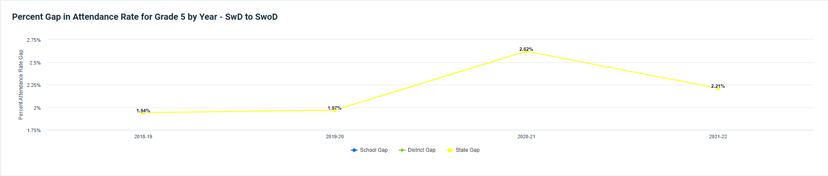
Achievement Gap – Trend Samples
Achievement Gap – Trend Samples

Slide 28
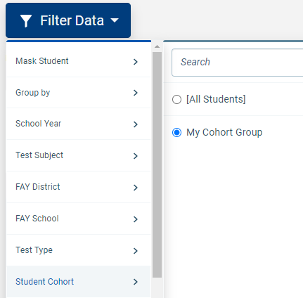
Cohort/Group Management (1 of 4)
Cohort/Group Management (1 of 4)
What is a Cohort in WISEdash - a grouping of students (or schools) that can be stored in WISEdash to show student results by this group

Slide 29
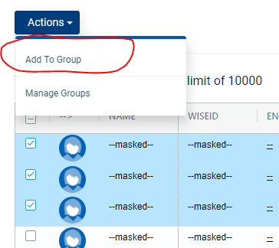
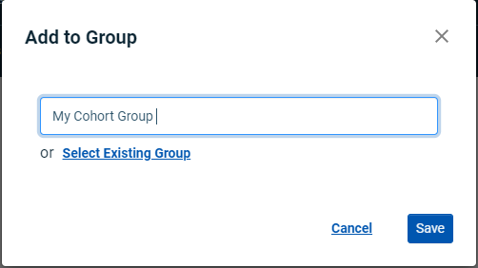
Cohort/Group Management (2 of 4)
Where to build a cohort- Student-level cohorts are often built by choosing the checkbox in the student-level detail screen and then “Add to Group”.
See Group Management Guide for more information.

Slide 30
Cohort/Group Management (3 of 4)
Cohort/Group Management (3 of 4)
Choose a Tailored Group - Allows users to see results for a tailored group of students that are not otherwise addressed by filters
View Results by Tailored Group - Such groups allow the user to analyze various metrics across dashboards and over time
Targeted Student Improvement - Becomes valuable in student improvement or in analyzing school policy changes
Custom Group By - If you don’t see a filter or a group by that encompasses your set of students, WHY NOT create a custom student cohort?

Slide 31
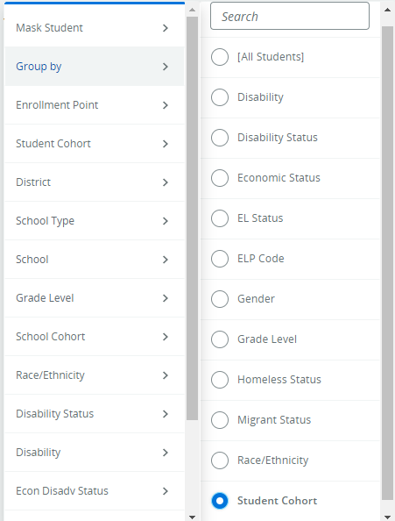
Cohort/Group Management (4 of 4)
Cohort/Group Management (4 of 4)

Slide 32
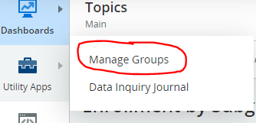
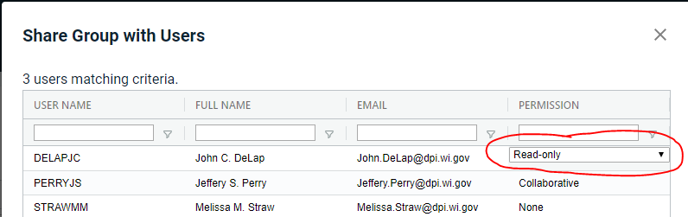
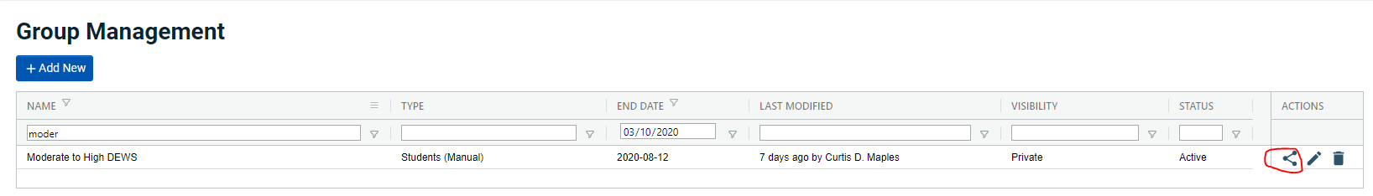
Sharing Cohorts

Slide 33
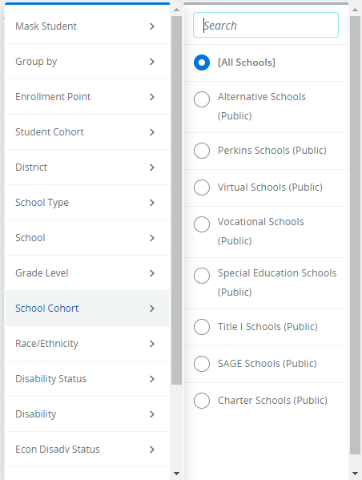
Predefined School Cohorts
Predefined School Cohorts (1 of 2)
Predefined school types that you can choose from any WISEdash for Districts Menu
When chosen, will only show results for all students in the chosen school type in your district/school list
All other filters are still active when using this filter

Slide 34
Predefined School Cohorts (2 of 2)
Predefined School Cohorts (2 of 2)
It is possible to create a School Cohort in a similar manner as a Student Cohort.
Find -in WISEdash- where a school listing exists -with check boxes- instead of a student list
Two obvious places
    School Listing (Tools -> Schools -> School List)
    Achievement Gap detail

Slide 35

Q&A
Q & A

Slide 36
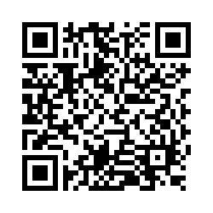

Thank You!
Thank You!
Please scan the QR Code to provide us with your feedback!

