Slide 1
WISEdata For New Users Training: WISEdata Portal
Navigation & WISEdata Basics
WISEdata For New Users Training: WISEdata Portal
Navigation & WISEdata Basics
Jodyann Hunter
Customer Service
March 2024

Slide 2
Training Objective
By the end of this training session, you will be able to:
Navigate WISEdata Portal
Identify errors and warnings
Submit a quality help ticket
Become a WISEdata expert

Slide 3
Why Does DPI Collect Data
Why Does DPI Collect Data
Compliance with all State and Federal reporting requirements and establish funding
Offer resources to stakeholders (e.g., teachers, administrators, taxpayers)
Assist LEAs and instructors with tracking:
  overall and individual student growth and student achievement
  needs of additional services (e.g., language support, special education)
  patterns: testing, punishment, attendance, etc.

Slide 4
WISEdata Portal: What is it?
WISEdata Portal is an application used to confirm that data is sent from your student information system (SIS) to the Department of Public Instruction (DPI).
Multi-vendor, open data collection system
“Read-only” or “view-only” application
Data is ‘pushed’ from an LEA’s SIS to the WISEdata Portal
Data visible in WISEdata Portal today will be visible in WISEdash the following day

Slide 5
Data Privacy
To guarantee that data is linked to the right individual, WISEdata connects to WISEid.
PII (Personally Identifiable Information): Any information that permits the identity of an individual to be directly or indirectly inferred, including any information that is linked or linkable to that individual.
Student Data Privacy Resources webpage
DPI Examples of PII

Slide 6
Examples of PII
PII may include but may not be limited to:
General Student Data
Social Security Number
Driver’s License or State ID Card
Passport Number
DNA Profile
Biometric Identifiers (x-ray, retinal scan, fingerprints, etc.)
Medical Information
Authentication Information (passwords and information to re- enable passwords)
Financial Information (bank account, credit/debit card, etc.)

Slide 7
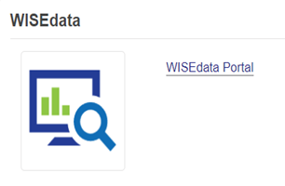
Getting Started with WISEdata Portal
Navigate to WISEhome (please bookmark)​.
Log in using your WAMS or Google login information.​
Select WISEdata Portal.

Slide 8
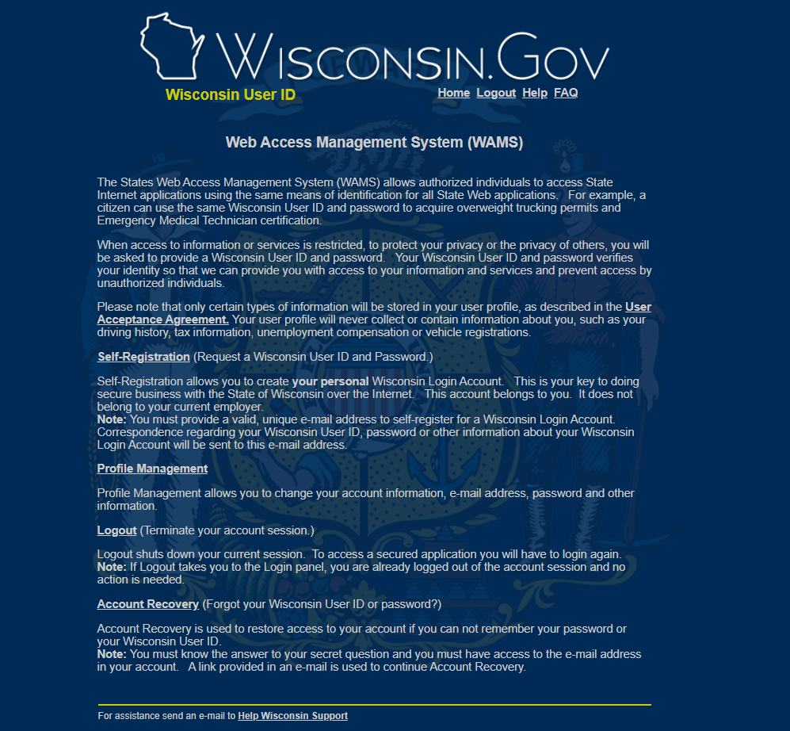
Accessing WISEdata Portal
If you do not have a WAMS ID or Google account to access the WISEdata Portal application, please register for an account from WAMS homepage, found here: WAMS homepage

Slide 9
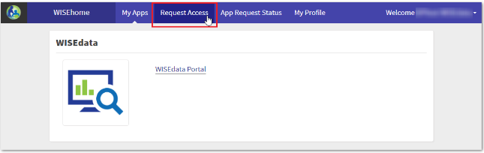
Request Access to a WISE Application
There are 2 WISEdata Portal roles, these are agency, and agency read. The Agency role allows users to acknowledge warnings, and update contacts. However, Agency Read is a view only access and no changes can be made with this role.
Your DSA ( District Administrator will either approve or deny your request, once you request access to an application.

Slide 10
Procedure for Submitting Data
The LEA (school/district) inputs student information into their local student information system (SIS).
Portal Submission
WISEdata Portal Submission: Schools transmit data from their SIS to the WISEdata Portal to be checked.
Validation Review: Users watch for and examine errors or warnings and make any required corrections in their SIS.
After the data has been entered accurately, it will move into the data warehouse, also referred to as WISEdash.

Slide 11




Data Flow
LEA / School / District
Student Information System
WISEdash for Districts
WISEdata Portal
WISEdash Public Portal

Slide 12
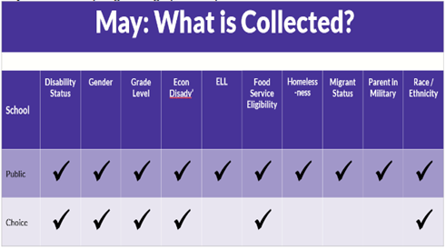
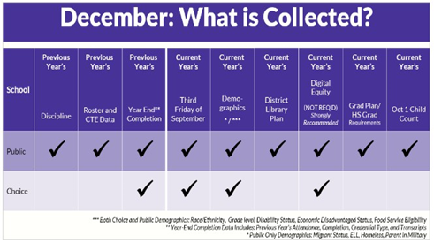
Sample Text Slide
Snapshot
DPI snapshots are taken at regular intervals to gather certain data statistics for a specific date. This information is then utilized to meet state and federal reporting needs.

Slide 13
WISEdata Data Elements
WISEdata Data Elements
Use the WISEdata Data Elements pages to view all the specific data elements for WISEid, WISEstaff, WISEdata, and more.
The main page provides a quick summary of each element.
The links take you to individual pages that provide more detail about the element and which codes to report, as well as uses and FAQs.
This resource will be a staple when completing WISEdata reporting tasks and should be referenced often.
You can link directly to data element pages from the WISEdata Portal.

Slide 14
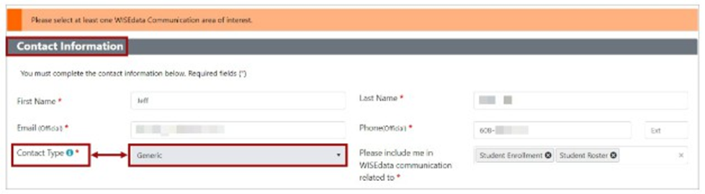
Update Agency Contacts
Update Agency Contacts
WISEdata users are expected to update their Agency contact information at the start of each school year.
Top-Right Corner→ Agency Contacts
Both Primary and Secondary Contacts are required for each agency and must be updated each year- school year. Generic contacts are optional.
It is critical to ensure that the contact details at your local education agency remain updated over the course of the academic year.
Update Agency Contacts Mini-Tutorial

Slide 15
Data Validation
Data Validation
Your data goes through validations to ensure its quality when you submit it to WISEdata from the student information system (SIS) in your district.
Any inaccurate data will be returned to you with errors and warnings in the WISEdata Portal following a validation cycle against business rule logic.
In the WISEdata Portal you can view your error and warning messages from the Data Quality and Validation Messages page or directly from the Student Details screen of a particular student.

Slide 16
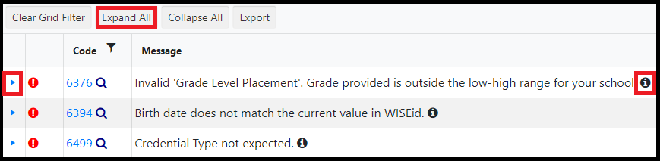
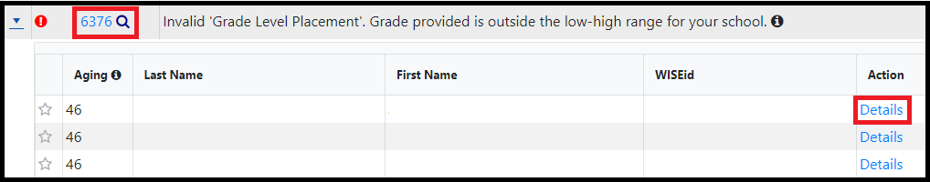
Student Detail

Slide 17
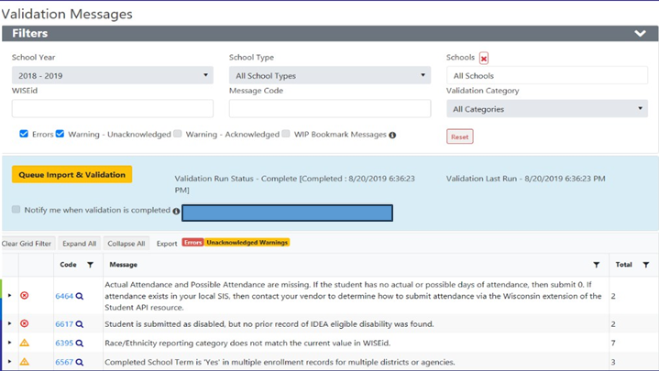
Errors and Warnings
Errors and Warnings
WISEdata Portal presents a variety of errors and warnings when unexpected data is received:
Warning
Unacknowledged data alerts
Other alerts and errors

Slide 18
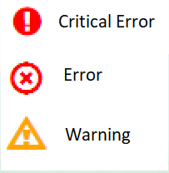
Types of Errors and Warnings
There are three types of errors and warnings, also known as validation messages. All of these validation messages will need to be viewed for correction or acknowledgment. However, errors cannot be acknowledged only warnings.
Learn more about Validation messages here: WISEdata Validation Messages Mini Tutorial.

Slide 19
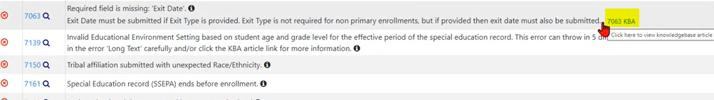
How to Open a KBA from WDP
KBA stands for knowledge-based article.
The KBA can be viewed by selecting the validation.
Your browser will then route to a new tab, and the KBA page will populate (open as a new tab in your browser).

Slide 20
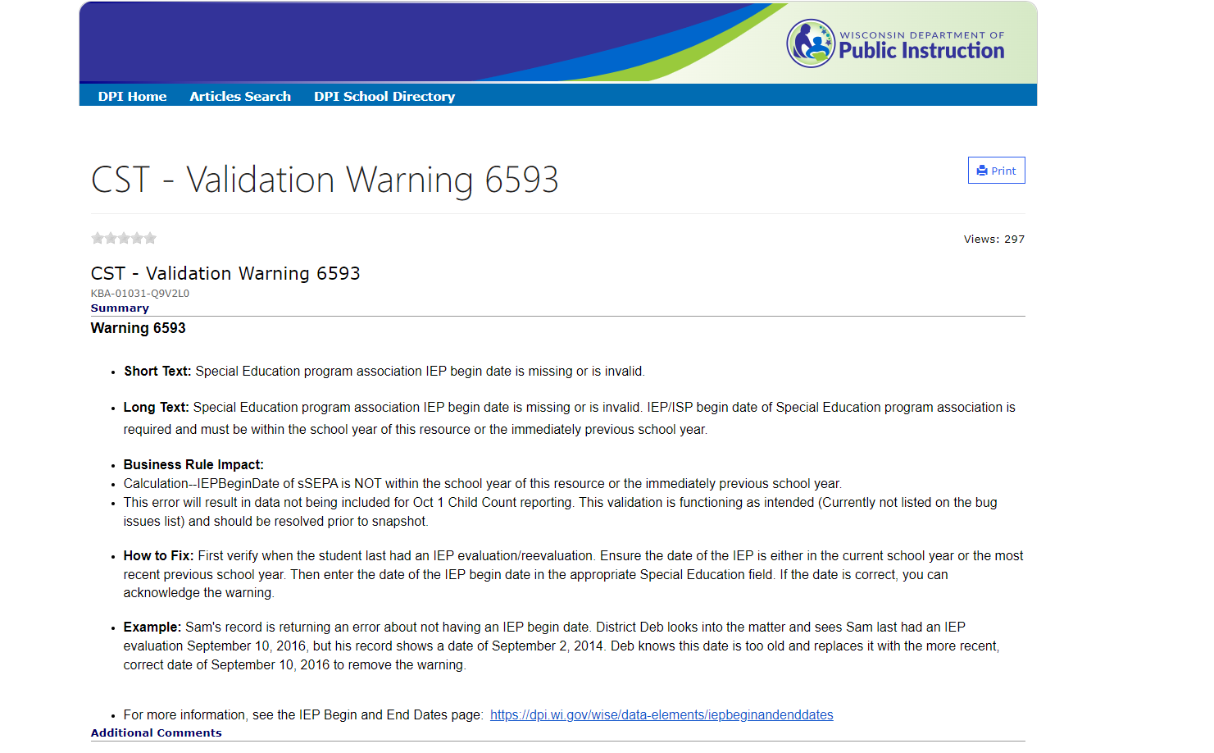
Example of a KBA

Slide 21
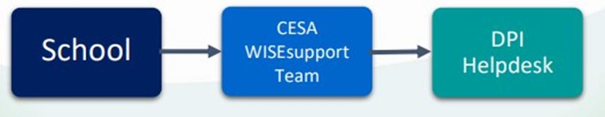
Submit a Help Ticket
Submit a Help Ticket
DPI is here to help you! Anyone can submit a Help Ticket.
We even have a webpage, Help Ticket Tips to help you create great Help Ticket requests!

Slide 22
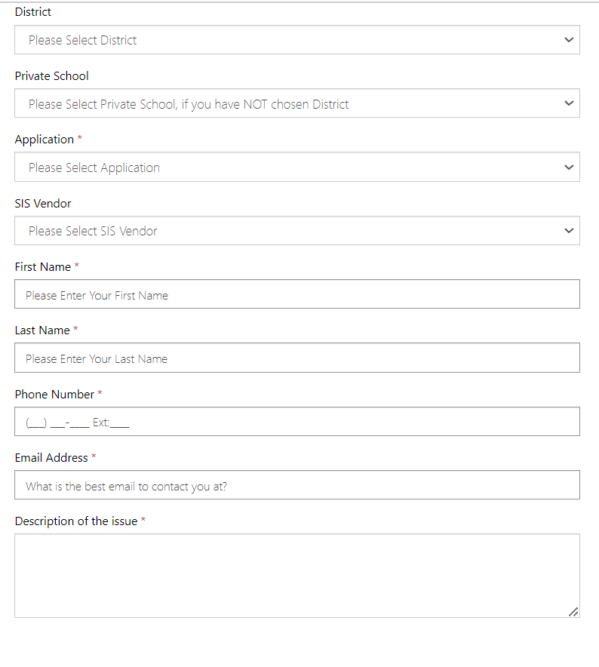
Help Ticket

Slide 23
Examples of “Not Helpful” Help Ticket
Examples of “Not so Helpful” Help Ticket
I am missing data.
My count is not correct.
I cannot log in.
A student who was fine is now throwing an error.
I have errors that I cannot fix.
The site is broken.
All of these examples will result in a follow up email, asking for more clarifying information. This may hinder a solution in a timely manner.

Slide 24
Examples of “Helpful” Help Ticket
Examples of a “Helpful” Help Ticket
I have these specific students who are missing these specific pieces of data (sSEPA records, graduation records, discipline).
My 3rd Friday count is not correct. I am missing two students; they are….
I cannot log in to the WISEhome or WISEid application, etc. Student WISEid (XXXXXXXXX) is now throwing error 6464, and I can’t figure out why.
How do I fix error XXXX?
By following these examples when submitting a help ticket, a resolution to your problem will have a much quicker turnaround time.

Slide 25
Helpful Advice
Helpful Advice
Provide key details, such as:
Which application you are using
Where the error occurred (name the screen)
How urgent the issue is
How often it occurs
If there is an error message, provide the exact error message you see.
What steps you have already taken to resolve
Include screenshots whenever possible.

Slide 26
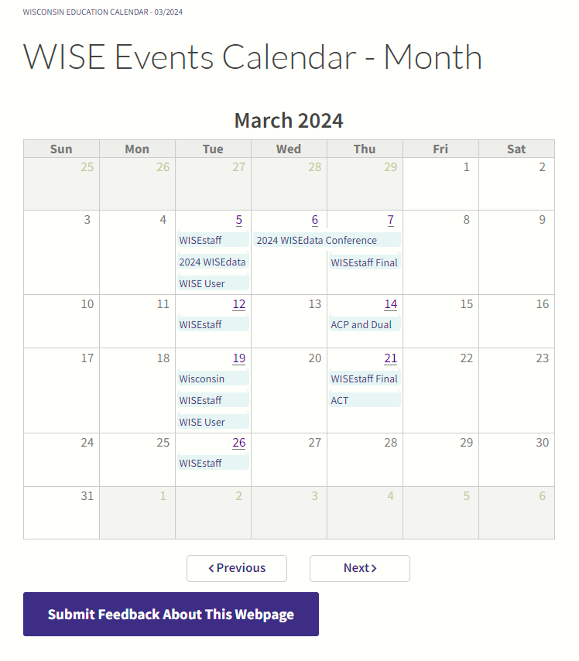
WISEdata Events Calendar
WISE Events Calendar
To view deadlines for snapshot and data submission, use the WISEdata Events Calendar.
Additionally, you can sign up for CESA trainings, User Group webinars, and SIS vendor conferences.
View by day or month to see important events and dates.

Slide 27
Save the Date
Save the Date
August 2024: 2023-24 Year End - Attendance, Exits, Graduates, Roster, etc.
October 2024 : DPI Data Quality Outreach begins
December 2024, Snapshot: 2023-24 Year End, 2024 25 Third Friday of September Enrollment, 2024-25 Oct. 1 Child Count
View more events on the WISEdata Events page to stay up to date on information.

Slide 28

Learn more with WISE Training
Learn more with WISEtraining
Sharpen your skills with our WISEtraining E-Learnings
WISE User Basics
WISEid Basics
WISEdata Portal Basics
WISEdata: Understanding Economically Disadvantaged Status Data Reporting

Slide 29
Resources
WISEdata Help: Links to WISE help pages and useful resources
Data Elements: List of links to all WISEdata data elements and their descriptions, uses, and codes
Knowledge Base Articles: (KBA) Useful articles on validations and other related topics
Info for Schools: Basics of getting started with WISEid
WISEdata Annual Tasks Checklist: General guide of necessary tasks and preparation for each of the collections and snapshots
Google Community: WISEdata community to view and post questions and comments to fellow users
WISEdata Events Calendar: View deadlines, trainings, webinars, etc.

Slide 30
Stay Connected
Participate in the weekly WISE User Group Calls to listen to updates from various teams and ask questions to DPI employees during the call.
Join our Google Community to connect with other WISEdata users and receive announcements and notifications from DPI and the WISEdata community. (Now, ‘Chat’ in Google Workspaces, formerly "Currents.")

Slide 31

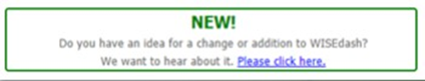
Your Voice Matters
We would love to hear from you! Your feedback matters. With most DPI webpages, you can give feedback straight away, propose a new recommendation, and cast your vote on recommendations made by others.

Slide 32
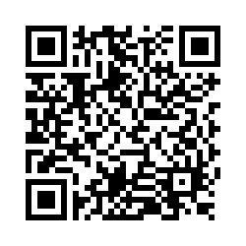
Questions?
Thank you! Thank you!
Please scan the QR code to provide us with your feedback!

