Slide 1
WISEstaff Final Certification
Jennifer Janik
Joshua Roy
Julie Hagen
3/6/24

Slide 2
Introduction
Information about the WISEstaff data collection
Final Certification process for the final annual staff license audit
  Cover steps 3 and 4 of the Staff Collection Checklist
  Completing the Final Certification
  How to troubleshoot incorrect reporting or reporting errors
Data Quality Goals
  What should you be looking for?
  Why should data quality be important to you?
What’s next after deadline?
  Data errata process
  Public Staff Reports

Slide 3
WISEstaff Data Collection Includes?
WISEstaff facilitates the collection of agency staff demographic, contract, and assignment data.
It is a point in time data collection of all staff members in public schools as of the Third Friday of September and includes known assignments as of that date for the entire regular school year.
Does NOT include summer school staff
For convenience, you don’t need to include reporting turnover you didn’t know of on the Third Friday of September. If you do, you must prorate WISEstaff Contract and Assignment FTE.

Slide 4
Important Dates
Date | Description
March 7, 2024 | Final Agency Certification window opens
March 21, 2024 | Agencies must have completed any final corrections in WISEstaff, passed validations, reviewed all staff reports in WISEstaff and indicated that they are certified for the Final Agency Certification
April, May 2024 | Public WISEstaff Reports for 2023-24 are available
May 2024 | LEAD* starts the licensing audit based on the WISEstaff data snapshot taken after the March 21st final certification window closes
July 2024 | 18th (Approx.) Final Audit Reports Ready
* LEAD is DPI's Licensing, Educator Advancement and Development team.

Slide 5
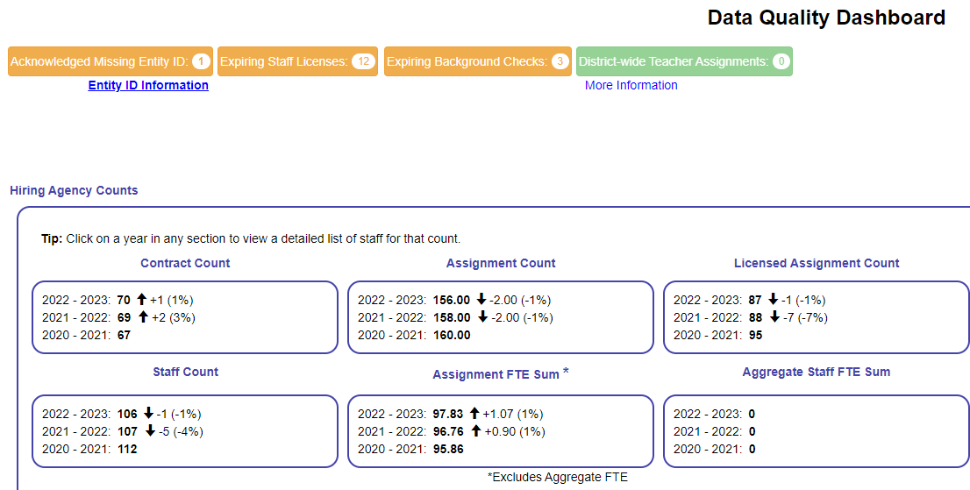
Data Quality Dashboard Reminder
Each time you log in, check this page.
It's also important to check every time you update or upload data, and
Prior to signing off on your data in step 2e and 3g.
Compare prior year’s numbers to current
Good for spot checking data at-a-glance
Notes:
This should be the first stop when you log into WISEstaff. This is a great place to spot check your data. Below you will find stats on teacher salaries which can also help you spot check data.

Slide 6
Final Certification Checklist
Final Certification Steps
Tips for using the checklist
Current focus: Step Three - Review Preliminary Audit Results and Apply Corrections
  Review Preliminary Licensing Audits
  Enter all missing Entity IDs
  Verify Data Quality
  Run Data Validation
  Submit Final Certification

Slide 7
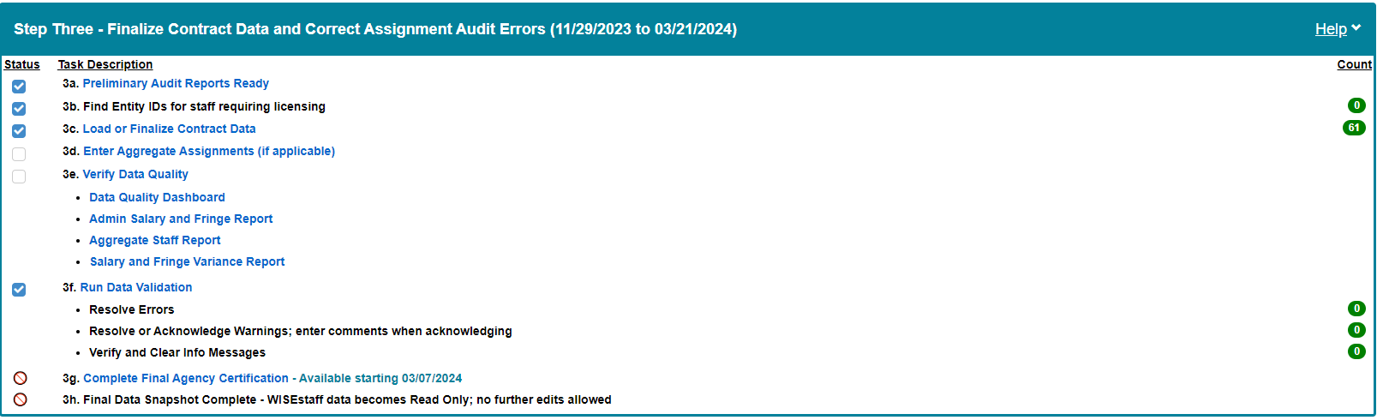
Final Certification Checklist: Step Three

Slide 8



Final Certification Checklist - Tips
Checklist Tips
Status column shows task status
  = Completed - most auto updated but require manual check
  = Incomplete
Task descriptions in blue are clickable links to take you directly to that WISEstaff page
More details about each task step available in Help link at far right in section header
View the number of open items for each task in the Count column
Notes:
Let’s start with some tips about using the checklist:
Each task has a status: some tasks have a system-generated status and some have a checkbox for you to click when you’re ready to mark it as completed. Here’s a look at a stripped-down version of the task statuses; you can see that 3a, 3b, 3c and 3f are marked as complete and 3d, 3e, 3g and 3h are incomplete.
Within the task list, any task description in blue font can be clicked to take you right to the screen where you can complete that task.
If you’re not sure what’s expected for a task or how to complete it, click on the Help link in the upper right corner of the Step Three banner - you’ll find more information about each step.
On the far right side of the Step Three tile, you’ll see a count of the number of open items for certain tasks. To be ready for your final certification, all counts should be zeroes, which are shown in green.

Slide 9

Final Certification Checklist - 3a (1 of 4)
Checklist Step Three: 3a - Preliminary Audit Reports Ready
Preliminary Audit Reports are done each year to show you which staff are inadequately licensed for their current assignments.
You can find the 23-24 Preliminary reports in the previous format under “Audit results prior to the 2023-24 school year.”
  Error Report and Special Education Error Report show staff whose license/s don’t cover their reported assignment and/or grades.
  Reject Report shows staff without an Entity ID; not audited
New filter audit report under the top section for 2023-24 and forward
Notes:
3A - (show on check list then switch back to slides)
Each year, the Licensing, Educator Advancement and Development (LEAD) team, conducts an audit of all public school districts in the state of Wisconsin to ensure that all professional staff members are appropriately licensed.
Review your audit reports and make the corrections needed prior to moving forward with the other steps in step 3. Example, if you have assignment changes to make and work on step 3C first, you will end up having to go back and redo some of your work. Once the contracts and data are set, then move on to the next step in step 3.
These reports show you where your staff’s licenses are not matching up with their reported assignments for this year. Remember, you can click that task description to go right to the Audit Results report page.
There are four reports issued after each stage of the audit, so at this time of year you’ll see four preliminary reports for the 23-24 school year. Review the error reports to see which staff may need to obtain additional licensing based on their reported assignment, and the reject report to see which staff are missing Entity IDs and were not audited. Read the auditor comments in the error reports to determine the course of action needed for each issue. The main report to pay attention to is the Audit Error Report. Look through to see who doesn't have licenses or who doesn't have the appropriate license for the assignments given. The reports have dates on them, it is possible you've fixed some of this after the date, so be sure to check the dates on the audit report and then cross check to make sure it has indeed been updated.
Keep in mind that the expectation for educator licensing, per state statute, is to have Entity IDs and valid licenses in place at the start of the school year. But you do still have time to rectify license errors for any staff without an Entity ID or without proper licensing.
The goal of the preliminary audit is to have the corrections made prior to the final audit.

Slide 10
Final Certification Checklist - 3a (2 of 4)
3a - Preliminary Audit Reports Ready
Staff requiring licenses
  Have educator submit license applications through ELO or follow up on outstanding items on active applications
  Ensure that all licensing errors are resolved before the final audit in May
Staff requiring assignment modifications
  If a coding error is found with a staff assignment, make the correction in WISEstaff before final certification
  Corrections made by March 21 will be included in the final licensing audit in May
Notes:
For staff on the report who don’t have an Entity ID or who need additional licensing for their reported assignment, have the educator submit their license application through ELO or have them follow up on outstanding items on their active applications to keep them moving forward. All license errors need to be resolved before the final licensing audit in June.
If you discover that a coding error was made when reporting a staff assignment, you can make those corrections directly in WISEstaff before completing your final certification. All corrections made on or before March 21st will be included in the snapshot and final licensing audit.

Slide 11
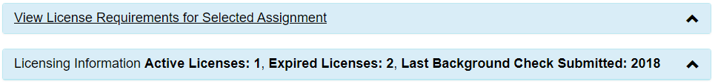
Final Certification Checklist - 3a (3 of 4)
3a - Preliminary Audit Reports Ready
Staff not audited (missing Entity ID; assignment not entered)
  Obtain Entity ID, and then manually review qualifying licenses per assignment on the Edit Assignment page in WISEstaff.
  https://dpi.wi.gov/licensing/general/what-can-i-teach
Notes:
For staff whose assignments were not audited due to a missing Entity ID or outstanding validation errors, you can manually review their qualifications using the Edit Assignment page in WISEstaff and information on the DPI website. Below the assignment fields on the Edit Assignment page, there is a section called “View License Requirements for Selected Assignment” and one called “Licensing Information”. Click the arrow to expand each section to review the requirements for the assignment you’ve selected and compare them to the license information for that educator.
We’ve also included a link to the “What Can I Teach” page on the DPI website where you or the educator can find more information on whether their current license covers their reported assignment and grade levels.

Slide 12
Final Certification Checklist - 3a (4 of 4)
3a - Preliminary Audit Reports Ready
Consequences of improperly licensed staff on final licensing report:
  Public Reports: Ineffective / Inexperienced / Out of Field Teachers
  Staff funding streams are jeopardized when staff are not properly assigned / licensed (Special Education, Grants and Title I funding)
  Implications for obtaining Lifetime License
Notes:
There are several potential consequences when staff are not properly licensed by the time the final audit is run and published:
Staff assignment data is used to generate staff reports that DPI publishes, which include data on ineffective, inexperienced, and out-of-field teachers by district. Those metrics are impacted when staff are reported in the wrong assignments or are not properly licensed for their reported assignments.
Special Education, Grants, or Title I funding may be jeopardized if staff are not reported in the correct assignments or licensed for those assignments
In addition, staff wishing to obtain a Lifetime License may have challenges documenting their experience if it is not reported correctly in WISEstaff

Slide 13
Final Certification Checklist - 3b
3b - Enter all missing Entity IDs
All staff in assignments requiring a license must have an Entity ID in WISEstaff
  Dashboard shows # of missing Entity IDs
  Enter Entity IDs in WISEstaff through April
  Entity ID is issued when license application is submitted; follow up with staff who say they have applied but don’t have an Entity ID.
Entity IDs still missing in final license audit will prevent educators from being audited (automatic failure to be licensed).
Notes:
3B
verify that you have all required Entity IDs in place for staff with assignments requiring a license. We provide this information in several places throughout WISEstaff because it is such an important part of reporting staff data. You’ve got task 3b on the checklist, which shows you the number of staff who have an assignment requiring a license but no Entity ID. We also have the widget on the dashboard that shows you the number of missing Entity IDs, and we’ve got validation warning 4034 that you may see on your Validate Staff Data page if you have staff without Entity IDs.
If that Missing Entity ID number on your checklist is anything besides zero, you’ll need to follow up with those staff to have them provide you with their Entity ID before May. Even though the ability to edit staff assignment and contract data will close after March 21st, you can still enter Entity IDs into WISEid until May. Remember that Entity IDs are issued when a license application is submitted, so at the bare minimum, all staff requiring licenses should have submitted their applications and provided you with their Entity IDs by this time of year.
If there are any remaining missing Entity IDs at the time of the final license audit, those staff will not be audited, which may lead to some of those consequences covered on the previous slide.
If you need to merge entity IDs, you will need to reach out to the licensing team. This is a different then a standard help ticket and will be covered further on in this session.

Slide 14
Final Certification Checklist – 3c
3c – Load or Finalize Contract Data
If you haven’t, make sure to load WISEstaff Contract data for those with assignments that require it.
New this year, you were not required to enter the Contract data for the preliminary certification. However, you need to have this information complete for the final certification.
New this year, if your agency's WISEstaff Contract salary and fringe amounts are the correct final data for all staff in WISEstaff, click the button “Set All To Yes,” which updates all Contracts for your agency to Yes.
Notes:
3C Verify Data Quality (show in WISEstaff)
The first step here will be to review the data quality dashboard. Again this is a great place to compare last year's data this year data.
In addition to the dashboard, we recommend reviewing the salary and fringe variance reports as well as the aggregate staff report. If you have other tools that you use in your office, maybe HR reports that you compare to WISEstaff, this is the time to do those reviews as part of this task.
Admin Salary and Fringe Report - just the people with admin position types. You can see which ones those are in the drop down under Position. This is data can be easier to look at in the download. This is helpful to see the percentage increase in salary, percentage fringe increase and fringe total percentage of salary.
Aggregate Staff Report - This will only be available if you have these types of employees. These types of employees would be contractors hired out to the school, such as bus drivers, cafeteria and maintenance workers. For these types of employees, we don't collect their demographics and they do not have WISEids. This report will give you how many employees of these types you have. When using the report, make sure to click “filter” for the data to display. If you look at the screen where you enter the data, it will give you this years number and last year's numbers, which is helpful when comparing and spot checking.
Salary and Fringe Variance Report - Great for checking salary change and fringe benefit change. You can set thresholds and it will highlight percentages above those thresholds. The report page here can be easier to use and find issues vs the download. When something is highlighted in red, either from the preset thresholds or the thresholds you set, we don't know if the data is correct or if there is an error, we are just calling it out for you to review as the person familiar with it. The red boxes highlighting data will not prevent you from completing the final certification. Again, this is just to help you review your data.
Clicking Verify Data Quality will show you some other options for verifying data.
When you’ve completed your reviews and believe your data is accurate and complete, check the box to mark the task as done.

Slide 15
Final Certification Checklist – 3d
3d – Enter Aggregate Assignments (if applicable)
If you enter any assignments as Aggregate FTE for bus driver, plant and maintenance and operation personnel and/or cafeteria workers’ assignments, they should be entered for the final certification.
Checkbox is not auto calculated, so click to add the green check mark once your data is complete.

Slide 16
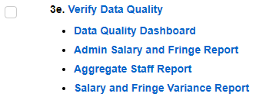
Final Certification Checklist – 3e
3e - Verify Data Quality
The best tools for verifying data quality are listed in the task description with links to them. Other tools under the Reports top menu are also useful.
Click the Status checkbox when you have completed verification of data quality, as it is not auto calculating.
Notes:
3D Verify Data Quality (show in WISEstaff)
The first step here will be to review the data quality dashboard. Again this is a great place to compare last year's data this year data.
In addition to the dashboard, we recommend reviewing the salary and fringe variance reports as well as the aggregate staff report. If you have other tools that you use in your office, maybe HR reports that you compare to WISEstaff, this is the time to do those reviews as part of this task.
Admin Salary and Fringe Report - just the people with admin position types. You can see which ones those are in the drop down under Position. This is data can be easier to look at in the download. This is helpful to see the percentage increase in salary, percentage fringe increase and fringe total percentage of salary.
Aggregate Staff Report - This will only be available if you have these types of employees. These types of employees would be contractors hired out to the school, such as bus drivers, cafeteria and maintenance workers. For these types of employees, we don't collect their demographics and they do not have WISEids. This report will give you how many employees of these types you have. When using the report, make sure to click “filter” for the data to display. If you look at the screen where you enter the data, it will give you this years number and last year's numbers, which is helpful when comparing and spot checking.
Salary and Fringe Variance Report - Great for checking salary change and fringe benefit change. You can set thresholds and it will highlight percentages above those thresholds. The report page here can be easier to use and find issues vs the download. When something is highlighted in red, either from the preset thresholds or the thresholds you set, we don't know if the data is correct or if there is an error, we are just calling it out for you to review as the person familiar with it. The red boxes highlighting data will not prevent you from completing the final certification. Again, this is just to help you review your data.
Clicking Verify Data Quality will show you some other options for verifying data.
When you’ve completed your reviews and believe your data is accurate and complete, check the box to mark the task as done.

Slide 17
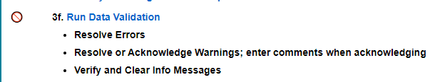

Final Certification Checklist – 3f
3f - Run Data Validation
Statewide data validation runs daily to look for missing / incomplete data and data outside expected thresholds and can be rerun manually for new updates.
Three types of validations:
  Errors - must be resolved to certify
  Warnings - must be resolved or acknowledged to certify
  Info Messages - review message; may not require any action; system will clear them before snapshot is generated

Slide 18
Final Certification Checklist – 3g (1 of 2)
3g – Complete Final Agency Certification
Final Certification due end-of-day March 21
  All errors must be resolved and warnings resolved or acknowledged in order to certify.
  Review hiring agency counts (same as Dashboard).
  If you did not complete the Preliminary Certification in January, complete that step before doing Final Certification.
  Submit Final Certification.
Notes:
3g will take you to the Certify Data page where you’ll do one final review of your hiring agency counts and then check the box to indicate your certification and click Save to submit that certification to DPI. So again, Make sure that you actually “check” the box, and then click “save”.
Prior to completing this step, look over the data quality dashboard one last time. This is provided on the same page where you will be completing step 3E.
It's important to note that you will not able relock to certify until all of your errors and warnings have been resolved or acknowledged.
Ideally you don't want to do this step until close to the deadline so that your looking at the most current and accurate data.
DPI pays close attention to the status of each LEA and we need everyone to have a status of Final Certified on or before March 21.
Lets take a look at this in WISEstaff, (open step in wisestaff)

Slide 19
Final Certification Checklist – 3g (2 of 2)
3g – Complete Final Agency Certification
This step is important for DPI to track which LEAs are finished and which may need assistance. Data edits after clicking, but prior to snapshot you don’t need re-click.
Notes:
3g will take you to the Certify Data page where you’ll do one final review of your hiring agency counts and then check the box to indicate your certification and click Save to submit that certification to DPI. So again, Make sure that you actually “check” the box, and then click “save”.
Prior to completing this step, look over the data quality dashboard one last time. This is provided on the same page where you will be completing step 3E.
It's important to note that you will not able relock to certify until all of your errors and warnings have been resolved or acknowledged.
Ideally you don't want to do this step until close to the deadline so that your looking at the most current and accurate data.
DPI pays close attention to the status of each LEA and we need everyone to have a status of Final Certified on or before March 21.
Lets take a look at this in WISEstaff, (open step in wisestaff)

Slide 20
Final Certification Checklist – 3h (1 of 2)
3h - Final Data Snapshot Complete
Final Snapshot takes a picture of all staff data to be used for reporting and final licensing audit.
    Access to making changes in WISEstaff will be disabled, and snapshot will be taken on March 21st. No changes after that.
Enter missing Entity IDs through April, if needed (only data in WISEstaff you can update after the snapshot that will be included for the final audit).
Encourage staff without necessary licenses to get licensed by May, so they will pass the final license audit.
Notes:
3h This task is completed by DPI and you’ll see the task marked as complete once the final snapshot is taken after March 21st. After the certification deadline, we disable edit access in WISEstaff so you can no longer make updates to assignment or contract data. During that time, we take the snapshot of all staff data for the year, which is then used for the final licensing audit and for generation and publication of staff reports.
The one thing you’ll still be able to do after WISEstaff data is locked, is to enter any Entity IDs into WISEid that may still be missing. You’ll be able to add Entity IDs into WISEid through April.
Show in WISEstaff

Slide 21
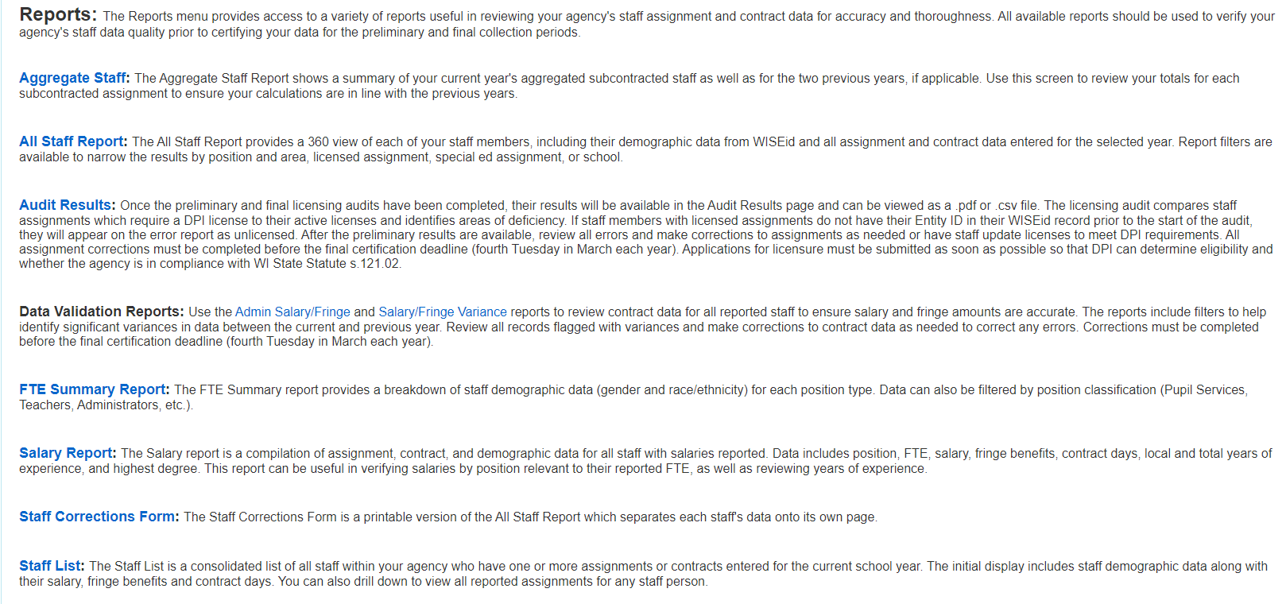
Final Certification Checklist – 3h (2 of 2)
Recommend reviewing all reports in the Reports submenu before the snapshot

Slide 22
Data Quality Tools
How to use WISEstaff tools to verify data quality:
Data Quality Dashboard
  District-wide totals for contracts, assignments, staff FTE
Staff Reports
  Focus on staff-specific contract and assignment details
  FTE Summary is aggregated by position classification
Validation Errors and Warnings
  System alerts that indicate data is missing or questionable
Customer Services Outreach
Notes:
Keeping those data quality goals in mind, let’s look at how to meet them. We have four sets of tools to help with verifying data quality. We’ll start with a high level summary of the tools and then break them down in more detail in the upcoming slides.
First up is the Data Quality Dashboard. The dashboard is a summary of some key metrics that can be useful as an indicator of the overall health of your data quality. You’ll see counts of your district’s assignments, contracts and staff numbers, as well as some key things to look at regarding teacher salaries.
Next are the staff reports, some of which are called out on the Staff Collection Checklist as part of task 3c - Verify Data Quality. These reports will give you the full detail of what’s behind those numbers on the dashboard.
Next are the data validation errors and warnings. WISEstaff runs a “health check” of staff data on a nightly basis and generates errors and warnings when certain criteria are not met or fall short of what’s expected. Monitoring those errors and warnings and resolving the reported issues will help to keep staff data in good shape.
Finally, during the weeks leading up to the final certification deadline, DPI’s Customer Services Team monitors the certification status of each LEA along with a variety of data quality markers and may contact you to ask you to review certain elements of your staff data if they fall above or below the expected thresholds. We’ll look at where in WISEstaff you can find and review some of the items you may be asked to verify.

Slide 23
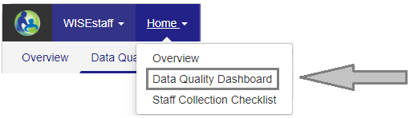

Data Quality Tools: Dashboard
Use the Data Quality Dashboard to review specific metrics
Find it in the Home menu / Data Quality Dashboard
Hiring Agency Counts
Compare current year to previous years
Review total count, numeric change, percentage change, direction change
Click any of the counts to view a full list of staff for that metric
Counts in red indicate a variance exceeding standard thresholds
Not necessarily an error, just something to review more closely
Notes:
Now, to learn more about those groups of tools, we’ll start with the Data Quality Dashboard. Located in the Home menu in WISEstaff, the dashboard is a great way to get a quick glance of how your data is looking. The Hiring Agency Counts section shows you how your numbers for key metrics look this year compared to last year and how last year compared to the previous year. This data is pulling dynamically from the staff data you enter so what you see on your dashboard is current based on your most recent updates.
In each of the tiles, you’ll see the number of items for this year and the two previous years, and you’ll see a variance (both numeric and percentage) between this year and last year along with an indicator of whether this year’s number is higher or lower than last year’s. We have tiles for the number of overall assignments and licensed assignments, number of contracts, number of staff as well as total FTE, and FTE for aggregate staff, if that’s applicable for your district.
Numbers in red indicate there may be an issue with the data, but it’s not a guaranteed diagnosis. It’s highlighted to call your attention to it so you can review it in more detail and determine whether there are errors or not.

Slide 24
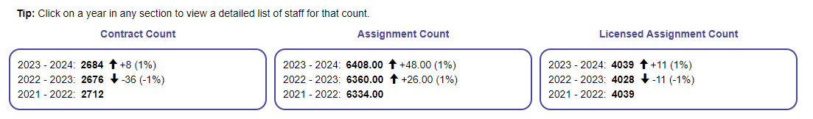
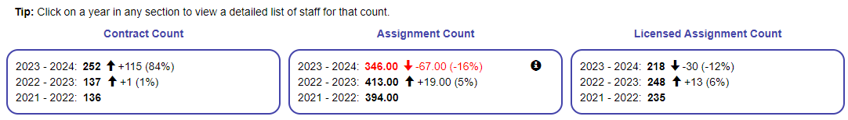
Data Quality Tools: Dashboard (1 of 3)
Compare these
two dashboards:
Some counts
exceed standard
variance:
Notes:
When reviewing the tiles, look for whether this year’s numbers are higher or lower than last year’s. Is that what you expected to see? Use these numbers to identify areas you should take a closer look at. To help with that, you can click on any of the count numbers to view a list of the staff who comprise that metric. So, if you click on the Assignments count for this year, you’ll get a list of all staff assignments, including staff with multiple assignments each. If you see a count that’s in red, it indicates that the variance from last year to this year exceeds what DPI considers the standard. Numbers that are in red are not necessarily errors; you could very well have a large increase or reduction in staff from year to year. We call those variances out in red to bring them to your attention so that you can review them in more detail to make sure this year’s contract and assignment counts are accurate. If the numbers prove to be correct, there’s nothing you need to do; having numbers in red will not prevent you from certifying your data.
In this slide we see dashboard views for two districts. The top one has no counts showing red and the bottom one has one count that is red. In the bottom image, for the licensed assignment count, a decrease of fourteen assignments may be appropriate. We don’t know whether either number is correct, but when seeing them in red, you would want to confirm that they are accurate against my HR staff records, and then make any adjustments necessary.

Slide 25
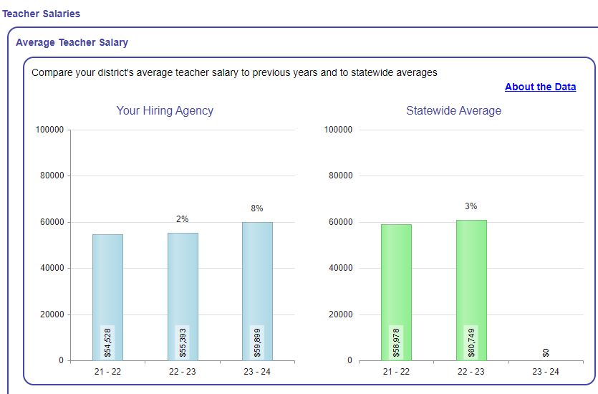
Data Quality Tools: Dashboard (2 of 3)
Teacher Salaries
Review district-wide average salary compared to statewide average for current and previous years
  How does yearly change in your district compare to the statewide average?
Notes:
The next section on the dashboard includes information about teacher salaries. We all know that teacher salaries can be a hot media topic, so it’s important that they are entered correctly so the data is accurately reported to the public. The section on the bottom left of the dashboard is a three-year comparison of the average teacher salary in your district and how it compares to the statewide average. You can also look at how changes in your average salary compare against the statewide change by looking at the percentage number above each bar in the graph. In this example the district’s average salary in 20-21 increased 9% from the year before and then decreased 4% for this year. To determine if the salaries this year are accurate and the decrease in average salary is expected, look for salary anomalies in the Salary and Fringe Variance report. More on that in a bit.

Slide 26
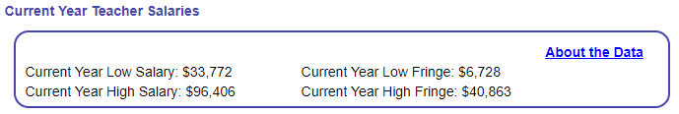
Data Quality Tools: Dashboard (3 of 3)
Teacher Salaries
Review high and low salary and fringe amounts; do they look correct?
  If a dollar amount looks wrong, hover over it to view the staff person with that salary or fringe amount
  Any staff with very low or high salaries?
Salaries are counted for staff meeting these criteria:
  Position Code = 53, omitting interns, subcontracted staff, staff hired by a CESA
  FTE for 53- assignments is .95 or greater
  Contract days of 160 or greater
Notes:
To the right of the average teacher salary graph is another tile that shows high and low salary and fringe amounts for your district. This is a great tool to use to find typos in salary data. If your lowest teacher salary is $7,540, you’d want to look at that staff record to make sure the number is correct. Same thing goes for the high salary. To view the staff person who has the salary shown, just hover over the salary number and you’ll see their name and WISEid in a tooltip. In addition to the low and high salary and fringe amounts, we also show you how many salaries you reported that are below an amount considered low for a teacher salary, which is twenty-four thousand dollars, and how many are above a high salary of ninety thousand dollars. To view those staff, you can click on the number of salaries to see a list of staff names. As with the hiring counts tiles, calling out salaries below twenty-four thousand or above ninety thousand does not indicate an error; it indicates something you should look into to confirm.
One thing to note with these teacher salaries is understanding what we use to signify a “teacher”. This information can be found in the ‘About the Data’ link that’s included in each of the teacher salary sections on the dashboard. When displaying these figures, we use only staff with a position code of 53 for teacher, omitting interns, subcontracted staff and staff hired by a CESA. We further filter out staff with a total teaching FTE that’s less than .95 or with contract days fewer than 160. That’s done to exclude part-time teachers who may be receiving a lower salary as a result of a lowered workload; we don’t want partial year or part-time salaries to alter the numbers for full-time teachers.

Slide 27
Data Quality Tools: Reports
Use Staff Reports to review staff data summaries and to drill-in to details
Staff Reports Overview
  Overview page contains a summary of each report; click on report name to open that report page.
Report styles: some show all data, others call out variances
  Summary reports: All Staff, Staff Corrections Form, Staff List
  Detailed reports: Salary Report, Admin Salary/Fringe, Salary/Fringe Variance, Aggregate Staff, FTE Summary
Protecting personal information
  Use caution when emailing / printing reports
What else would be helpful to have?
Notes:
The next group of data quality tools we have are the staff reports. There are a number of reports available, each of which slices and dices your staff data in various ways. A great way to get an understanding of the reports available is to read through the Reports Overview page in WISEstaff. This page includes a summary of each report and you can click the report name to go right to that report page.
Among the reports, we have summaries that are a view of all staff and their data. We also have detailed reports that focus on a specific part of staff data, such as salaries or FTE by position classification. In the next few slides we’ll look at examples of each type of report.
Since these reports may contain personally identifiable information, or PII, like WISEid or birth date, please remember that if you choose to print or email staff reports, make sure copies with personal information are handled securely, since that data should be kept private

Slide 28
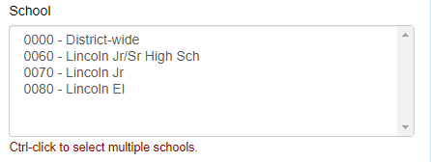
DQ Tools: Summary Reports, All Staff
Summary Reports - All Staff Report and Staff Corrections Form
All Staff Report includes all contract, assignment, and demographic data for staff with an assignment.
  For smaller districts, this report might work well to see a full picture of each staff person and compare against HR data.
New to All Staff is the ability to filter results by one or more schools, after selecting a Working Agency, if you want each to review their own staff.
Notes:
The first group of reports we’ll cover are the summary reports, which include a view of all combined staff data, including contract, assignment, and demographic details. The All Staff Report and Staff Corrections Form are examples of summary reports. Both are available in the Reports menu and contain a combination of contract, assignment, and demographic data. Any staff person with an assignment will appear in these reports, even if their assignment does not require that a contract be entered. In the All Staff Report, you can filter staff by one or more schools. You’ll need to select By Working LEA as the Report Type, then select your LEA in the Working LEA field, then you’ll see a list of all schools for your agency. Use control-click to highlight multiple schools in that list.

Slide 29
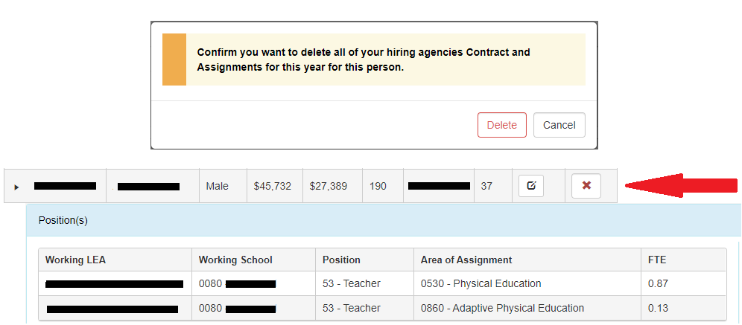
DQ Tools: Summary Reports, Staff List
Summary Reports - Staff List
Includes all staff with an assignment or contract
From Staff List, you can open individual staff records to view their assignment and contract.
You can also delete your district’s assignments and contracts for a specific person from Staff List.
Notes:
Next up in the summary reports is the Staff List, accessible in the WISEstaff Reports menu. The staff list has a record for each person with a contract or assignment and is a slimmed down version of the All Staff Report in how much data it shows. It has a subset of demographic data, along with a few contract details, like salary, fringe benefits, and contract days. You’ll also see assignment information for each staff person in a sub-grid that is displayed by clicking the chevron to the left of the person’s WISEid. Each assignment displays in its own row.
An additional feature of the Staff List is the ability to delete a person’s contracts and assignments right from the report. This is useful if you accidentally created an assignment or contract for a person who should not have been reported as working in your district for the current year. To delete the contract and all assignments for your hiring agency for a staff person, click the red x icon on the far right of the staff record, then click delete in the pop-up message to confirm you want to delete the contract and assignments. Use this option only if you want to delete everything for a staff person. If you want to delete only an assignment or a contract, do that on the person’s Edit Staff page.
Speaking of the Edit Staff page, you can go straight there from the Staff List by clicking on a person’s WISEid, or on the edit icon to the left of the delete icon.

Slide 30
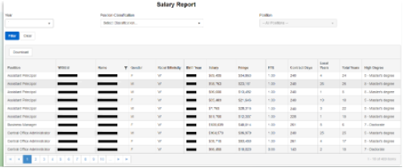
DQ Tools: Detailed Reports, Salary Report
Detailed Reports - Salary Report
Includes contract data, FTE, and demographic data for all staff with assignments
Useful for comparing to HR data to verify accuracy
Staff can be filtered by position classification and position, if desired
View page by page in WISEstaff or download to Excel
Pulls from live staff data: re-run the report to view changes made
Notes:
Next up are the detailed reports, which are reports with a specific set of data and meant for a specific purpose.
The first one we’ll look at is the Salary Report. This report is good for reviewing all contract data and comparing it to your HR data, since it displays all contract data elements: salary, fringe, contract days, years of experience, and highest degree earned. It also includes FTE and some demographic details. You can filter this report by position classification and specific position, if desired, for example to review all teacher salaries, or all administrator salaries. Within the Salary Report screen, you can sort the data by any of the column headers, and you can download the full report into Excel and then sort and filter there however you’d like

Slide 31
DQ Tools: Detailed Reports, Admin Salary/Fringe
Detailed Reports - Admin Salary/Fringe Report
Includes contract and assignment data for staff with administrative assignments; staff can be filtered by position
Shows current and previous year salary and fringe; % change
View page by page in WISEstaff or download to Excel
Notes:
The next two reports can help you recognize significant data variances, like the data quality dashboard does, to call your attention to data that may be incorrect. The first of these is the Admin Salary/Fringe Report. This report includes contract and assignment data for staff with an administrator position classification. We have seen that these salaries are the most highly scrutinized by researchers and reporters, so we have this report just for administrative salaries. The content is similar to the All Staff Report, but the reason it’s a specialized report is that it also includes a comparison to data from the previous year. It’s like the Hiring Agency Counts tile on the dashboard but detailed for every administrator staff person.
As you can see in my screen shot, we’ve got a staff person with a 99% reduction in salary and fringe benefit amounts for this year compared to last year, which should prompt you to take a second look at their contract and their WISEstaff record. An easy way to find all the records with a high variance percentage would be to download this report to Excel, then sort the data by the Salary Change column, or the Fringe Benefit Change column, and look for numbers higher than what a standard salary change would be from year to year. Anything above that number would warrant a closer look.

Slide 32
DQ Tools: Detailed Reports, Salary/Fringe Variance (1 of 2)
Detailed Reports - Salary/Fringe Variance Report
Includes contract data plus FTE for all staff with contracts
Purpose of report is to highlight significant variances in salary or fringe benefits from year to year
  Adjust report filters to fit your desired view
View page by page in WISEstaff or download to Excel
Pulls from live staff data: re-run the report to view changes made
Notes:
My favorite report is the Salary/Fringe Variance Report. It is similar to the Admin Salary/Fringe Report in that it includes salary and fringe data for the previous and current year, but it also lets you set your own filters and it highlights records that fall outside your selected variance ranges.
As with the other reports, this shows the most current staff data and can be downloaded into Excel, but I would utilize the highlighting that the report screen has to draw attention to records that vary significantly from last year. Let’s take a look at the report page on the next slide

Slide 33
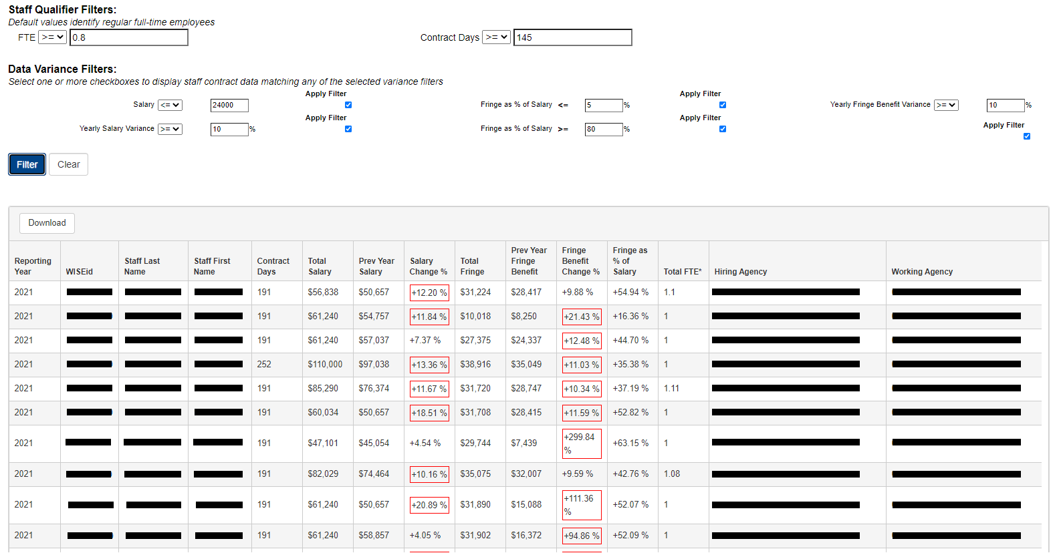
DQ Tools: Detailed Reports, Salary/Fringe Variance (2 of 2)
Detailed Reports - Salary/Fringe Variance Report
Notes:
At the top of the page are staff qualifier filters and data variance filters. It’s a lot of fields. I know. We tried to give you a place to start by defaulting some standard values in those fields, but you are more than welcome to adjust them to suit your needs. Our default filters are set to look for full-time staff, by asking for results where the FTE is .80 or higher and the contract days is 145 or higher. The data variance filters are set to search for records that fall outside the standard salary and fringe amounts we see most often across the state. The blue checkboxes indicate that those filters will be applied. If you don’t want to include any of those filters in your report, you can uncheck those boxes, then click the Filter button to refresh your results.
Once the results are displayed, the system outlines any values in red which exceed a filter. In our example here, some records have overages in the salary change and fringe change from last year to this year. Some records have only one overage. And what’s been our theme today with using data quality tools? These call-outs don’t guarantee there’s an error in the data. The red outlining is meant to grab your attention and say “maybe make sure that this educator’s fringe benefits this year really are two-hundred ninety-nine percent greater than last year’s.” And maybe they are. If so, that’s fine. But you checked it, and verified it, and that’s all we’re asking you to do.
Looking at this screen shot, you can see how it’s helpful to review this data on the page itself, rather than downloading to Excel, but of course that’s your choice. The option to download is there if you want it.

Slide 34
DQ Tools: Detailed Reports, Aggregate Staff
Detailed Reports - Aggregate Staff Report
Shows FTE totals for all aggregate assignments entered; used only when staff are subcontracted through a third party for limited assignments:
  Bus driver / Special Education bus driver
  Cafeteria Worker
  Plant Maintenance and Operation Personnel
Even more useful is the Enter Aggregate Staff FTE screen itself
  Shows current year’s FTE and last year’s - good for comparison
Notes:
The next detailed report we have is the Aggregate Staff Report, which is something not all of you may use since aggregate staff are those who are subcontracted from a third party for specific positions, like cafeteria worker, bus driver, or plant maintenance. While there is an Aggregate Staff Report available in the Reports menu, I am going to recommend you do your review of aggregate staff FTE on the screen where you entered it rather than using the report.

Slide 35
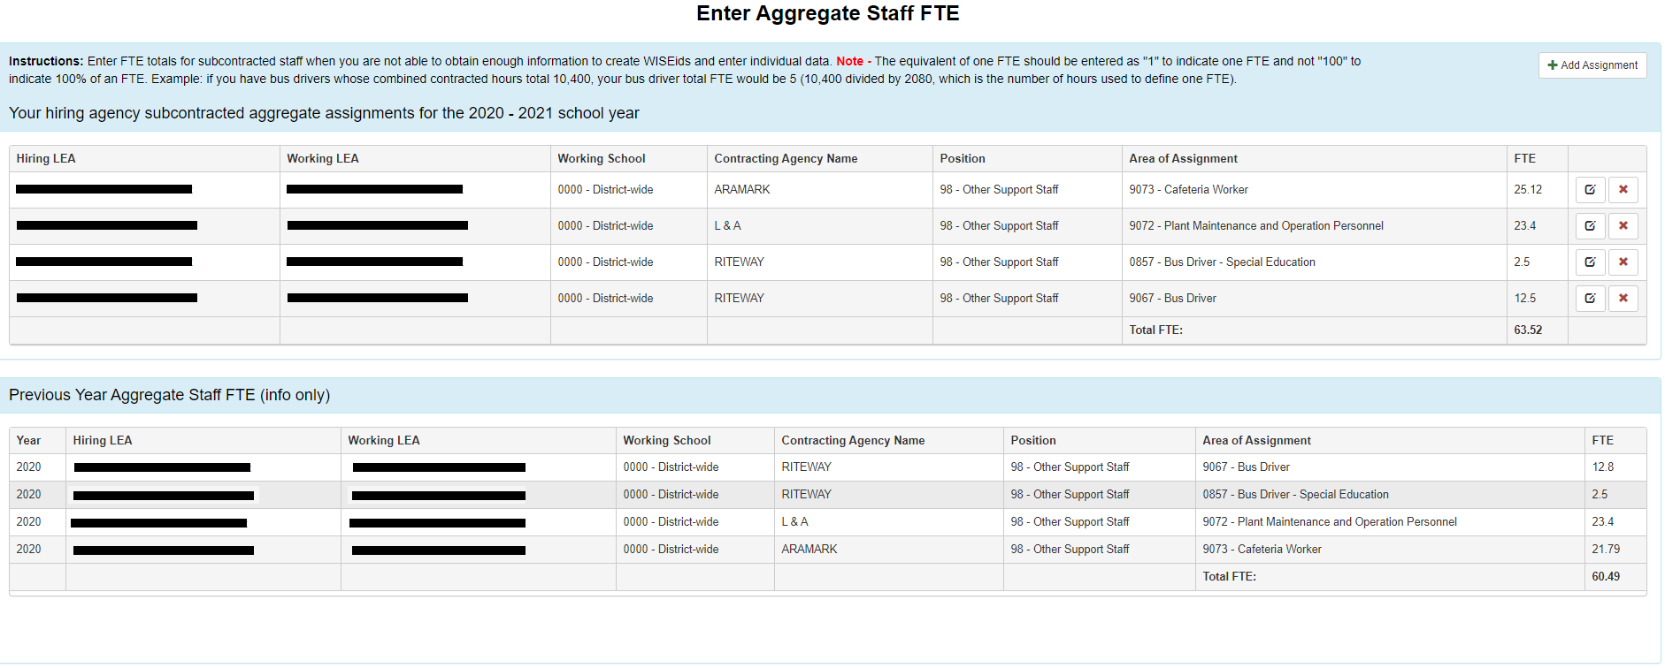
DQ Tools: Detailed Reports, Enter Aggregate Staff FTE
Detailed Reports - Enter Aggregate Staff FTE (Aggregate Staff Report)
Notes:
And here’s why: the Enter Aggregate Staff FTE page now includes last year’s entries in addition to this year’s entries, which I think makes it more useful because you can compare your contracts between years. If you remember back to an earlier slide, there is a tile on the Data Quality Dashboard that shows you a comparison of aggregate FTE for this year and two previous years, so that’s a good place to review the Aggregate FTE number as a whole. This page is a bit better because it shows you the breakdown of which assignments and which contractors you used this year compared to last year. We can see each contracting agency and the assignment areas and FTE for those assignments, and then the total FTE for each year. So, this is a great way to make sure aggregate assignments are accounted for.

Slide 36
DQ Tools: Detailed Reports, FTE Summary
Detailed Reports - FTE Summary Report
FTE Summary report sums FTE by position classification and breaks it down by demographic characteristics: gender and race/ethnicity
  FTE Demographic data is available to the public as the Public Staff FTE by Ethnicity and Gender report
  Use FTE Summary Report to review assignment totals by gender and ethnicity
Useful for reviewing FTE totals by position type, e.g., Teacher, Support Staff, Program Coordinator
Notes:
Our final detailed report is the FTE Summary. This report sums assignment FTE by position classification and then breaks it down by gender and race/ethnicity. This data is also available to the public in the Public Staff FTE by Ethnicity and Gender report, so it’s helpful to review it prior to final certification to make sure your staff are represented accurately. This report can also be useful to review FTE totals by position type, such as teachers, support staff, program coordinators, et cetera.

Slide 37
Data Quality Tools: Validations (1 of 5)
Validation Errors and Warnings
A nightly process runs to check statewide staff data and identify certain missing values
Critical issues are reported as errors; other important issues are reported as warnings. Minor issues are reported as info messages.
Requirements for final certification:
  All errors must be resolved.
  All warnings must be resolved or acknowledged.
  Info messages should be read; system will remove them before the snapshot.
Notes:
Our next group of data quality tools are the automated data validations. During the preliminary and final certification periods, WISEstaff runs a nightly data validation process to review all staff data and identify missing or suspect values. The issues are reported as errors, warnings, or informational messages, based on the severity of the issue.
An issue of critical severity, which indicates that data is missing or must be changed because it doesn’t follow the standard staff data rules, is reported as an error. An issue of lesser severity but still important and may be acceptable as is wise staff reported as a warning. A minor issue, typically data that has been entered but is not required based on a person’s assignment, is reported as an informational message.
In order to complete your final certification, all errors must be resolved and all warnings must be acknowledged or resolved. Informational messages will be cleared out prior to the final data snapshot so once you’ve viewed them, you don’t need to do anything further with them.

Slide 38
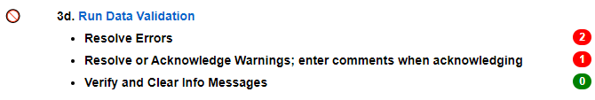
Data Quality Tools: Validations (2 of 5)
Validation Errors and Warnings
Counts of validation errors and warnings can be found on the Staff Collection Checklist.
Click Run Data Validation to view details of the validation messages.
Notes:
There are several places you can go to view your active validation errors and warnings. You’ll see them on the Staff Collection Checklist, under task 3d - Run Data Validation. The number of errors will show in red, indicating they must be resolved before final certification. The number of warnings shows in red when they are active and not yet acknowledged. Informational messages may show in red, but because they are a low severity, will not prevent you from finishing your final certification step. Within the checklist, you can click on the Run Data Validation task description to go to the Validate Staff Data page to view details of each validation message.

Slide 39
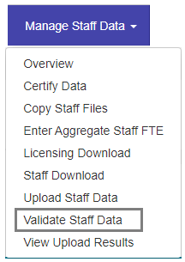
Data Quality Tools: Validations (3 of 5)
Validation Errors and Warnings
Details of validation errors and warnings can be found on the Validate Staff Data page.
  Also accessible in the Manage Staff Data menu
Notes:
In addition to viewing your validation message counts on the Staff Collection Checklist, you can also go directly to the Validate Staff Data page to view those validation messages in further detail. From the Manage Staff Data menu, select the Validate Staff Data option. This is where you will view the details of the validation message and have the ability to resolve or acknowledge the issue.

Slide 40
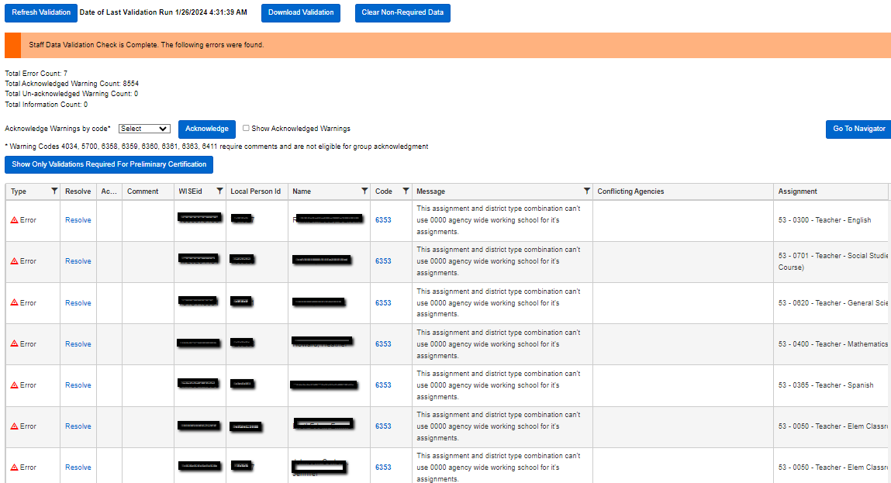
Data Quality Tools: Validations (4 of 5)
Validation Errors and Warnings
Read description of the issue in the Message field.
Click the Resolve link to go to the edit staff page and update data.
If a warning can’t be resolved or is not an issue, click View/Edit to enter a
comment, then check the Ackn box to acknowledge the warning.
Notes:
The Validate Staff Data screen will show you a running total of errors, warnings, and info messages. The warnings are divided into acknowledged and unacknowledged counts. When you’re ready to complete your final certification step, you will need to have zero errors and zero unacknowledged warnings.
To work the errors and warnings, you can review the description of the issue in the Message field and then click the blue resolve link in the resolve column to navigate to the page where you can view and/or resolve the issue. Depending on the type of issue, that link may direct you to the Staff List, in a case where you are missing a certain assignment type, or to a specific staff person’s Edit Staff page in a case where their contract information is missing, to name just a few examples.
When the issue you are working on is a warning and you cannot fully resolve the issue, you may need to acknowledge it to clear it out of the unacknowledged warnings list. Some warnings require comments to be entered before acknowledging them; those warning codes are listed on the Validate Staff Data page. In those cases, you can click the View/Edit link in the Comment column, enter your comment explaining why the issue will not be resolved, and then click the check box in the Acknowledge column, which is abbreviated as Ackn.

Slide 41
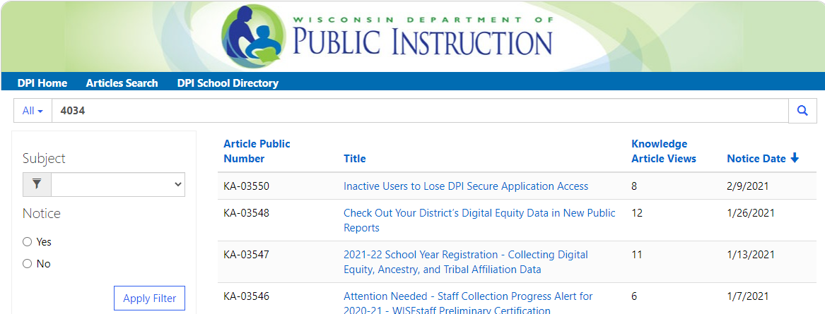
Data Quality Tools: Validations (5 of 5)
Validation Errors and Warnings - More Information
Knowledge Base Articles (KBAs) can provide more info.
Most validation codes now link directly to their KBA.
Additional articles are accessible from DPI website, WISEstaff Help page.
  Other Useful Links / Knowledge Base Articles
  Type a specific validation code (e.g., 4034) into the Search field, or search for WISEstaff to browse related articles.
Notes:
To get more information on why an error or warning was generated or to better understand how to resolve it, check out the knowledge base article repository. Our KBA tool includes descriptions of why errors happen and how to fix them. For the 21-2022 school year we now link directly to those KBAs from WISEstaff for most validation codes. You can also find them on the DPI website. Search for WISEstaff help, and on that page scroll down to Other Useful Links, then click Knowledge Base Articles.

Slide 42
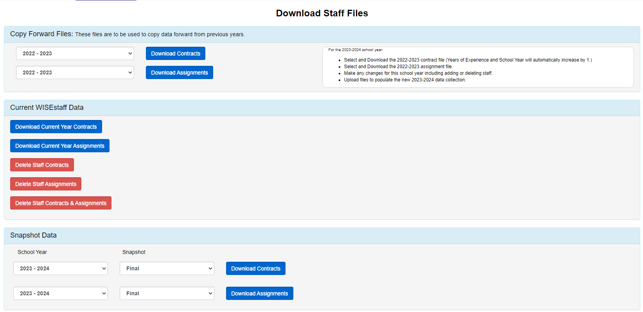
Download Staff Files (1 of 2)
Download Staff Files under the Manage Staff Data menu

Slide 43
Download Staff Files (2 of 2)
Once the snapshots are created, download copies of the Contract and Assignment data from Snapshot Data section to be sure what you submitted for the audits.
You can also download data during the collection from the Current Staff Data and Copy Forward Files and make edits in Excel to reupload changes.

Slide 44
Data Problems After the Final Snapshot
How to handle errors after deadline
Assignment and contract data cannot be changed after the final certification deadline.
If errors are found, submit a data errata through WISEadmin Portal.
  https://dpi.wi.gov/cst/data-collections/data-errata
    See link to the WISEadmin Portal user guide.
    See link to WISEstaff Data Collection-specific data errata near bottom of page.

Slide 45
Public Staff Reports
April/May we publish the annual data to the Public Staff Reports site
A small amount of person level records are removed from reporting because of personal privacy security concerns. Their data is included in summary data calculations.
Main report to download all data is the Public All Staff Report download

Slide 46
Licensing Help (1 of 2)
Information about the appropriate license for an assignment can be found within WISEstaff:
  Manage Staff Data / Upload Staff Data / select Assignment as file upload type
  Person Search / Edit Staff / Add Assignment / View License Requirements for Selected Assignment
Notes:
Here is some good information on Licensing and where to find it in WISEstaff and on our DPI site.
What can I teach? this will help with what license is needed for a teaching assignment.
For help with licensing, remember you can submit a separate help ticket for that under the Need Help? inside WISEstaff.

Slide 47
Licensing Help (2 of 2)
Assignment-specific license info can also be found on DPI’s WISEstaff Reporting Information page: https://dpi.wi.gov/cst/data-collections/staff/data-collection/staff
  Under the Technical Documentation section, select Assignment to License mappings
  Or, the “What Can I Teach” page: https://dpi.wi.gov/tepdl/licensing/what-can-i-teach
A link to the Licensing Help page has been added to the WISEstaff Need Help? Menu.
Notes:
Here is some good information on Licensing and where to find it in WISEstaff and on our DPI site.
What can I teach? this will help with what license is needed for a teaching assignment.
For help with licensing, remember you can submit a separate help ticket for that under the Need Help? inside WISEstaff.

Slide 48
Helpful Resources & Links
WISEhome
Reporting Information Homepage
WISEstaff Help
Data Elements
Release Notes
WISEdata Events Calendar
Decision Tree Diagram (Who to Report)
Residential Care Centers (RCC) Staff Reporting Guidance
Aggregate FTE examples
FTE Calculation Guidance
Minimum FTE = .01
District Maximum FTE = 1.99
Statewide Multiple Districts Maximum FTE = 1.50
Notes:
WISEstaff Help: Links to WISE help pages and useful resources
Data Elements: List of links to all WISEstaff data elements and their descriptions, uses, and codes
Knowledge Base Articles: (KBA) Useful articles on validations and other related topics
WISEdata Events Calendar: View deadlines, trainings, webinars, etc.

Slide 49
Giving Feedback
Within most DPI applications, you can:
provide feedback directly
enter a new suggestion, and
vote on suggestions made by other people.
WISEstaff Feedback
Notes:
We are always looking for feedback. A lot of enhancements have come from user feedback so if you have any recommendations definitely let us know. Also feel free to submit feedback via a help ticket.

Slide 50
Stay in Contact
Join the weekly WISEstaff User Group Calls to hear weekly updates from different teams and ask questions of DPI staff on the call
Join our Google community (“Spaces”) to connect with fellow WISEstaff users and receive announcements and notifications from DPI and the WISEstaff community.
Submit a Help Ticket
Notes:
To recap, here are a few ways for you to stay in contact with us.
The WISEstaff user group calls are very helpful for getting weekly updates and connecting with DPI staff. I would definitely recommend attending them.
I would also recommend the Google+ community as you’re able to ask questions to your peers about vendor issues you may be experiencing, as well as receiving notices from DPI if there is an application outage or communication sent out. And again, we are always available via help ticket to assist with any questions you have during your data submission process.

Slide 51
Keep Track of Dates & Deadlines
Use the WISEdata Events Calendar to view snapshot and data submission deadlines. You can also register for User Group webinars and CESA trainings, as well as SIS vendor conferences.
You may view by the day or month to see important events and dates.
WISEdata Events Calendar
Notes:
Here is another link you'll want to bookmark. This is our events calendar page. This will have events like the WISEdata conference, WISEstaff user group calls, CESA and DPI trainings, and SIS vendor conferences to name a few and will also have important dates like snapshots. So definitely a good page to have bookmarked.

Slide 52
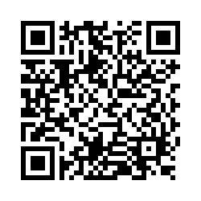
Questions?
Thank you! Thank you!
Please scan the QR code to provide us with your feedback!

