Slide 1
WISEdata Spring Snapshot Preparation
https://dpi.wi.gov/wisedata/schools/snapshot-prep
Last update: April 2024
Notes:
Welcome to the WISEdata Snapshot Preparation workshop! In this workshop, we are going to go over some important information as it pertains to the December 6th Snapshot, including why the data is collected, how to best prepare within your district or school, and how to use your WISEdata and WISEdash tools for review.
Slide 1 – Adam
Slide 2-7 Jodyanne
Slides 8-13 Jeff
Slides 14-29 Adam
Slides 30 – 42 Jeff
Slides 43- 45 Adam
Slide 46 – Jodyanne
Slides 47-48 Jeff
Slides 49-53 Adam

Slide 2
Snapshot Reporting Requirements
May 21st, 2024 Snapshot
2023-2024 Demographics
Economic Disadvantaged Status
Homeless Status
English Language Proficiency
Special Education Services
Special Education Assessment
Digital Equity (optional)
Choice Participant Indicator (Choice Schools only)
Notes:
Talk about the data being collected on the Dec 6th snapshot, read through each part of the tuesday 6th
August is a good time to have the prior years data wrapped up to better get a start on the new school years data
In october & november we start data outreach calls, these are to touch base with districts that may be missing large pieces of data, or have major issues. We dont reach out for every error or warning
December 6th - read slide, These are some of the bigger data elements, this is not an all inclusive list, for a list of all data elements collected during the december snapshot, go to the annual tasks checklist page, which we will talk about a bit later

Slide 3
Snapshot Purpose
Why We Collect the Data
The snapshots will serve as the permanent data source for certified reporting by DPI. Snapshot data is used for the following:
Federal reporting, including ESSA*
Public Reporting in the WISEdash Public Portal*
Accountability Report Cards
Some funding determinations, such as IDEA, high poverty aid, maintenance of effort (MOE), and others.*
*applicable to public schools only
Notes:
Why do we collect data? We collect data for a number of reasons. (read slide).
Because WISEdata is continuously collecting data throughout the year from your SIS, we need to take a picture of that data at a certain point in time in order to use for reporting. We call this a snapshot.
The snapshot is always taken at the same time of year. The main snapshot is in early December, the second smaller spring snapshot is in May. You’ll have the opportunity to clean up any the errors and warnings on your data prior to the snapshot date. As this is tied to funding and public reporting outside of just report cards, It is VERY important that this data is correct at the time of the snapshot. Incorrect data can delay funding and impact the accuracy of reporting viewable by the public.
The December snapshot is for all data where as the spring snapshot focuses on demographic information.

Slide 4
Data Flow for Snapshot
Data is:
entered into your vendor tool (SIS, Special Ed tool, etc.)
pushed to WISEdata and run through data quality checks (validations)
validated in the system on the day and time of the snapshot, loaded to WISEdash, and “snapped” for reporting purposes
Users can use WISEdata Portal validation results to go back to their vendor tool to make corrections and push the corrected data to WISEdata through May 21st.
Notes:
-The school or district enters the student data into their SIS.
-That information pushes to WISEdata for validation and the user can monitor it there. Its important to note that each SIS has their own schedule for sending data to WISEdata. You will want to work with your SIS to know when this happens.
**If the data needs to be corrected, the user will correct it in their SIS and then be re-pushed back to WISEdata. DPI does not have the ability to edit or modify your data. WISEdata is basically a read only application and changes to the data must be made in your SIS.
-Once the data is submitted correctly it will flow to the data warehouse, also known as WISEdash.
-There are two versions of WISEdash, there is WISEdash for Districts and WISEdash public portal.
-The WISEdash Public Portal is a redacted version of WISEdash for Districts used for public reporting.
- WISEdash is not available to Choice schools at this time.
-Next we will see a visual representation of this process.

Slide 5
Data Flow Diagram
Data Warehouse/WISEdash
LEAs:
Data Entry
School/district collects student data and enter into the local SIS.
WISEdata Portal Submission
LEAs push data from their SIS to the WISEdata Portal for validation.
Validation Review
LEAs monitor and review the errors and warnings and make any necessary corrections in their SIS.
Data Warehouse
Once the data is submitted correctly, it will flow into the data warehouse, also known as WISEdash for Districts.
WISEdash Extracts are also available
in WISEdata Portal
for Choice schools.
School and District Report Card calculations are based on the data in WISEdash.
Notes:
-The school or district enters the student data into their SIS.
-That information pushes to WISEdata for validation and the user can monitor it there. Its important to note that each SIS has their own schedule for sending data to WISEdata. You will want to work with your SIS to know when this happens.
**If the data needs to be corrected, the user will correct it in their SIS and then be re-pushed back to WISEdata. DPI does not have the ability to edit or modify your data. WISEdata is basically a read only application and changes to the data must be made in your SIS.
-Once the data is submitted correctly it will flow to the data warehouse, also known as WISEdash.
-There are two versions of WISEdash, there is WISEdash for Districts and WISEdash public portal.
-The WISEdash Public Portal is a redacted version of WISEdash for Districts used for public reporting.
- WISEdash is not available to Choice schools at this time.
-Next we will see a visual representation of this process.

Slide 6
Goals for May 21st, 2024 Snapshot
All demographic errors should be fixed, and
All demographic warnings either acknowledged or fixed prior to
the snapshot
This ensures the best possible data for reporting purposes.
Any data with a validation message
has the potential to impact the
snapshot data and subsequent reporting!

Slide 7
Snapshot Preparation Steps
Step 1: Your Vendor System
Step 2: WISEdata Portal Tasks
Step 3: WISEdash For Districts
Step 4: Final Tasks
Notes:
Here is how to best prepare for the Snapshot…

Slide 8
Step 1: Your Vendor System
Ensure the latest version of the SIS platform is installed.
Make sure that your vendor can transmit the required data to DPI for required collections. Confirm using the Vendor WISEdata Status webpage.
Be sure to attend any vendor provided training so you are clear on how to send required data to the DPI within the vendor tool and basic troubleshooting steps (e.g., full synchronization).

Slide 9
Step 1: Begin Submitting Data
Begin submitting data from your vendor tool (i.e., SIS) to WISEdata via Ed-Fi.
Make sure all needed data is entered into SIS.
Keep non-reporting software products synced.
Resolve validation messages, errors, or alerts located in your SIS vendor tool.
Points to remember:
Missing data cannot be validated.

Slide 10
Step 1: Review and Resolve L1s
Review WISEdata Ed-Fi API Level 1 (L1) errors using your vendor report, vendor error logs, or the WISEdata Portal Home Page. These errors prevent the data from getting to DPI. If these errors aren’t cleared, you will need to request assistance from your vendor.
WISEdata Portal Home Screen mini tutorial
Resolve the WISEdata Ed-Fi API L1 errors in your vendor system and re-submit the data to the WISEdata Ed-Fi API. Repeat as needed.
Correct ALL data with errors in your vendor system.

Slide 11
Step 1: Your Vendor System to
WISEdata Portal, Data Pipeline Status (1 of 2)

Slide 12
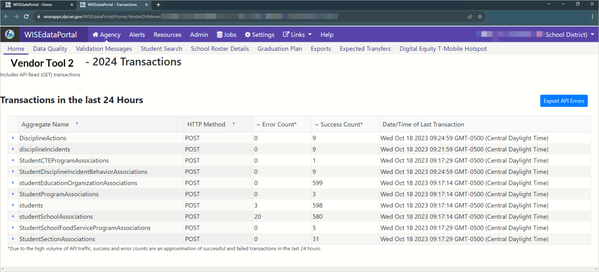
Step 1: Your Vendor System to
WISEdata Portal, API Error Drill Down

Slide 13
Step 1: Your Vendor System to
WISEdata Portal, Data Pipeline Status (2 of 2)

Slide 14
Step 1: WISEdata Portal - Data Quality

Slide 15
Step 1: WISEdata Portal, Data Quality Indicators
Notes:
Use the Data Quality page and the Data Quality metrics to verify that all of the steps mentioned so far have been successful. If the high level metrics are not matching what is expected, your next steps are to identify individual students that may be missing or being sent with incorrect values.
On the screen, you can see there are two Enrollment graphs. The first on the left is for current enrollment counts - these counts can change based on the students exiting and entering your district. The second on the right is only for count dates - TFS and Oct 1. These counts should remain the same once you have these count inclusion values finalized and should not change throughout the year.

Slide 16
Step 2: WISEdata Tasks, Imports and Validations (1 of 2)
Run Import & Validation in the WISEdata Portal.
This will import the data from WISEdata Ed-Fi into the WISEdata Portal and then run validations.
If the Import & Validation job is not manually queued, it runs for all agencies around 5pm.
Notes:
Pior to running a validation, make sure your data is current from your SIS. This can be done on the home screen. It's important to work with your SIS to know how to manually push data and when the data is schedule to flow if not manually pushing. Example, different years may push at different times from your SIS.
When you run a validation, it will only run the validation for the school year you are on, so make sure if you are working on multiple years you run the validation for each year.

Slide 17
Step 2: WISEdata Tasks Important and Validations (2 of 2)
A validation request is queued with a projected time of processing
Look to see that validation has completed…
Or use the email feature!
This can be requested from either the:
Home page
Validation Messages page

Slide 18
Step 2: WISEdata Tasks: Review Validations
Once the validation step is complete, review data quality metrics and validation errors in the WISEdata Portal on the Validation Messages page.
Repeat as necessary.

Slide 19
Step 2: WISEdata Tasks Correct Validations in SIS
In your vendor system, correct the data containing validation errors and warnings.
Visualize the numbers of errors & warnings on the Data Quality page and utilize the metrics to look for odd or unusual patterns.
Prioritize critical errors. Data with critical validation errors may not be loaded to WISEdash or otherwise will have a large impact on your resulting data.
In the WISEdata Portal--Validation Messages page, utilize the Validation Category filter to focus on validations relating to topics the snapshot is capturing for the selected School Year.

Slide 20
WISEdata Portal: Types of Validation Messages
~200 validation rules
User can manually trigger validation, or it runs overnight
List of Validations
Critical icon indicates a severe error that will greatly impact snapshot data
Error icon indicates data is submitted incorrectly
Warning icon indicates something may be wrong with the submitted data but not necessarily
Notes:
message type - critical error, regular error, warning
Critical: Data doesnt flow to WISEdash
Regular Error: Data will flow to WISEdash, but will be incorrect
Warning: Data will flow but is unexpected from what our system is expecting, data MAY be correct or incorrect, can acknowledge if reviewed or un-acknowledge
i - short - long - KBA code
Short Text
Long Text
Here you will also see a blue hyperlink. This blue hyperlink is for the KBA relating to the error or warning. The KBA will explain the issue in more detail then the short and long text. The majority of KBAs also contain scenarios to help you understand the situation.
When you click the little drop down arrow on the left, it will show you the students affected by the error/waring. You can then click the details button which will bring up the student detail page. (go to next slide)

Slide 21
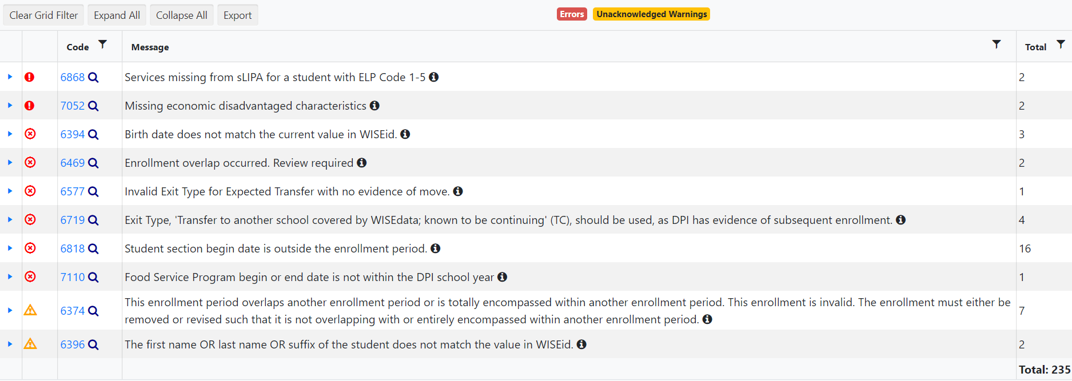
WISEdata Portal: Validation Messages
Click the black icon to see more information about the validation!
Notes:
message type - critical error, regular error, warning
Critical: Data doesnt flow to WISEdash
Regular Error: Data will flow to WISEdash, but will be incorrect
Warning: Data will flow but is unexpected from what our system is expecting, data MAY be correct or incorrect, can acknowledge if reviewed or un-acknowledge
i - short - long - KBA code
Short Text
Long Text
Here you will also see a blue hyperlink. This blue hyperlink is for the KBA relating to the error or warning. The KBA will explain the issue in more detail then the short and long text. The majority of KBAs also contain scenarios to help you understand the situation.
When you click the little drop down arrow on the left, it will show you the students affected by the error/waring. You can then click the details button which will bring up the student detail page. (go to next slide)

Slide 22
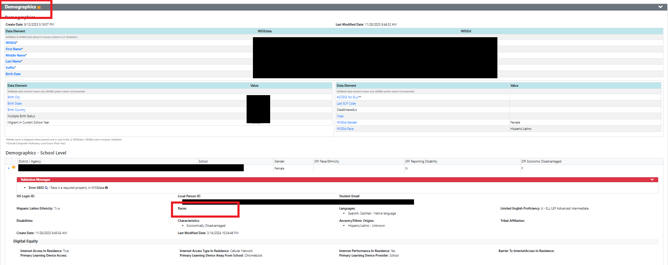
WISEdata Portal
Example: Student Detail Validations
Notes:
This is the student details page, which again you can access by clicking the details link under a specific error or warning. You can also get here by doing a student search and clicking the details button.

Slide 23
WISEdata Portal: Exports
Exports:
Multiple export files
Tool to view data comparisons
Files for each data collection
Notes:
This is the exports page, accessible in WISEdata in the blue bar. This is a very helpful page that is somewhat underutilized.
Now before pulling an export, its important to make sure that the data your going to pull is current. You can do this by checking on the home screen for the last time data was pushed from your sis, and the check the last time the data was validated in wisedata. These reports are only as fresh as your last validation.
The best way to identify individual students with issues is to compare the export files provided by the WISEdata Portal to reports that are generated by your SIS. Learning to compare data tables in Excel can quickly help you to find records that should be reviewed, through all the steps we have discussed.
Having specific lists of students with a particular issues will also dramatically speed up support requests with DPI or your SIS vendor.

Slide 24
Step 2: WISEdata Data Quality Alerts (1 of 3)
To cut down on the number of data quality emails from the Customer Services Team, Data Quality alerts are also displayed in WISEdata Portal.
Click the ‘Learn More’ button to be taken to the Alert page to see the details.
Notes:
WISEdata Alerts were just turned on recently so if you have not already taken a look at this banner in your WISEdata Portal, please do so ASAP. These are generated by DPI reports based on the data you’ve submitted to WISEdata and will indicate data issues that you will need to review.

Slide 25
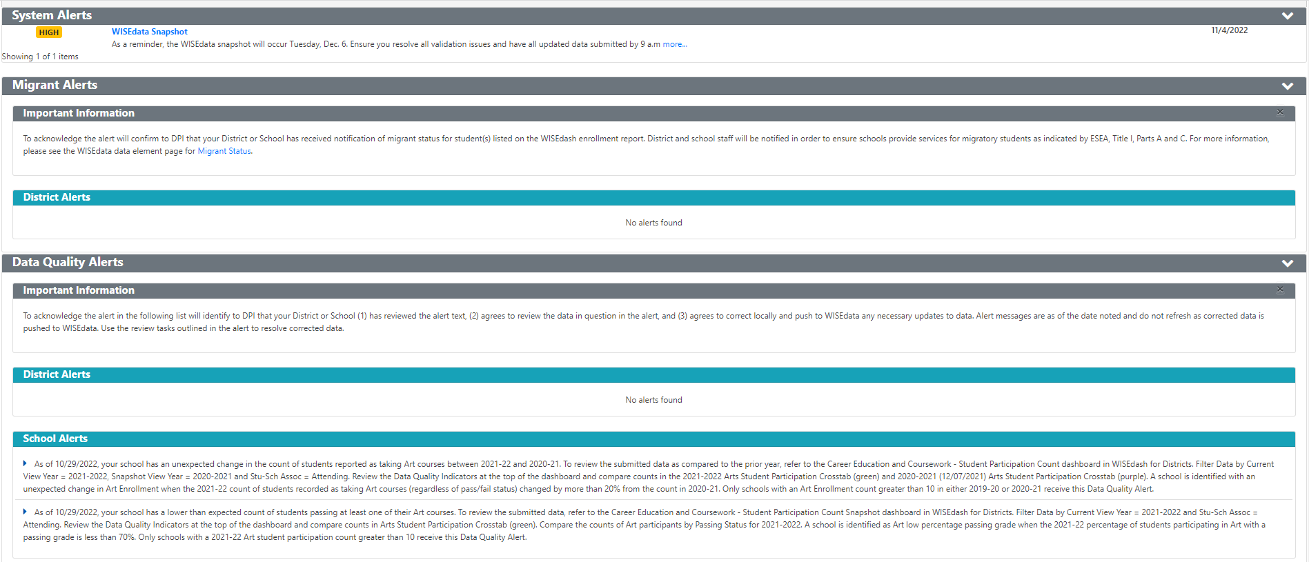
Step 2: WISEdata Data Quality Alerts (2 of 3)
Follow the instructions to investigate, review, and/or correct your data.
Notes:
This is what the alerts look like once you click the orange banner.
You will see System Alerts, such as the Snapshot Date reminder, Migrant Alerts, and Data Quality Alerts. Alerts will also be broken down into District level and School Level.
Each alert will tell you exactly where to go, usually in WISEdash, to review the information we’ve flagged as needing review.
Please be aware that when looking at the School Level alerts, you will need to open the alert using the little triangle on the left side, similar to opening a validation message for the student list, this will open the alert so it shows you the specific school with the issue. This is often overlooked.

Slide 26
Step 2: WISEdata Data Quality Alerts (3 of 3)
Acknowledge the alert once you follow the Instructions in the Important Information section of the page.
Only the Primary or Secondary WISEdata contact can acknowledge the alerts.
Notes:
Once you have reviewed the information indicated in the alert, you will Acknolwedge the alert. Be aware, these alerts do not refresh the way Validation messages do, so the alerts will not disappear or correct themselves after you acknowledge or correct the data in your SIS.
Acknowledging can only be done by the Primary or Secondary WISEdata contact, so if you do not see an acknowledge button available to you, that is why. Acknowledging the alert tells us you are aware and reviewing the issue so it can either be resolved and acknowledged as correct.
*Quick note on contacts, this is a good example on why you should be listing the primary contact as the person actually working in WISEdata. Please dont list admins or DSA’s as your primary contact if they are not the person working in the portal.

Slide 27
Step 2: Reviewing WISEdata Tasks
Prior to a snapshot make sure that:
All demographic errors are resolved.
All demographic warnings are either acknowledged or resolved.
Look for and read notifications from the DPI Customer Services Team.
Operational data quality checks.
May reach out to you to help with specific issues they find.
Notes:
Read side
I would also highly recommend attending the weekly user group calls, which are on tuesdays at 1:30. Information on those can be found on the wisedata events calendar.

Slide 28
Snapshot Preparation Summary
Use WISEdata Regularly. | Use WISEdata to Prep for a Snapshot.
You and your team should be checking the WISEdata Portal weekly, if not daily. It’s critical that this is a team process, not just one person in the office. Remember! Frequent, regular review means less burden at snapshot time! | In the weeks prior to a snapshot, review the data frequently. Include anyone who has reason to use or know about the data: assessment, accountability directors, principals, food service directors, special ed directors, etc.
Notes:
Read slide…
There is no way to lock in your data prior to the Snapshot so it is important to be reviewing it daily leading up to the Dec 6 deadline. Even if your data looks good and all errors are cleared, data is still flowing and can be changed at any time so make sure you are paying attention and aware of your Portal until the Snapshot is taken.

Slide 29
Step 3: WISEdash Extracts for Choice Schools

Slide 30
Step 3: WISEdash For Districts
WISEdash for Districts –
Training and User Guide pages
https://dpi.wi.gov/wisedash/districts/user-guide

Slide 31
WISEdash for Districts: Source of Snapshot Data
Snapshots are taken of data in the WISEdash “data warehouse”.
Use WISEdash to review your reporting data before a snapshot.
Additional charts and graphs
Available to public schools only
Reminder!
Data is updated NIGHTLY
from WISEdata Portal to WISEdash for Districts.
Notes:
Snapshots are taken in WISEdash rather than WISEdata because that is the final landing place for data that is submitted and is the source for reporting purposes. In most cases if your errors and warning are addressed your data will look good in WISEdash, however, you’ll still want to review WISEdash periodically and a little more frequently prior to the snapshot.
WISEdash also does additional calculations that are not done in WISEdata, such as official Graduation Rate and Dropout calculations.
As mentioned earlier, some data that flows into WISEdata does NOT flow into WISEdash due to critical data quality errors.

Slide 32
WISEdash for Districts: Available Snapshot Dashboards
WISEdash for Districts Training - How-To: Locate the Snapshot Data https://dpi.wi.gov/wisedash/districts/user-guide/locate-snapshot
Third Friday of September (TFS) Count Date
Oct 1 Child Count
Attendance
Discipline
YE (Year-End) Completion
Career Education and Coursework
Perkins
Spring Demographics Snapshot
Tip!
Be sure to scroll all the way to the bottom of these dashboards so you know all of the types of charts available to you for data review.
Notes:
Use Snapshot dashboards to review current data in more detail. Current data is what will be pulled into the snapshot at the time of the snapshot.
**COMMON QUESTION** - ATTENDING VS ACCOUNTABLE - When comparing to WISEdata (data they have "submitted") they probably want to filter for Attending. On the other hand, if they want to see all the students for which they are accountable - including those submitted by other districts, then they may want to choose Accountable.

Slide 33
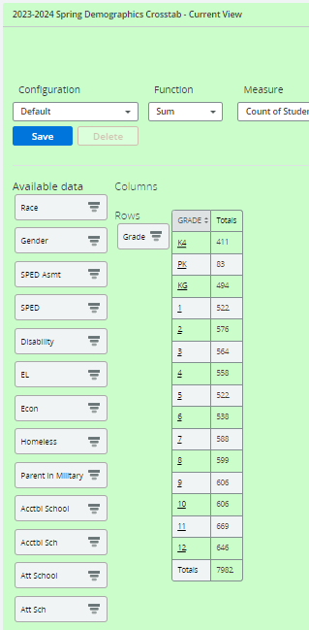
WISEdash Snapshot Dashboards: Dynamic Crosstabs
Many of the snapshot dashboards utilize crosstab metrics that function much like pivot tables in Excel. Drag and drop the Data Fields to either the Rows or Columns area to create a detailed chart.
Common demographics:
Race, Disability, Econ or ELL status
Notes:
The chart is taken from the Third Friday of September Snapshot dashboard, “TFS Enrollment Crosstab - Current View” chart. The user is displaying the current student counts by grade. You can drill into any of the underlined labels or values shown in the crosstab. If you want to review all of the students displayed in the crosstab in one list, drill on any row or column and when presented with the list of students, “x” the filter value in the Filter Data list that you just drilled on to show all students.
More information on the Economic Indicator Analyst role can be found here (scroll down to WISEdash and review the WISEdash User Roles): https://dpi.wi.gov/wise/secure-home-info/asm-roles

Slide 34
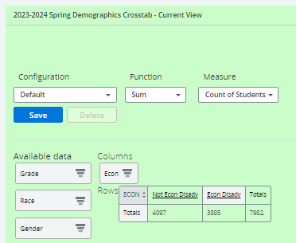
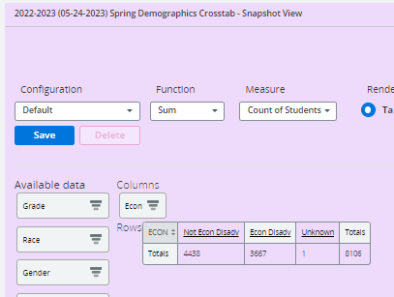
WISEdash Snapshot Dashboards: Year over Year
The primary use of the Snapshot dashboards is to compare current data to prior snapshot data.
The Green charts and
selected filters represent the Current View for the selected year.
Purple charts and selected filters represent the Snapshot View for the selected year.
Notes:
The chart from the same dashboard “TFS Enrollment Crosstab - Current View” is on the left showing student counts for current data. Compare to note differences that are potential data issues. Each crosstab must be configured to include the same data elements, they operate independently.
Note: the TFS enrollment crosstab - Snapshot View is automatically filtered for Count Incl TFS = Yes.

Slide 35
Spring Demographics (1 of 3)
Use filters to disaggregate the data into more manageable size (grade, school, race) to review against SIS reports
Use filters to review totals for important demographics
Economic Disadvantaged
English Learners
Students with Disabilities
SPED Assessment
Homeless
Notes:
I do want to specifically touch on two dashboards - the Spring Demographics Dashboard since that snapshot is coming up soon on May 23rd, and the Year-End Dashboard. You are going to want to pay attention to each of the demographic topics since that is the primary purpose of this dashboard. These demographics are captured on the snapshot date and used in assessment data reporting for the State Accountability Report Cards, Indicator 3 for children with disabilities, federal consolidated state performance reports (CSPR), and ESSA federal Accountability Indicators.
If anything looks incorrect, look at how the students are reported in the WISEdata Portal under their demographics tab and make any necessary changes in your SIS.

Slide 36
Spring Demographics (2 of 3)
If the totals are incorrect, view the student list to see the discrepancy. Once determined,
Review the student(s) in WISEdata to see if a validation message is impacting data
Review the student(s) in your SIS to see if the demographics are reported and sending correctly
Notes:
I do want to specifically touch on two dashboards - the Spring Demographics Dashboard since that snapshot is coming up soon on May 23rd, and the Year-End Dashboard. You are going to want to pay attention to each of the demographic topics since that is the primary purpose of this dashboard. These demographics are captured on the snapshot date and used in assessment data reporting for the State Accountability Report Cards, Indicator 3 for children with disabilities, federal consolidated state performance reports (CSPR), and ESSA federal Accountability Indicators.
If anything looks incorrect, look at how the students are reported in the WISEdata Portal under their demographics tab and make any necessary changes in your SIS.

Slide 37
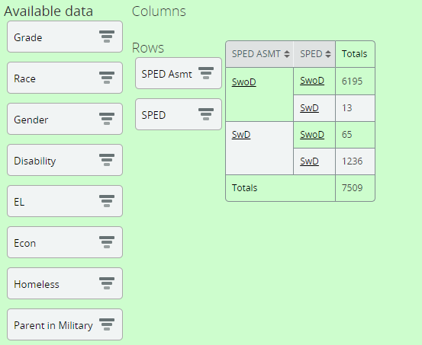
Spring Demographics (3 of 3)
SPED Assessment - student had an IEP at any point during the assessment window (Dec-Jun)
SPED - student’s current IEP status
Notes:
SPED Assessment indicates whether a child has an IEP (SwD) or does not have an IEP (SwoD) at any point during the assessment administration window (December to June). SPED is the student's current (or last if now inactive) status. So in this example, there were 65 students who had an IEP at some point in the assessment window but do not currently – these students show as Student with Disability (SwD) under SPED Assessment filter and Student without Disability (SwoD) under SPED
(if asked when you see SPED Asmt of SWoD – without disability and SPED of with disability the 13 – it is usually students with an IEP who transferred out of your district before the assessment window)

Slide 38
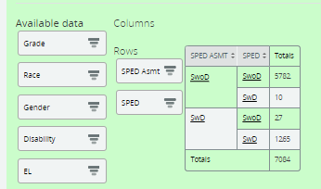
View Student List
If you want to see the students listed within a filter topic, click the underlined topic total for a list of students within that filter selection
Notes:
Now let’s say we discovered the issue. We used our filters and we see the discrepancy in the count totals and we want to know exactly the students impacted so we can fix their data. Once you have a filter topic, you can click that topic total and it will bring up a student list. I have the student data masked in this screenshot but for you, you will be able to see all the student details. You will see the list of students within that filter topic you selected so you can know exactly who to look at, or who may be missing from the list that you would expect to be there.

Slide 39
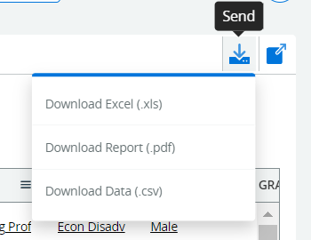
Download Student List
If you want to download the student list, click the Send button in the upper right corner of the graphic and download your preferred file type
Notes:
Now that we have the list, you might want to pull it out of WISEdash. By clicking the Send button in the upper right corner of the student list, you can download the list into your preferred file type.

Slide 40
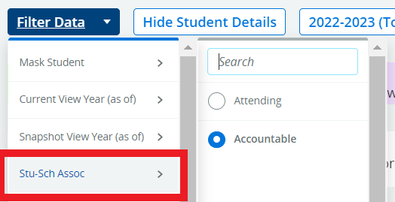
Important to Note
Accountable vs Attending
Accountable (default) – the student may or may not attend your district but you are responsible for the accountability of the student
Attending – the student attends your district but you may or may not be accountable for them
Acctbl School vs Acctbl Sch
Acctbl School – longer title of school name
Acctbl Sch – shorter title of school name
Notes:
Here are two other tips I want to make you aware of. The data in WISEdash is automatically defaulted to students your district is accountable for. This means, you may see a student included that is not attending your district. An example of this is students receiving service from a state school, such as the Wisconsin School for the Visually Impaired or the Wisconsin School for the Deaf and Hard of Hearing. These state schools will provide service to and report their students in WISEdata, but you as the resident district are still accountable for them. That is an example of when you might see a student listed in your dashboard that isn’t attending. If you want, you can change the Student-School Association filter to Attending, this could make reviewing against your local SIS reports easier, but be aware that the Snapshot is based on your accountable students, not just the attending ones, so be aware of that.
The other tip is in most dashboards, you will see a handful of filter options that look identical. We have Acctbl School, spelled out, and Acctbl Sch, shortened. These are the exact same filter, only difference is whether the school name is spelled out or shortened. For those of you with schools that have somewhat longer names, it might be easier to use the shortened filter so you’re scrolling all over the place.

Slide 41
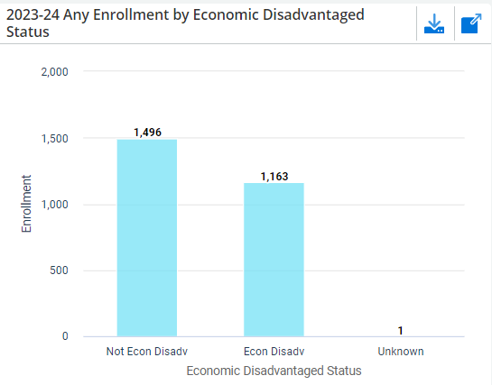
Review Econ Status
Topics > Enrollment > All Subgroups Dashboard

Slide 42
Review Digital Equity Data
Topics > Digital Equity Dashboard

Slide 43
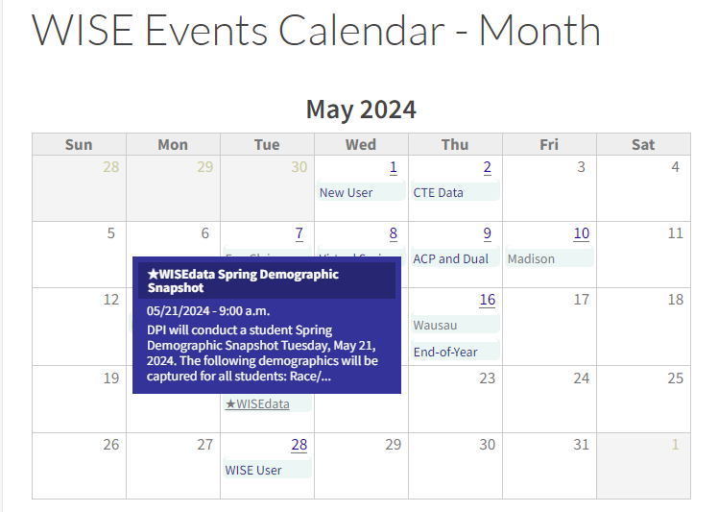
WISE Events Calendar
A quick link to the snapshot calendar on the DPI website.
Allows for quick check-ins on upcoming important dates for annual snapshots.

Slide 44
Step 4: Final Tasks - Snapshot Help Docs
WISEdata Annual Tasks Checklist webpage: An organized checklist of items that need to be completed for WISEdata reporting.
Knowledge Base Articles (KBAs): Useful articles on validations and other related topic
Mini Tutorials: Cover a variety of topics you may have questions on
Snapshot Preparation Guidance webpage: Provides in-depth guidance on snapshot information
Notes:
Data elements included in each collection listed at the bottom of the webpage.

Slide 45
Final Tasks: Getting Help
Notifications from the DPI Customer Services Team
3 weeks before snapshot DPI will begin data quality checks and may find specific issues to reach out to you on.
Review Data Quality alerts in WISEdata Portal
Help Tickets
Create a Help Ticket, so the DPI Customer Services Team can help you resolve issues, including those that may be vendor related.
Notes:
Data Quality calls from the DPI Customer Services Team (CST) - are starting this week, DPI CST will begin to contact districts regarding data quality items. In addition, review and attend to any Data Quality alerts present in the WISEdata Portal. Data Quality alerts are generated once or two prior to snapshot, and are not updated daily.

Slide 46
Post-Snapshot: Data Errata Letters
Once the snapshot is taken the data in the WISEdash database cannot be changed.
Data errors after snapshot are addressed with a Data Errata Letter submitted via the WISEadmin Portal.
Remember: no PII!
WISEdash Public Portal now provides higher visibility for data errata
The most common issues are demographics (SPED, ELL, Econ Disadv, etc.).
More info: https://dpi.wi.gov/cst/data-collections/data-errata

Slide 47
Year End Tasks (1 of 2)
Exit student enrollments
Exit Date and
Exit Type
Term Completion Indicator
High School Completers
HSC exit type and
Academic Record (diploma)
Exit program records*
Special Education record (sSEPA) exit date must match student's enrollment exit date
Reason Exited SPED must match student's enrollment exit
*applicable to public schools only

Slide 48
Year End Tasks (2 of 2)
Exit program records, continued
Language Instruction (sLIPA)*
Food Service Eligibility
Homeless Status*
Roster*
Every course needs an Attempt Status Descriptor = Sufficient
Career Education (CTE & CRR)*
Performance Based Conversion Type
*applicable to public schools only

Slide 49
More Helpful Resources
WISEdata Flyer: High level overview describing how WISEdata has improved our data collection process, data quality, and system integration.
Info for Schools: Basics of getting started with WISEdata
WISEdata Help: Links to WISE help pages and useful resources
Data Elements: List of links to all WISEdata data elements and their descriptions, uses, and codes
NEW Microsoft Teams WISE Community: WISEdata community to view and post questions and comments to fellow users.
Please submit a Help Ticket if you would like to join WISE Community

Slide 50
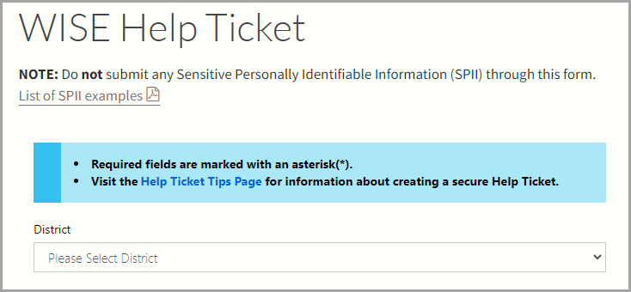
Help Ticket
Help Ticket
Notes:
Have a question, comment, and/or suggestion? Submit a help ticket and someone will respond to your question.

Slide 51
Giving Feedback
Within most DPI applications you can
Provide feedback directly.
Enter a new suggestion.
Vote on suggestions made by other people.
feedback.dpi.wi.gov

Slide 52
Thank You!
Thanks for all that you do!

Slide 53
Questions
Q&A Document

